Slide 1
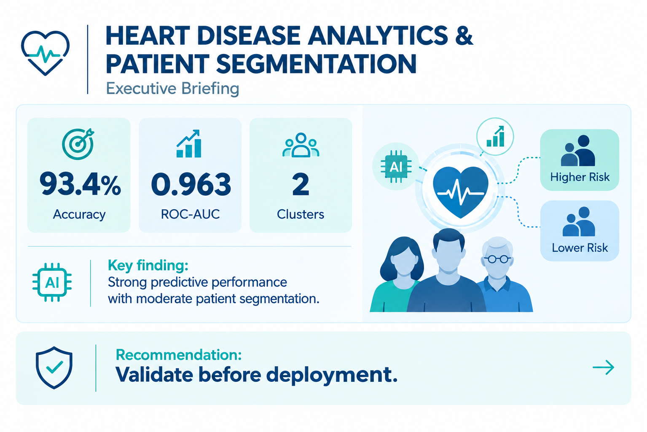
Notes:
Executive Summary
Heart Disease Analytics & Patient Segmentation
Objective: Explore patient segmentation and heart disease prediction.
Dataset: UCI Heart Disease Dataset.
Key Findings
Machine learning models were developed to analyze cardiovascular risk patterns.
Random Forest delivered the strongest predictive performance (ROC-AUC: 0.958).
Clustering revealed moderate patient grouping structure.
Patient segmentation identified two moderately differentiated patient groups.
Key risk drivers included cardiac test results, vessel abnormalities, chest pain type, and exercise-related measurements.
Further validation is required before operational deployment.
Executive Recommendation
Proceed with further validation and pilot testing before considering clinical or operational implementation.

Slide 2
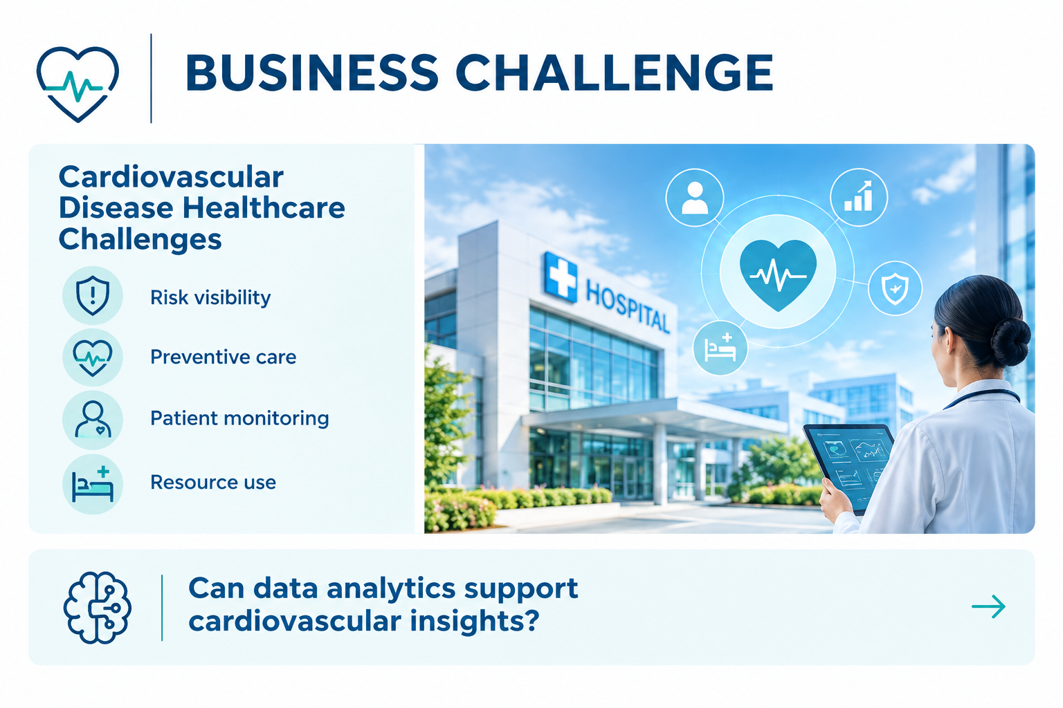
Notes:
Business Challenge
Why This Matters
Cardiovascular disease remains a significant healthcare challenge. Healthcare organizations seek better ways to:
Understand patient populations
Identify individuals who may require closer monitoring
Support preventive care initiatives
Improve allocation of healthcare resources
risk stratification,
population health analysis,
monitoring strategies,
future resource planning.
Business Drivers
Growing burden of cardiovascular disease
Need for earlier risk identification
More effective allocation of clinical resources
Support data-informed decision making
Question
Can data-driven analysis reveal meaningful patient patterns and support cardiovascular risk assessment?

Slide 3
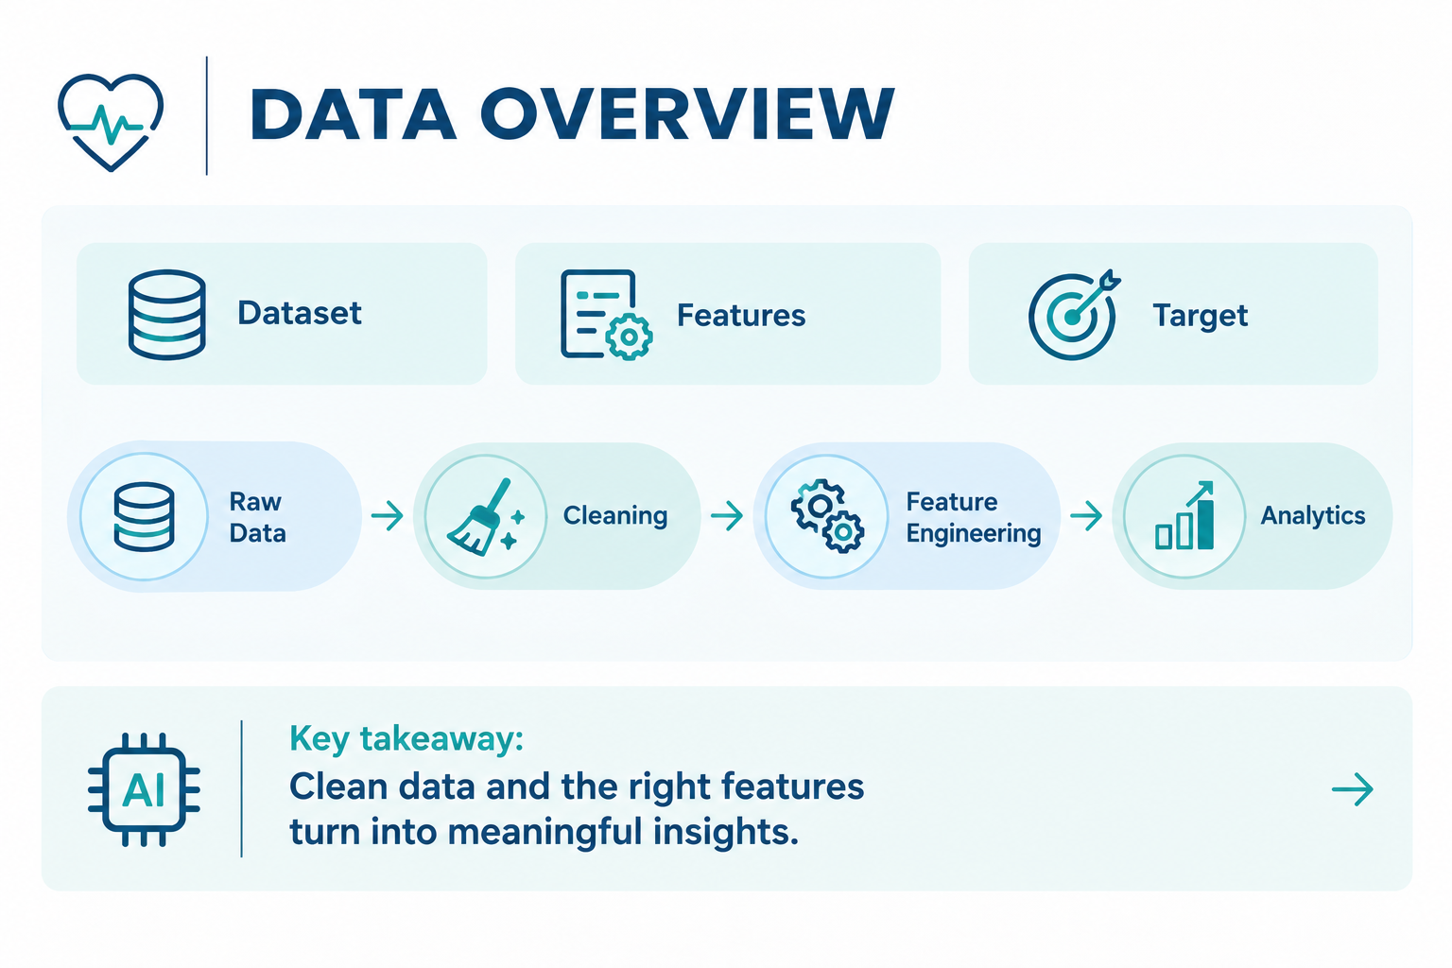
UCI Heart Disease Dataset
Clinical and diagnostic patient data
Cardiovascular risk-related variables
Heart disease outcome
Notes:
Data Overview
Dataset Used
UCI Heart Disease Dataset
Clinical and diagnostic patient data
Cardiovascular risk-related variables
· 15 selected features
Heart disease outcome available
Data Preparation
Missing values addressed
Duplicate records removed
Outliers treated
Features engineered and scaled
Data prepared for clustering and predictive modeling

Slide 4
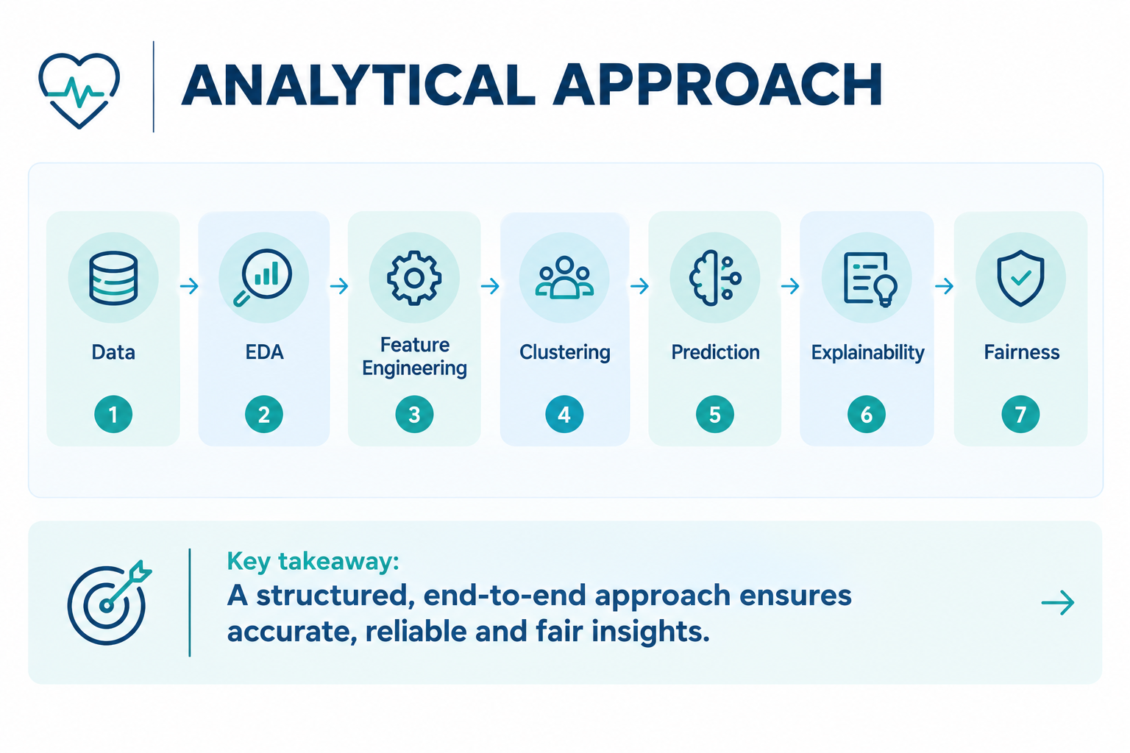
Notes:
Analytical Approach
End-to-End Workflow
Data Preparation
Exploratory Analysis
Feature Engineering
Clustering
Predictive Modeling
Explainability Analysis
Bias and Fairness Assessment
Objective
Understand patient patterns and evaluate predictive potential using machine learning techniques.

Slide 5
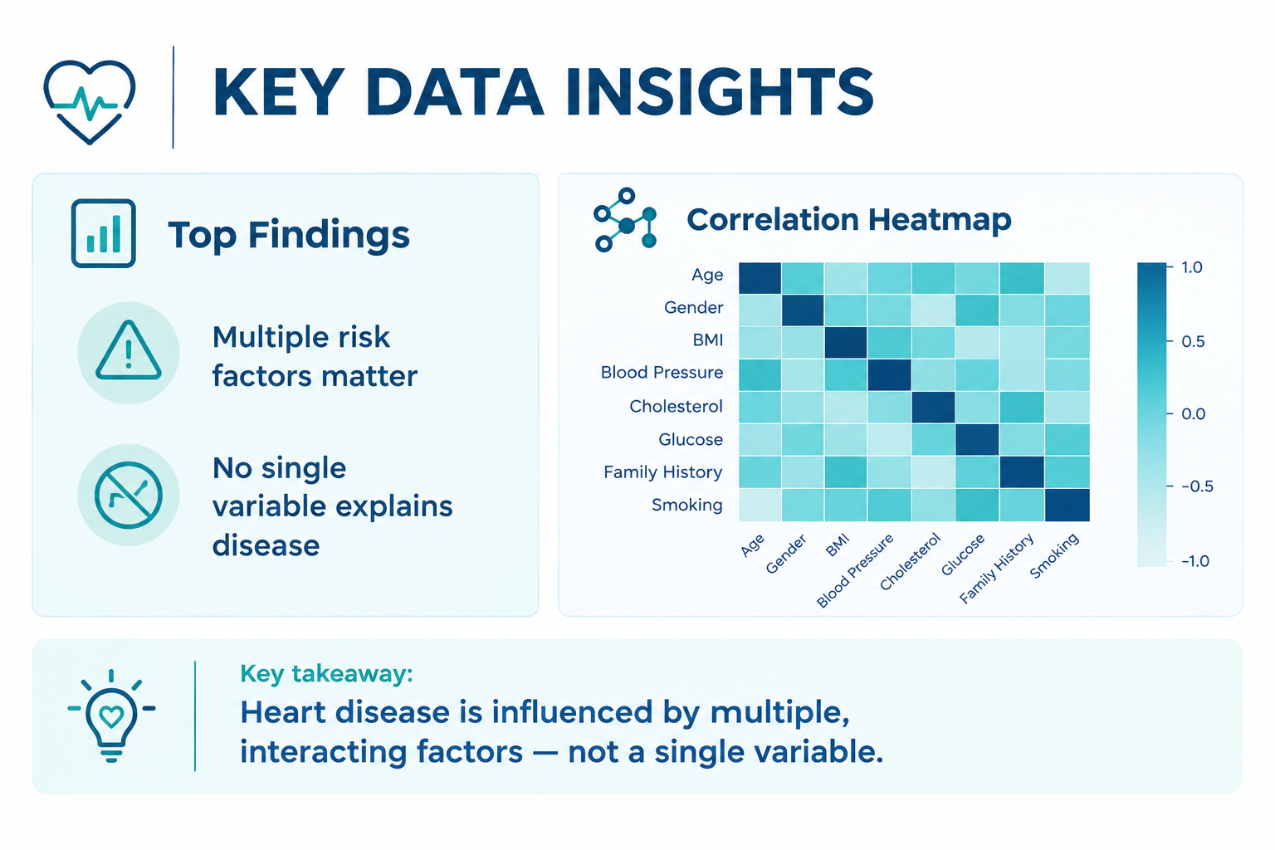
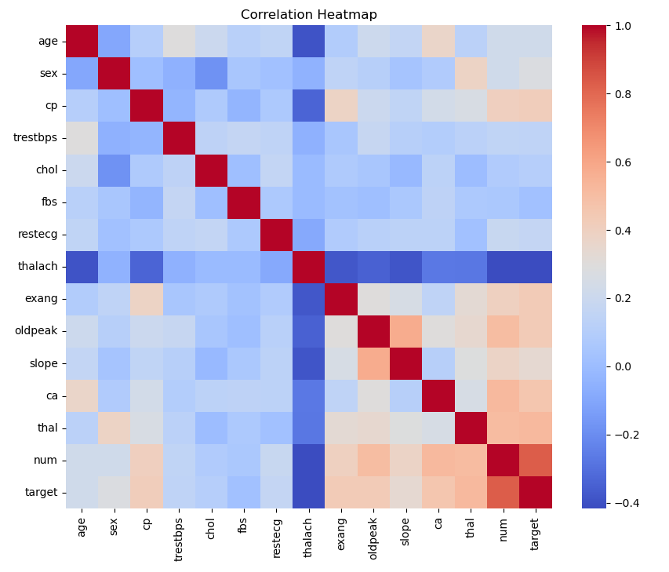
Notes:
Key Data Insights
Major Findings
Cardiac test variables appear more informative than demographic factors.
Cholesterol and blood pressure alone provide limited separation.
Multiple variables jointly contribute to risk patterns.
Data exhibits moderate clustering tendency.
Include:
Correlation Matrix
Distribution Highlights

Slide 6
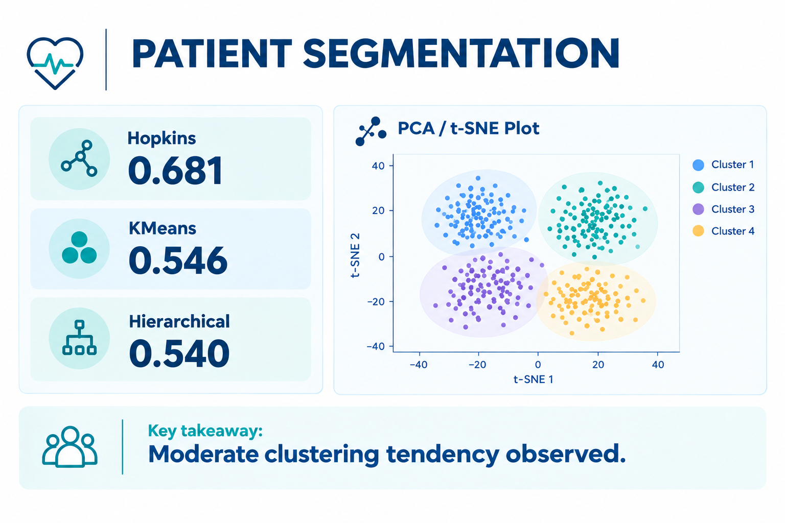
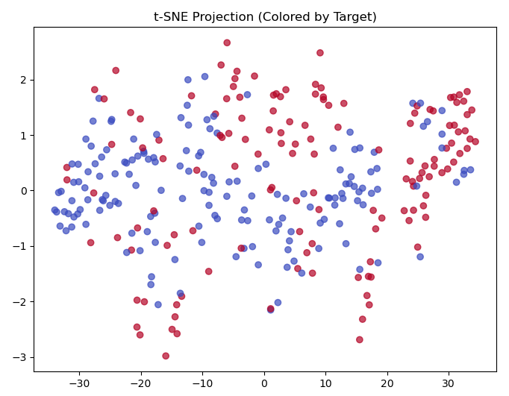
Notes:
Patient Segmentation Results
Clustering Findings
Results
Hopkins Statistic: 0.681
K-Means Silhouette Score: 0.546
Hierarchical Silhouette Score: 0.540
Interpretation
Some underlying patient groupings exist, but boundaries are not strongly separated.
Evidence of moderate clustering tendency.
Two broad patient segments were identified.
Significant overlap remains between groups.
Business Implication
Patient populations may exhibit useful patterns, though segments should be viewed as exploratory rather than definitive risk categories.
The t-SNE figure better supports the business message:
"There is some evidence of patient segmentation, although the groups are not sharply separated."

Slide 7
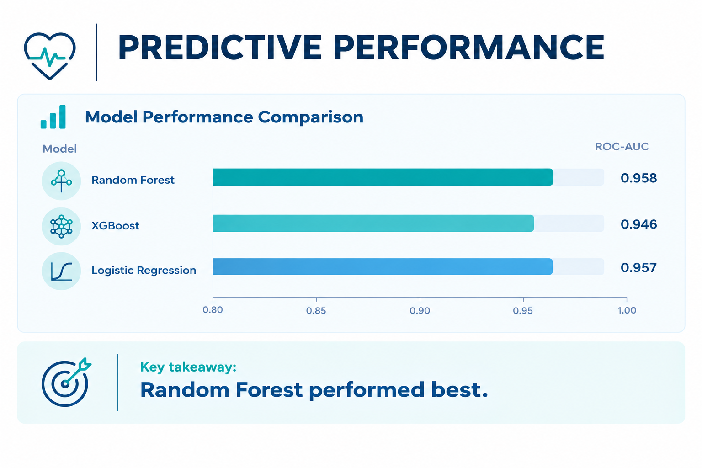
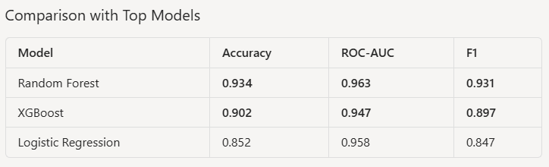
After Hyperparameter Tuning
Notes:
Predictive Modeling Results
Model Performance Comparison
Model Accuracy ROC-AUC
Random Forest 91.8% 0.958
XGBoost 90.2% 0.946
Logistic Regression 86.9% 0.957
Key Finding
Random Forest provided the strongest overall performance while maintaining strong interpretability through explainability techniques.

Slide 8
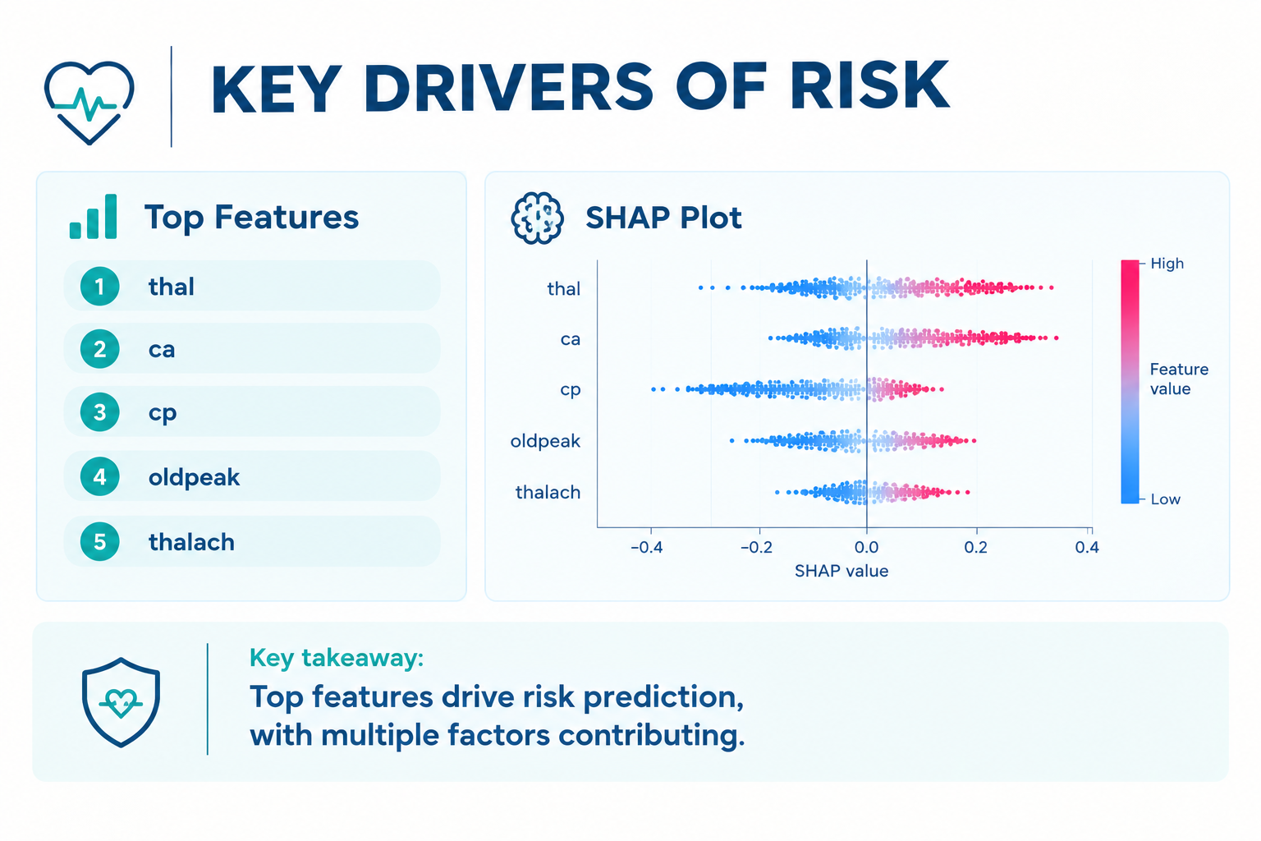
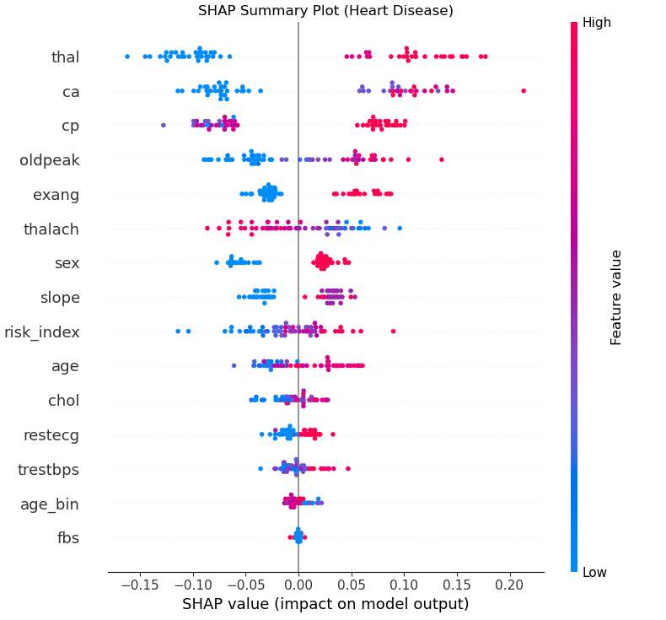
Thalassemia Test Results
Number of Major Vessels
Chest Pain Type
ST Depression
Maximum Heart Rate
Notes:
Key Drivers of Cardiovascular Risk
Most Influential Factors
Top predictors identified by SHAP and Feature Importance analyses:
Thalassemia Test Results (thal)
Number of Major Vessels (ca)
Chest Pain Type (cp)
ST Depression (oldpeak)
Maximum Heart Rate (thalach)
Key Message
Model decisions were primarily driven by clinically relevant cardiovascular indicators.

Slide 9
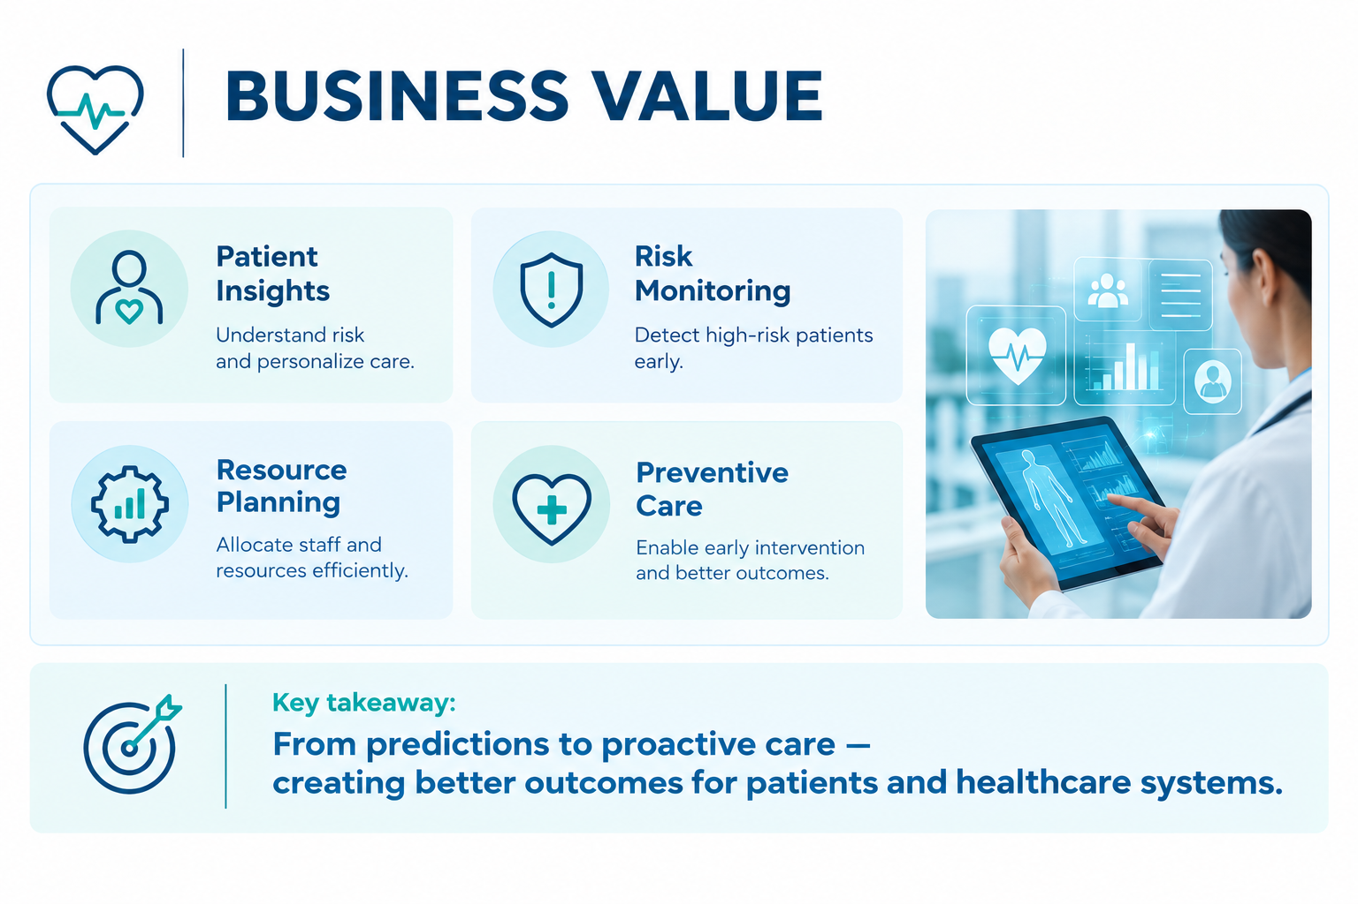
& Potential ROI
Notes:
Business Value & Potential ROI
Potential Benefits
Better understanding of patient populations
More targeted monitoring initiatives
Data-driven prioritization of follow-up activities
Improved visibility into cardiovascular risk patterns
Important Caveat
This study did not measure financial savings or clinical outcome improvements.

Slide 10
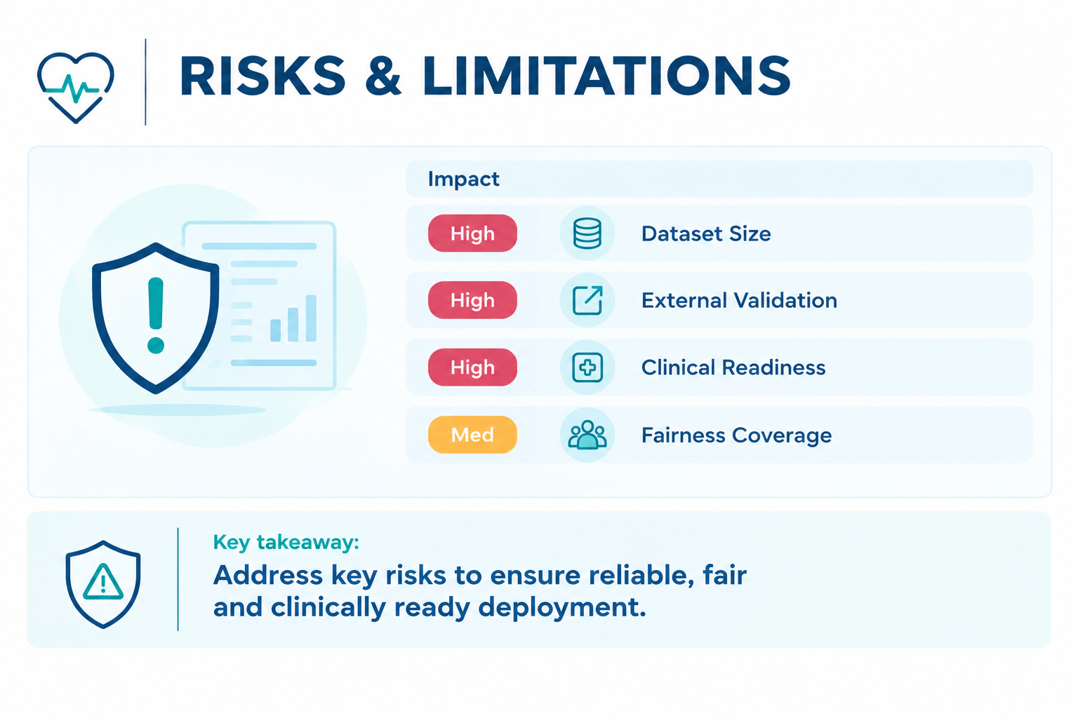
Notes:
Risks and Limitations
Key Risks
Data Risks
Limited dataset size
Potential population representativeness concerns
Modeling Risks
Moderate clustering separation
Need for external validation
Business Risks
Results should not be used for clinical decision-making without further validation

Slide 11
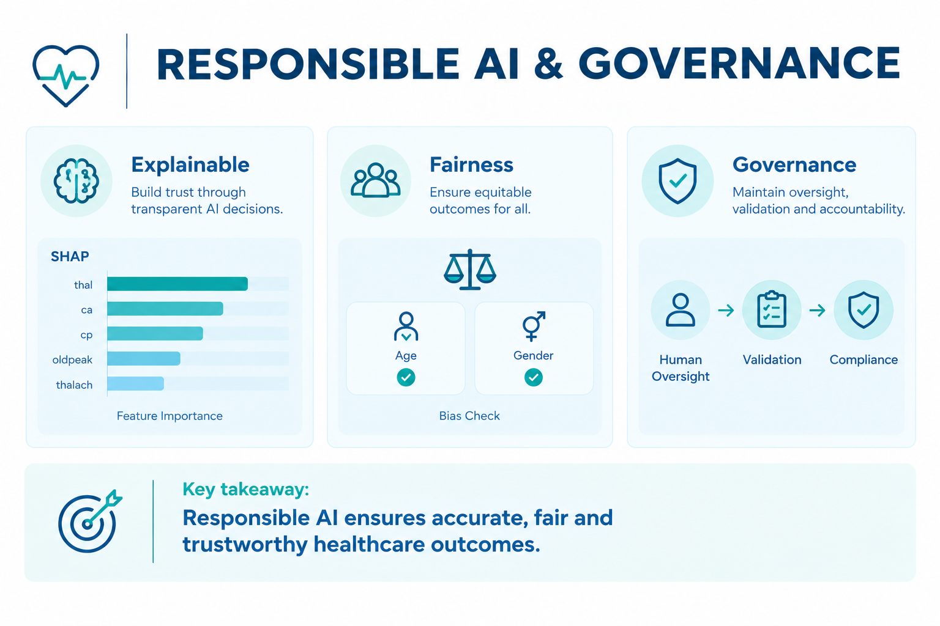
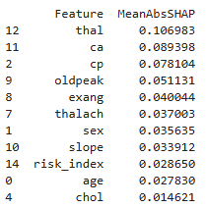
Notes:
Responsible AI & Governance
Explainability
SHAP analysis performed
Feature importance reviewed
Model behavior evaluated
Fairness
Gender and age available
Race and socioeconomic variables unavailable
Governance
Human oversight required
Validation prior to any real-world use

Slide 12
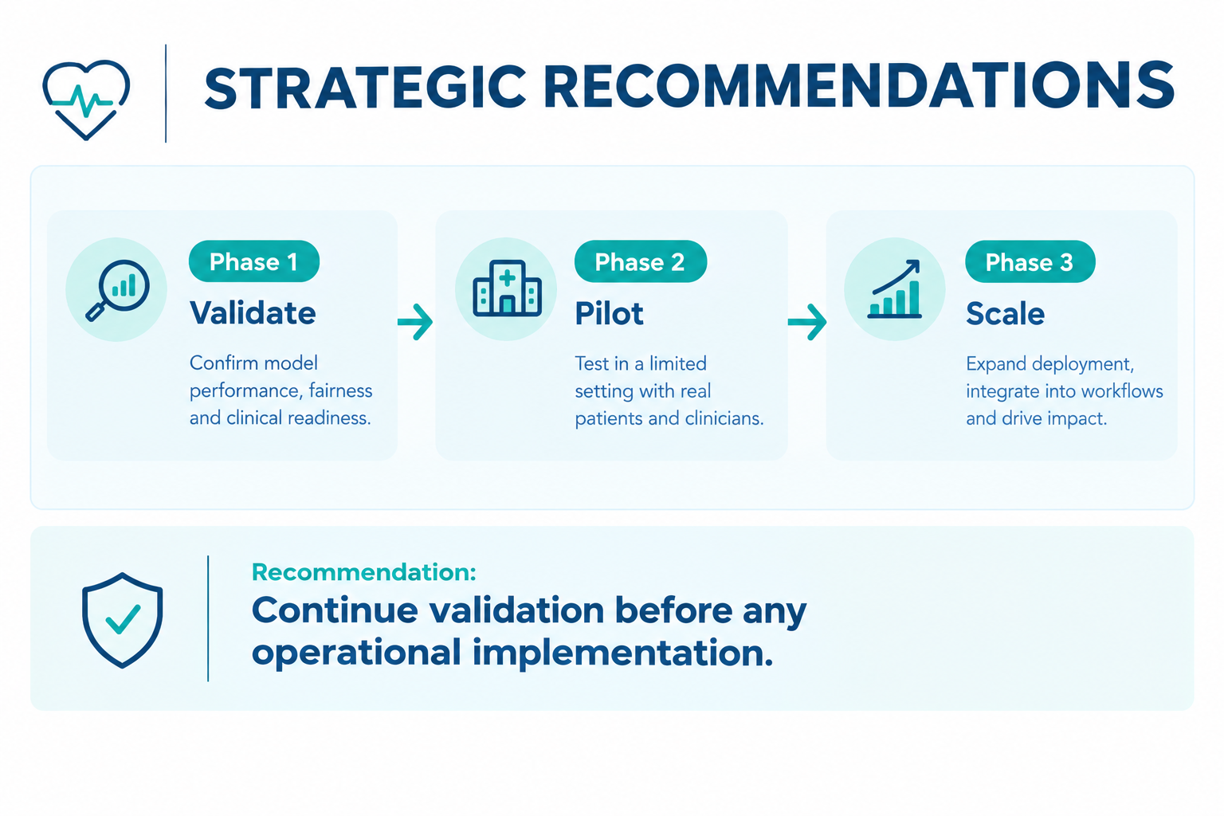
Notes:
Strategic Recommendations & Next Steps
Short-Term
Validate on larger datasets
Conduct subgroup fairness testing
Expand feature coverage
Medium-Term
Build risk monitoring dashboards
Pilot clinician decision-support tools
Executive Recommendation
Machine learning shows promise for cardiovascular risk analysis; however, additional clinical validation is required before operational adoption.

