Slide 1
An Efficient Methodology for Mapping Quantum Circuits to the IBM QX Architectures
Eric Schinwald

Slide 2
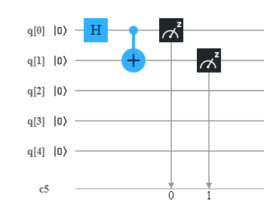
What is a Quantum Circuit?
Qubits instead of Bits
Hadamard Gate – Puts a Qbit into superposition
CNOT Gate – Inverts target Qubit if control Qubit is set to 1
Measure Gate – Measures output at a Qubit

Slide 3


Why we need Quantum Ciruits

Slide 4
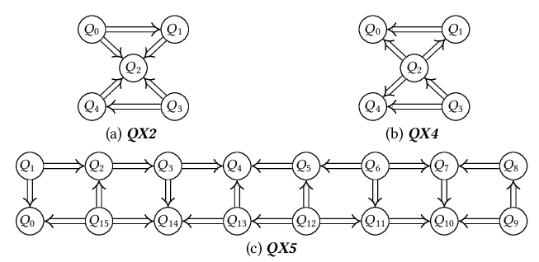
Limitation of the IBM QX Quantum computer
We can not run arbitrary circuits:

Slide 5
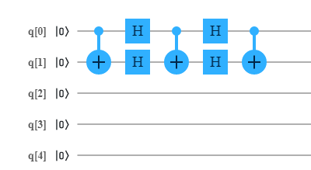
How to get around this limitation
We introduce SWAP gates:
Qubit 0 and Qubit 1 have now been swapped

Slide 6
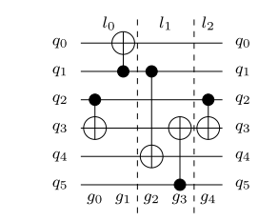
Partition Circuit into layers
We combine all CNOT gates that can run concurrently into layers
Then we find a mapping that fits the IBM QX architecture in each layer

Slide 7
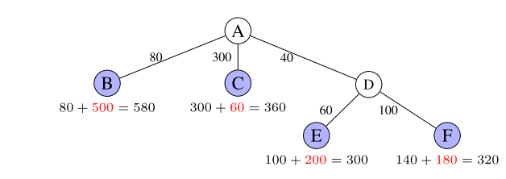
Find a mapping that satifies the constraints
Using the A* algorithm
Turns problem into a path search problem
Optimal solution if given the right heuristic

Slide 8
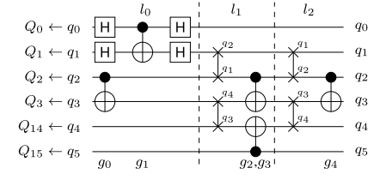
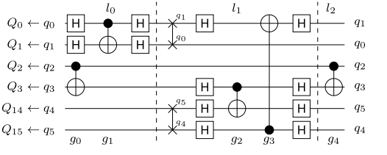
Optimizations
So far only looked at one layer at a time
Looking ahead leads to more efficient solutions being found

Slide 9
Previous solution
From IBM
Searches for solutions semi randomly
Sometimes doesn‘t find a solution within and hour

Slide 10
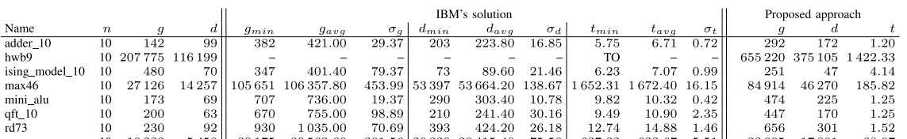
Evaluation
Proposed mapping algorithm significally faster
d – depth of circuit
g – number of quantum gates
t – runtime of mapping algorithm

