Slide 1
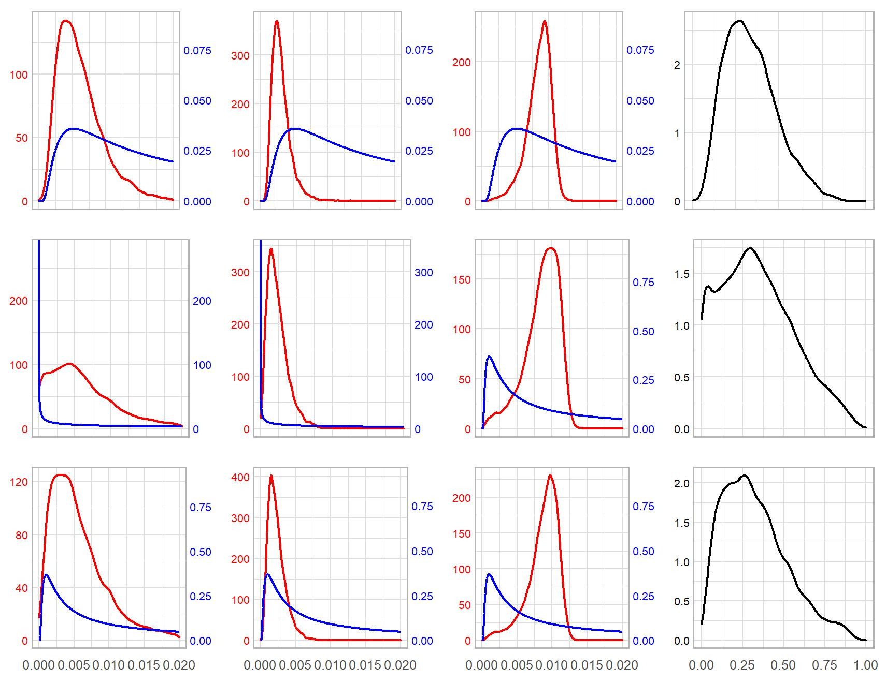
Additive genetic
Clutch
Residual
Heritability
Prior 1
Prior 2
Prior 3

Slide 2
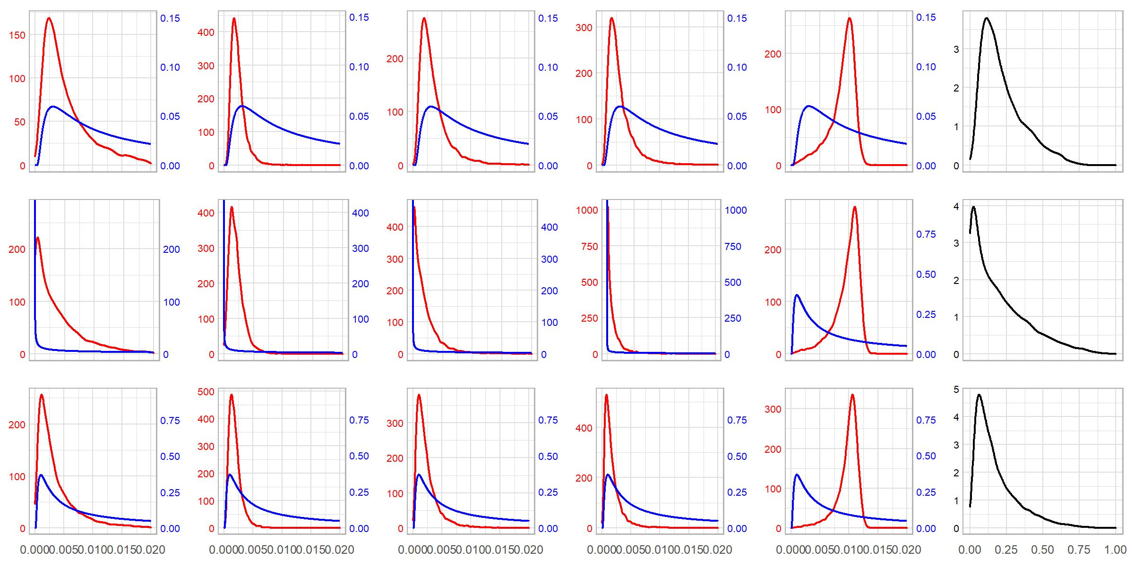
Additive genetic
Clutch
Maternal
Paternal
Residual
Heritability
Prior 1
Prior 2
Prior 3

Slide 3
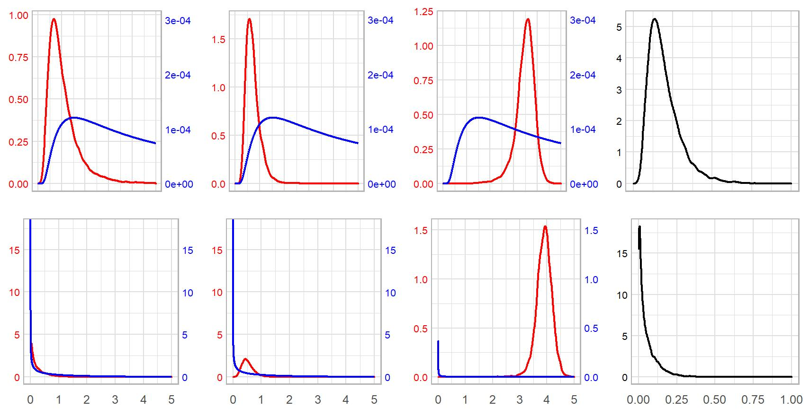
Additive genetic
Clutch
Residual
Heritability
Prior 1
Prior 2

Slide 4
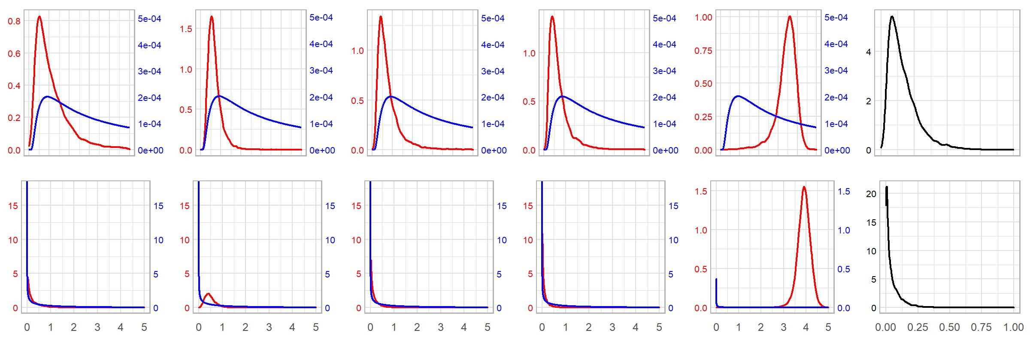
Additive genetic
Clutch
Maternal
Paternal
Residual
Heritability
Prior 1
Prior 2

