Slide 1

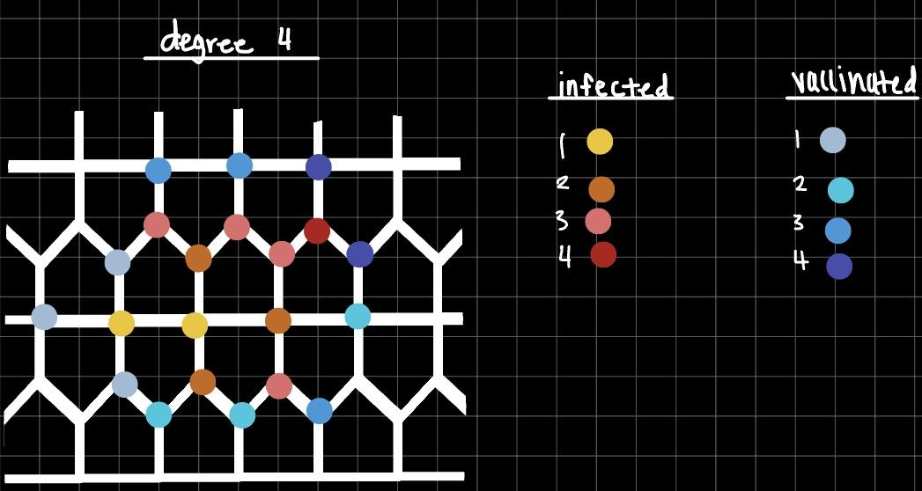
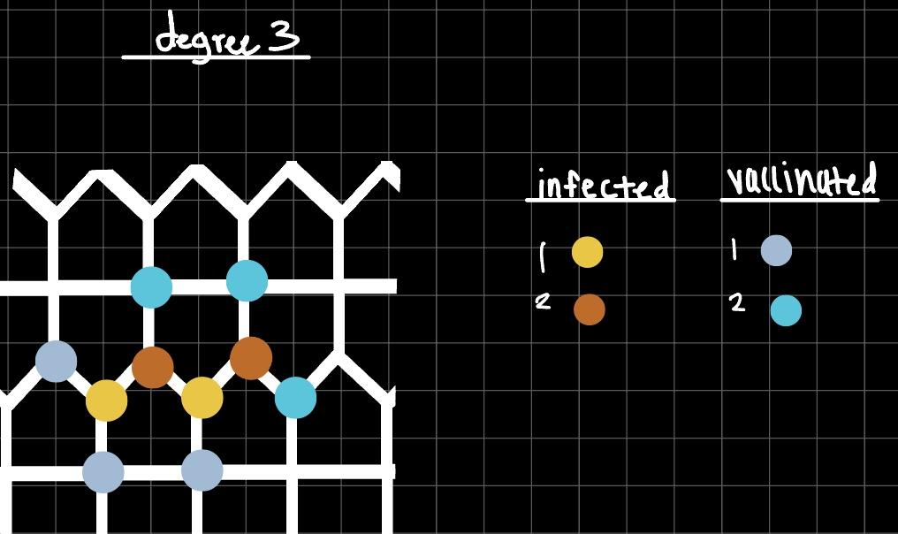
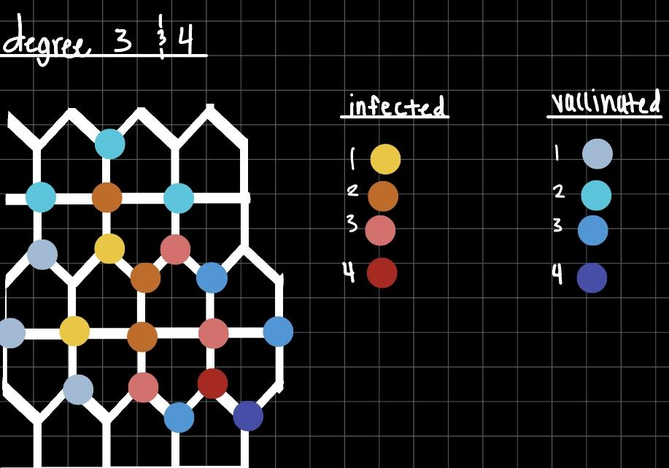
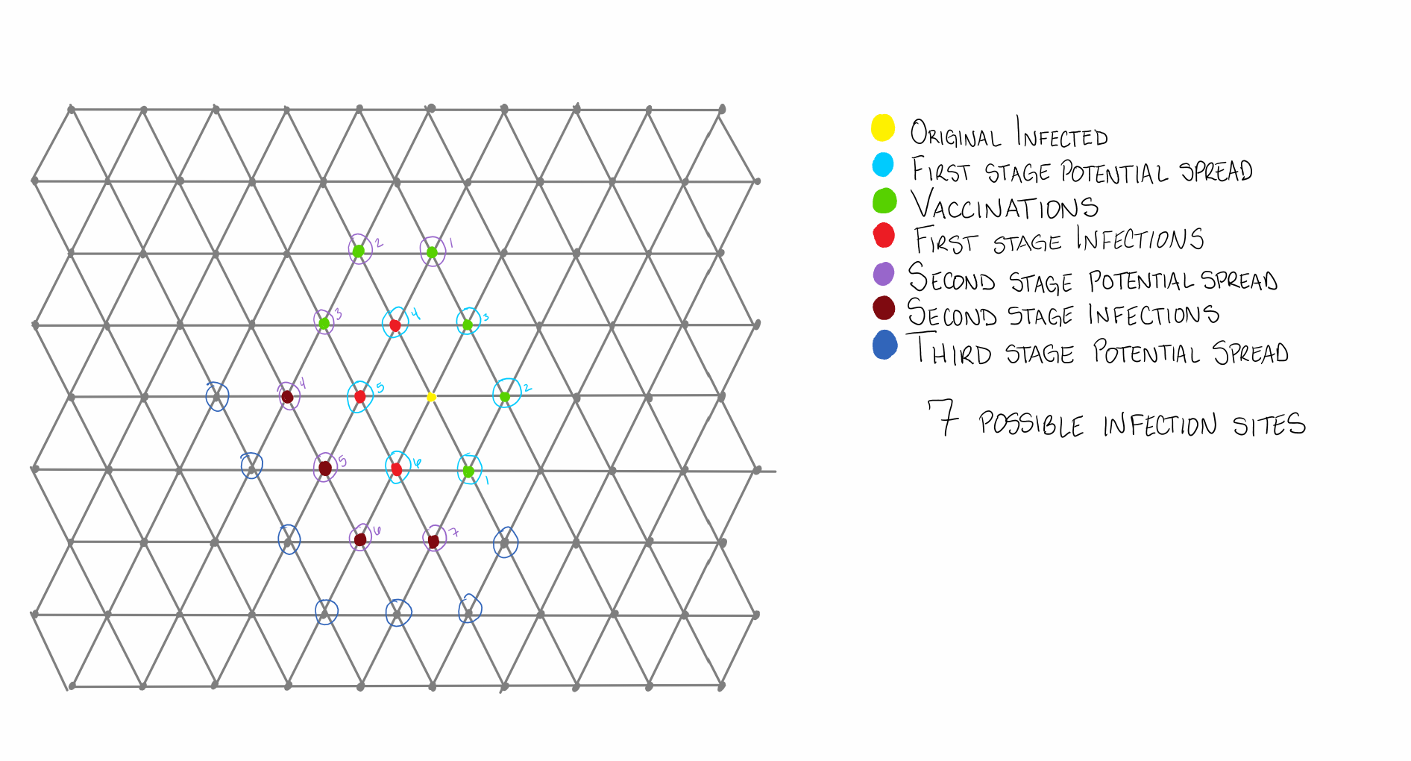
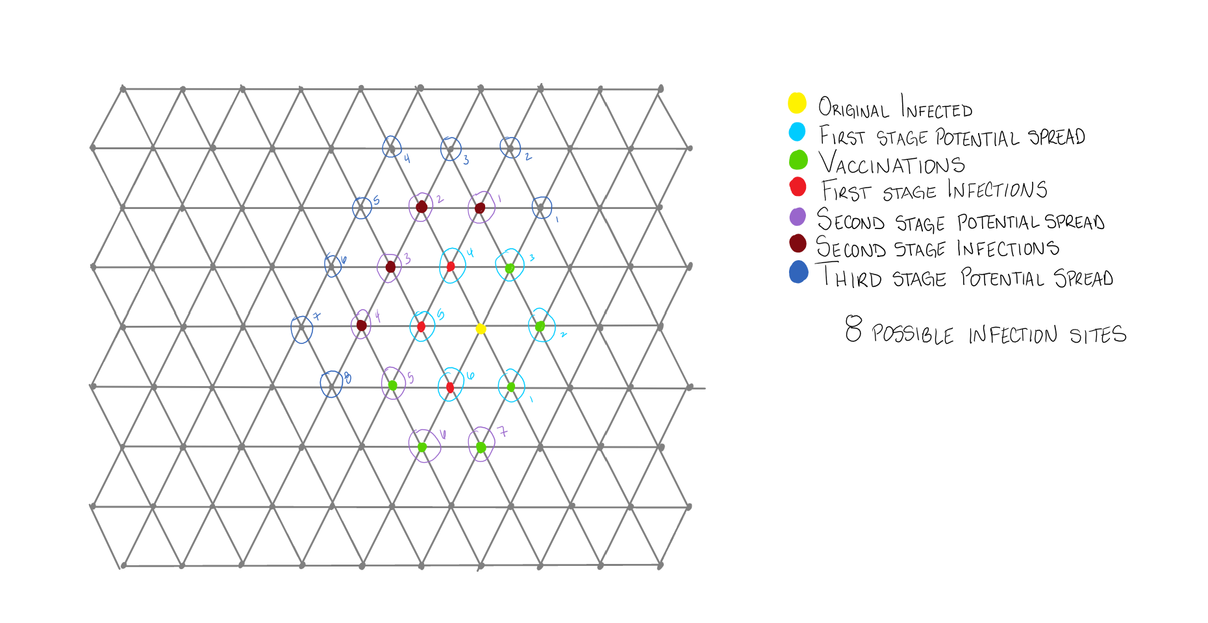

Do you have time right now to edit your poster over zoom?
The Most Efficient Way to Contain a Virus with Limited Vaccinations
Andrea Barnett, Ely Schoenfield, Anthony Macias, Marco Ocampo & Medardo Perez
Abstract
We have recently experienced the pandemic of COVID and know how a biological virus can spread globally in a matter of months. Initially vaccinations were in short supply, raising the question of how to quickly contain a virus with limited vaccinations. Using the previous models of Moeller and Wang, Hartke, Messinger, and Fogarty, we will endeavor to find the most efficient use of vaccinations to contain a viral spread. We focus on an irregular pentagon graph and a regular hexagon grid. The pentagon will have vertices with degrees of three or four. We will create different simulations where the infection starts on two vertices, either both of the degree three, both of the degree four, or one of each. In contrast, the hexagon is regular, all vertices having degrees of six. We will run several simulations on both graph types to see which placements of the vaccinations will be most efficient in containing the viral spread.
Results
Figure 1. 5-irregular graph with 2 infections starting at degree 4. Providing 3 vaccinations per round.
Figure 2. 5-irregular graph with 2 infections starting at degree 3. Providing 3 vaccinations per round.
Figure 3. 5-irregular graph with 2 infections starting at degree 3 and degree 4. Providing 3 vaccinations per round.
Problem
COVID-19 has shown us how quickly a virus can spread globally [5]
New viruses have limited vaccinations due to financing shortfalls, manufacturing capacity, and logistical challenges
How to slow and/or contain a virus spread with limited resources
Definitions
A 6-regular graph is a graph where each vertex has a degree of 6.
A 5-irregular graph is a graph where vertices have either degree 3 or 4.
Figure 4. A 6-regular graph with one starting infection. First round of vaccinations are on V₁, V₂, V₃. The second round of vaccinations are on V₁, V₂, V₃. There are 8 possible infection sites.
Figure 5. A 6-regular graph with one starting infection, and providing three vaccinations per round. First round same as Figure 4. Second round vaccinations are on V₅ , V₆ , V₇. It has 8 possible infection sites, showing that it has the same effect as Figure 4.
Results we are looking for
We want to find the best results for containing the virus
Having as few viruses as possible in each step
Making sure that the virus doesn’t spread around the vaccine
References
[1] Fogarty, P. (2003). Catching the fire on grids (Doctoral dissertation, University of Vermont).
[2] Messenger’s Thesis
[3] Hartke, S. G. (2004). Graph-theoretic models of spread and competition (Doctoral dissertation, Rutgers University).
[4] Wang, P., & Moeller, S. A. (2002). Fire control on graphs. Journal of Combinatorial Mathematics and Combinatorial Computing, 41, 19-34.
[5] Hadi, A. G., Kadhom, M., Hairunisa, N., Yousif, E., & Mohammed, S. A. (2020). A review on COVID-19: origin, spread, symptoms, treatment, and prevention. Biointerface Research in Applied Chemistry, 10(6), 7234-7242.
[6] Han, S., Cai, J., Yang, J., Zhang, J., Wu, Q., Zheng, W., ... & Yu, H. (2021). Time-varying optimization of COVID-19 vaccine prioritization in the context of limited vaccination capacity. Nature communications, 12(1), 4673.
Observations
When observing the virus spreading for two time steps we notice creating a connected component of the vaccine set is directly correlated to how effective a containment protocol is as well as the overlap of two or more infected vertices on an healthy-unvaccinated neighbor vertex can limit spread.
Methodology
We start with either one or two infected vertex and calculate the number of vaccines that are used at each time step by taking the roof of half of the greatest vertex degree.
At each time step we can evaluate the effectiveness of all possible containment protocols by observing how many vertices the virus spreads to in two time steps.
Acknowledgement
We would like to thank Dr. Thomas Mattman for his support and help with our research project.

