Slide 1
First Steps with eSciDoc and Java Client Library

Slide 2
Overview
eSciDoc XML representation http://<host>:8080/ir/item/escidoc:ex5
Structure of example package
Creation of eSciDoc resources

Slide 3
eSciDoc Resources
Organizational Unit
User, Grants
Context
Item
Container
…

Slide 4
Structure of example Package
Class Mapping
REST Handler
Templates
Structure of example classes

Slide 5
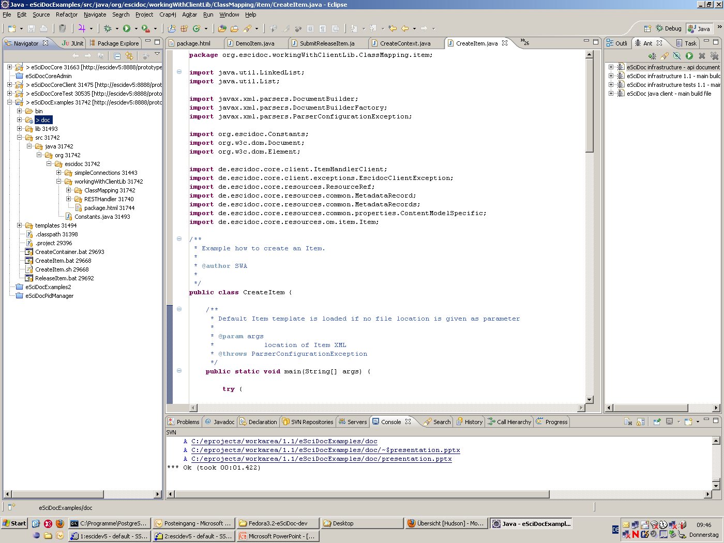

Slide 6
Creating of the Basic Objects
Create Organizational Unit
Set status of OU to ‚open‘
Create Context
Create User
Set user grant
Create Content Model
Create Item
Create Container

Slide 7
Organizational Unit (OU)
Define OU properties
Created by user with system administrator grants
Set status of OU to open
Retrieve: http://<host>/oum/organizational-unit/<objid>

Slide 8
Context
Define Context properties
Name of Context
Description
Related Organizational Unit(s)
Created by user with system administrator grants
Set status to ‚open‘
Retrieve http://<host>/ir/context/<objid>

Slide 9
User
Define user poperties
Login name
Related Organizational Unit
Real Name of User
Email address
..
Created by user with system administrator grants
Retrieve http://<host>/aa/user-account/<objid>

Slide 10
Set User Grants
Define used Role
Define valid Context
Retrieve http://<host>/aa/user-account/<objid>/ resources/current-grants

Slide 11
Content Model
Define properties
Name
Retrieve http://<host>/cmm/content-model/<objid>

Slide 12
Item
Create
Submit
Release
Update
Submit
Release
http://<host>/ir/item/<objid>

Slide 13
Container
Create
Submit
Release
Update
Submit
Release
http://<host>/ir/container/<objid>

Slide 14
Second Container
Create
Add Member
Item
Container

Slide 15
Organizational Unit Hierarchy
Create second OU as child of first OU

Slide 16
Vielen Dank! Fragen?
Mailingliste: infrastructure-user@escidoc.org
Website: www.escidoc.org

