Slide 1
First Steps with eSciDoc and Java Client Library

Slide 2
Overview
Explain Example Package
Class Mapping
REST Handler
Explain eSciDoc Resources
Organizational Unit
User, Grants
Context
Item, Container, …

Slide 3
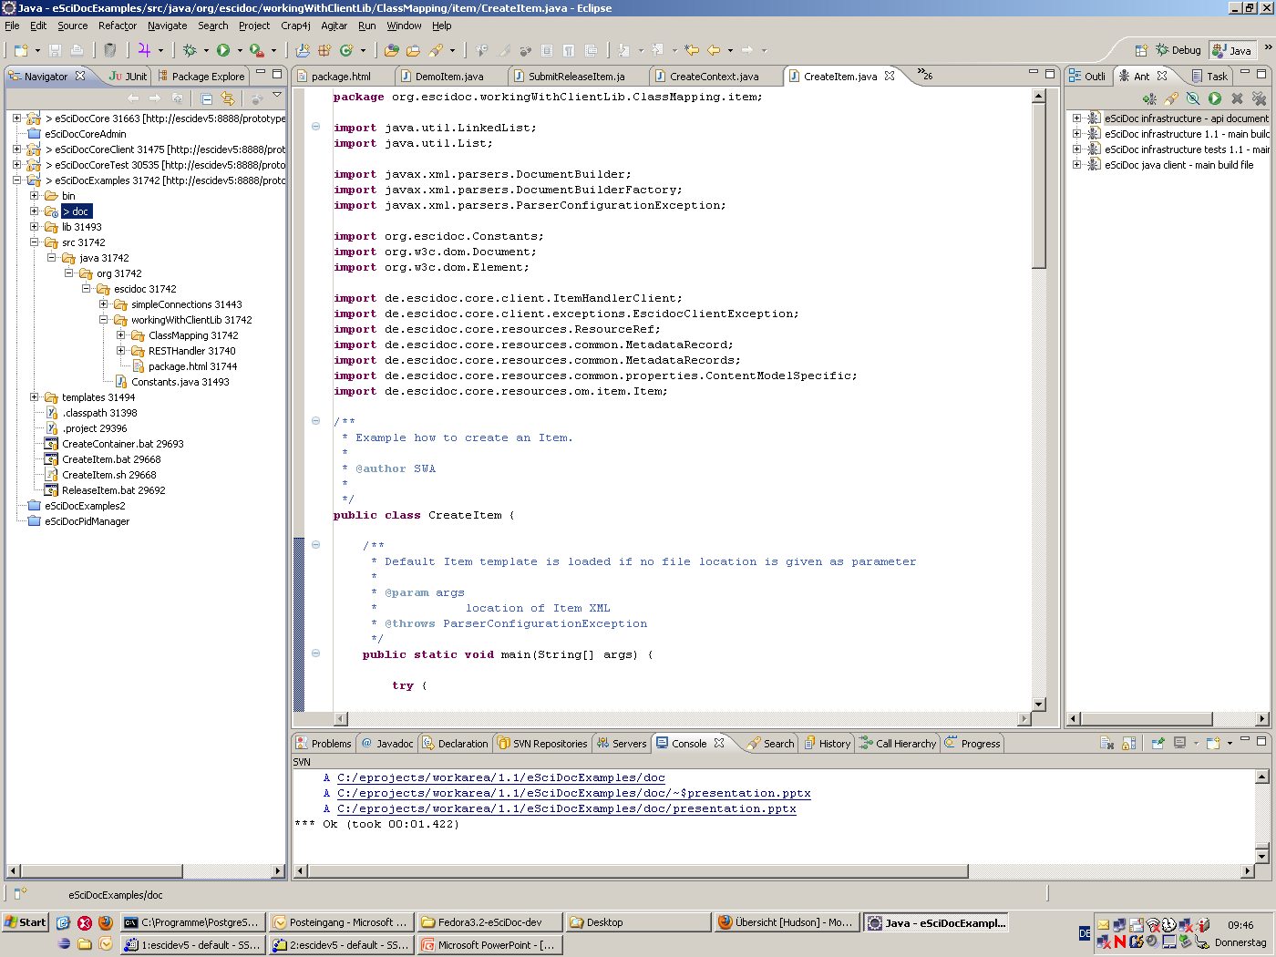

Slide 4
Creating of the Basic Objects
Create Organizational Unit
Create User
Create Context
Create Content Model
Set user grant
Create Item and Container

Slide 5
Organizational Unit (OU)
Define OU properties
Created by user with system administrator grants
Set status of OU to open
Create second OU as child of first OU
(optional) just to show OU hierarchy
Retrieve: http://<host>/oum/organizational-unit/<objid>

Slide 6
User
Define user poperties
Login name
Related Organizational Unit
Real Name of User
Email address
..
Created by user with system administrator grants
Retrieve http://<host>/aa/user-account/<objid>

Slide 7
Context
Define Context properties
Name of Context
Description
Related Organizational Unit(s)
Created by user with system administrator grants
Retrieve http://<host>/ir/context/<objid>

Slide 8
Content Model
Define properties
Name
Retrieve http://<host>/cmm/content-model/<objid>

Slide 9
User Permission
Define Role
Define Context
Retrieve http://<host>/aa/user-account/<objid>/ resources/current-grants

Slide 10
Item
Create
Submit (incl. Release)
Update
Submit
release

Slide 11
Container
Create
Submit (incl. Release)
Update
Submit (incl. Release)

Slide 12
Second Container
create
Add Member
Item
Container

