Slide 1
First Steps with eSciDoc and Java Client Library

Slide 2
Overview
eSciDoc XML representation
Structure of example package
Creation of eSciDoc resources

Slide 3
eSciDoc Resources
Organizational Unit
User, Grants
Context
Item
Container
…

Slide 4
Structure of example Package
Class Mapping
REST Handler
Templates
Structure of example classes

Slide 5
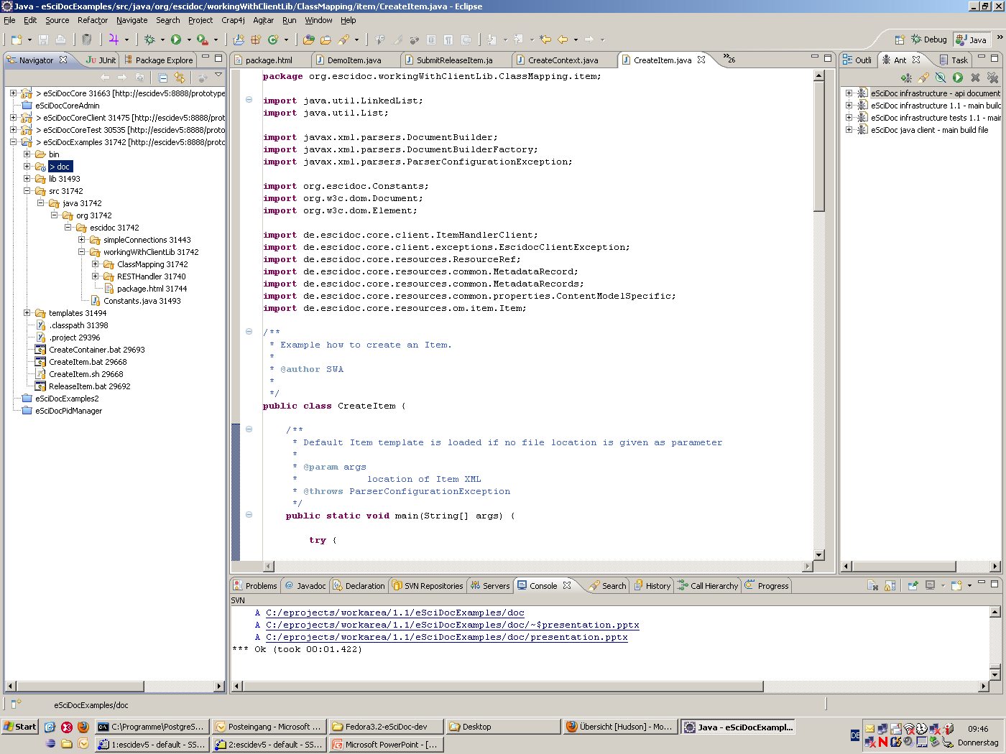

Slide 6
Creating of the Basic Objects
Create Organizational Unit
Set status of OU to ‚open‘
Create Context
Create User
Set user grant
Create Content Model
Create Item
Create Container

Slide 7
Organizational Unit (OU)
Define OU properties
Created by user with system administrator grants
Set status of OU to open
Retrieve: http://<host>/oum/organizational-unit/<objid>

Slide 8
Context
Define Context properties
Name of Context
Description
Related Organizational Unit(s)
Created by user with system administrator grants
Set status to ‚open‘
Retrieve http://<host>/ir/context/<objid>

Slide 9
User
Define user poperties
Login name
Related Organizational Unit
Real Name of User
Email address
..
Created by user with system administrator grants
Retrieve http://<host>/aa/user-account/<objid>

Slide 10
Set User Grants
Define used Role
Define valid Context
Retrieve http://<host>/aa/user-account/<objid>/ resources/current-grants

Slide 11
Content Model
Define properties
Name
Retrieve http://<host>/cmm/content-model/<objid>

Slide 12
Item
Create
Submit
Release
Update
Submit
release

Slide 13
Container
Create
Submit
Release
Update
Submit
Release

Slide 14
Second Container
Create
Add Member
Item
Container

Slide 15
Organizational Unit Hierarchy
Create second OU as child of first OU

