Slide 1
Formative assessment

Slide 2
Overview
Mental models and expertise
Misconceptions
How can formative assessment be useful?
How should you use formative assessment?
Examples
Exercise

Slide 3
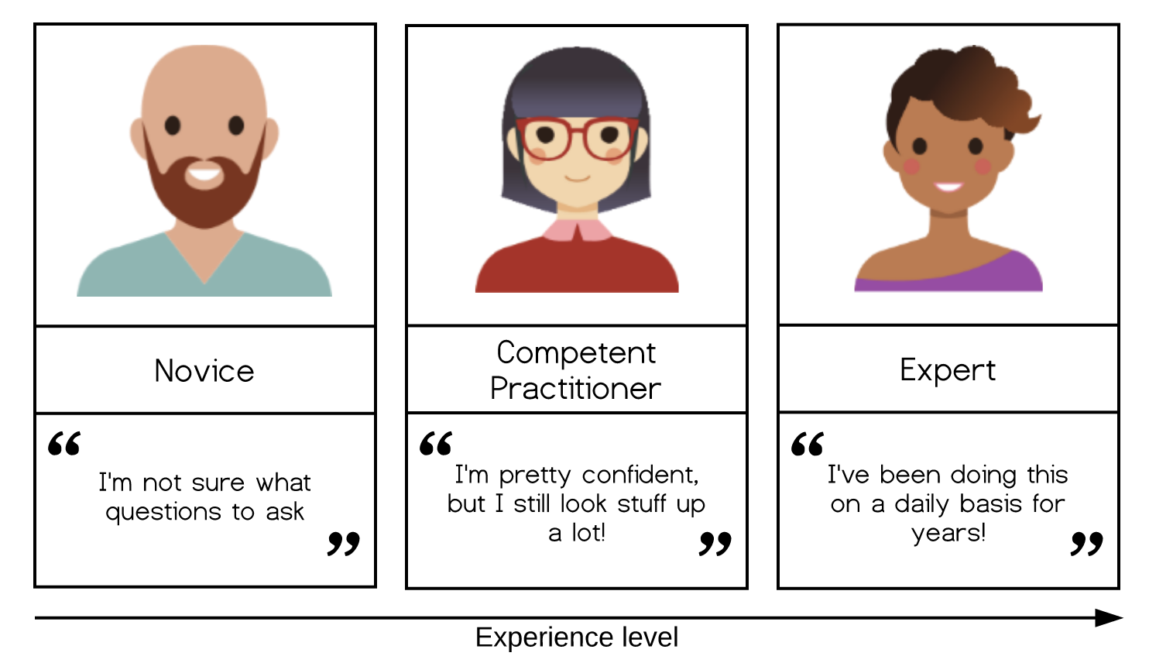
Mental models and expertise

Slide 4
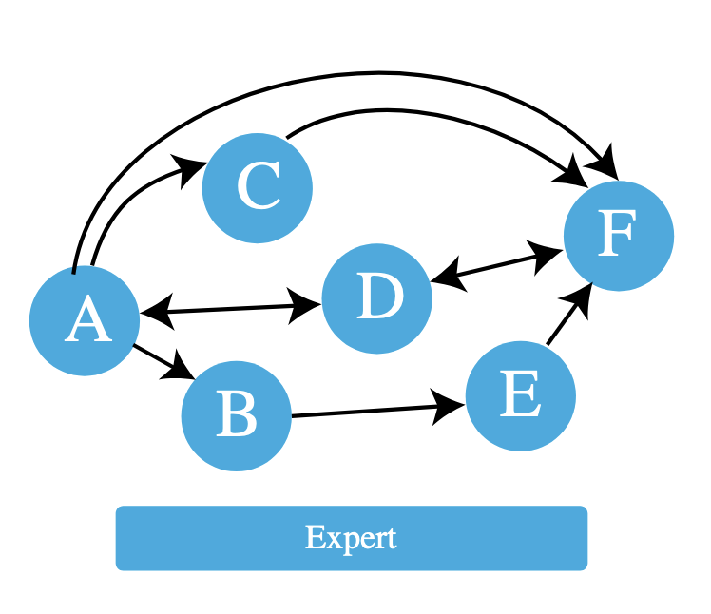
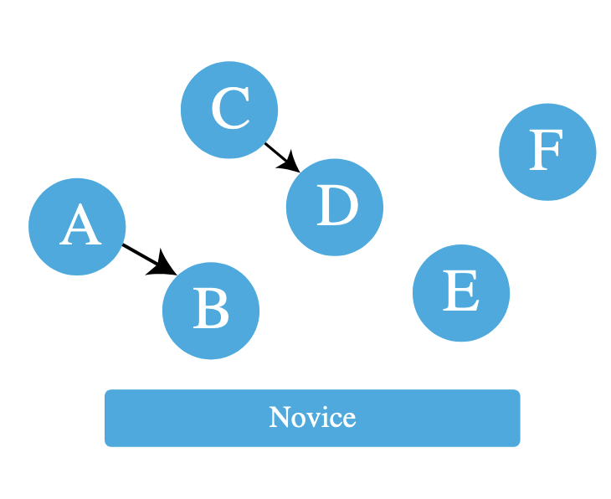
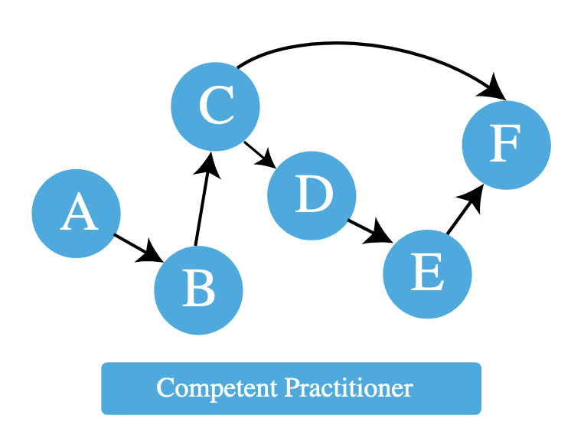
Mental models and expertise

Slide 5
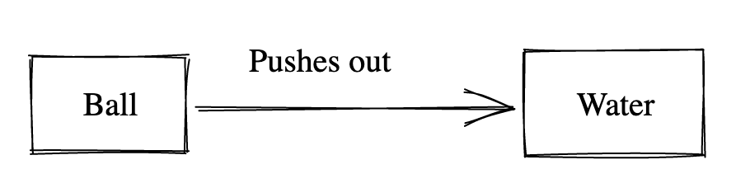
A simple mental model
A kid has a ball and a full bucket of water

Slide 6
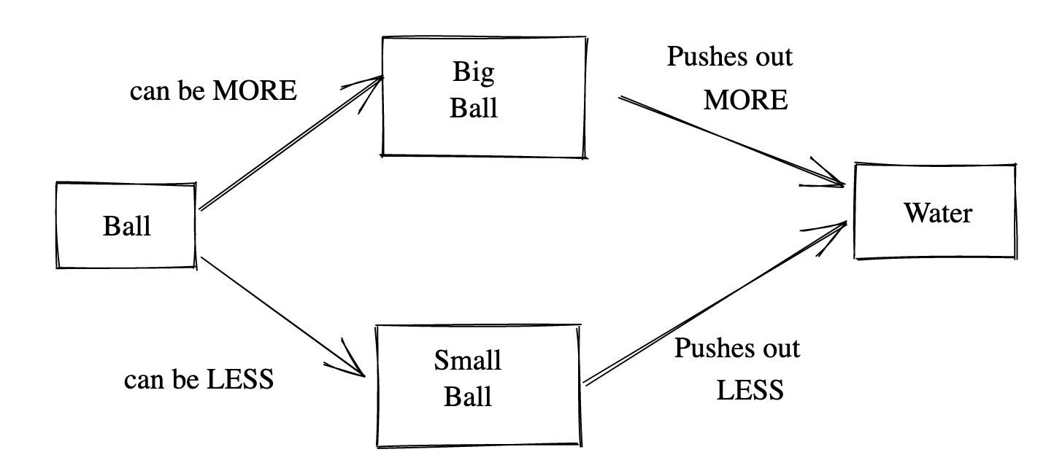
A simple mental model
Now, the kid has 3 different-sized balls:

Slide 7
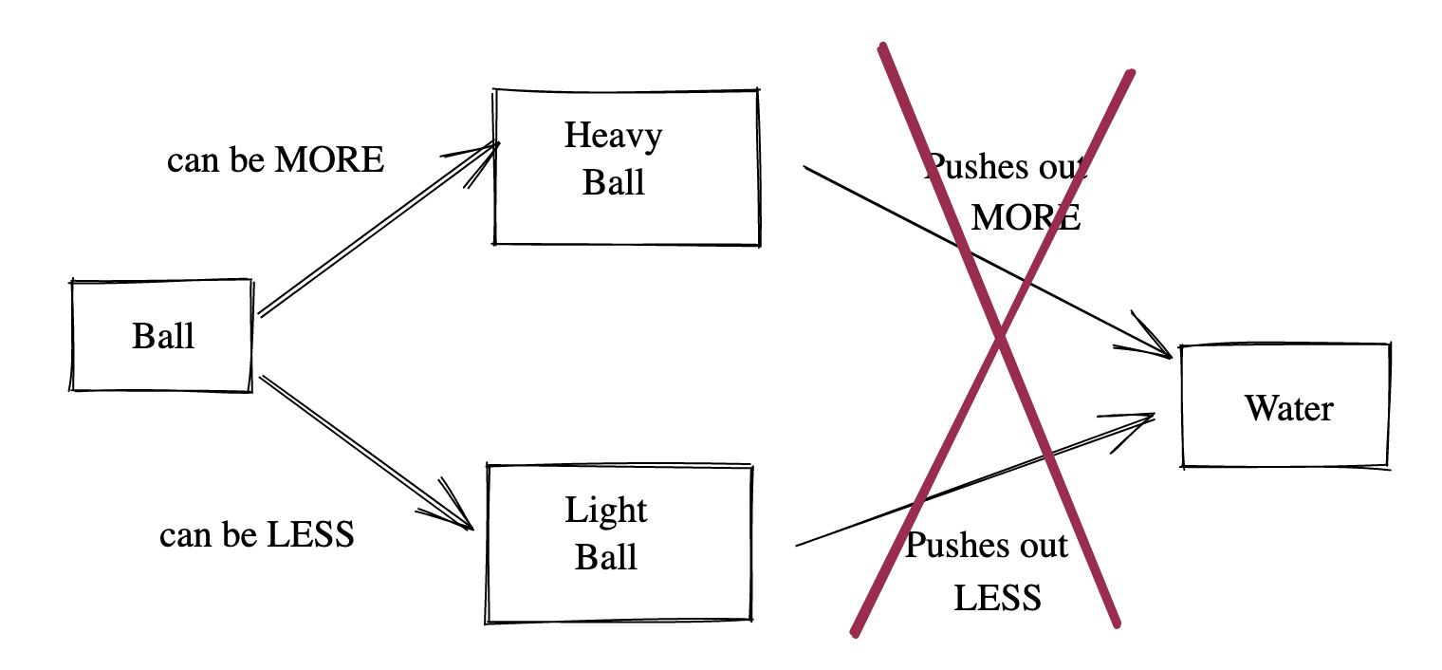
Misconceptions
What if they also have different weights?

Slide 8
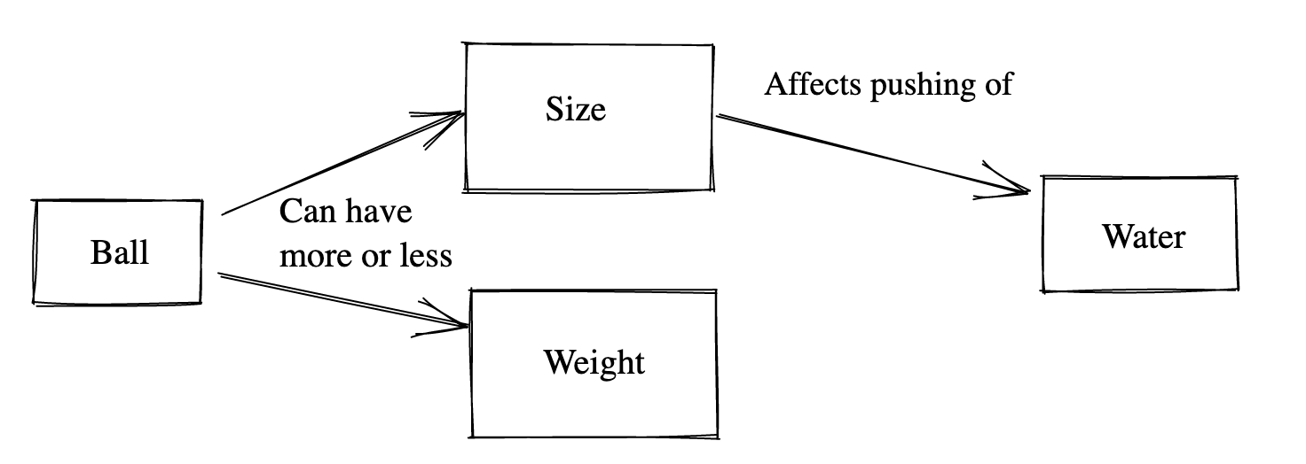
Correcting mental models
Unlearning takes time!

Slide 9
Formative assessment
Any instructional tool that generates feedback that is used in a formative way

Slide 10
How can formative assessment be useful?
It generates immediate feedback for both learners and instructors
The feedback helps us assess the mental model that is forming in our learners
We can identify misconceptions
We can go on to correcting those misconceptions
Committing information from working memory to long-term memory
Formative assessment is different from summative assessment

Slide 11
How should you use formative assessment?
Use it regularly (ideally an exercise every 10 minutes)
Make sure all learners are assessed
Respond promptly to the results of the assessment

Slide 12




Example: plausible distractors
A) 42
B) 32
C) 312
D) 33

Slide 13
Example: plausible distractor
What does each wrong answer tell you about the learner's misconception about long addition?
A) 42
B) 32
C) 312
D) 33

Slide 14
Examples of different exercise formats
Plausible distractors
Fill in the blanks
Minimal fix
Think-pair-share

Slide 15
Fill in the blanks
Fill in the blanks so that the code below prints the string ’hat’.
text = 'all that it is'
slice = text[____:____]
print(slice)

Slide 16
Minimal fix
This function is supposed to test whether a number lies within a range (open interval (lower, higher) ).
Make one small change so that it actually does so.
def inside(point, lower, higher):
if (point <= lower):
return false
elif (point <= higher):
return false
else:
return true

Slide 17
Think-pair-share | Describe storage facilities
Student instructions
Describe properties of the storage facilities you might use for your research data. Address the following aspects:
Capacity:
Backup procedures:
Accessibility (local, server, cloud, etc.):
Level of security:
Costs:
Possibility to assign and revoke access rights:
Link to more information:

Slide 18
Think-pair-share | Describe storage facilities
Teacher perspective
Make groups
Provide references to resources where students can find information about storage locations
Ask each group to search for information about a storage location
Provide a place where they can collect their information (flipchart in classroom, Google Doc in online course)
Ask each group to present main characteristics to the rest of the group

Slide 19
Exercise
Come up with a formative assessment that you can use in your teaching
Choose one type and work out the exercise:
Plausible distractors in multiple choice questions
Fill in the blanks
Minimal fix
Think-pair-share

Slide 20
Resources
Teaching Tech Together - key ideas you can use to create and deliver effective programming lessons
HBO werkvormen (in Dutch) - lesson activities to activate students that can also be used to do formative assessment
Research Support Games list – inventory of games and game-related resources that can be used as educational tools to train researchers or research support staff, including:
Descriptions of the games
Platforms that can be used during the games
Related resources

