Slide 1
Spreadsheets

Slide 2
Raise your hand if
You are here to learn about Python, not about spreadsheets

Slide 3
Raise your hand if
You have used spreadsheets in your research

Slide 4
Raise your hand if
You have accidentally done something in a spreadsheet program that made you frustrated or sad?

Slide 5
Data pipeline
Spreadsheets → Openrefine → Python
Data entry Data cleaning Data analysis

Slide 6
Rationale
After this lesson you will:
Understand how to organize data so computers can make the best use of the data

Slide 7
Do not use excel for something else than data entry! Maybe some quick and dirty plotting. Use Openrefine and Python!
Potential problems:
Difficult to replicate your steps
Easy to make small errors without spotting them

Slide 8
SAFI dataset
SAFI (Studying African Farmer-Led Irrigation) is a currently running project which is looking at farming and irrigation methods. This is survey data relating to households and agriculture in Tanzania and Mozambique. The survey data was collected through interviews conducted between November 2016 and June 2017. The survey covered such things as; household features (e.g. construction materials used, number of household members), agricultural practices (e.g. water usage), assets (e.g. number and types of livestock) and details about the household members.

Slide 9
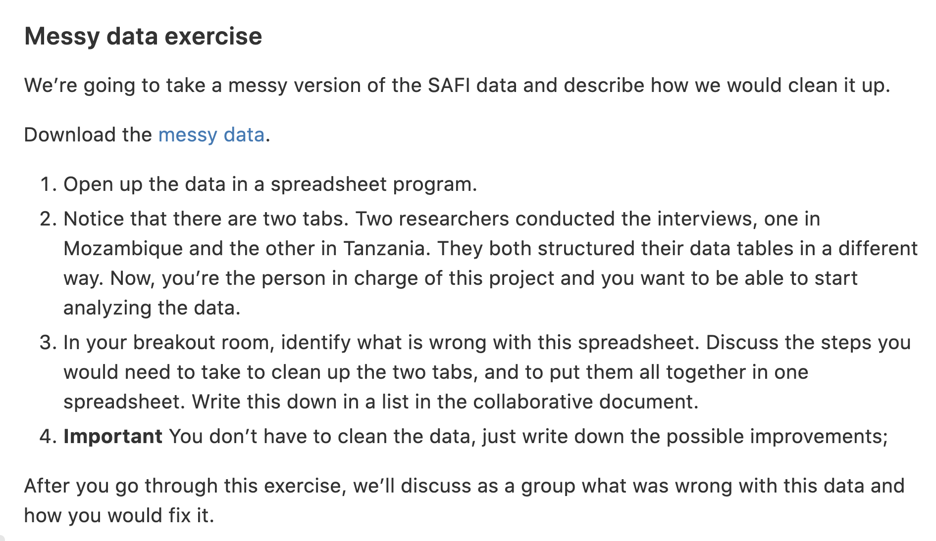

Slide 10
Do not touch your raw data

Slide 11
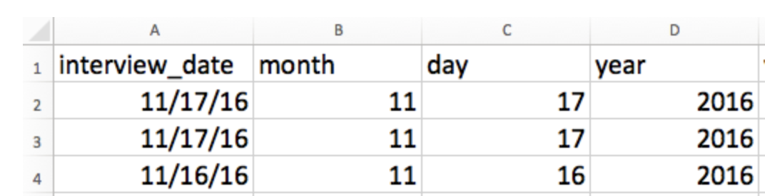
Dates as data
Separate into month, day, year to avoid confusion
Be consistent

Slide 12
Save as .csv or .tsv !
Data stored in common spreadsheet formats will often not be read correctly into data analysis software, introducing errors into your data.
Exporting data from spreadsheets to formats like CSV or TSV puts it in a format that can be used consistently by most programs.

Slide 13
Save as .csv or .tsv !
Data stored in common spreadsheet formats will often not be read correctly into data analysis software, introducing errors into your data.
Exporting data from spreadsheets to formats like CSV or TSV puts it in a format that can be used consistently by most programs.

Slide 14
Data pipeline
Spreadsheets → Openrefine → Python
Data entry Data cleaning Data analysis

Slide 15
Take-home messages
Do not use excel for something else than data entry!
Keep your data organized!
Do not touch your raw data!

