Slide 1
Parallel Programming in Python
Digital Skills

Slide 2
Digital skills
Who we are
https://www.esciencecenter.nl
Academic research, powered by pioneering software
We’re making sense of digital for science and scholarship
Notes:
We are the eScience Center. We are a national center for digital expertise. We do two things: we help researchers develop the digital tools needed to perform high quality research. We also try and teach researchers how to build their own digital tools. You can see the projects we are involved with on our website. There you can also find information about open calls for projects.

Slide 3
Digital skills
How can I work together with the eScience Center?
https://www.esciencecenter.nl/calls-for-proposals/
​
Apply for a contribution to your research project from us!
Notes:
We are the eScience Center. We are a national center for digital expertise. We do two things: we help researchers develop the digital tools needed to perform high quality research. We also try and teach researchers how to build their own digital tools. You can see the projects we are involved with on our website. There you can also find information about open calls for projects.

Slide 4
Digital skills
Who we are
https://www.esciencecenter.nl
Digital Skills Workshops
https://www.esciencecenter.nl/digital-skills/
Checkout upcoming workshops and signup for the newsletter.
Notes:
We teach digital skills in as a part of our training programme. You are now in one of the workshops organized as a part of it. We organize many more workshops, which you can all find on the link listed on this slide. That link is also in the collaborative document.

Slide 5
Digital skills
Who we are
https://www.esciencecenter.nl
Digital Skills Workshops
https://www.esciencecenter.nl/digital-skills/
NL-RSE
https://www.nl-rse.org
Do you write software for your research? Join the community of 200+ Research Software Engineers!
Notes:
Lastly, we have been a part in setting up a network of research software engineers in the Netherlands. You may not think of yourself as a research software engineer, but many of you are, if you are writing software as a part of your research. If you are interested in open science, reproducible science and developments in digital research tools, we recommend you check out the NL-RSE website. We organize meetups once every two months, where we try and recognize the awareness and scientific recognition of research software.

Slide 6
tinyurl.com/ds-parallel-day1

Slide 7
Parallel Programming in Python
Common problems:
Code is too slow
Code uses too much memory
Speedup & Parallelization
threading & multiprocessing
dask
numba
Snakemake
Not: distributed programming
Why Python?

Slide 8
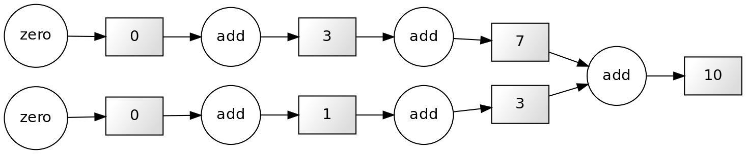
What is parallel computing?

Slide 9
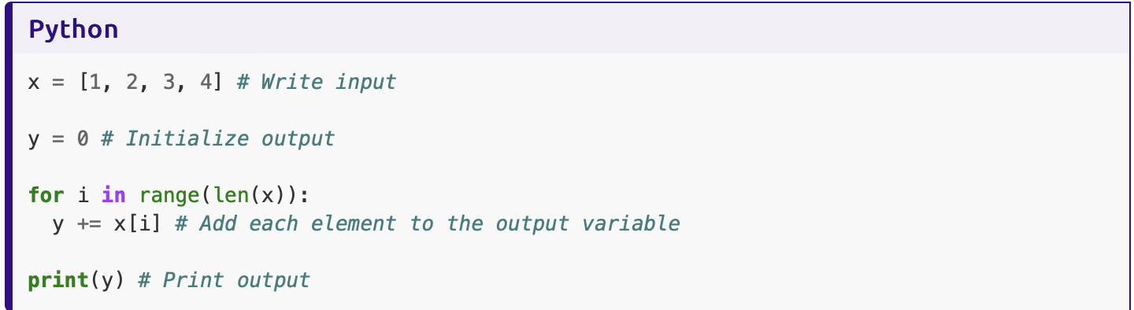
Parallelizable and non-parallelizable tasks

Slide 10
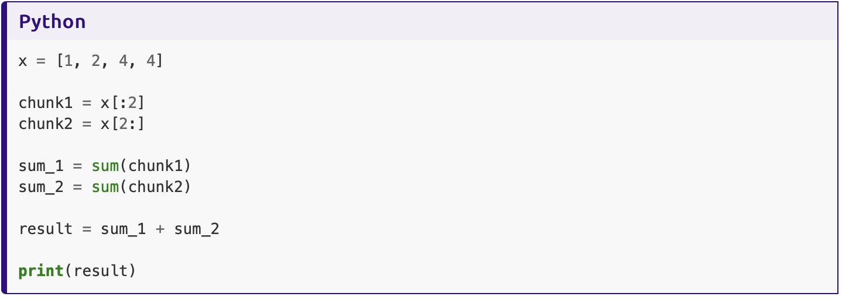
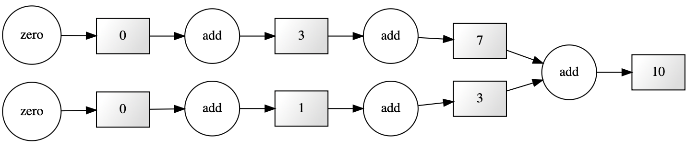
Parallelizable and non-parallelizable tasks

Slide 11
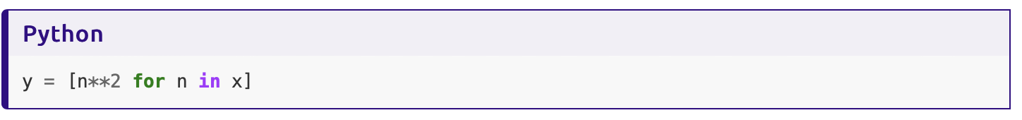
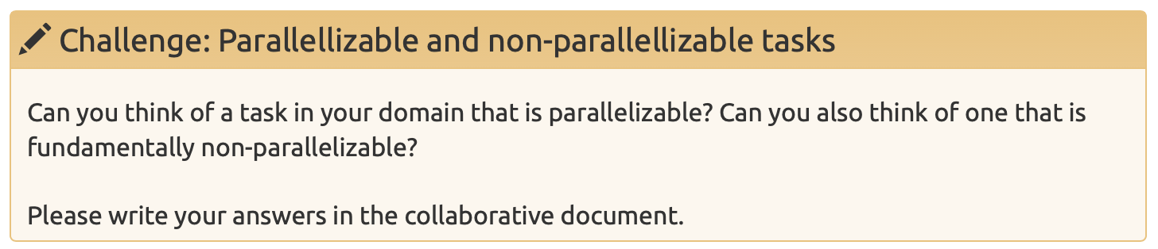
Parallelizable and non-parallelizable tasks
Ficonacci sequence: F_{n} = F_{n-1} + F_{n-2}

Slide 12
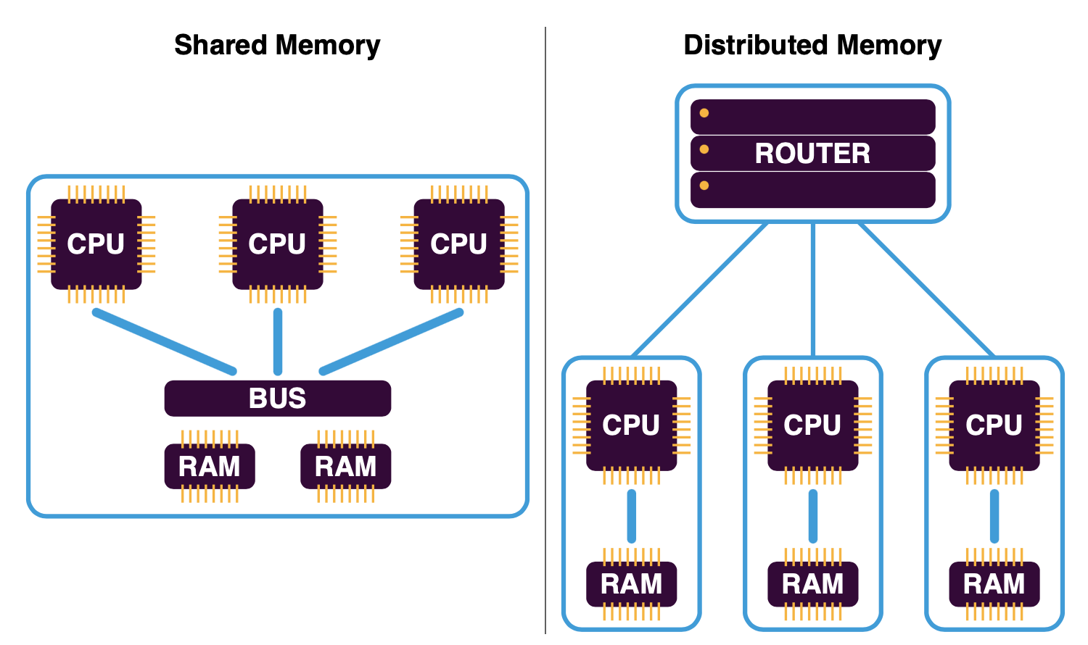
Shared vs Distributed Memory

