Slide 1






Software Management Plans

Slide 2
How can we, at the start of a project, ensure that our software will be FAIR?

Slide 3

What is a Software Management Plan?
A document that describes how a specific software project is developed, maintained, and curated.
Goal: ensure usable and maintainable software in the long term
Written by developers, maintainers, and/or other stakeholders of a software project

Slide 4
A Software Management Plan is yet another form that I have to fill in because management tells me to do so.

Slide 5
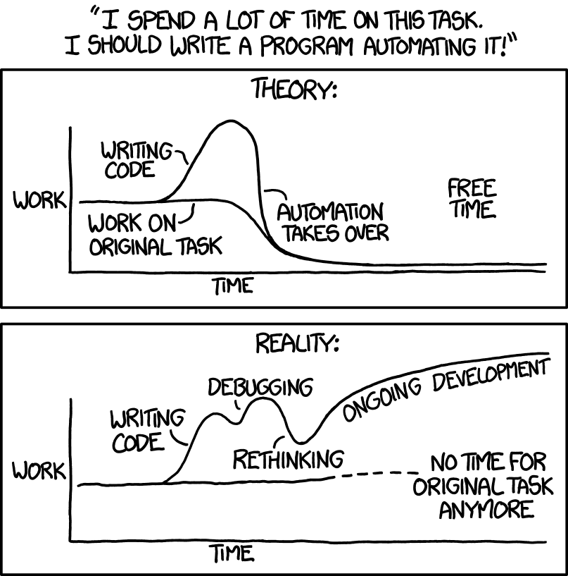
Benefits of writing a Software Management Plan
Explain why developing new software is necessary
Make research software reusable and sustainable. In other words: ensure that software is FAIR
Plan for resources
Verification of work that went into software implementation. Also: explain what it takes to build software succesfully.
Start the discussion!

Slide 6

When should you have considered writing a Software Management Plan?
"The best time to plant a tree is 20 years ago. The second best time is now."

Slide 7
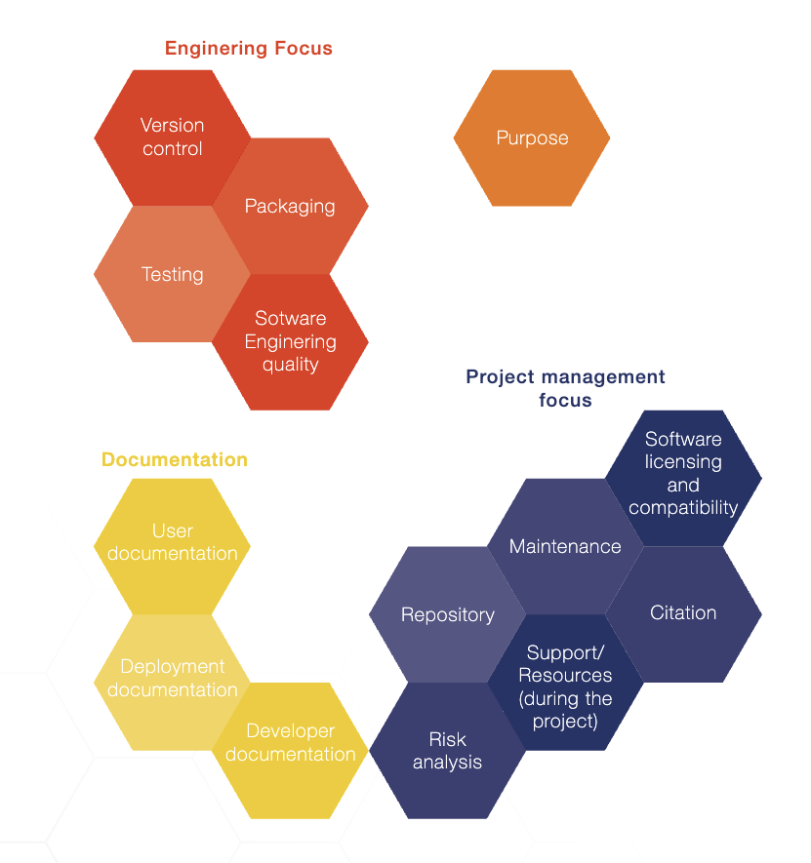
Core requirements for a Software Management Plan

Slide 8
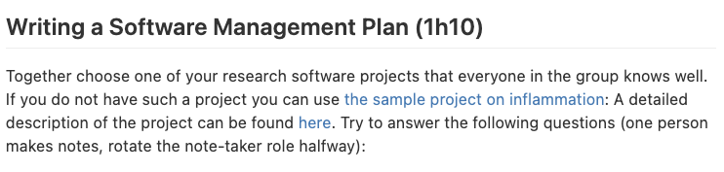

Slide 9
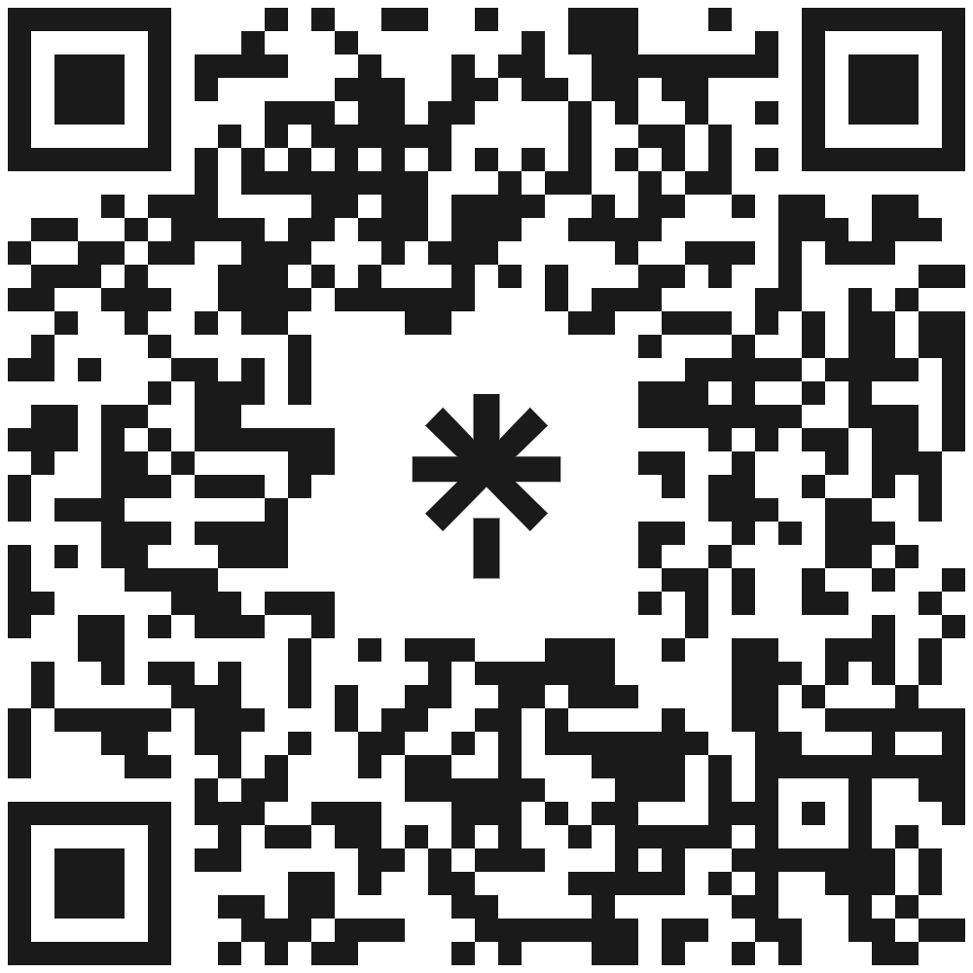







Let’s stay in touch
www.eScienceCenter.nl
info@esciencecenter.nl
+31 (0)20 460 4770
@eScienceCenter
Netherlands Escience Center
@eScienceCenter@akademienl.social

