Slide 1
Concluding remarks

Slide 2
Congratulations for making it so far! 🎉

Slide 3
Content:
Recap
Organising machine learning projects
Beyond machine learning: the bigger picture
Next steps

Slide 4
Recap

Slide 5
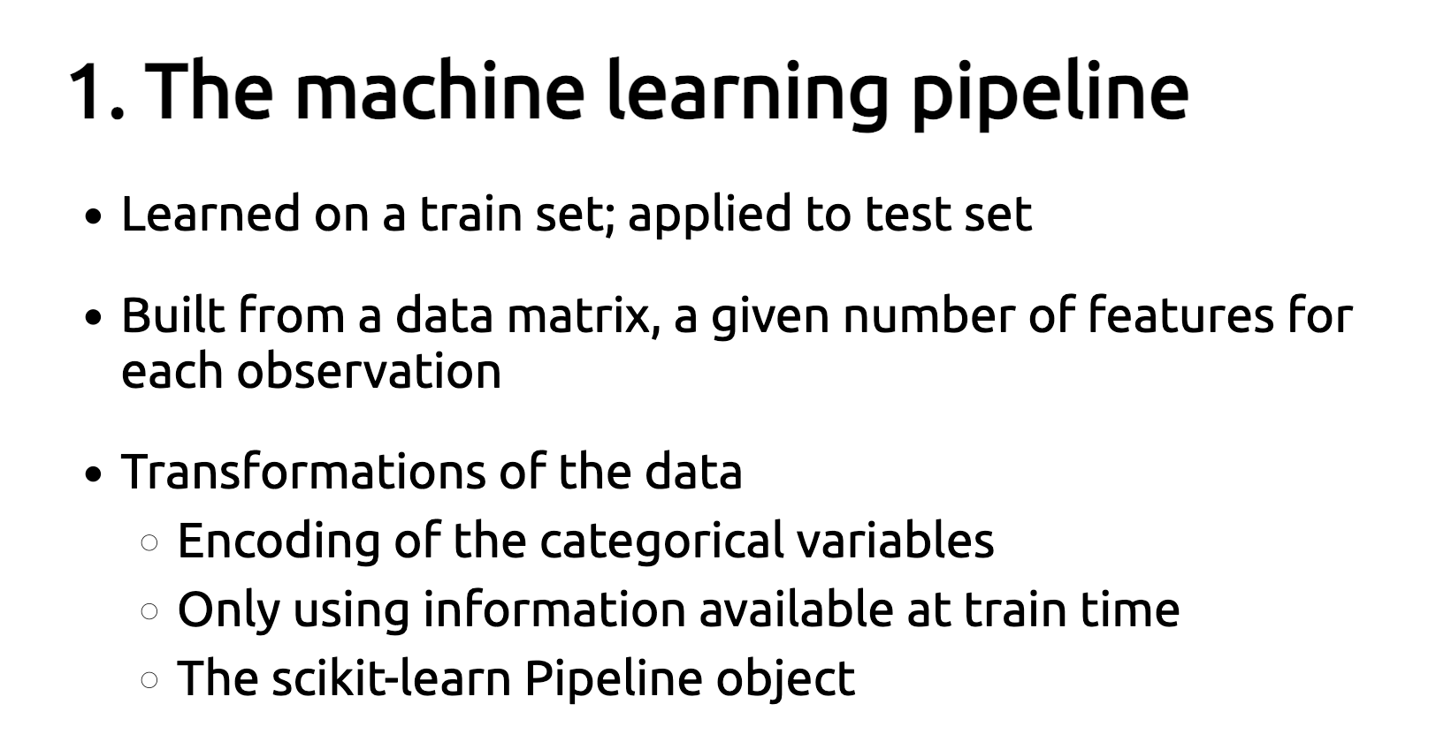

Slide 6
2. Adapting model complexity to the data
Minimize the error on the test set
Find the right level of complexity so the model does not overfit nor underfit but generalizes well to unseen data

Slide 7
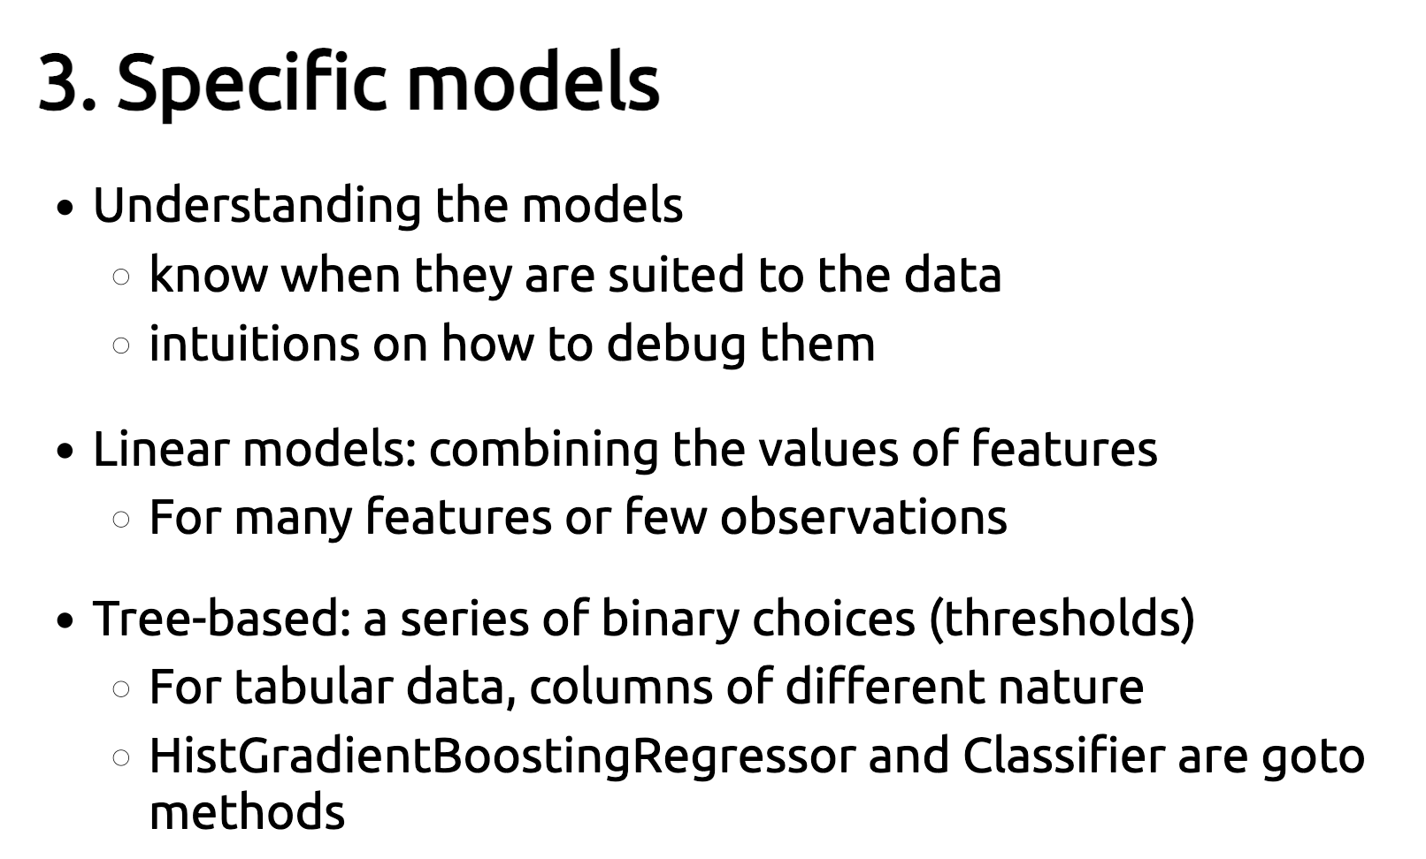

Slide 8
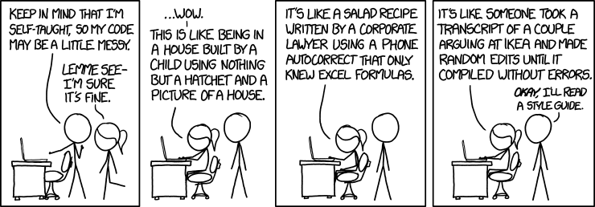
Organising machine learning projects

Slide 9
Organise experiments in notebooks
Notebooks allow for rapid prototyping, but can become a big mess
Give consistent and meaningful names
Add a rationale on top and a conclusion on the bottom of each notebook
Use Python modules
Code that is repeatedly used should not be copied to multiple notebooks
Write a module and import functions/classes in notebooks

Slide 10
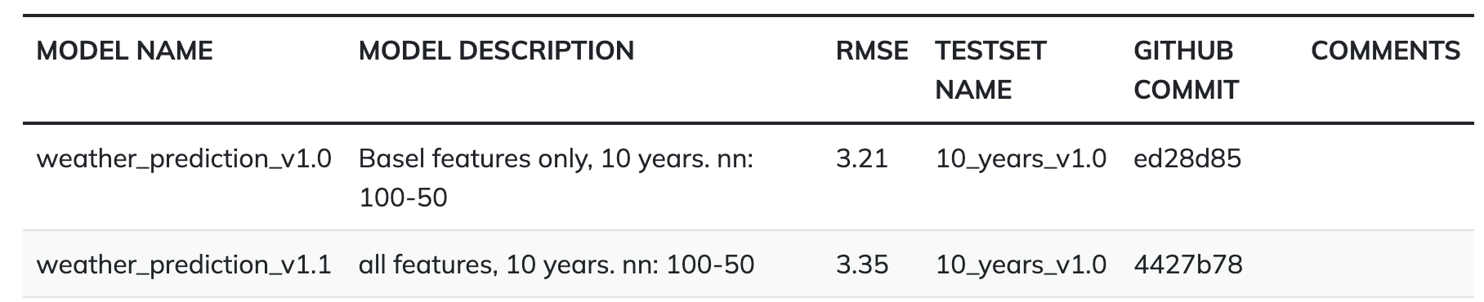
Keep track of your results in a central place
Always evaluate your experiments in the same way, on the exact same test set.
Document experiments in a consistent and meaningful way:

Slide 11
Useful tools for organising projects
Weights and Biases: https://wandb.ai/site
Cookiecutter data science: https://drivendata.github.io/cookiecutter-data-science/

Slide 12


Slide 13
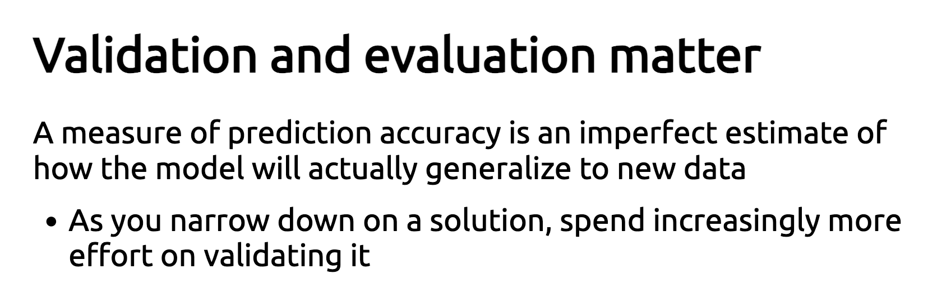

Slide 14
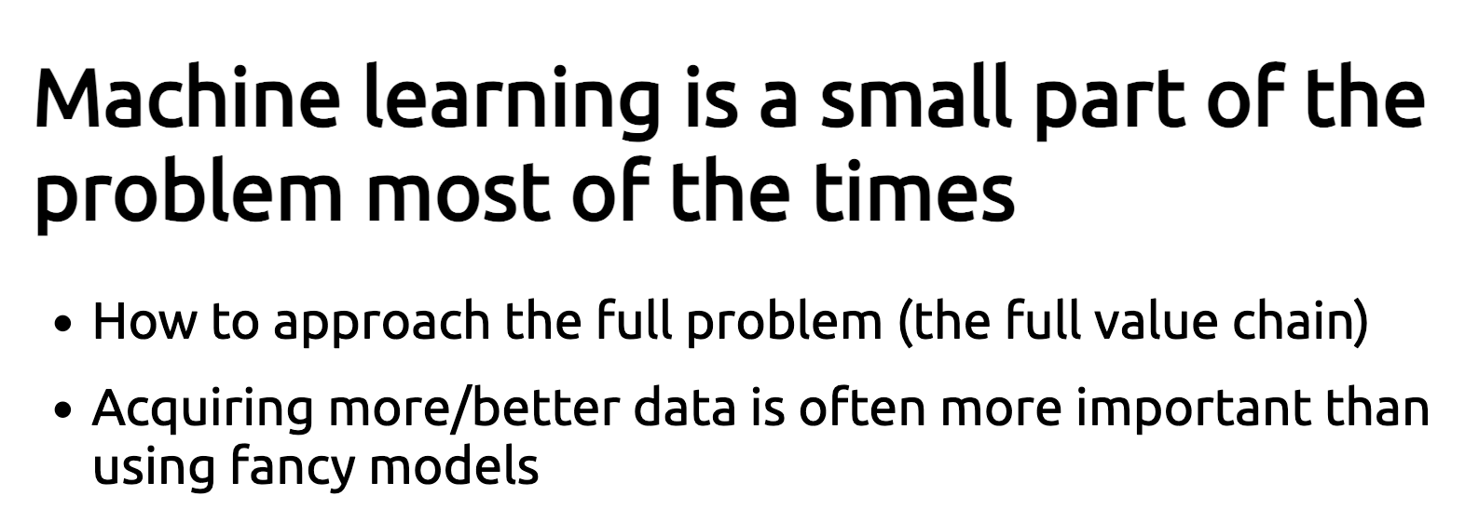

Slide 15
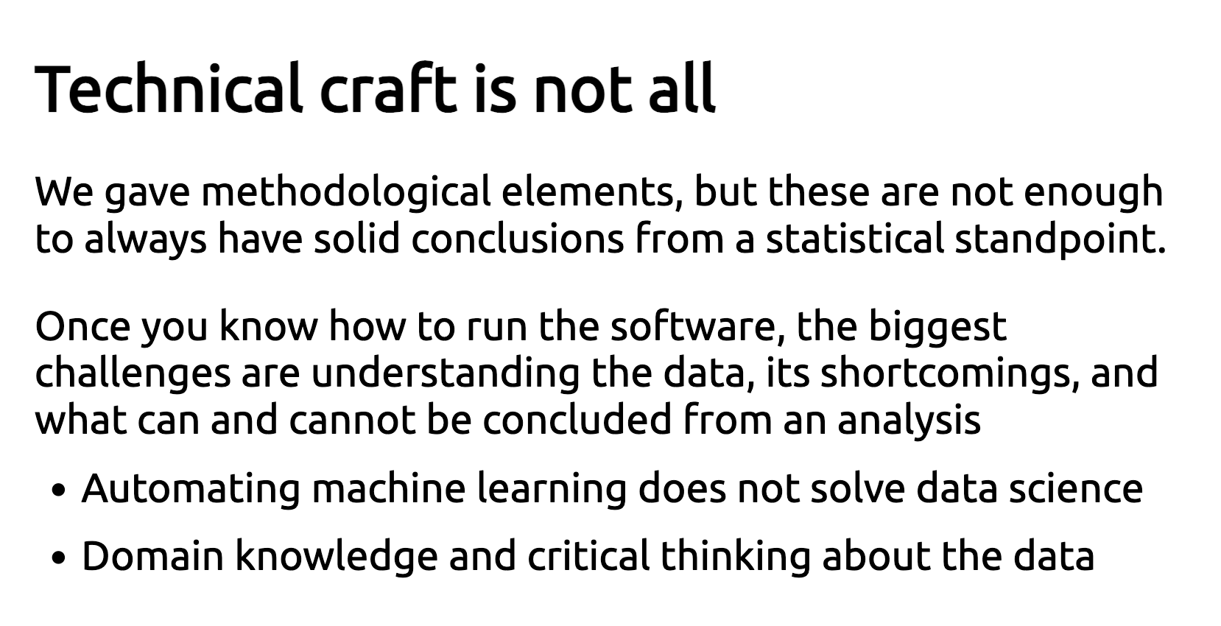

Slide 16
How the predictions are used
Errors mean different things
Operational risk:
Medicine: errors can kill
Operational logic: Better a false detection or a miss?
Detecting brain tumors:
Sent to surgery: false detections are very dangerous
Do an MR scan: misses should be avoided

Slide 17
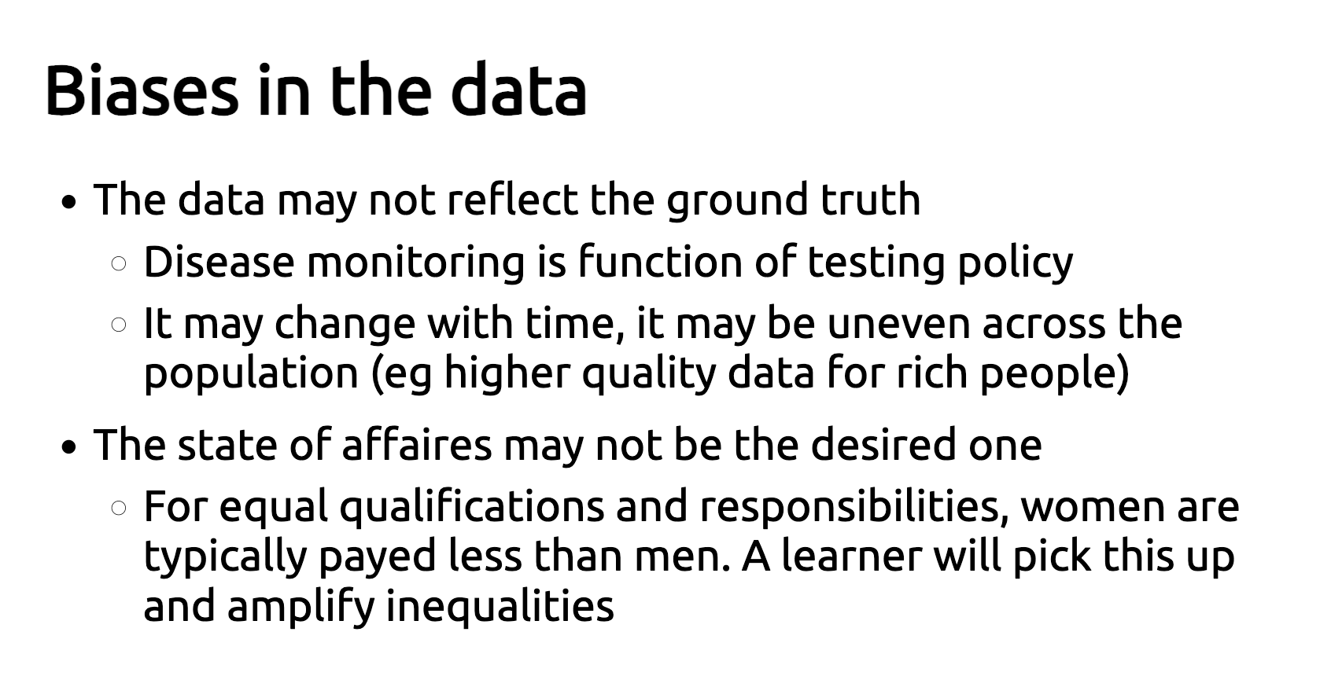

Slide 18
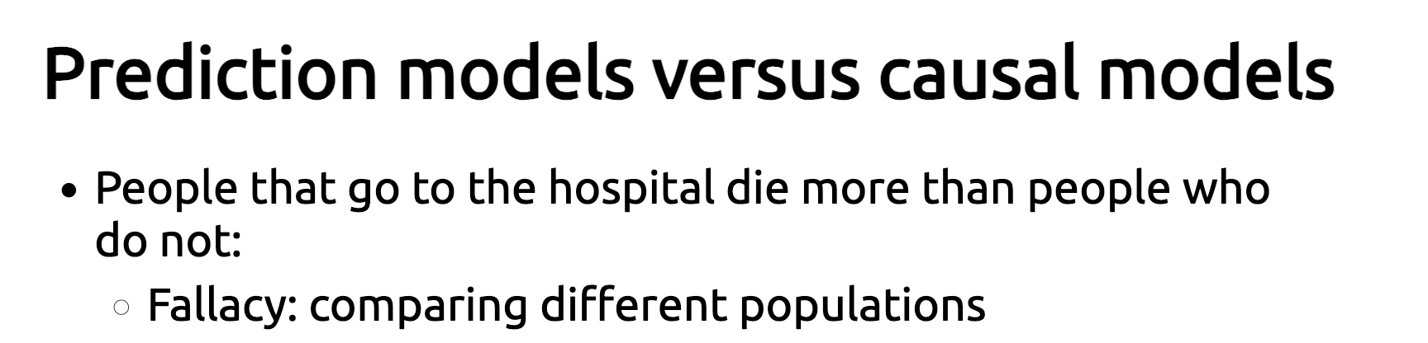

Slide 19
Next steps
Apply what you have learned to your own projects. Start as simple as possible, and incrementally increase the complexity of your approach.
Compete in a Kaggle competition to practice what you have learned.
Checkout the resources section in the collaborative documents and https://inria.github.io/scikit-learn-mooc/concluding_remarks.html#studying-machine-learning-further

