Slide 1






How does this relate to the TNO coding guidelines?

Slide 2
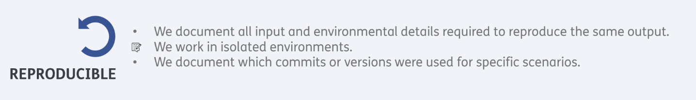

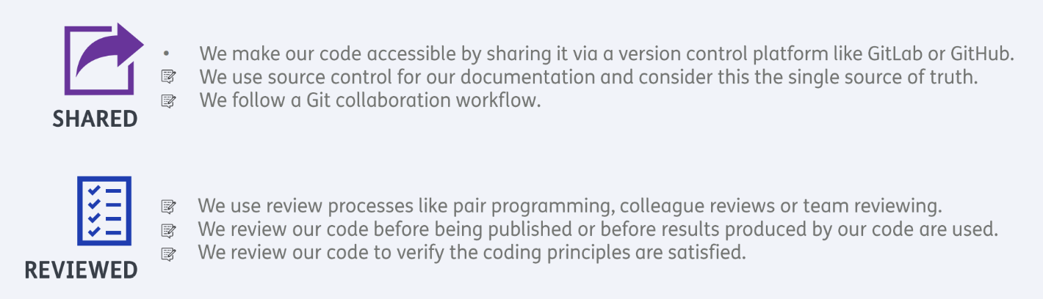
Git & GitLab

Slide 3

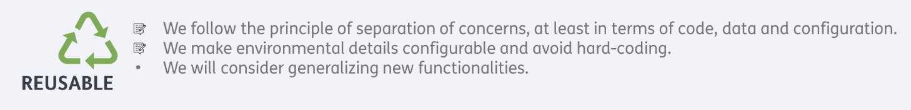
Modular code development

Slide 4
Software development as a process & software architecture and design

Slide 5
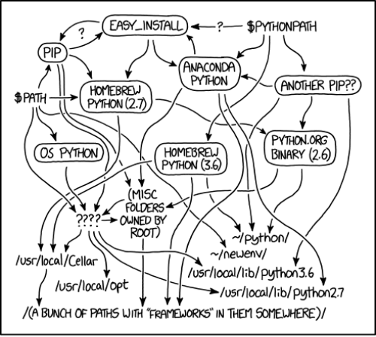

Slide 6
Package manager
  Pip
  conda
Virtual environment manager
  virtualenv
  venv
  conda
  poetry

Slide 7
Why (ana/mini)conda?
A lot of scientific packages install out of the box
GUI interface
Why not:
License
Slow
…?

Slide 8

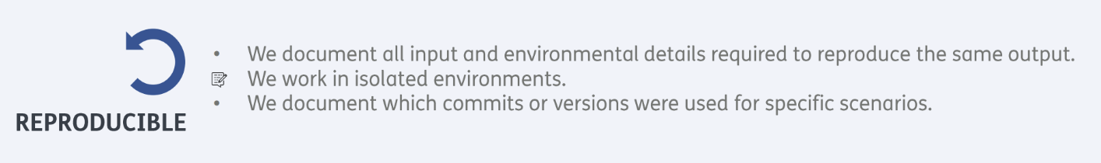
Documenation

Slide 9
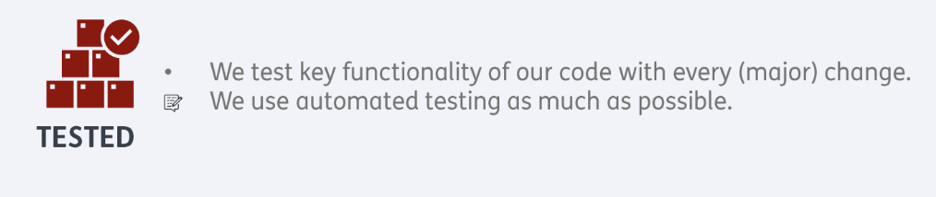
Testing

Slide 10
Code style conventions
Code style conventions are a set of rules that dictate how code should be written and formatted to ensure consistency and readability within a project.

Slide 11
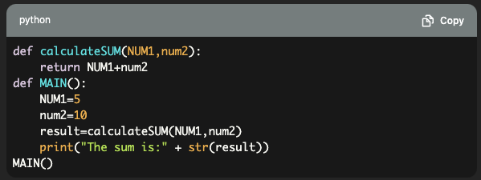
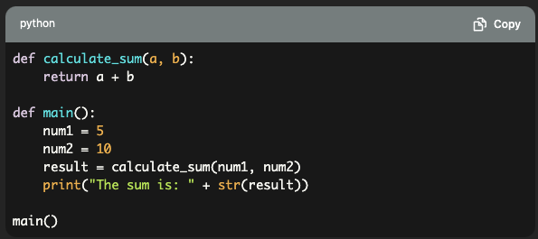
Low-level ‘rules’, such as function names are in snake_case
BAD
GOOD
Specific to a programming language!

Slide 12
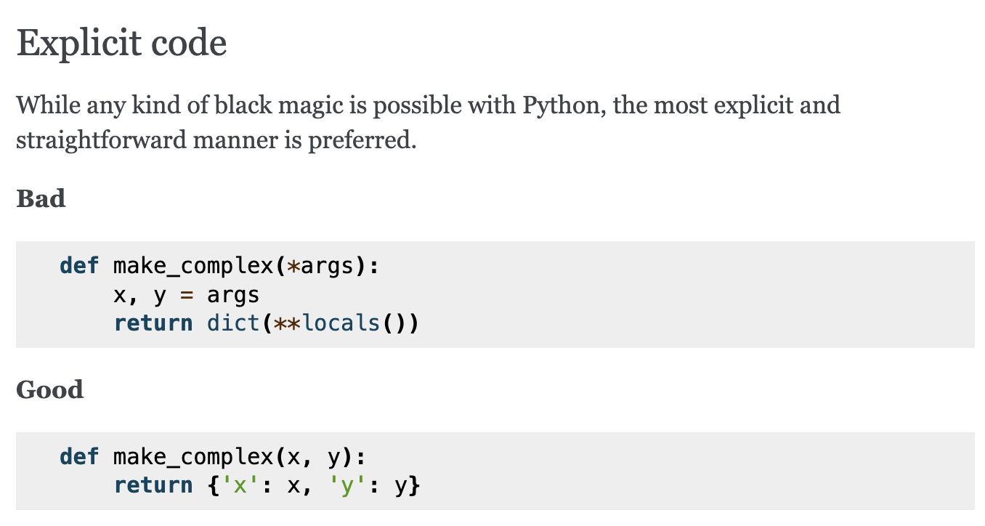
High-level ‘guidelines’ such as: write explicit code
More generic!

Slide 13
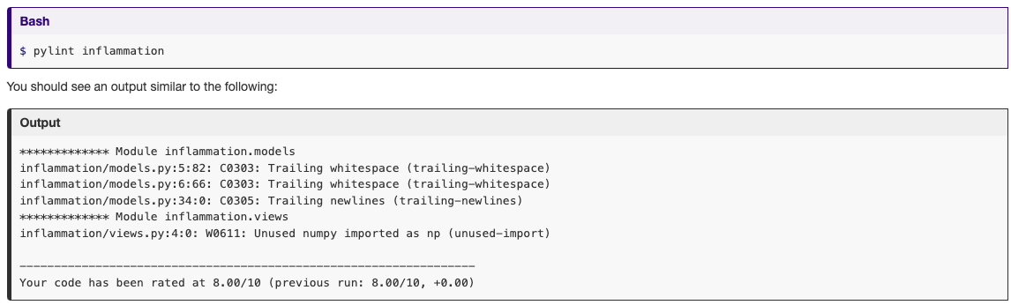
Linting: automatically checking your code for code style conventions

Slide 14
How to learn more about code style conventions?
Peer-review!
Read a book or online resource
  (please share in resources section of collab doc)
Setup your IDE (i.e. code editor) to highlight code style violations
Use a linter and fix violations yourself

Slide 15

Code style conventions & linting

Slide 16


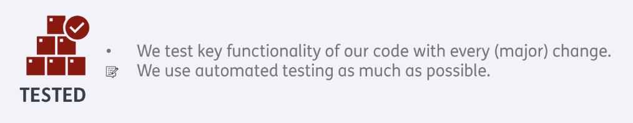
Continuous Integration

Slide 17

Congratulations! You have evolved from a simple programmer to a full-grown software engineer!

Slide 18
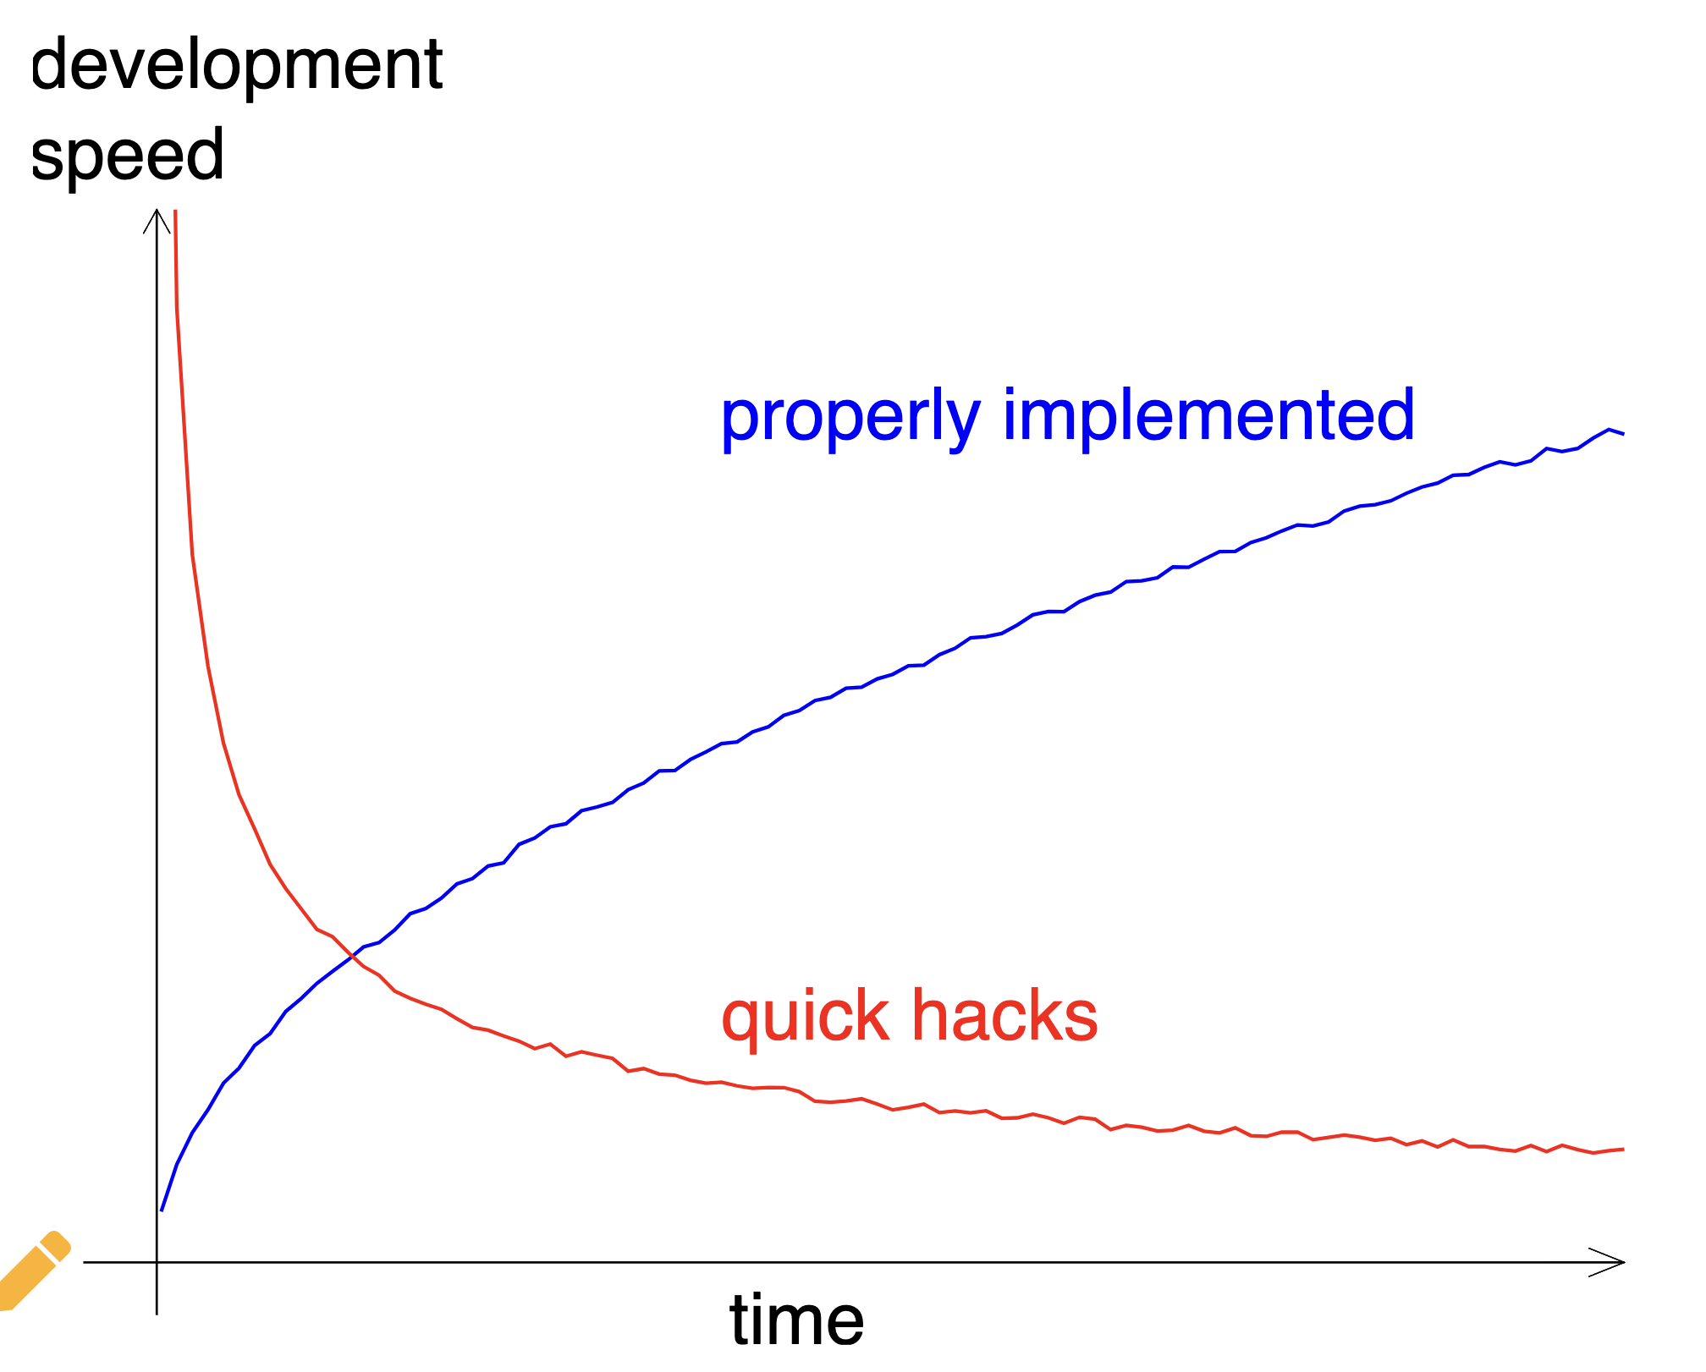
Design
Requirements
Automated testing
Code quality
Linter
Continuous Integration
Packaging
Documentation
Peer review
Project organisation
Feature branching

Slide 19
Next steps
Apply what you learned in your own projects.
Self-learning (see collaborative documents for resources)
  Read a book
  Watch youtube
  Online courses and tutorials

Slide 20








Let’s stay in touch
https://www.esciencecenter.nl/digital-skills/
training@esciencecenter.nl
+31 (0)20 460 4770
@eScienceCenter
Netherlands Escience Center
@eScienceCenter@akademienl.social

