Slide 1
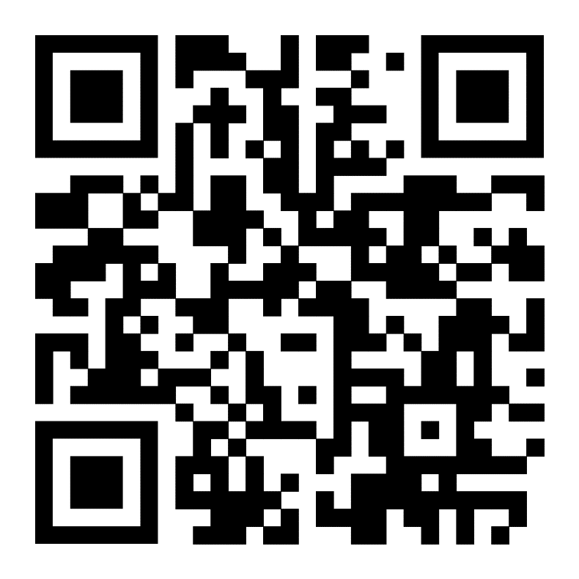
Medical Image Processing
Python-based workshop for researchers
September 18th , NL eScience Center
Pilot edition: free, including free lunch
MRIs, DICOMS, CTs, nuclear medicine imaging, digital pathology
Image processing, machine learning, anonymization, generative AI
https://www.esciencecenter.nl/event/pilot-medical-image-processing/

