Slide 1
Reproducible research through reusable code
Workshop – 3 December 2024
Sven van der Burg, MSc – eScience Center
Eduard Klapwijk, PhD – Erasmus University Rotterdam

Slide 2
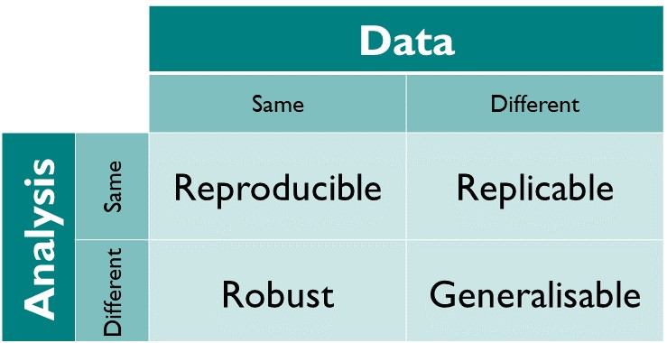
What is reproducibility?
Our focus today is on computational / methods reproducibility:
Is there enough detail to repeat the same study?
Source: Turing Way
Notes:
In theory or in actuality?

Slide 3
Why is reproducibility important?
Independent recomputation
→ increased trust in results
Prerequisite for reproducibility is full transparency of code
→ allows for better understanding, interpretation, and re-use
Reproducible workflows will make your life easier
→ easier to correct, update, continue your work
Notes:
Increased trust in the results: one of the elements that increases the likelihood that the results are true
Because by doing transparent research we can keep track of the work of our peers, control for biases, and correct errors.

Slide 4
Working reproducibly is not trivial
Takes time to learn new tools and to document your process as you go
Documentation is key: number of lines of documentation may exceed your code
But partially reproducible is better than not at all reproducible. Just try to make your next paper or project better organized than the last.
Notes:
Although it will make your life easier in the end, it is not easy to adopt all practices

Slide 5
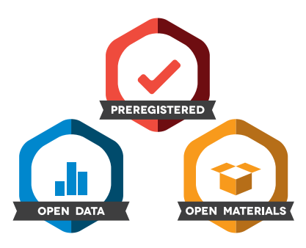



Improving computational practices and code sharing
Best practices for scientific computing are not widely adopted
Focus on basic, computational reproducibility (same data and code reproduce same results)
Notes:
In social and behavioral sciences, a lot of quantitative work is done but best practices for scientific computing are not widely adopted
Luckily, data sharing is more and more becoming the norm, but sharing associated code is less common (e.g. Cruwell et al, https://doi.org/10.1177/09567976221140828)
This is partly due to a lack of training and high reliance on graphical user interface programs for data analysis
A culture of sharing code is missing, researchers are still afraid that others catch errors in their code (I think they should embrace it)
What is needed is more researchers gaining experience with sharing their code and checking reproducibility levels of their results
The idea is to start with basic level of computational reproducibility: will using the same data and code produce the same results?

Slide 6

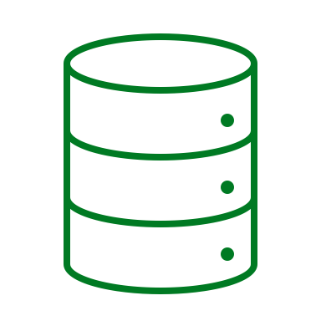

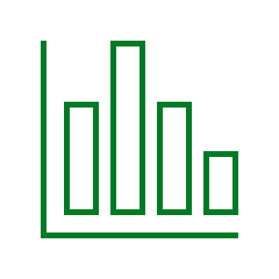
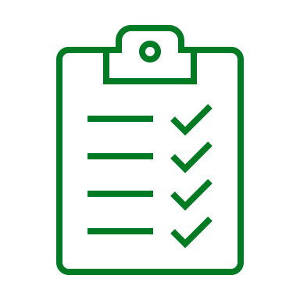


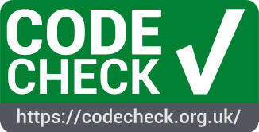


Reproducibility checks to improve computational practices
Aim: develop a workflow to provide a reproducibility check for data and code submitted alongside research publications
submits data & code
publishes report
Checker
executes code &
writes report
Researcher
Similar initiatives:
can reference report
in publication
Notes:
The aim of my plan is to work together with researchers at the faculty to establish a workflow in which I or other researchers perform a reproducibility check for data and code before a result gets published
The researcher submits their data and code to the Checker
Checker tries to find its way around the data and code to see if they can produce the same numerical results. In my experience, this is usually harder than expected. This means that using a checklist the Checker can provide an actionable list of improvements to the Researcher.
But once the code is reproducible, a report can be published (which can be an optional step). The Researcher can then reference this report in their publication, showing their code has been checked by an independent checker Of course, this is not an entirely new idea and I will build on the great examples of Codecheck, ReproHack, and the University of Sussex where they hired an independent statistician to perform reproducibility checks at the School of Psychology

Slide 7
Program
09:30 Welcome & icebreaker
09:45 Workshop introduction: why is reproducibility important?
10:00 Uploading a coding project to GitHub
10:30 Break
10:40 Software dependencies and software documentation
11:30 Break
11:40 Code conventions and modular coding
12:30 Lunch
13:30 Next steps: how to make your code reusable?
13:45 Work on your own project
15:30 Reusability check
16:15 Wrap-up
16:30 End
Notes:
We will touch upon the surface of many things. For example, we won’t really go into collaboration in GitHub, and also not in using R Markdown / Quarto
One day is short, see it more as a hackathon to improve your code. Goal is to upload code to GitHub that someone else can run

