Slide 1
Formative assessment & Inclusive language
Mateusz Kuzak & Lieke de Boer

Slide 2


Who are we?
Dr. Lieke de Boer
Community Manager
Fellowship Programme &
Research Software Training NL Coordinator
Carpentries Instructor Trainer
Mateusz Kuzak
Team Lead Training Programme
Carpentries Instructor Trainer

Slide 3
Afternoon Agenda
13.45 – 14:25 | Formative assessment
14:25 – 14:35 | Tea break
14:35 – 15:15 | Inclusive language
15:15 – 15:45 | Update / work on own material

Slide 4
What are we going to learn?
How to assess participants learning progress?
Formative vs summative assessment
What are the different examples of formative assessment?
How to design a good, informative formative assessment
How to create a positive learning environment by
avoiding jargon
and using inclusive language?
What are the different tools that will help you develop more inclusive training content?

Slide 5
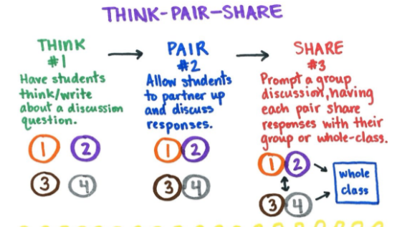
pendalearning.zendesk.com

Slide 6
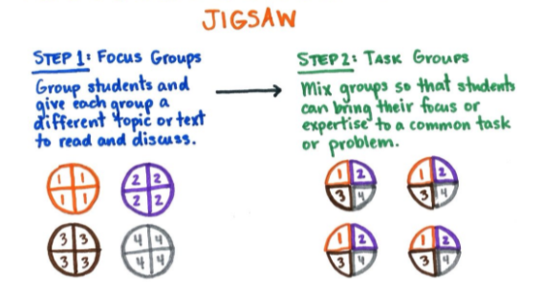
pendalearning.zendesk.com

Slide 7
Formative Assessment
During training, we want to monitor if the learning proceeds according to plan and not going off in an unpredicted direction.
We want to get this feedback while we teach so that we can respond to that information and adapt our instruction to get learners back on track.

Slide 8
This kind of assessment has a name:
it is called formative assessment because it is applied during learning to form the practice of teaching and the experience of the learner.
This is different from exams, for example, which sum up what a participant has learned but are not used to guide further progress and are hence called summative.

Slide 9
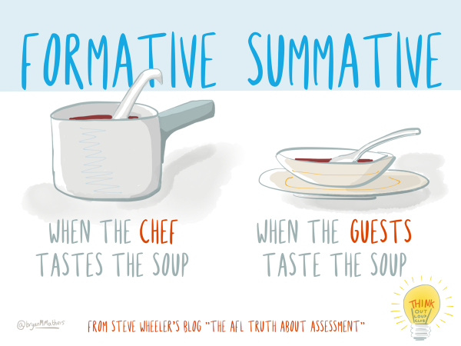

Slide 10
Practice: Think – Pair - Share
Any instructional tool that generates feedback that is used in a formative way can be described as “formative assessment.”
Based on your previous educational experience what types of formative assessments do you know?

Slide 11
Types of exercises:
Multiple Choice Question
Fill in the blanks
Minimal fix
Think-pair-share
♾️

Slide 12















Multiple Choice Question

Slide 13









Slide 14
Fill in the blanks
Fill in the blanks so that the code below prints the string ’hat’.
text = 'all that it is'
slice = text[____:____]
print(slice)

Slide 15
Minimal fix
This function is supposed to test whether a number lies within a range (open interval (lower, higher) ).
Make one small change so that it actually does so.
def inside(point, lower, higher):
if (point <= lower):
return false
elif (point <= higher):
return false
else:
return true

Slide 16
Think-pair-share Describe storage facilities
Describe properties of the storage facilities you might use for your research data. Address the following aspects:
Capacity
Backup procedures
Accessibility (local, server, cloud, etc.)
Level of security
Costs
Possibility to assign and revoke access rights
Link to more information

Slide 17
Let’s practice:
Think – Pair - Share
Think of a formative assessment that you can use in your teaching.
Choose topic from your domain.
Think of the suitable assessment type.
Discuss with your partner.
Share with the group.

Slide 18
Inclusive language
Notes:
Why are we talking about using inclusive language and avoiding jargon? Because we want everyone to be able to learn – this is one of our core values as instructors.¹
That requires creating a positive learning environment, which helps people concentrate on learning.
We want to avoid language and terms that exclude or demotivate learners.
Today we focus on inclusive language to create a more positive learning environment, although we should understand that there are many more aspects to including all learners in your teaching. For example, colour contrast and font size in websites and printed text are important if you expect learners to read the text, and so is wheelchair accessibility for physical gatherings.

Slide 19
Goal of this session
To learn how to create a positive learning environment by using inclusive language and avoiding jargon

Slide 20
Inclusive language
Think carefully about the language you use and how you interact with learners
Notes:
to avoid reinforcing systemic bias.

Slide 21
Examples of non-inclusive language
“It’s easy, you just ….”
“Any questions?”
Presenting technical “fun facts”
Addressing a group using terms that not everyone may feel applies to them (instead use “everyone” or “all”)
Using political examples in lesson material
Notes:
Your understanding of terms may not fit with learners' mental models, so pay attention to the words you use interchangeably

Slide 22
Stereotypes
We all use stereotypes! And this is not a bad thing.
Stereotypes can:
Be implicit or explicit
Guide what we notice about people
Guide how we interpret people’s behaviors
Facilitate quick judgements (also appropriate ones)
Lead to systematically negative attitudes and behaviors towards members of a certain group
Notes:
Stereotypes are dangerous when they are explicit, but they are especially hazardous when they are implicit. This means that the people holding them may not be aware of them, even though their perceptions are guided by them.

Slide 23
Stereotypes
Stereotypes in instructors can :
Call unnecessary attention to differences
Give more or less attention to certain learners
Lead to different responses depending on which learner is asking
Stereotypes learners have about themselves can:
develop a fixed mindset about aspects of their own capability
Lead to stereotype threat
Notes:
Stereotypes are dangerous when they are explicit, but they are especially hazardous when they are implicit. This means that the people holding them may not be aware of them, even though their perceptions are guided by them.
Stereotype threat: experience increased cognitive load when reminded about a stereotype, interfering with the learning process

Slide 24
What can we do about our own stereotypes?
Get to know people from many different groups
Observe your own behavior, and build awareness of situations in which your perceptions and behaviors are influenced by stereotypes.
Avoid calling attention to common stereotypes, even in a way that seems positive.
Notes:
Stereotypes are dangerous when they are explicit, but they are especially hazardous when they are implicit. This means that the people holding them may not be aware of them, even though their perceptions are guided by them.
Stereotype threat: experience increased cognitive load when reminded about a stereotype, interfering with the learning process

Slide 25
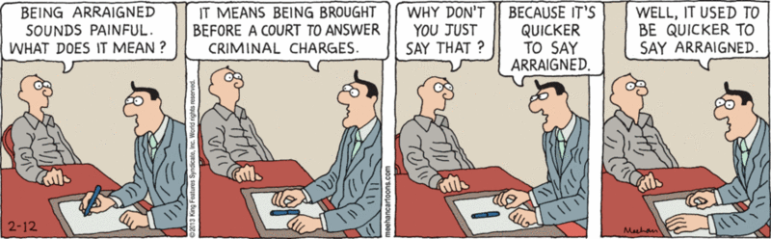
What is jargon?
Words or expressions used by a particular profession or group of people, and are difficult for others to understand (Oxford Leaner’s Dictionary)
Makes communication between experts easier, but not knowing terms can put you outside the group
https://www.weeklystorybook.com/comic_strip_of_the_daycom/2013/02/style-over-substance.html

Slide 26
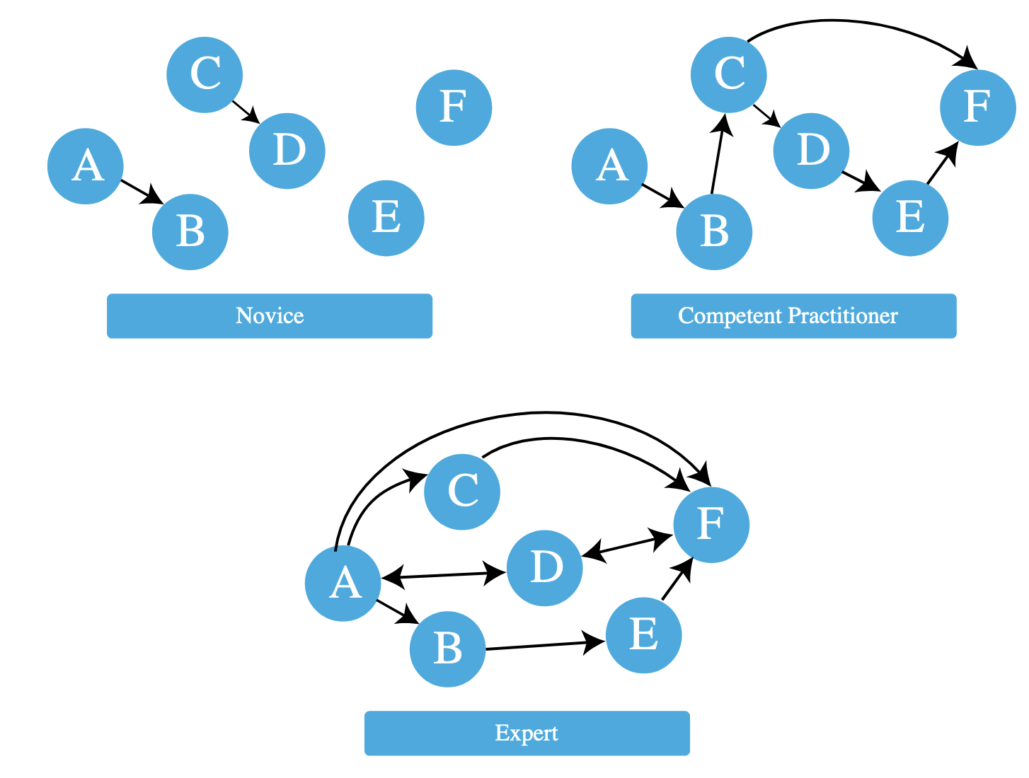
Mental models
https://carpentries.github.io/instructor-training/04-expertise.html
Notes:
Novice learners have an incomplete view of the domain. Competent practitioners have enough understanding for everyday purposes.
The expert awareness gap is the concept of an expert being unaware of gaps between a learner's understanding and their own.
Because your learners’ mental models will likely be less densely connected than your own, a conclusion that seems obvious to you will not seem that way to your learners. It is important to explain what you are doing step-by-step, and how each step leads to the next one. Novice learners do "not know what they don't know, i.e., they do not yet know what the key ideas in the domain are or how they relate."
Competent practitioners "have enough understanding for everyday purposes. They will not know all the details of how something works and their understanding may not be entirely accurate, but it is sufficient for completing normal tasks with normal effort under normal circumstances."
As a teacher you are usually an expert. Some things are natural to you that a novice or competent practitioner don't know are even relevant. A competent practitioner might have an imprecise or incorrect understanding of how certain concepts relate.
The expert awareness gap is the concept of an expert being unaware of gaps between a learner's understanding and their own. The expert awareness gap can lead to making explanations sound jargonic.
Don't bombard learners with concepts; build their mental model in increments. Remove and replace incorrect relationships.
Pay attention to language that you use interchangeably, as your understanding of such terms may not fit with learners' mental models

Slide 27
What words do you use interchangeably?
Share an example of words or notation that you sometimes use to accomplish or refer to the same thing.
Building awareness of how you can represent the same concept in multiple different ways will help you avoid doing so without explanation while teaching.

Slide 28
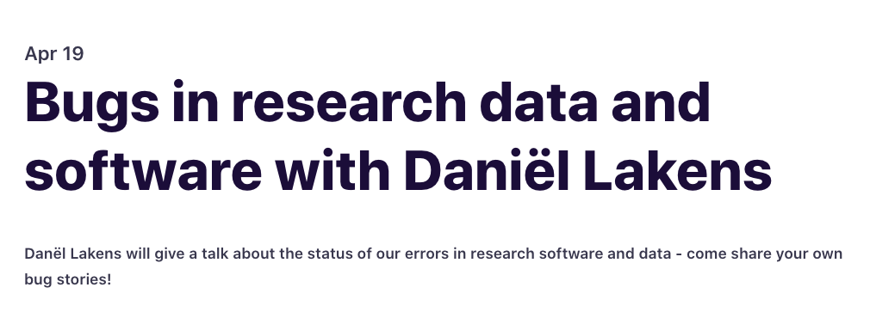
What words do you use interchangeably?
Notes:
Explaining a concept using terms that have not been explained or that may mean different things to different learners:
In a programming course, we used the terms method and function interchangeably while demonstrating built-in functions, but this confused learners.
This became clear when we got questions about the differences between functions and methods. We confused them more by mentioning related concepts that were even more off-track, like object-oriented programming.
Instead, we should have focused on concepts that are relevant to functions (and methods), like inputs and outputs and how to call functions.
One question that surprised us a little was 'What are inputs and outputs?' – a good example of our expert awareness gap.

Slide 29

Upgoer five example
https://xkcd.com/1133/

Slide 30
Exercise: check your jargon (15 minutes)
Pair up with your neighbor, take some text from a piece you have written or from elsewhere, that contains jargon.
Within your pair, use one of these tools to rephrase the text or to receive suggestions on how to improve it:
Alt text generator in powerpoint
Upgoer five editor: https://splasho.com/upgoer5/
Grammar checker in word
Hemingway editor: https://hemingwayapp.com/
Bing or chatGPT
Nederlands: https://ishetb1.nl/
Add your own

Slide 31
Exercise: check your jargon (15 minutes)
What did you learn? What was helpful? What was not helpful?

Slide 32
Exercise: update your own training
Pick one of the tools you learned about and see if you can apply it to your own training material

Slide 33
Wrap-up (10 minutes)
One up (something you learned or went well), one down (something we could improve)
Notes:
Explaining a concept using terms that have not been explained or that may mean different things to different learners:
In a programming course, we used the terms method and function interchangeably while demonstrating built-in functions, but this confused learners.
This became clear when we got questions about the differences between functions and methods. We confused them more by mentioning related concepts that were even more off-track, like object-oriented programming.
Instead, we should have focused on concepts that are relevant to functions (and methods), like inputs and outputs and how to call functions.
One question that surprised us a little was 'What are inputs and outputs?' – a good example of our expert awareness gap.

Slide 34
Let’s stay in touch
www.eScienceCenter.nl
m.kuzak@esciencecenter.nl, l.deboer@esciencecenter.nl
+31 (0)20 460 4770

