Slide 1
Real-world problem exercise: Apply skills to LISS dataset

Slide 2


Slide 3
The assignment
In groups of 2 people:
Pick a problem:
Predict gross salary in 2021 (bruttoinc_imputed.21) given the data from 2011 (regression problem)
Predict contract type in 2021 (status.contract.21) given the data from 2011 (classification problem)
Solve the problem as best as you can!

Slide 4
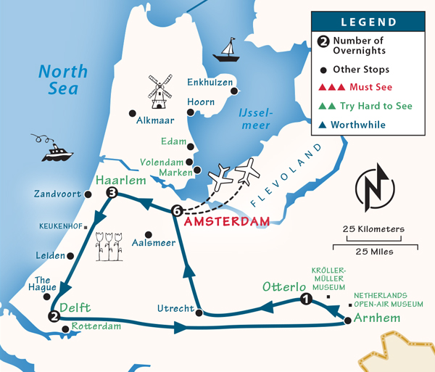
An example itinerary
Today:
15:00-15:30 → Pick a problem, checkin with someone from the instructor team
15:30-16:00 → Exploratory data analysis + prepare the data
Tomorrow:
12:30-14:20 → Train and evaluate your first model
14:40:16:00 → Iterate and try to improve your model
Guidelines:
Don’t shy away from taking shortcuts in any of these steps, try to get a first baseline model as soon as possible! For example:
Start with a subset of the features (for example 5)
NB: The instructor team is here to help you out!

