Slide 1
Real-world problem exercise: Apply skills to LISS dataset

Slide 2


Slide 3
The assignment
In groups of 2 people:
Pick an interesting problem that you can solve:
Using the available data
Using machine learning
Solve the problem as best as you can!

Slide 4
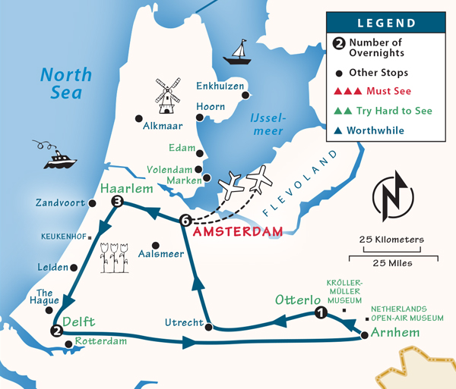
An example itinerary
Today:
15:00-15:30 → Pick a problem, checkin with someone from the instructor team
15:30-16:00 → Exploratory data analysis + prepare the data
Tomorrow:
??:?? → Train and evaluate your first model
??:?? → Iterate and try to improve your model
NB1: Don’t shy away from taking shortcuts in any of these steps, try to get a first baseline model as soon as possible!
NB2: Use the instructor team!

