Slide 1
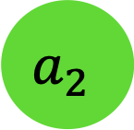
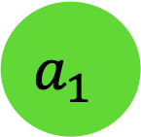
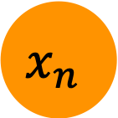

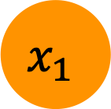
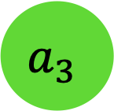
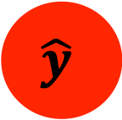
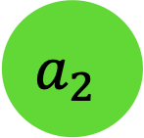
$$a_{1}$$
$$x_{1}$$
$$a_{2}$$
$$…$$
$$\hat{y}$$
$$a_{2}$$
$$x_{n}$$
$$a_{3}$$
input
hidden
output
input
hidden
output
Notes:
DL is a method based on ANN. ANN can represent very complex nonliear functions. How? Let me give you some intuition.
For example, we want to predict house price.
We have the data of number of rooms, and it indicates the house size that impact the house price…
That is the form of NN.
It has input layer and output layer, and the middle part are features learned by NN itself, so we call them hidden layer. The weights of the connections are also learned automatically, if weight is zero, the connection disappear.
But why we call deep learning deep, because when we have more hidden layers, it’s going deeper.

