Slide 1
Project management
Dafne van Kuppevelt , 2021-09-30
Soft Skill SIG / Team work SIG

Slide 2

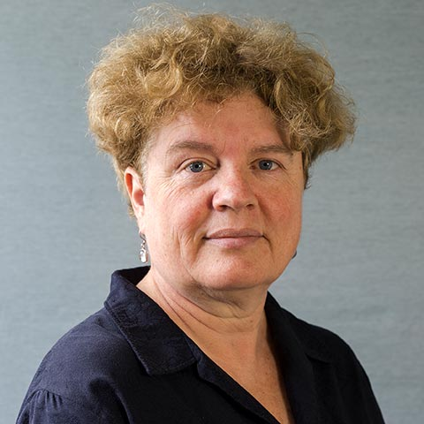
Project managament course 6 mornings, online
www.projectmanagement-training.nl
Everdien Breken

Slide 3
Topics
Project phases (“classic” waterfall model)
Budgeting and planning
Risk and quality assessment
Writing a project plan
Project and organization
Soft skills:
Active Listening
Giving feedback
Teamwork
Personality and role of project manager
Coaching

Slide 4
Topics
Project phases (“classic” waterfall model)
Budgeting and planning
Risk and quality assessment
Writing a project plan
Project and organization
Soft skills:
Active Listening
Giving feedback
Teamwork
Personality and role of project manager
Coaching

Slide 5
Definition of project
Done by group of people
Temporary nature, with clear beginning and end
Has a goal
Has planned deliverable(s)
Has constrained resources

Slide 6
Definition of project
Done by group of people
Temporary nature, with clear beginning and end
Has a goal
Has planned deliverable(s)
Has constrained resources
eScience center project = project!

Slide 7
Project organization
Project sponsor (“opdrachtgever”): determines goal, budget
Project manager: responsible for delivering results
Project team: anyone working on project, steered by PM
Stakeholders: anyone outside project team who has an interest in the project

Slide 8
Project organization
Project sponsor (“opdrachtgever”): determines goal, budget. LA?? Or project funder?
Project manager: responsible for delivering results Program manager, lead engineer, LA??
Project team: anyone working on project, steered by PM RSEs, LA/postdoc/PhD,…
Stakeholders: anyone outside project team who has an interest in the project Tech leads, DT, Peers of LA

Slide 9
Planning and steering
Steering point
Budget
Time
Organization and information
Risks
Quality

Slide 10
Planning and steering
Steering point | Tools
Budget | Estimated costs vs budgeted costs
Time | Gantt chart
Organization and information | Make clear agreements on meetings and information flow
Risks | Risk score = probability x impact
Quality | Set quality criteria for deliverables

Slide 11
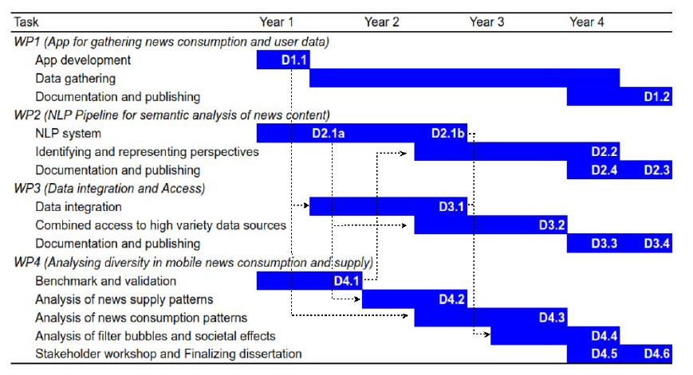
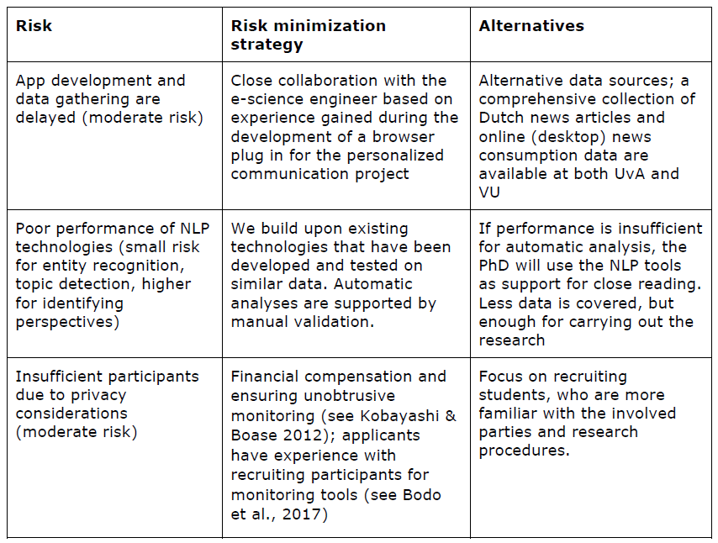
Planning and steering
Steering point | Tools | eScience example
Budget | Estimated costs vs budgeted costs | Hour administration
Time | Gantt chart | See project proposal
Organization and information | Make clear agreements on meetings and information flow | Agreements made in kick-off
Risks | Risk score = probability x impact | See project proposal
Quality | Set quality criteria for deliverables | Software quality checklist

Slide 12
Project maturity organization
Initial | No project managament methods present, much improvisation, every project works differently
Repetitive | Some people work with their own project managament methodologies
Embedded | Introduction of common, standardized project management methodology
Controlled | Projects are managed integrally from portfolio, clear norms
Self-learning | Organization learns from projects and continues to improve

Slide 13
So how useful is this stuff?

Slide 14
Extra slides

Slide 15
Active listening
Listen, Summarize and ask Follow-up questions
Don’t judge, assume, fill in
Ask many open questions (but closed can be useful too)
Keep your own emotions out, but be aware of the other’s feelings
Don’t be afraid of silence

Slide 16
Active listening in first meeting
What to discuss in first (kick-off) meeting?
Goal of project
Scope / out of scope
Global budget (time, money)
Project team
Risks
How to keep in touch

Slide 17
Project phases
Initial
Investigate and describe idea
Definition
Define requirements and wishes
Design
Design a solution
Preparation
Realization
Aftercare
Prepare for execution
Build the solution
Sustain results

Slide 18
Project phases
Initial
Investigate and describe idea
Definition
Define requirements and wishes
Design
Design a solution
Preparation
Realization
Aftercare
Prepare for execution
Build the solution
Sustain results

