Slide 1
Soft Skills SIG
Conflict resolution

Slide 2
Definition: Kenneth W. Thomas (1992)
K. W. Thomas, “Conflict and conflict management: Reflections and update,” Journal of organizational behavior, vol. 13, no. 3, pp. 265–274, 1992

Slide 3
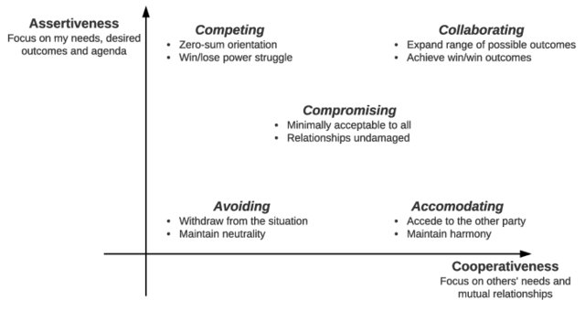
Thomas and Kilmann conflict styles
Adapted from: ‘Conflict and Conflict Management’ by Kenneth Thomas in Handbook of Industrial and Organizational Psychology, edited by Marvin D. Dunnette, p. 900, 1976

Slide 4
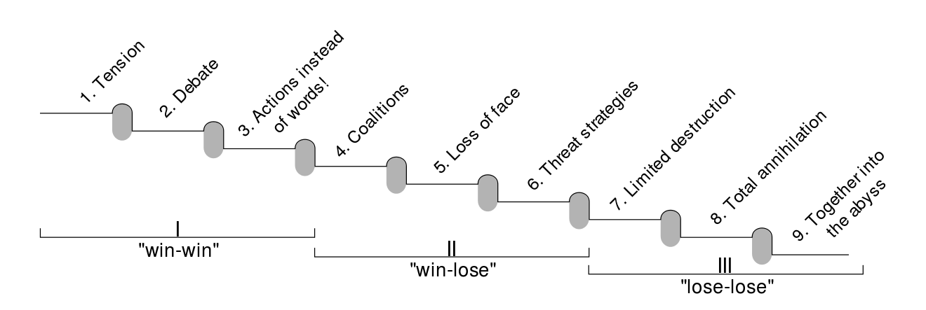
Friedrich Glasl: conflict escalation
https://en.wikipedia.org/wiki/Friedrich_Glasl%27s_model_of_conflict_escalation Derived from: Quelle: Glasl, 1994, S. 216, 218-219

Slide 5
Which types of conflicts could we have at the eScience Center? Do you know to whom to escalate each of them?

Slide 6
Have you ever had a conflict with an internal/external colleague while working at the eScience Center (or previous work place)?
If so, can you spot it in the conflict escalation chart? What did you do in such a case? Did you escalate the issue?

Slide 7
Regarding different degrees of conflict, up to which stage do you think you have enough resources to deal with?

Slide 8
How do you think your cultural background might influence the perception of conflict at different stages?

