Slide 1
Introduction to git and Github

Slide 2
How do you work on your projects? How do you save intermediate results? How do you backup your projects?

Slide 3
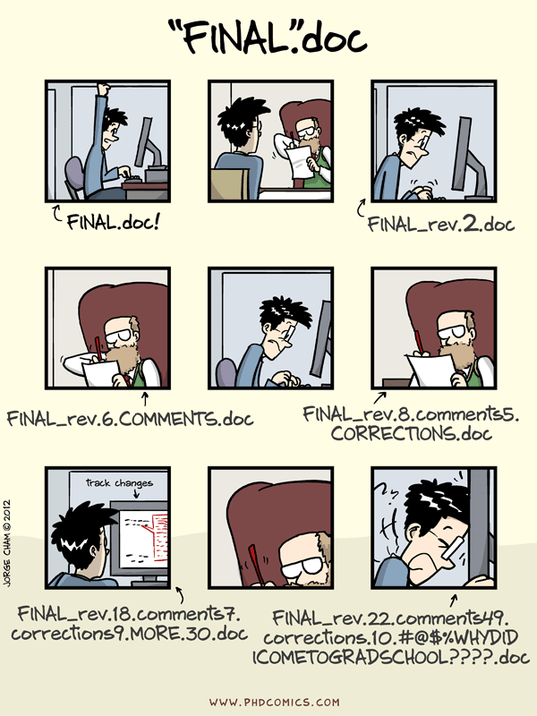
Why version control?
“Piled Higher and Deeper” by Jorge Cham, http://www.phdcomics.com

Slide 4
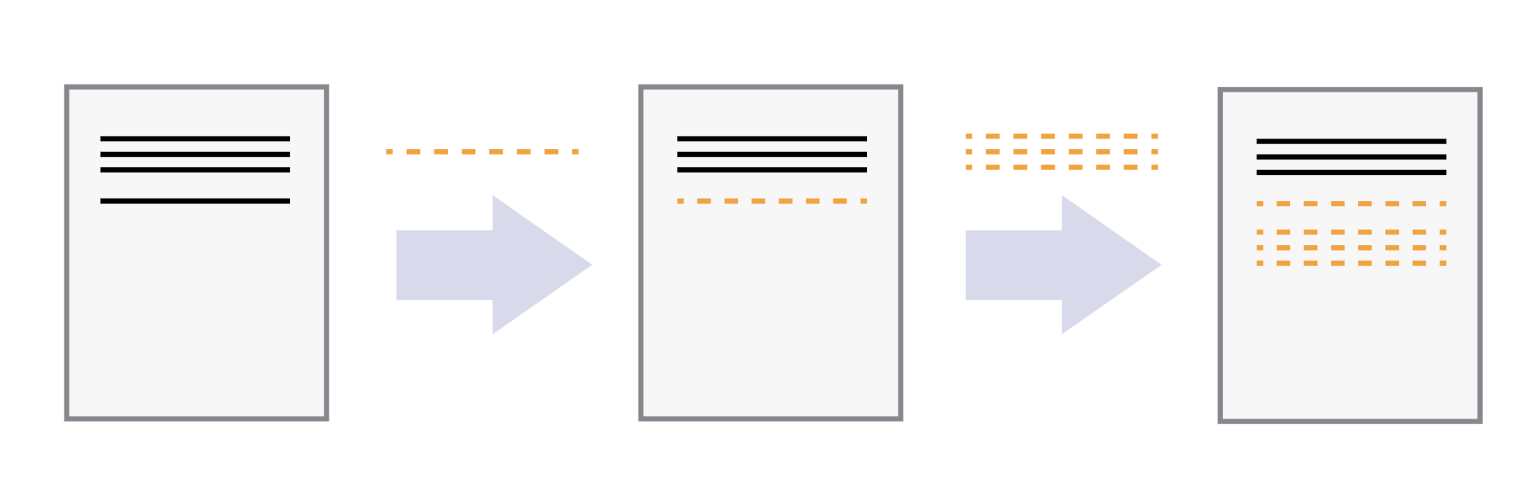
Keeping track of changes

Slide 5
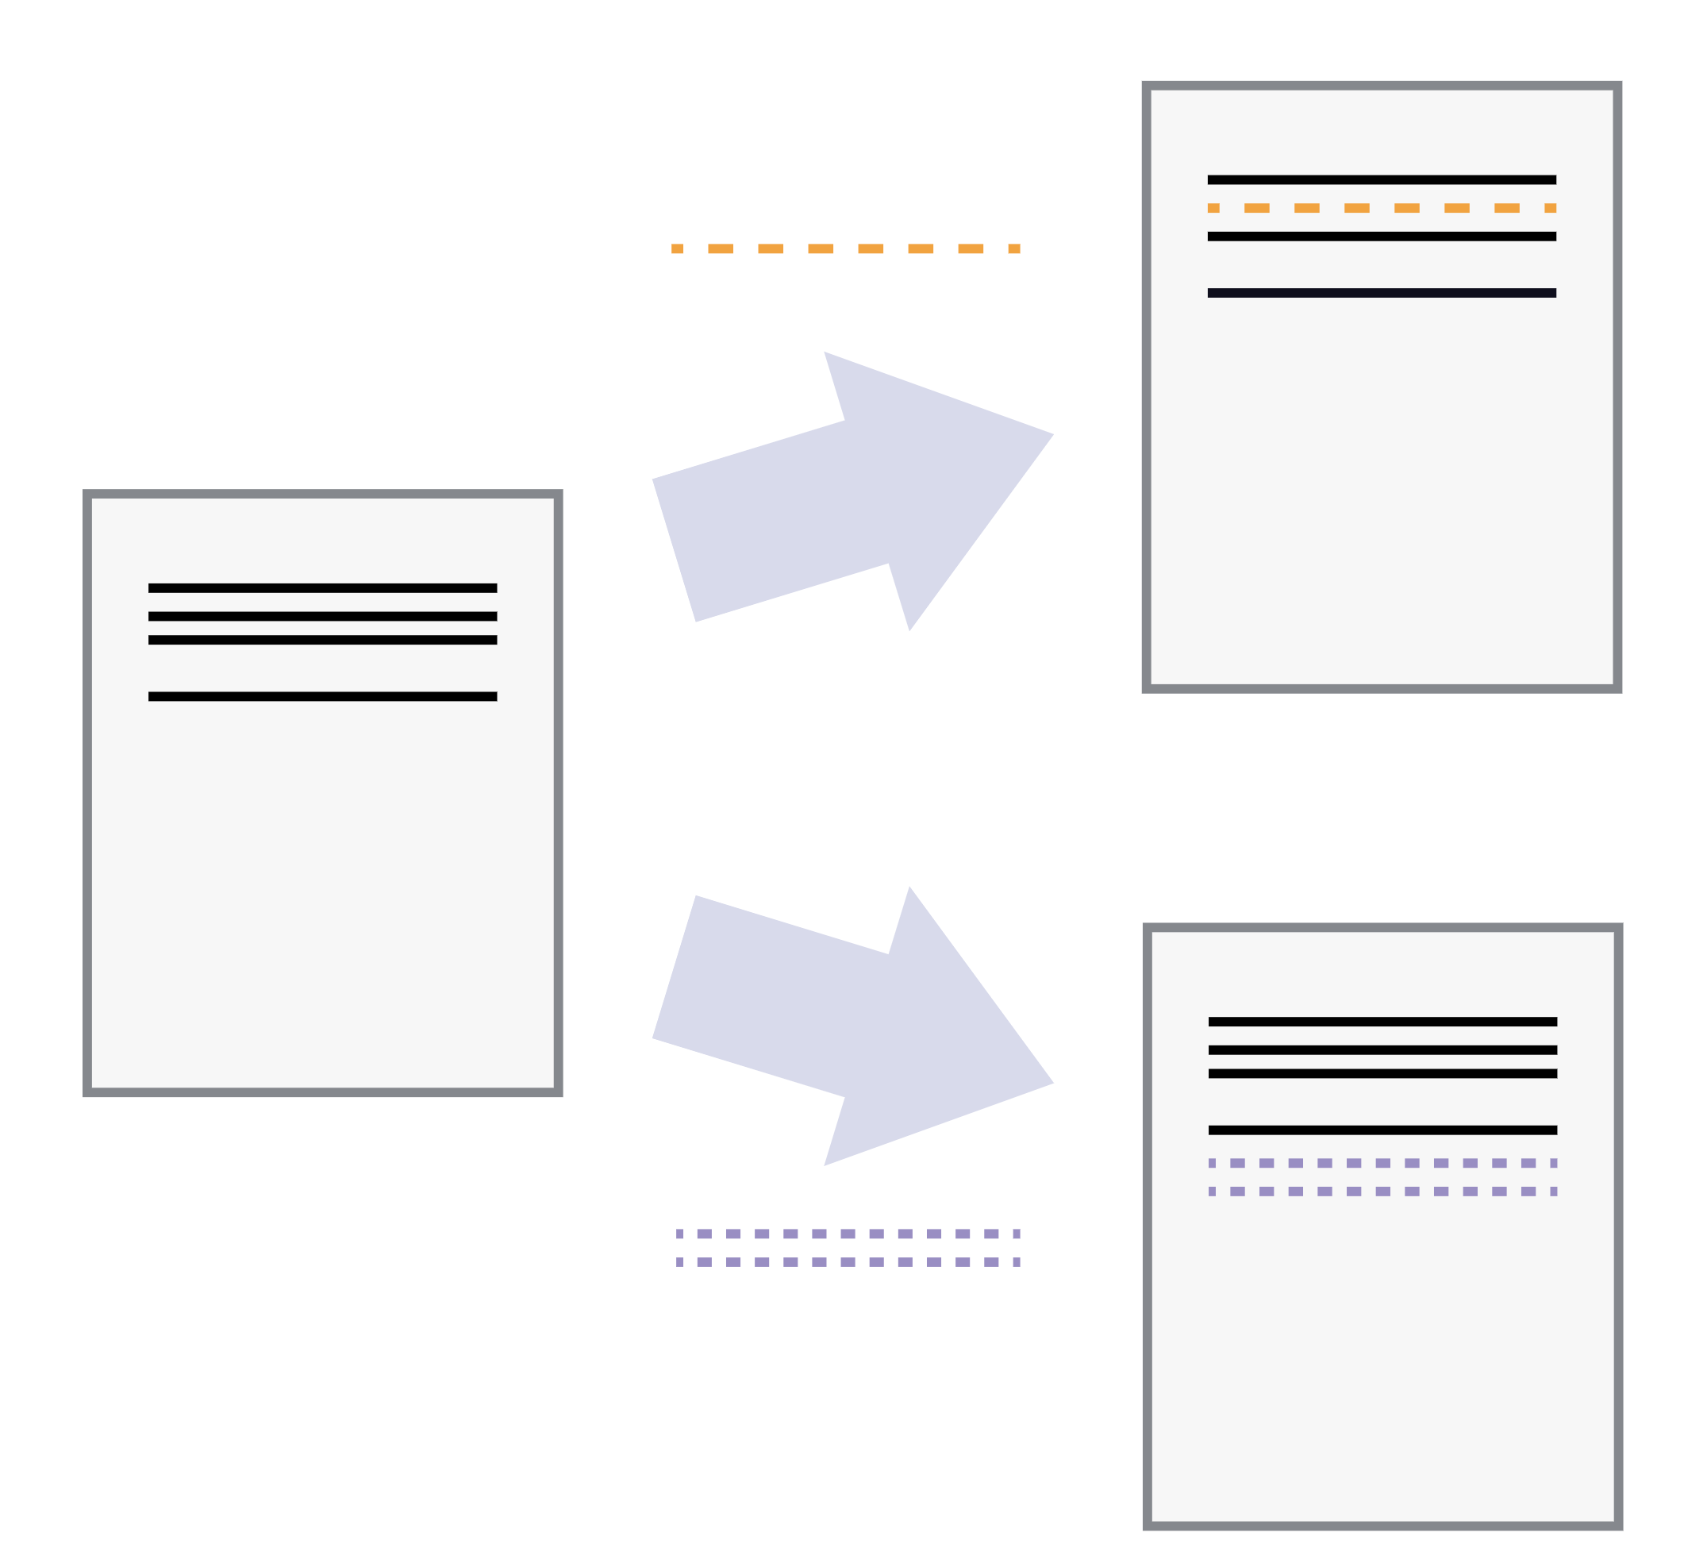
Playing back different sets of changes on the base document

Slide 6
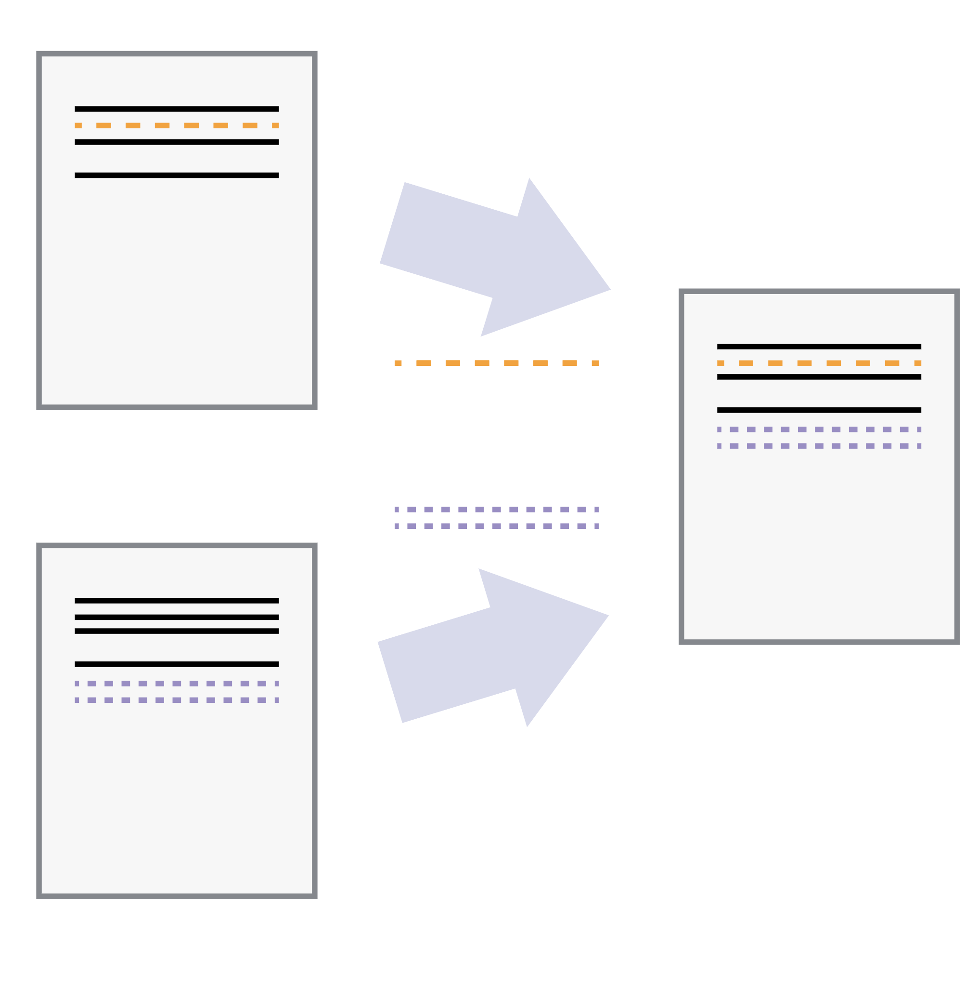
Incorporating two sets of changes into the same base document

Slide 7
Key points
Version control is like an unlimited ‘undo’.
Version control also allows many people to work in parallel.

Slide 8
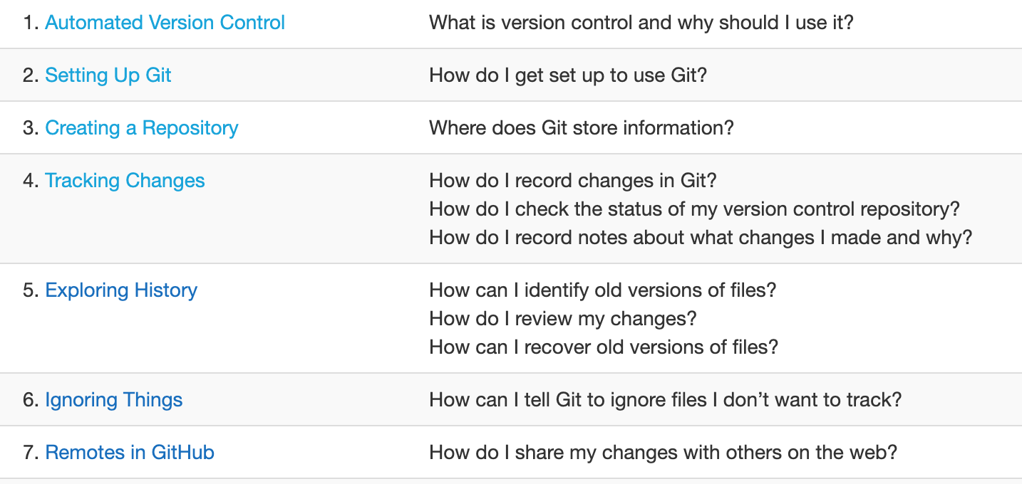
Schedule

