Slide 1
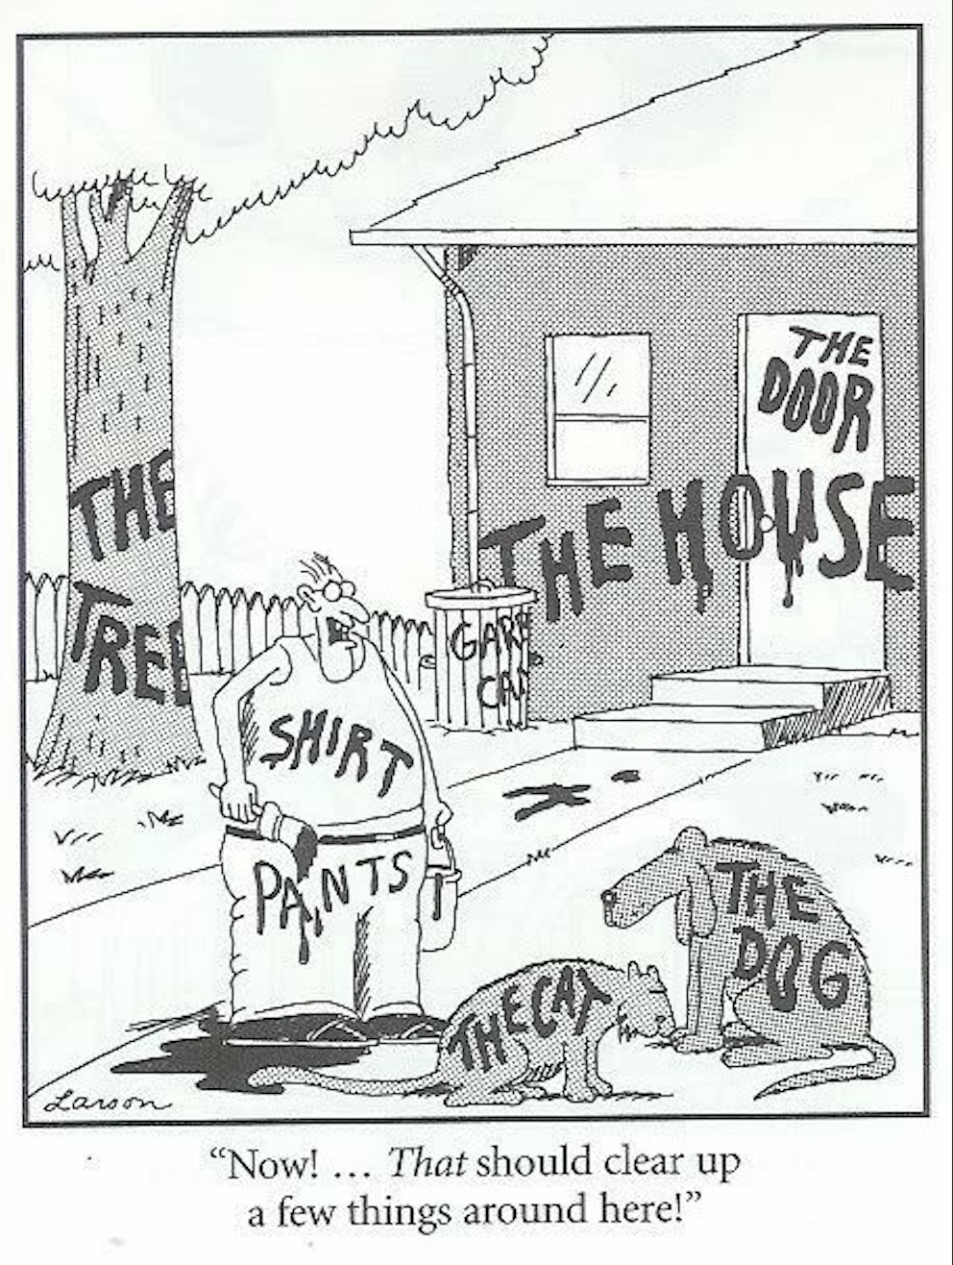
Code documentation

Slide 2
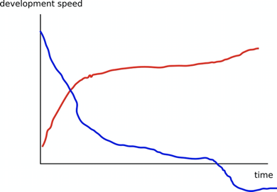

Slide 3
Code documentation lesson
Why would you document software?
What makes good documentation?
How do I write good in-code documentation?
How do I write good README files?
Demo creating documentation with Sphinx and deploying to ReadTheDocs.
Deploy a project website or personal homepage to Github Pages.
Independent of programming languages
Notes:
3

Slide 4
Episode 1 Motivation and wishlist
Why documenting code?
What is our wishlist on a suitably good documentation?
Notes:
4

Slide 5
Why document code?
Is project documentation important? Why? Take a few moments to think about it.
Notes:
5

Slide 6
Why document code?
Is project documentation important? Why? Take a few moments to think about it.
You will probably use your code in the future and may forget details.
You may want others to use your code (almost impossible without documentation).
You may want others to contribute to the code.
Shield your limited time and let the documentation answer FAQs.
Notes:
6

Slide 7
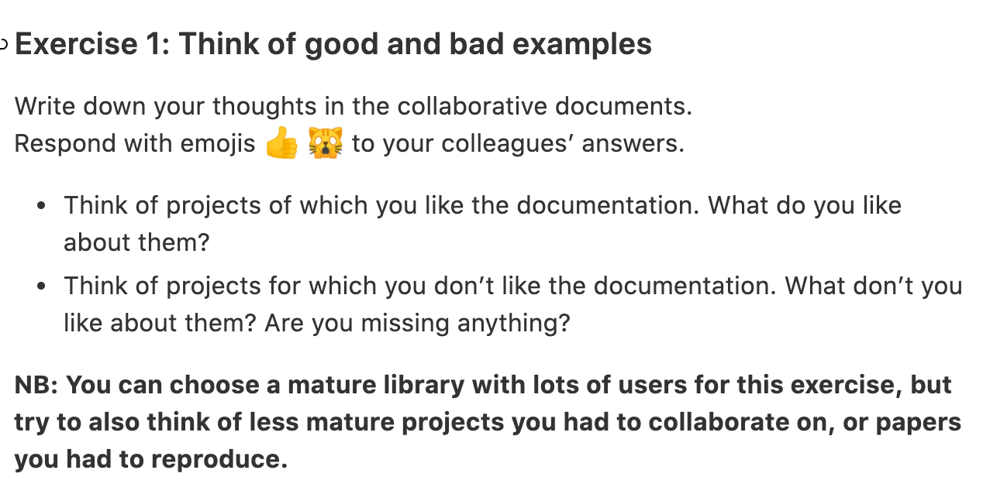
Exercise 1: Let’s think of good and bad examples
Notes:
7

Slide 8
What did we learn?
It is important to document code
Depending on the purpose and state of the project documentation needs to meet different criteria.
For most scientific projects, in-code documentation and a well thought out README file is enough.
Documentation should be tracked with corresponding code
Notes:
8

Slide 9
Episode 2: In-code documentation
What can I do to make my code more easily understandable?
What information should go into comments?
What information should go into docstrings?
Notes:
9

Slide 10
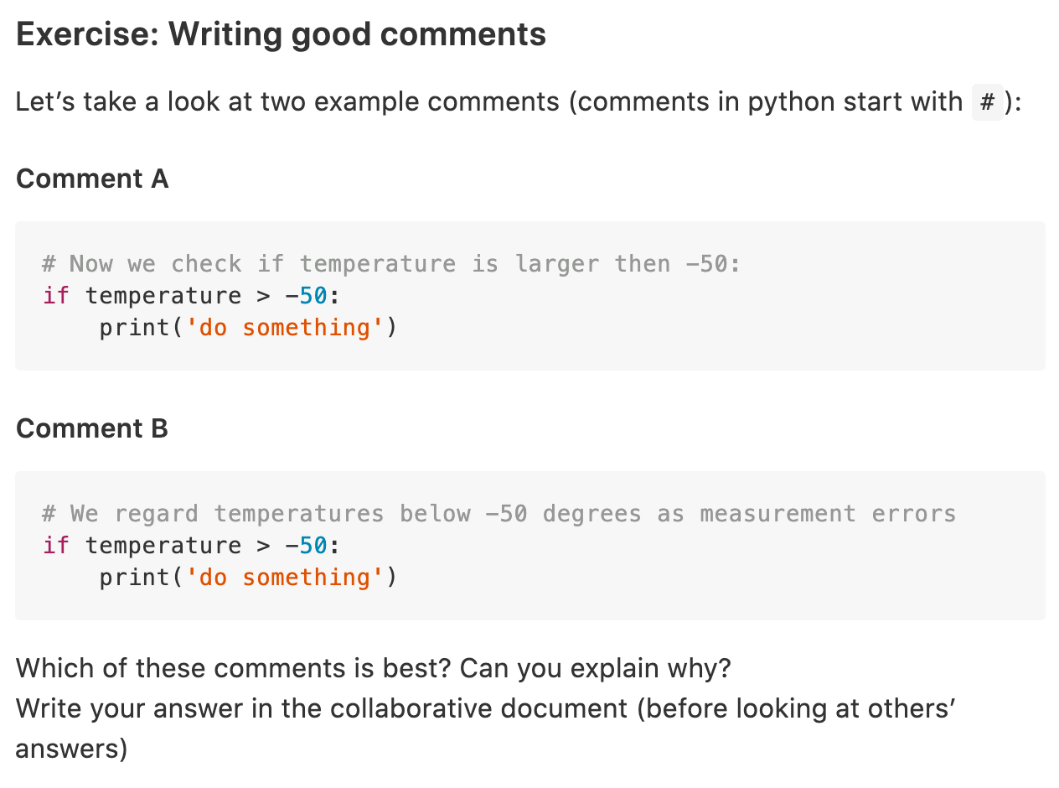
Warmup exercise: writing good comments
Notes:
10

Slide 11
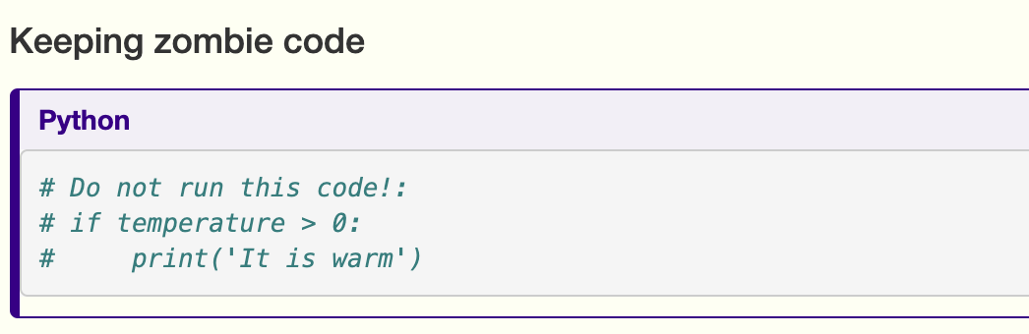
Do not use comments for
Notes:
11

Slide 12
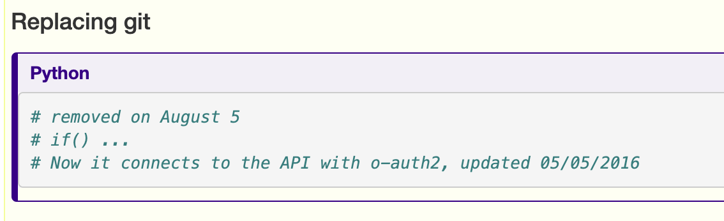
Do not use comments for:
Notes:
12

Slide 13
Writing docstrings in python
Demo + exercise
Notes:
13

Slide 14
Keypoints episode 2
Comments should describe the why for your code not the what.
Writing docstrings is an easy way to write documentation while you type code.
Notes:
14

Slide 15
Episode 3: Writing a good README file
README file is first thing a user/collaborator sees
What should be included as a bare minimum in README files?
Notes:
15

Slide 16
Exercise: Write a README file
You are going to write a README file for the example project
Notes:
16

Slide 17
What makes up a good README file?
A descriptive project title
Motivation (why the project exists)
How to setup
Copy-pastable quick start code example
Recommended citation
Notes:
17

Slide 18
User experience
Think about the user
What does the user need to know?
Make your README attractive
Notes:
18

Slide 19
Key point episode 3
A good README file is key to provide information about your project.
Notes:
19

Slide 20
Episode 4: Sphinx and ReadtheDocs demo
What if a README file is not enough?
How do I easily create user documentation?
Notes:
20

Slide 21
Sphinx and ReadtheDocs
Sphinx let’s you create nicely-formatted HTML pages out of simple markdown files. It is programming language-independent.
ReadtheDocs easily connects to your github page and automatically deploys your Sphinx documentation for free!
Notes:
21

Slide 22
Keypoints
Sphinx + ReadtheDocs provide a powerful way to create extensive (user) documentation.
Notes:
22

Slide 23
Hosting websites/homepages on Github Pages
How to serve a website/homepage using GitHub
Notes:
23

Slide 24
Recap documentation
What questions do you still have?
Whether there are any incremental improvements that can benefit your projects?
What’s nice that we learnt but is overkill for your current work?
Take-home message
It is important to document code
Depending on the purpose and state of the project documentation needs to meet different criteria.
Notes:
24

