Slide 1






Image processing w/ Python: skimage Dr. Candace Makeda Moore, MD

Slide 2
Image processing in Python: skimage
Basics with skimage
Read
Open
Display
Resize
Slice
Threshold

Slide 3
Image processing in Python: Skimage
Watching code: more than one way possible
Resizing: use the documentation
skimage.transform
skimage.transform.resize
https://scikit-image.org/docs/stable/api/skimage.transform.html#skimage.transform.resize
Exercise 1

Slide 4
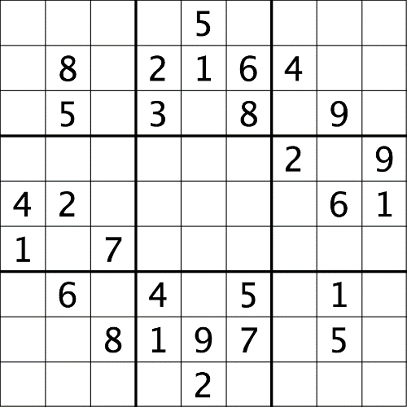
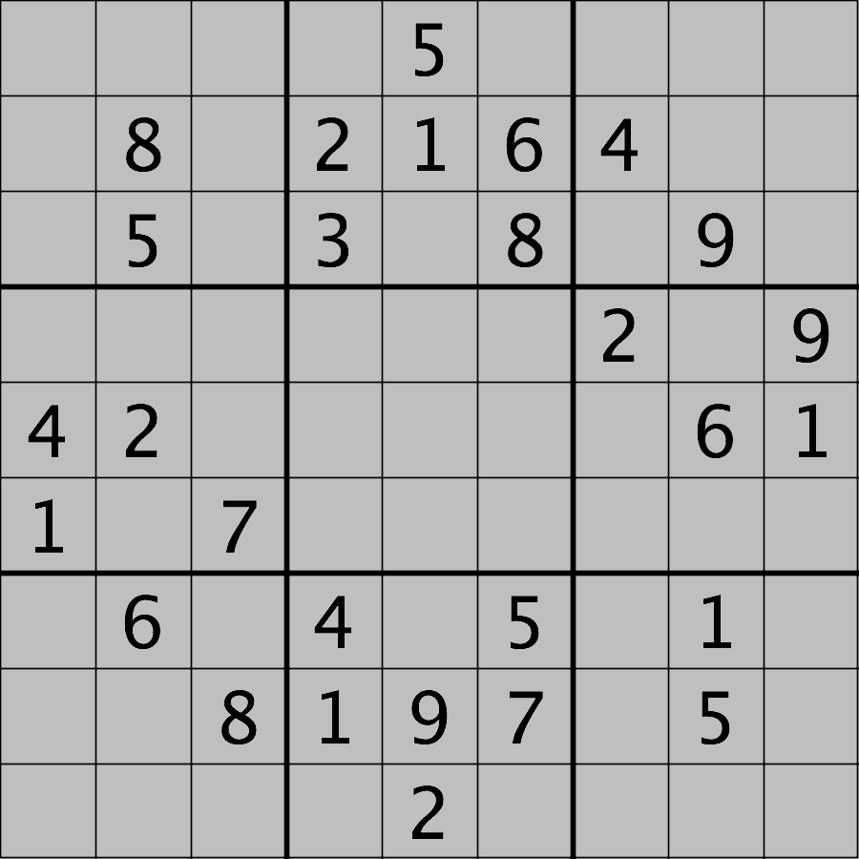
Image processing in Python: Skimage
Simple thresholding
Exercise 2: remake data/sudoku.png
Keep low intensity pixels, replace high
Super important: matplotlib defaults without a vmin and vmax

Slide 5
Image processing in Python: Skimage
Slicing: using the power of numpy
Watch or code along

Slide 6
Image processing in Python: Skimage
Images are read from disk with the iio.imread() function.
We create a window that automatically scales the displayed image with matplotlib and calling show()
Colour images can be transformed to grayscale using skimage.color.rgb2gray() or, in many cases, be read as grayscale directly by passing the argument mode="L" to iio.imread()
We can resize with the skimage.transform.resize() function
NumPy array commands, such as image[image < 128] = 0, can be used to manipulate the pixels of an image
Array slicing can be used to extract sub-images or modify areas of images, e.g., clip = image[60:150, 135:480, :].
Metadata is not retained when images are loaded as skimage images

