Slide 1
Image Processing with Python
Dr. Candace Makeda Moore, MD
Dr. Dani Bodor, PhD
Djura Smits, MS
Giulia Criocioni, MS
Notes:
this is 5min version of our 30min slidedeck :-)

Slide 2
Image processing in Python: Intro Lecture
Housekeeping:
All good early instruction followers will be punished
jupyterlab, ipympl
2. `git pull` to get the current everything
3. Change into environment: image_libraries
4. Hackmd : https://tinyurl.com/22kxuwnfhttps://tinyurl.com/22kxuwnf

Slide 3
Image processing in Python: Intro Lecture
What sort of scientific questions can we answer with image processing and computer vision?
With image processing we can answer questions on large numbers of images quickly
Classic example is stuff on petri dishes e.g. cell counts, colony count
Consider cost of imaging
What are morphometric problems?
Etymology: morphometric is from Greek μορϕή = "shape", -μετρία = "measurement"
Counting and shape analysis of objects inside an image

Slide 4
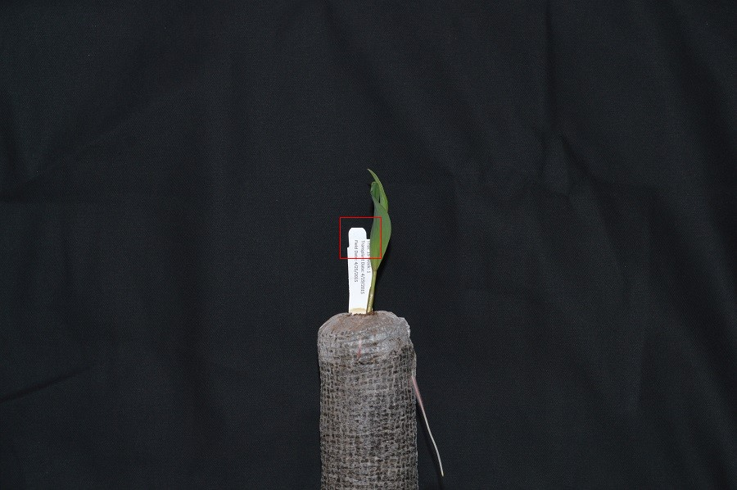
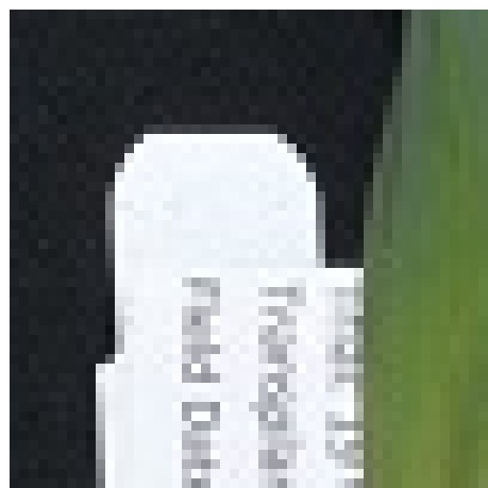
Image Processing in Python
Understand how images are represented in digital format
Explain how a digital image is composed of pixels
Define the terms bit, byte, kilobyte, megabyte, etc.
Digital images are a matrices/arrays of "picture elements" aka pixels
Can be in millions
Can be 'heavy'
Bit, byte, kilobyte, megabyte (0/1, 8, 8000, 8000000) metric
Bit, byte, kibibyte (0/1, 8, 1024 bytes, 1024KB ) IEC system

Slide 5
Image Processing in Python
Understand why skimage: numfocus FOSS
Skimage images are numpy, numpy (also numfocus) is optimized
Recommend image io module?
Imageio.v3.read() versus skimage.io.imread()
imageio supposedly better at handling metadata.
Skimage.io wraps parts of it
Structure of a numpy image
Time for exercise #1: please open notebook for students in episode 1
Exercise #1 is read in image (it is prefilled for you) then knowing you have a numpy array, print the image shape, size, min pixel value, finally show the image (prefilled)
Why is it this shape? What shapes could a color versus black and white possibly be?

Slide 6
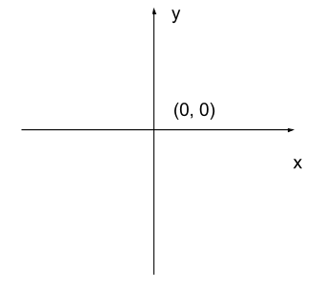
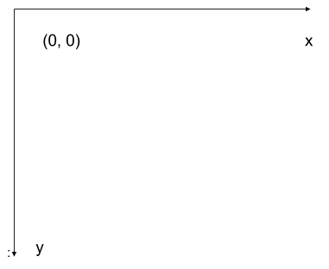
Image Processing in Python
RGB additive colour model used in digital images
and order of the three colour values in skimage images
Exercise 2: Show the image top half only one channel
left-hand coordinate system used in digital images
2d vs. 3d and beyond
Exercise 3:

Slide 7
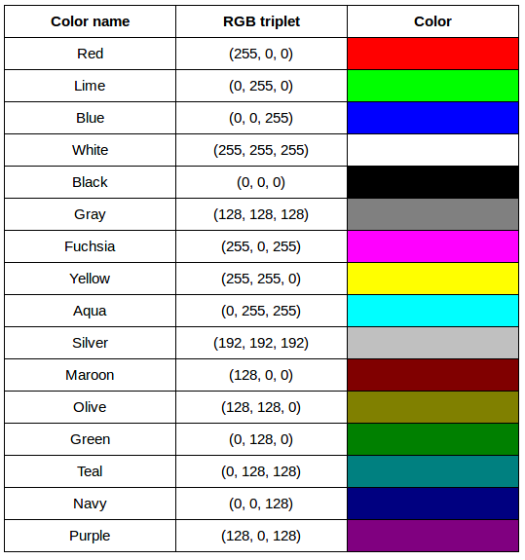
Image Processing in Python
From the carpentries : [red, green, blue], additive
(255, 0, 0)
(0, 255, 0)
(0, 0, 255)
(255, 255, 255)
(0, 0, 0)
(128, 128, 128)
Note: RGB is good for computers
Printers might want CMKY and an alpha even
In theory you can have n-channel images

Slide 8
Image Processing in Python
Compression: Lossless versus lossy
Different versions, different types, different types of encoding
Container versus payload format
JPEG is most commonly used format today, DICOM loves JPEG2000
PNG can have "luminance" channel (make LHS familiar printers really angry)
lossless
PNG
BMP: nearly clean raster
GIF
Can be either:
TIFF
MNG
lossy
JPEG (not all JPEGs are lossy)

Slide 9
Image Processing in Python
Compression: Lossless versus lossy
Why ever lossy?
Better in terms of certain numbers (control over quality of compression) as a payback for degraded quality, storage savings
Lossless encoding: information theory, exploits redundancies
JPEG: subsamples of image and makes a function for subsample- mathematical quilting? You can manipulate both subsample and precision of polynomial (which is not deterministic); therefore some images are much better as JPEGs than others (smoke is worst enemy)

Slide 10
Image Processing in Python
Format | Compression | Metadata | Advantages | Disadvantages
BMP | None * or lzw compression | None * experts disagree | Universally viewable, high quality | Large file sizes
JPEG | Lossy | Yes | Universally viewable, smaller file size | Detail may be lost
PNG | Lossless | Yes | Universally viewable, open standard, smaller file size | Metadata less flexible than TIFF, RGB only
TIFF | None, lossy, or lossless | Yes | High quality or smaller file size | Not universally viewable
Can be either:
TIFF
MNG

Slide 11
Image Processing in Python
What information could be contained in image metadata?
For DICOMs endless
For many image file formats less important but
imwrite() will not retain all metadata associated with the original image that was loaded into Python! If the image metadata is important to you, be sure to always keep an unchanged copy of the original image!

Slide 12
Image Processing in Python
Working with skimage specifically:
Check the premade cheat sheets and the notebook for syntax
Read and save images with imageio.
Display images (with matplotlib)
Resize images with skimage.
Perform simple image thresholding with NumPy array operations.
Extract sub-images using array slicing.

Slide 13
Image Processing in Python
Why make images stored as arrays?
Computer screens?
Human mind stores images differently (and by the way 12-16 shades)

