Slide 1
Image Processing with Python Histograms
Dr. Candace Makeda Moore, MD
Dr. Thijs Vroegh, PhD
Jaro Camphuijsen, MSc
Giulia Criocioni, MS
Notes:
this is 5min version of our 30min slidedeck :-)

Slide 2
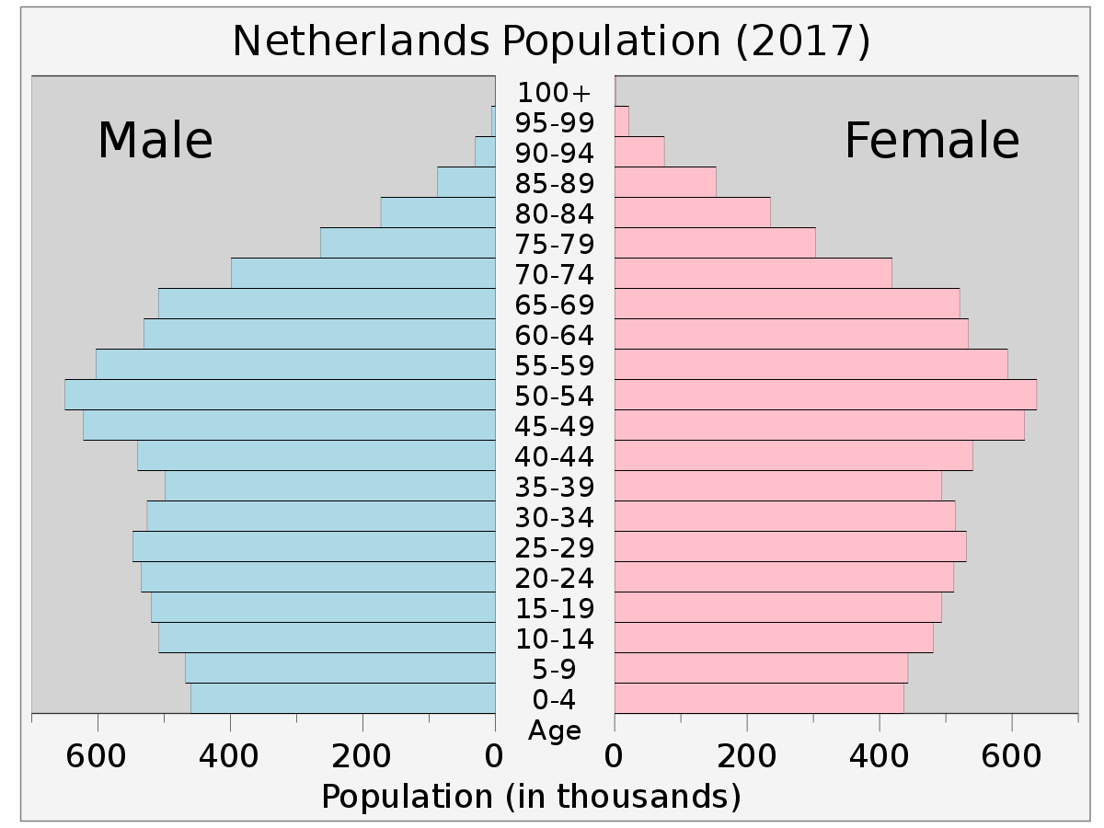
Histograms
Histograms categorize continuous data
They put numerical data into bins

Slide 3
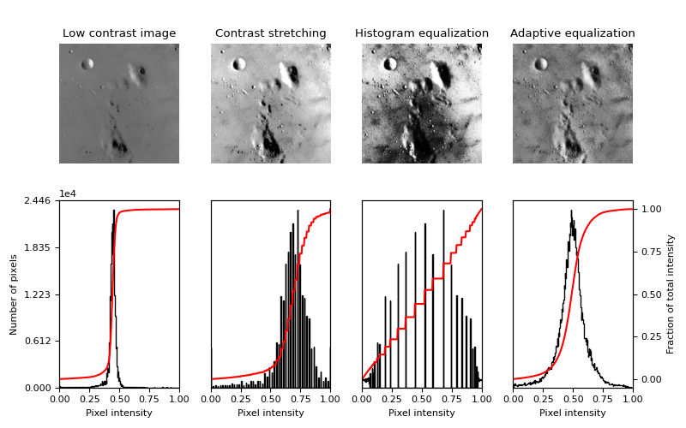
Histograms
If images are numbers they can also go -> histograms
Histograms are really useful for things like image quality
The below image is from skimage documentation

Slide 4
Histograms
AHE and CLAHE?
Important for simple thresholding (where do I binarize?)
Numpy is very convenient for making histograms
Let’s code!

Slide 5
Histograms
Final thoughts:
We can display histograms well if we understand matplotlib: matplotlib pyplot figure(), title(), xlabel(), ylabel(), xlim(), plot(), and show() functions.
We can separate the rgb channls by slicing
We can harness numpy i.e. np.histogram function
Histograms have lots of uses, not all covered

