Slide 1
Image Processing with Python Drawing and Bitwise Operations
Dr. Candace Makeda Moore, MD
Dr. Thijs Vroegh, PhD
Jaro Camphuijsen, MSc
Giulia Criocioni, MS
Notes:
this is 5min version of our 30min slidedeck :-)

Slide 2
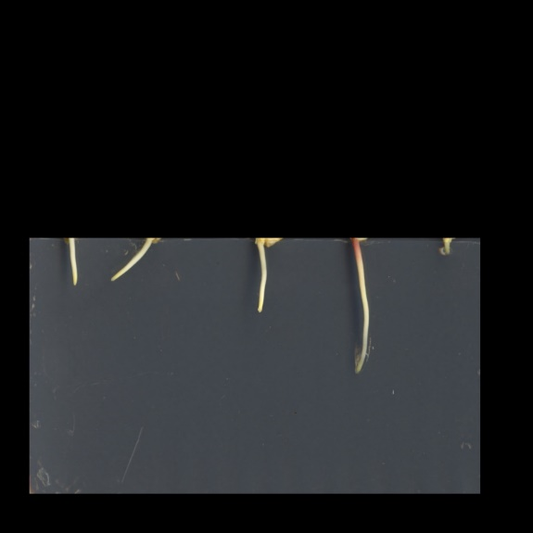
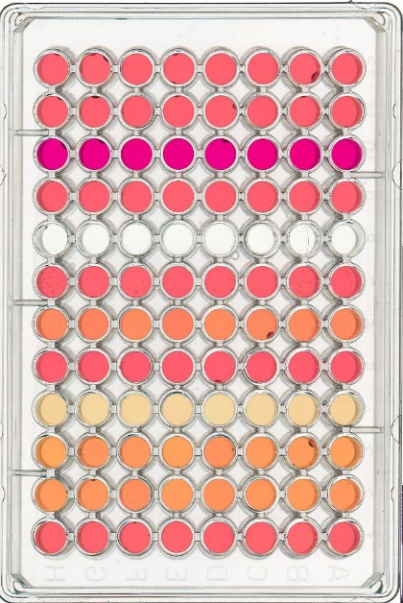
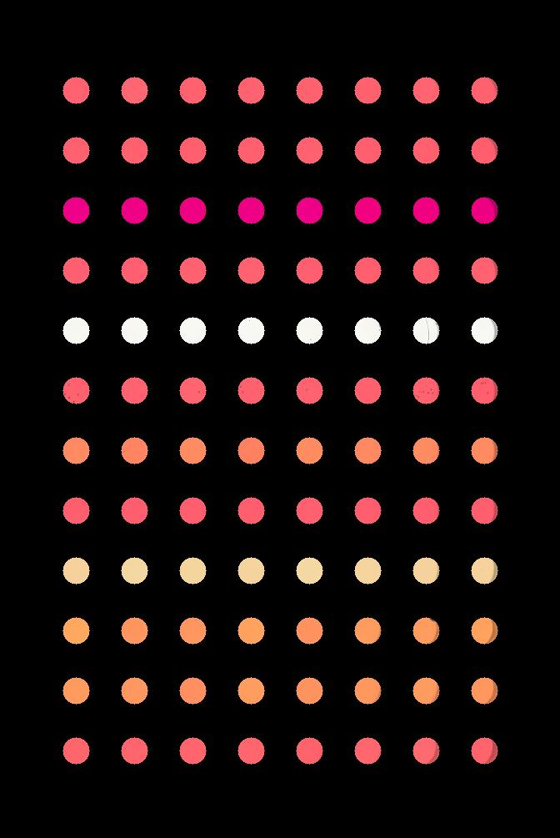
Drawing and Bitwise Operations
Drawing: changing parts of the image → what you want
Masking is a kind of drawing
Masking allows you to control what you will do analysis/processing or learning on

Slide 3
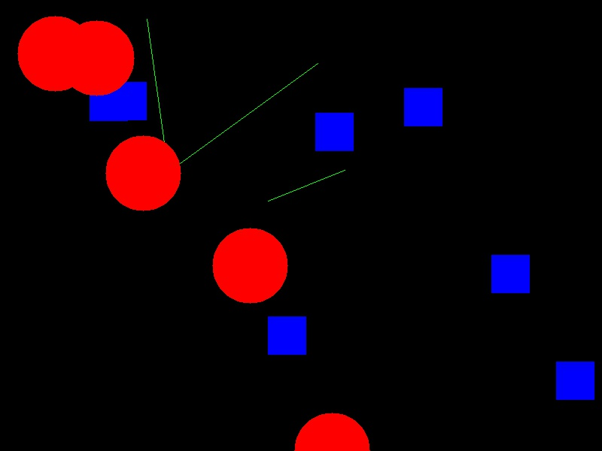
Drawing and Bitwise Operations
Drawing: skimage.draw documentation
Can you make an interesting drawing?

Slide 4
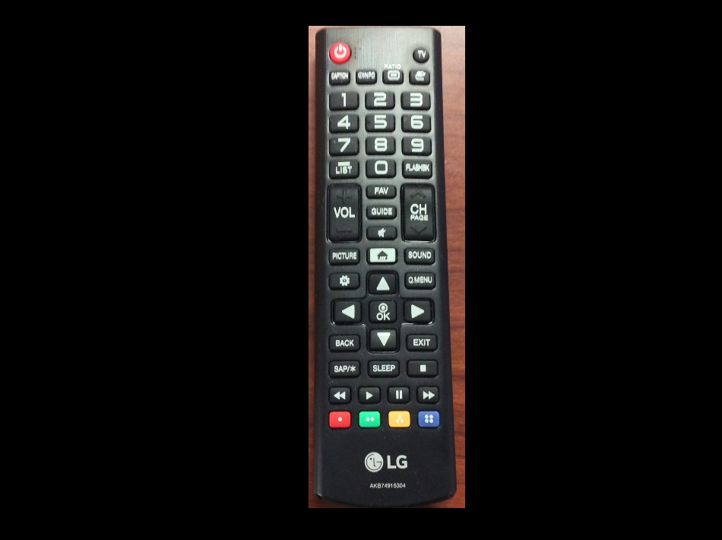
Drawing and Bitwise Operations
Exercises: making masks

