Slide 1
Image Processing with Python Histograms
Dr. Candace Makeda Moore, MD
Dr. Thijs Vroegh, PhD
Jaro Camphuijsen, MSc
Giulia Criocioni, MS
Notes:
this is 5min version of our 30min slidedeck :-)

Slide 2
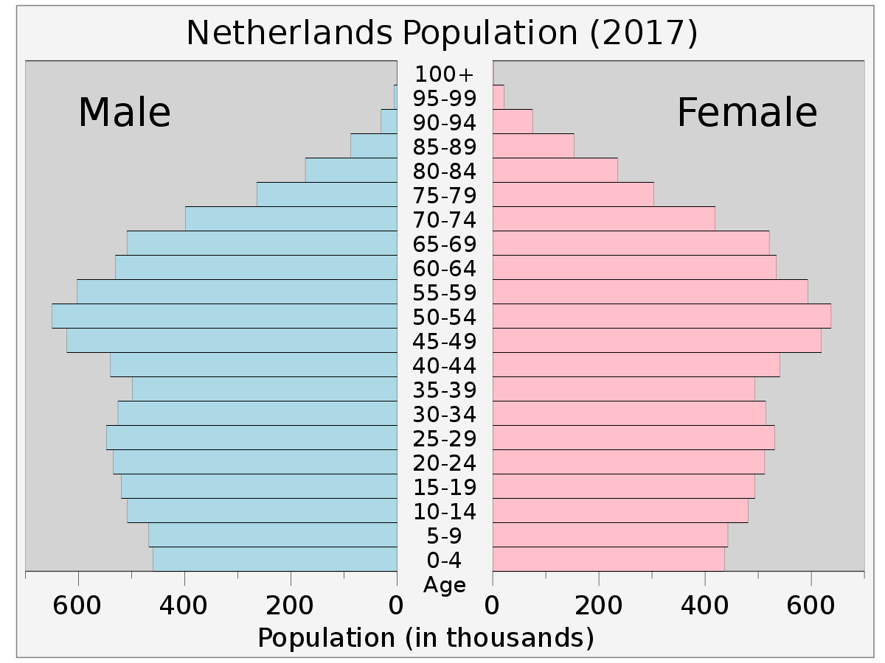
Histograms
Histograms categorize continuous data
They put numerical data into bins

Slide 3
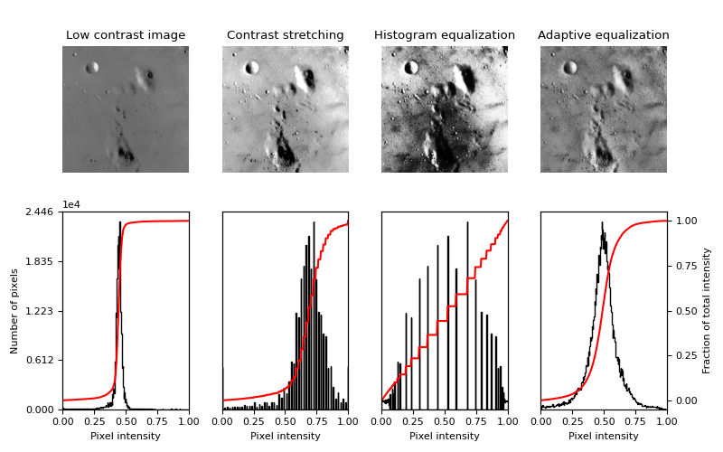
Histograms
If images are numbers they can also go -> histograms
Histograms are really useful for things like image quality
The below image is from skimage documentation

Slide 4
Histograms
AHE and CLAHE?
Important for simple thresholding (where do I binarize?)
Numpy is very convenient for making histograms
Let’s code!

