Slide 1






Image processing w/ Python: Image Basics Dr. Candace Makeda Moore, MD

Slide 2
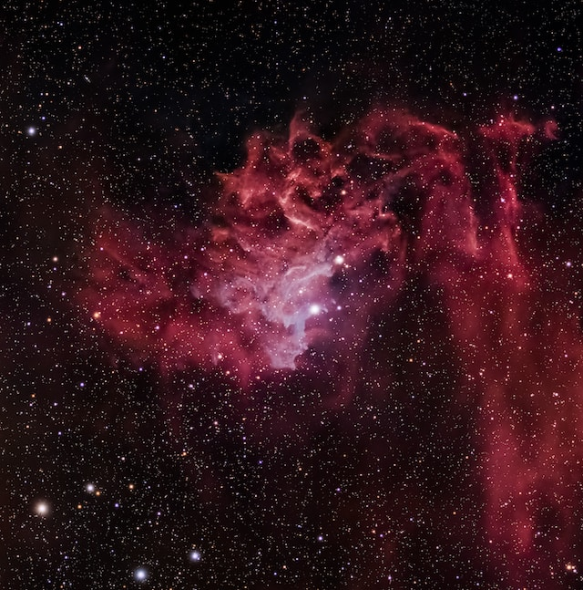


Set up continues:
Repo cloned
Environment entered
Collaborative document open?
There is a cheat sheet if you want one (later)
Photo by Scott Lord on Unsplash

Slide 3
Image processing in Python: Image Basics
What sort of scientific questions can we answer with image processing and computer vision?
With image processing we can answer questions on large numbers of images quickly
Classic example is stuff on petri dishes e.g. cell counts, colony count
But also, stars in sky, birds in trees, rows of trees with fruit..
Consider cost of imaging and computation
Also consider advantages of computation

Slide 4
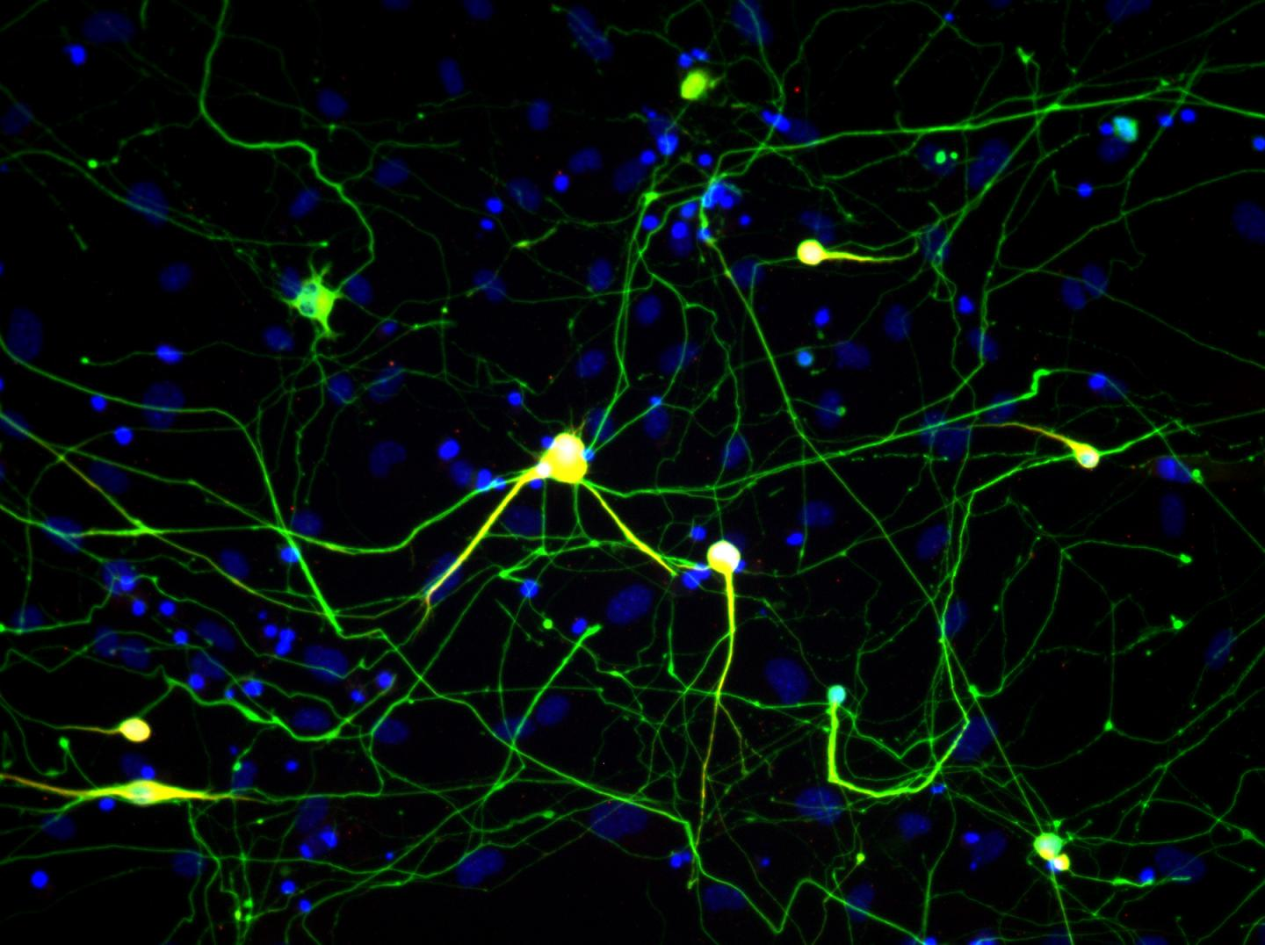
Image processing in Python: Image Basics
What are morphometric problems?
Etymology: morphometric is from Greek μορϕή = "shape", -μετρία = "measurement“
Counting and shape analysis of objects inside an image
Werning Lab/Stanford
Simple Python and scikit-image (or alternative libraries) techniques can be used to solve real problems

Slide 5
Image Processing in Python
Understand how images are represented in digital format
Explain how a digital image is composed of pixels.
Define the terms bit, byte, kilobyte, megabyte, etc.
Recommend using imageio (resp. skimage) for I/O (resp. image processing) tasks.
Explain how images are stored in NumPy arrays.
Explain the left-hand coordinate system used in digital images.
Explain the RGB additive colour model used in digital images.
Explain the order of the three colour values in skimage images.
Explain the characteristics of the BMP, JPEG, and TIFF image formats.
Explain the difference between lossy and lossless compression.
Explain the advantages and disadvantages of compressed image formats.
Explain what information could be contained in image metadata.

Slide 6
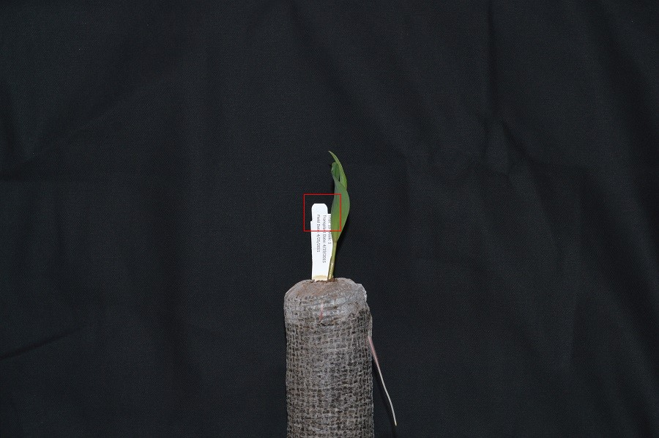
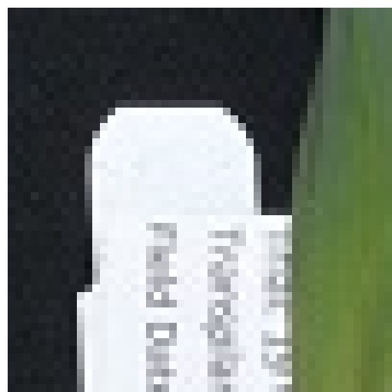
Image processing in Python: Image Basics
Digital images
Understand images as represented in digital format
Digital image as composed of pixels
Digital images are a matrices/arrays of "picture elements" aka pixels (or voxels)
Definitions: bit, byte, kilobyte, megabyte, etc.
Can be in millions
Can be 'heavy'
Bit, byte, kilobyte, megabyte (0/1, 8, 8000, 8000000)
Notes:
Pixels can be thought of as boxes of light with different color and shade. A matrix is a math concept and an array is a computer science concept. A matrix is numbers evenly spaced arranged in a rectangle or a cuboid (3-d equivalent to rectangle). In computing an array refers to the structure IN THE COMPUTER’S MEMORY WHERE DATA IS STORED IN EVENLY SPACED ELEMENTS. In reality we often use these terms interchangeably. A bit is a binary digit, and this is how your computer stores numbers. RAM memory is in terms of megabytes, gigabytes and even terabytes…(but some medical) images are gigabytes

Slide 7
Image processing in Python: Image Basics
Practice with a digital image
Let’s examine an image
Open Jupyter lab if you want to code along (not yet exercise)
`jupyter lab`

Slide 8
Image processing in Python: Image Basics
Digital image notebook 1
Implicit learning
Import brings in libraries (whole versus part)
Image is an array of numbers
Matplotlib displays
Matplotlib is where we assign a color schema to our numbers for viewing
Numpy lets us manipulate the array

Slide 9
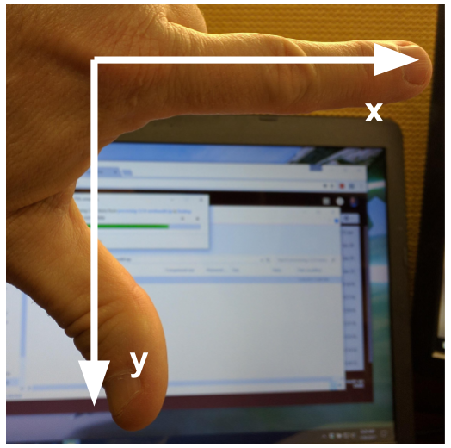
Image processing in Python: Image Basics
Understand why skimage: numfocus, FOSS, numpy (also numfocus) is optimized
Recommend image io module?
Imageio.v3.read() versus skimage.io.imread()
imageio supposedly better at handling metadata.
Skimage.io wraps parts of it
Structure of a numpy image
Image [rows, columns], left hand system
Time for exercise #1: please open notebook

Slide 10
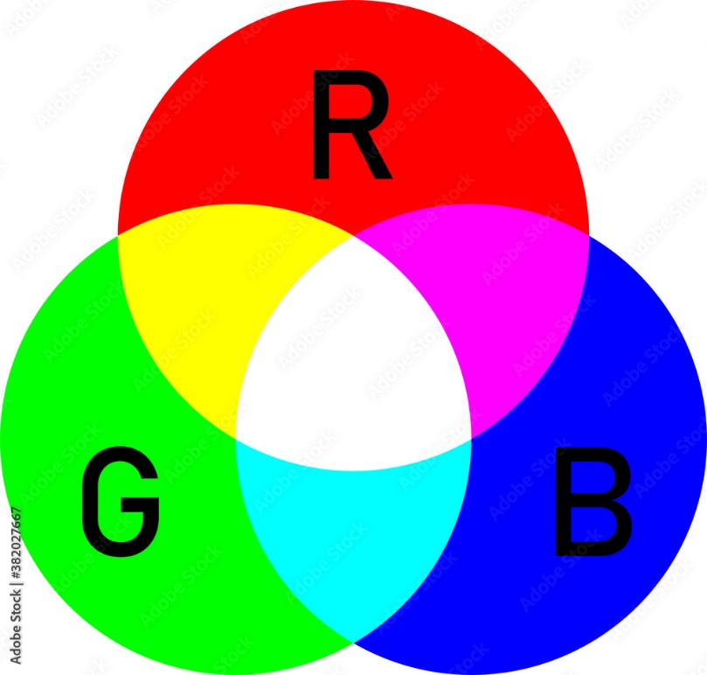
Image processing in Python: Image Basics
left-hand coordinate system used in digital images
2d vs. 3d and beyond
RGB additive colour model used in many digital images
and order of the three colour values in skimage images
Watch code for random checkerboard

Slide 11
Image processing in Python: Image Basics
RGB additive colour model used in digital images
and order of the three colour values in skimage images
Exercise 2:
Suppose that we represent colours as triples (r, g, b), where each of r, g, and b is an integer in [0, 255]. What colours are represented by each of these triples? (Try to answer these questions without reading/looking up)
(255, 0, 0)
(0, 255, 0)
(0, 0, 255)
(255, 255, 255)
(0, 0, 0)
(128, 128, 128)

Slide 12
Image processing in Python: Image Basics
Exercise 2:
(255, 0, 0)
(0, 255, 0)
(0, 0, 255)
(255, 255, 255) When we mix the maximum value of all three colour channels, we see the colour white.
(0, 0, 0) represents the absence of all colour, or black.
(128, 128, 128) represents a medium shade of gray..

Slide 13
Image processing in Python: Image Basics
Compression: Lossless versus lossy
Don't overlook exploiting lossy algorithms: did you want every detail?
JPEG is actually most commonly used format today
PNG has a luminance channel!
lossless
PNG
BMP
GIF
lossy
JPEG
Can be either:
TIFF
MNG

Slide 14
Image processing in Python: Image Basics
Format | Compression | Metadata | Advantages | Disadvantages
BMP | None | None | Universally viewable, | Large file sizes
 |  |  | high quality
JPEG | Lossy | Yes | Universally viewable, | Detail may be lost
 |  |  | smaller file size
PNG | Lossless | Yes | Universally viewable, open sd, smaller file size | Metadata less flexible than TIFF, RGB only
TIFF | None, lossy, | Yes | High quality or | Not universally viewable
 | or lossless |  | smaller file size

Slide 15
Image processing in Python: Image Basics
Metadata: non-pixel/voxel data
Depends on sensor/camera and file format and not the only place extra information can be lurking
Code along example:

