Slide 2
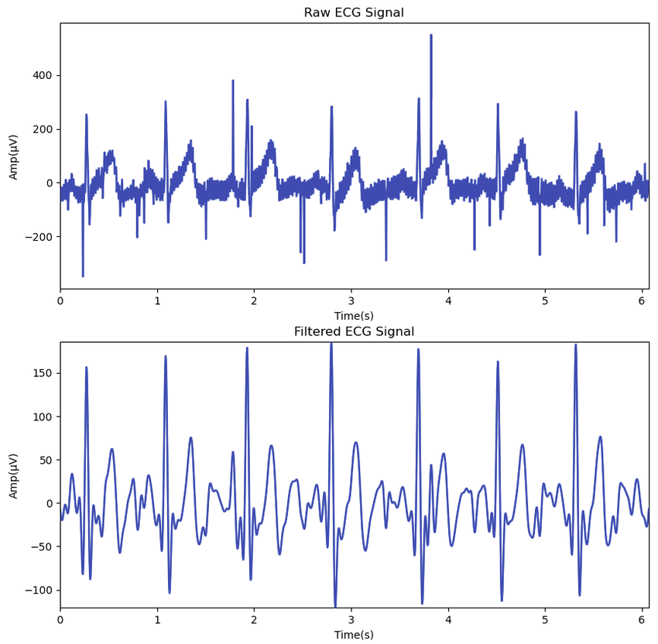


Raw versus filtered EKG
How would we filter an EKG signal?
We would take out high (and low) frequency noise.
Image available via license: Creative Commons Attribution 4.0 International from article:Wang, Jie & Zhu, Zhongpan. (2023). VTD-Visual and Tactile Database for Driver State and Behavior Perception. 10.36227/techrxiv.24432844.v1.

