Slide 1
Image Processing with Python
Dr. Candace Makeda Moore, MD
Dr. Dani Bodor, PhD
Djura Smits, MS
Giulia Criocioni, MS
Notes:
this is 5min version of our 30min slidedeck :-)

Slide 2
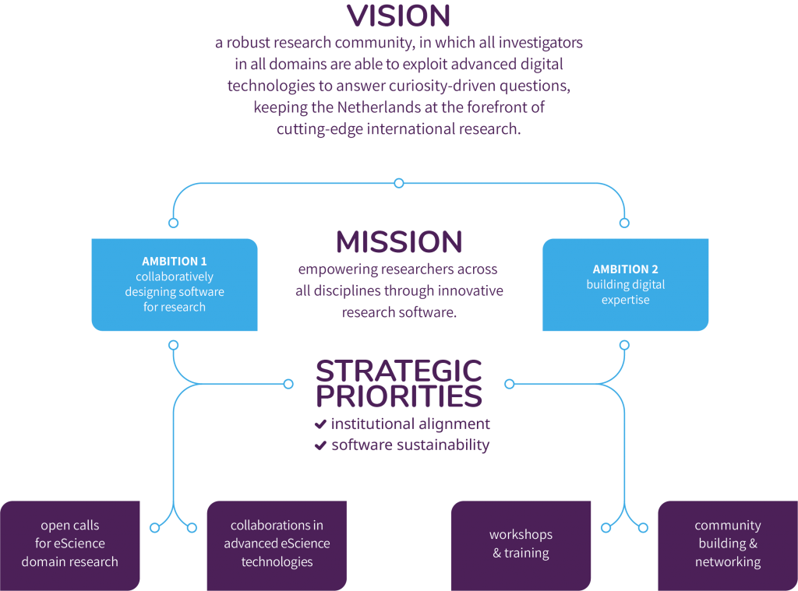


Netherlands eScience Center
Notes:
And our mission is empowering researchers across all disciplines through innovative research software.
The Netherlands eScience Center is the national centre for innovative software solutions in academic research. It was founded in 2012 as an independent foundation by NWO and SURF.
Our Mission: Empowering researchers across all disciplines through innovative research software.
Our Vision: Our vision is a thriving research community where researchers in all disciplines can make use of advanced software, computing and digital technologies, keeping the Netherlands at the forefront of research.

Slide 3
Image processing in Python: Intro Lecture
What sort of scientific questions can we answer with image processing and computer vision?
With image processing we can answer questions on large numbers of images quickly
Classic example is stuff on petri dishes e.g. cell counts, colony count
Consider cost of imaging
What are morphometric problems?
Etymology: morphometric is from Greek μορϕή = "shape", -μετρία = "measurement"
Counting and shape analysis of objects inside an image

Slide 4
Image Processing in Python
Understand how images are represented in digital format
Explain how a digital image is composed of pixels.
Define the terms bit, byte, kilobyte, megabyte, etc.
Recommend using imageio (resp. skimage) for I/O (resp. image processing) tasks.
Explain how images are stored in NumPy arrays.
Explain the left-hand coordinate system used in digital images.
Explain the RGB additive colour model used in digital images.
Explain the order of the three colour values in skimage images.
Explain the characteristics of the BMP, JPEG, and TIFF image formats.
Explain the difference between lossy and lossless compression.
Explain the advantages and disadvantages of compressed image formats.
Explain what information could be contained in image metadata.

Slide 5
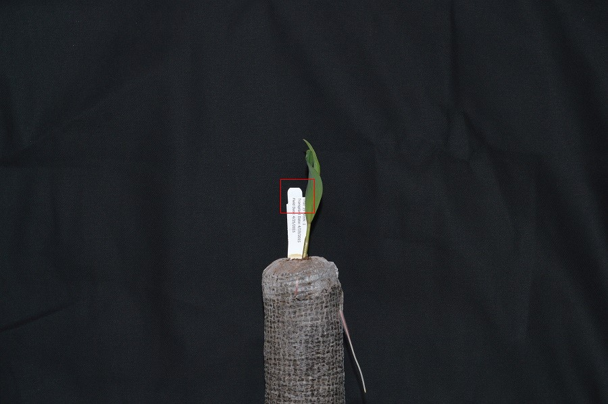
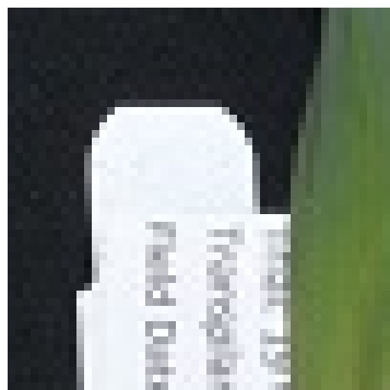
Image Processing in Python
Understand how images are represented in digital format
Explain how a digital image is composed of pixels.
Define the terms bit, byte, kilobyte, megabyte, etc.
Digital images are a matrices/arrays of "picture elements" aka pixels
Can be in millions
Can be 'heavy'
Bit, byte, kilobyte, megabyte (0/1, 8, 8000, 8000000)

Slide 6
Image Processing in Python
Understand why skimage: numfocus FOSS
numpy (also numfocus) is optimized
Recommend image io module?
Imageio.v3.read() versus skimage.io.imread()
imageio supposedly better at handling metadata.
Skimage.io wraps parts of it
Structure of a numpy image
Time for exercise #1: please open notebook

Slide 7
Image Processing in Python
left-hand coordinate system used in digital images
2d vs. 3d and beyond
Exercise 2:
RGB additive colour model used in digital images
and order of the three colour values in skimage images

Slide 8
Image Processing in Python
RGB additive colour model used in digital images
and order of the three colour values in skimage images
Exercise 3

Slide 9
Image Processing in Python
Compression: Lossless versus lossy
Don't overlook exploiting lossy algorithms: did you want every detail?
JPEG is actually most commonly used format today
PNG has a luminance channel!
lossless
PNG
BMP
GIF
lossy
JPEG
Can be either:
TIFF
MNG

