Slide 1
Image Processing with Python
Dr. Candace Makeda Moore, MD
Dr. Dani Bodor, PhD
Djura Smits, MS
Giulia Criocioni, MS
Notes:
this is 5min version of our 30min slidedeck :-)

Slide 2
Image processing in Python: Intro Lecture
Housekeeping:
All good early instruction followers will be punished
jupyterlab, ipympl
2. Pull `git pull` to get the current everything
3. Change into environment: image_libraries
4. Hackmd : https://tinyurl.com/22kxuwnfhttps://tinyurl.com/22kxuwnf

Slide 3
Image processing in Python: Intro Lecture
What sort of scientific questions can we answer with image processing and computer vision?
With image processing we can answer questions on large numbers of images quickly
Classic example is stuff on petri dishes e.g. cell counts, colony count
Consider cost of imaging
What are morphometric problems?
Etymology: morphometric is from Greek μορϕή = "shape", -μετρία = "measurement"
Counting and shape analysis of objects inside an image

Slide 4
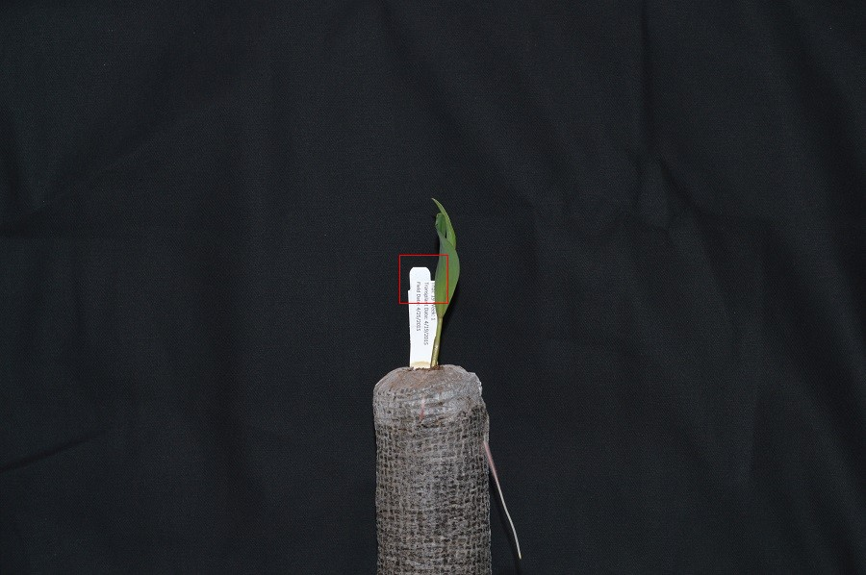
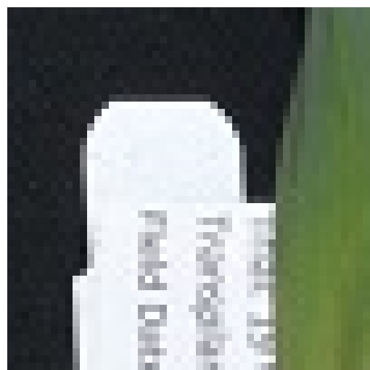
Image Processing in Python
Understand how images are represented in digital format
Explain how a digital image is composed of pixels.
Define the terms bit, byte, kilobyte, megabyte, etc.
Digital images are a matrices/arrays of "picture elements" aka pixels
Can be in millions
Can be 'heavy'
Bit, byte, kilobyte, megabyte (0/1, 8, 8000, 8000000)

Slide 5
Image Processing in Python
Understand why skimage: numfocus FOSS
Skimage images are numpy, numpy (also numfocus) is optimized
Recommend image io module?
Imageio.v3.read() versus skimage.io.imread()
imageio supposedly better at handling metadata.
Skimage.io wraps parts of it
Structure of a numpy image
Time for exercise #1: please open notebook for students in episode 1
Exercise #1 is read in image (it is prefilled for you) then knowing you have a numpy array, print the image shape, size, min pixel value, finally show the image (prefilled)
Why is it this shape? What shapes could a color versus black and white possibly be?

Slide 6
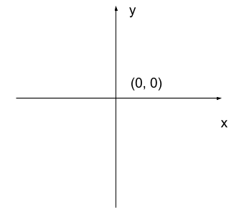
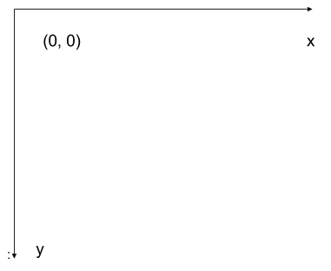
Image Processing in Python
RGB additive colour model used in digital images
and order of the three colour values in skimage images
Exercise 2: Show the image top half only one channel
left-hand coordinate system used in digital images
2d vs. 3d and beyond
Exercise 3:

Slide 7
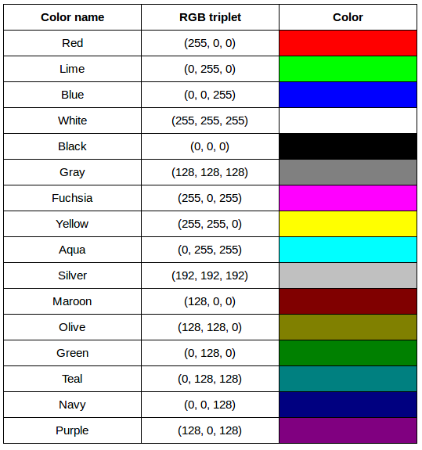
Image Processing in Python
From the carpentries : [red, green, blue], additive
(255, 0, 0)
(0, 255, 0)
(0, 0, 255)
(255, 255, 255)
(0, 0, 0)
(128, 128, 128)

Slide 8
Image Processing in Python
Compression: Lossless versus lossy
Don't overlook exploiting lossy algorithms: did you want every detail?
JPEG is actually most commonly used format today
PNG has a luminance channel!
lossless
PNG
BMP
GIF
lossy
JPEG
Can be either:
TIFF
MNG

Slide 9
Image Processing in Python
Format | Compression | Metadata | Advantages | Disadvantages
BMP | None | None | Universally viewable, | Large file sizes
 |  |  | high quality
JPEG | Lossy | Yes | Universally viewable, | Detail may be lost
 |  |  | smaller file size
PNG | Lossless | Yes | Universally viewable, open standard, smaller file size | Metadata less flexible than TIFF, RGB only
TIFF | None, lossy, | Yes | High quality or | Not universally viewable
 | or lossless |  | smaller file size
Compression: Lossless versus lossy
lossless
PNG
BMP
GIF
lossy
JPEG
Can be either:
TIFF
MNG

Slide 10
Image Processing in Python
What information could be contained in image metadata?
For DICOMs endless
For many image file formats less important but
imwrite() will not retain all metadata associated with the original image that was loaded into Python! If the image metadata is important to you, be sure to always keep an unchanged copy of the original image!

Slide 11
Image Processing in Python
Working with skimage specifically:
Check the premade cheat sheets and the notebook for syntax
Read and save images with imageio.
Display images (with matplotlib)
Resize images with skimage.
Perform simple image thresholding with NumPy array operations.
Extract sub-images using array slicing.

