Slide 1
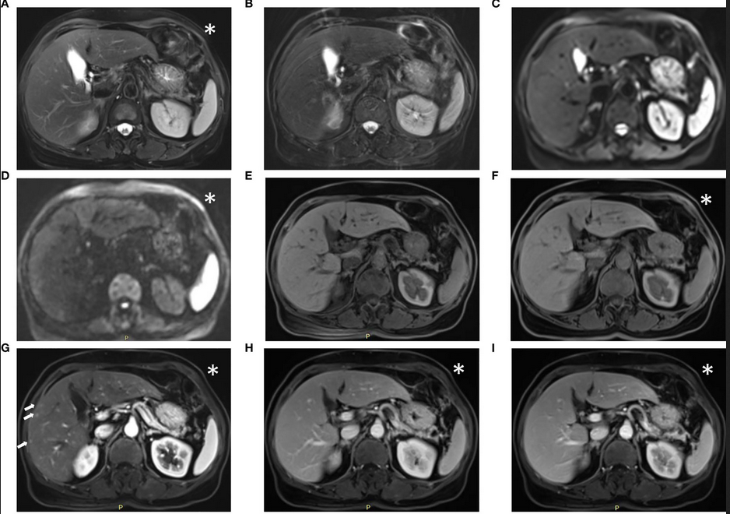
MRI
Image from The Feasibility of a Fast Liver MRI Protocol for Lesion Detection of Adults at 3.0-T, Li et al.
Notes:
this is 5min version of our 30min slidedeck :-)

Slide 2
MRI
MRI files
Working with the data
Types of MRI scans

Slide 3
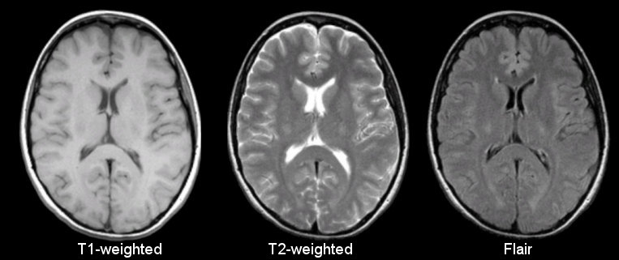
Basic sequences in anatomical MRI
Different sequences produce different intensities for various phenomena and tissues

Slide 4
MRI: anatomical
Sample images acquired with the fast liver workflow of a man with liver metastasis:
(A) T2-weighted BLADE; (B) DWI, b = 1000 s/mm²; (C) T2-HASTE; (D, E) in-phase and out-of-phase DIXON VIBE;
(F) water images of DIXON VIBE; (G–I) contrast-enhanced T1WI VIBE with arterial-phase (G), venous-phase (H), and delayed-phase (I). The metastasis (arrow) in liver segment VII appeared as slightly high signal intensity on the T2 BLADE and T2 haste image, whereas the hepatic cysts [arrowhead in (A)] in liver segments II and IV show high signal intensity in T2 BLADE.
The metastasis is hyperintense in DWI and has low intensity in T1WI.
Image from The Feasibility of a Fast Liver MRI Protocol for Lesion Detection of Adults at 3.0-T, Li et al.

Slide 5
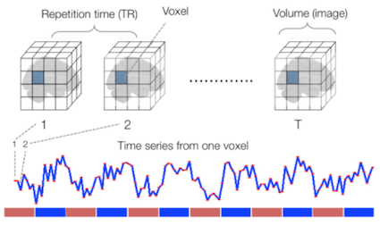
MRI: functional
Functional
Sourced from Wagner and Lindquist,2015
Reveals blood oxygen level-dependant (BOLD) signal
Four dimensional image (x, y, z and time)

Slide 6
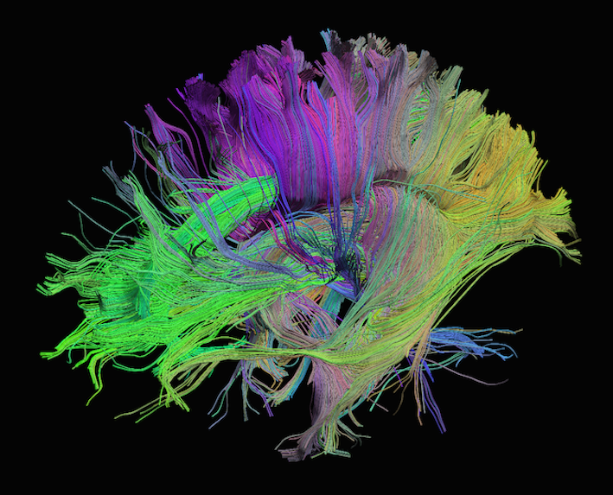
MRI: diffusion
Measures diffusion of water in order to model tissue microstructure
Four dimensional images (x, y, z + direction of diffusion)
Has parameters about the strength of the diffusion “gradient” and its direction in .bval and .bvec files

Slide 7

MRI: more and more
MRA, TOF, Perfusion sequences, new sequences…and spectroscopy

Slide 8
MRI : file formats
Format Name | File Extension | Origin/Group | Info
DICOM | none or .dc | ACR/NEMA Consortium | https://www.dicomstandard.org/
Analyze | .img/.hdr | Analyze Software, Mayo Clinic | https://eeg.sourceforge.net/ANALYZE75.pdf
NIfTI | .nii | Neuroimaging Informatics Technology Initiative | https://brainder.org/2012/09/23/the-nifti-file-format/
MINC | .mnc | Montreal Neurological Institute | https://www.mcgill.ca/bic/software/minc
NRRD | .nrrd |  | https://teem.sourceforge.net/nrrd/format.html

Slide 9
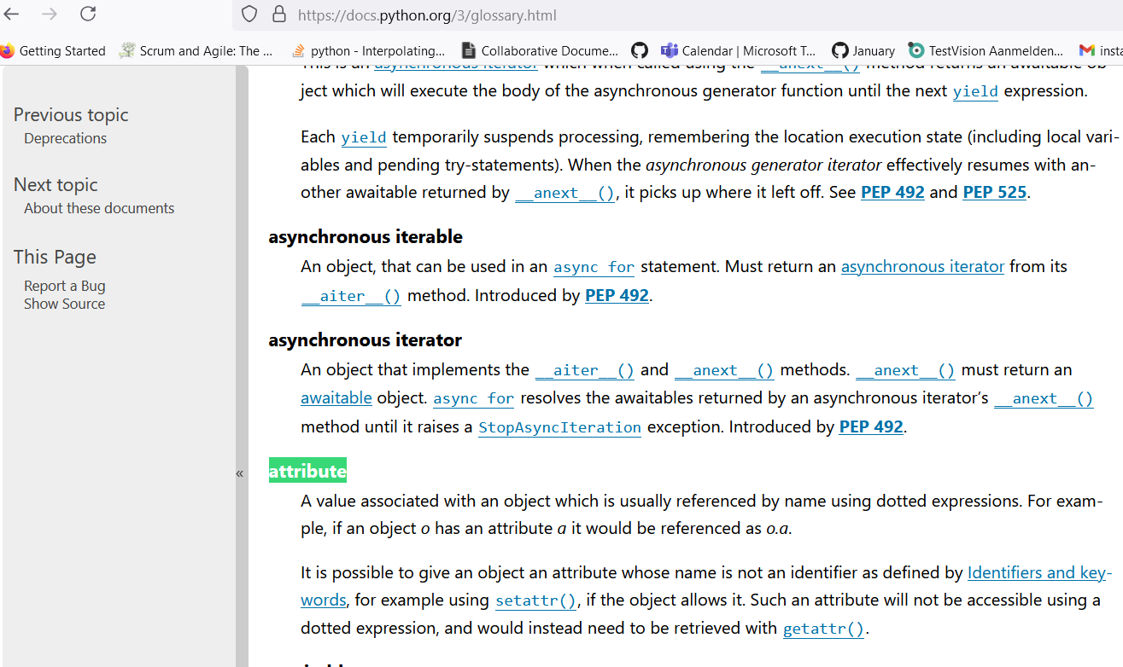
MRI: programming nomenclature
Properties, Method and Attributes in Python:
For precise definitions use the Python docs glossary
Methods can be exposed as properties i.e. array is value stored in property in get_fdata() method of nibabel

Slide 10
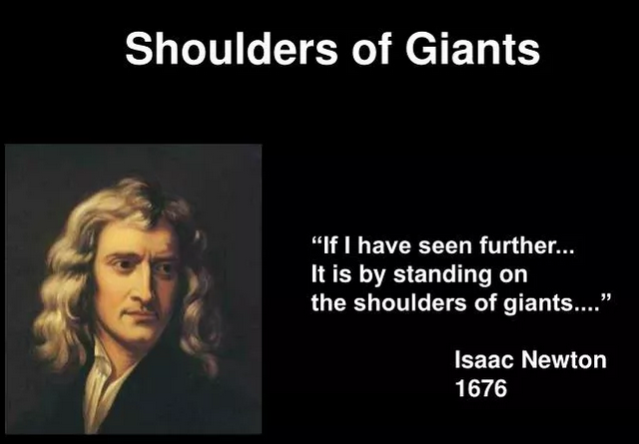
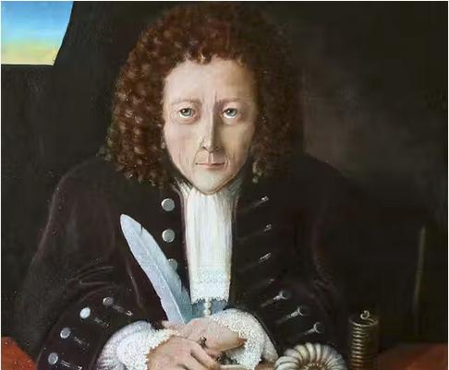
MRI: Nomenclature in general
It may be safe to use property and attribute interchangeably.
Maybe… or maybe we are all Robert Hooke

Slide 11
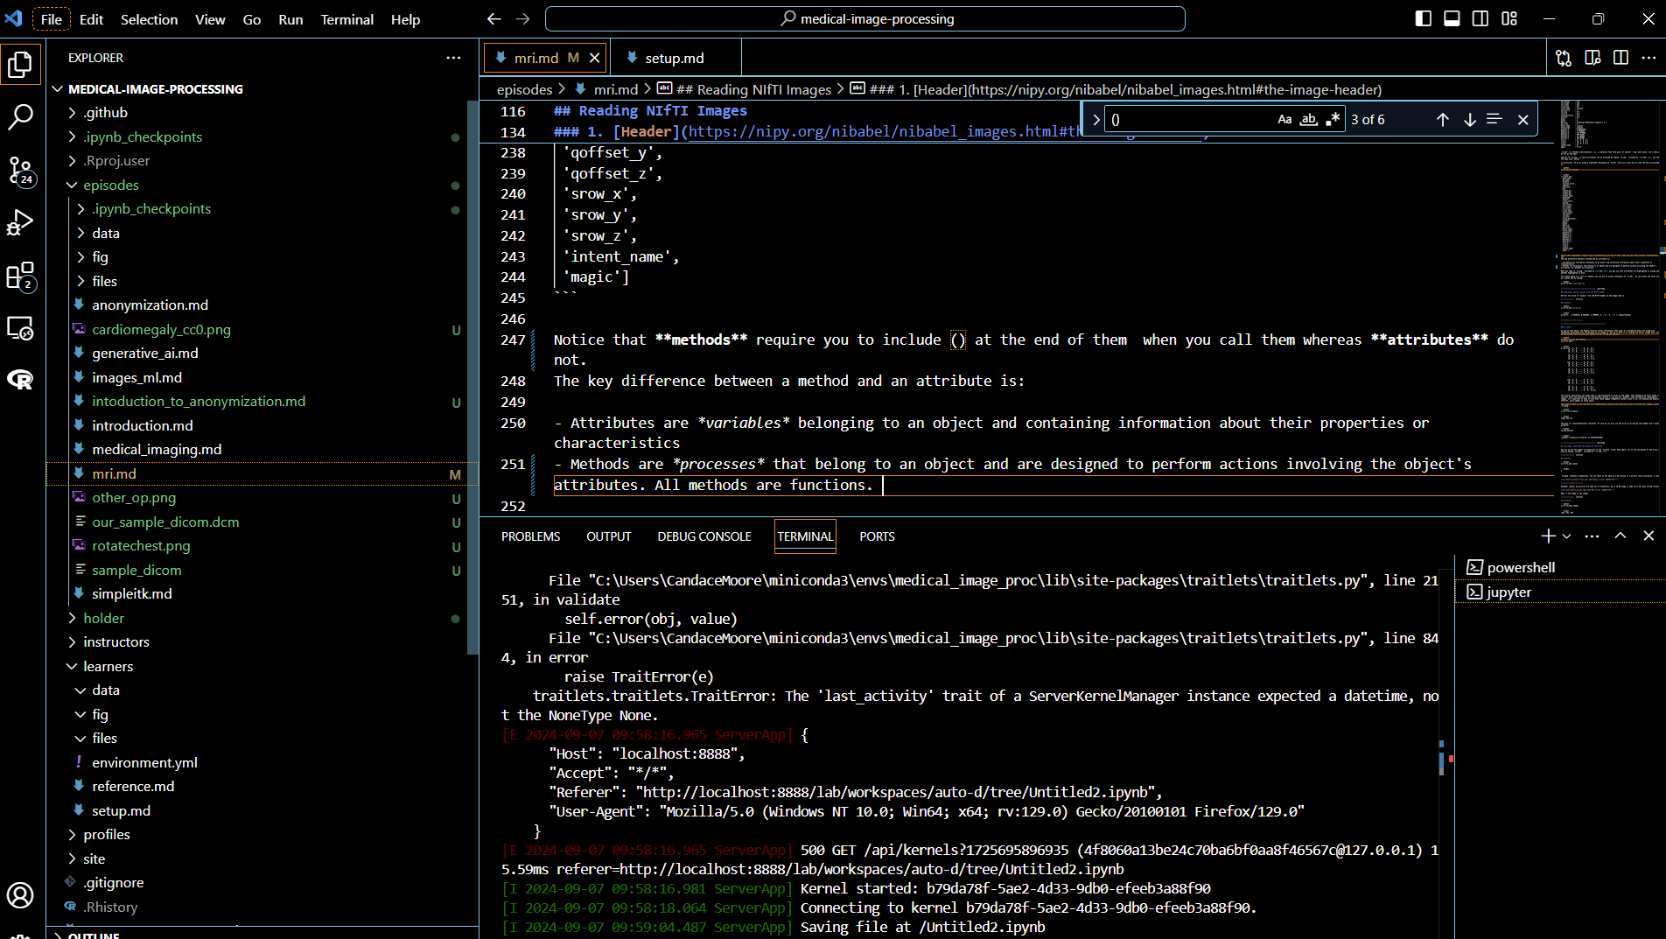
MRI: coding along
Online materials at https://esciencecenter-digital-skills.github.io/medical-image-processing/mri.html

Slide 12
Medical image processing
Course outline
09:30 | Welcome and icebreaker
09:45 | Course and Center Introduction
10:00 | Introduction to Medical Imaging
10:30 | MRI I
11:00 | Coffee Break
11:15 | MRI II
12:30 | Lunch
13:30 | Registration and Segmentation with SITK
15:00 | Coffee Break
15:15 | Preparing Images for ML
16:00 | Anonmymization
16:30 | Generative AI
16:45 | Wrap-up
17:00 | Drinks

