Slide 1
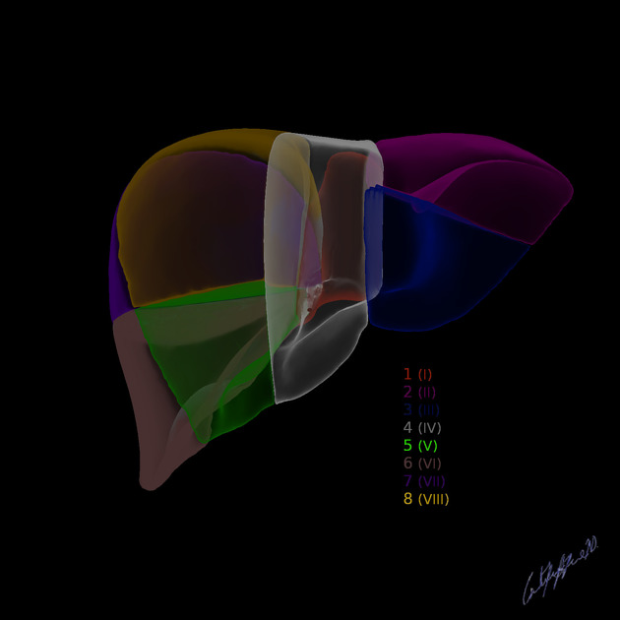
Intro to Medical Image Processing
Candace Makeda Moore, MD
Giulia Crocioni, MS
Ou Ko, MS
Notes:
this is 5min version of our 30min slidedeck :-)

Slide 2
Medical image processing
About our center
About our course
Practical stuff
Schedule
Set-up check

Slide 3
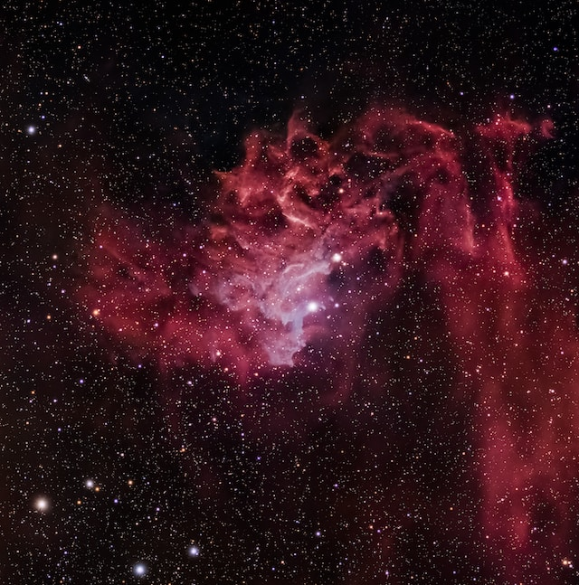


Set up check:
Data downloaded?
(You can download from Zenodo by instructions)
Environment entered?
Collaborative document open?
https://tinyurl.com/medical-image-2024
Post-it notes ready?
Photo by Scott Lord on Unsplash
Notes:
Switch here to the collaborative document

Slide 4

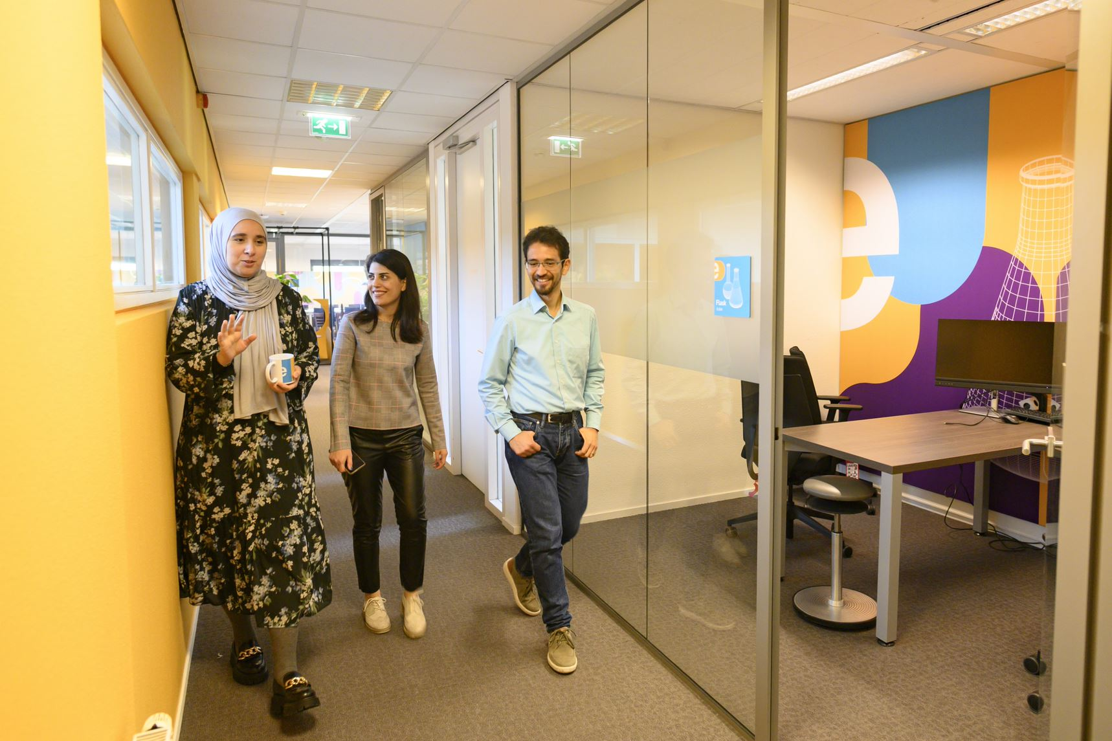
Who are we?
The Netherlands eScience Center is a national center for innovative software solutions in academic research.
Our Research Software Engineers
help researchers interpret results,
make tools and methods reusable for the wider research community,
co-author research and methodological publications.

Slide 5
Training Programme​​
1. For researchers & RSEs
Digital skills workshops, see schedule next slide
2. For data stewards, information specialists and DCCs
Research support masterclass
Online materials
3. For training the trainer
Carpentries instructor training
Carpentries collaborative lesson development
4. For organisations (externally organized workshops based on our digital skills workshops)
Format
Hands-on courses, 2-3 days
In person & online
Based on The Carpentries & CodeRefinery, and in-house developed materials.

Slide 6

Schedule 2024
January |  | July
February | Introduction to deep learning Good Practices in Research Software Development | August | Parallel Programming with Python
March | Image Processing with Python Parallel Programming with Python | September | Introduction to Deep Learning Image Processing with Python
April | Good Practices in Research Software Development Machine learning in python with scikit-learn Intermediate Research Software Development with Python | October | Collaborative version control with git and GitHub Machine learning in python with scikit-learn
May | Introduction to Geospatial Raster and Vector Data with Python Collaborative version control with git and GitHub | November | Carpentries instructor training Reproducible research with R packages
June | GPU programming Carpentries instructor training | December | GPU programming Intermediate Research Software Development with Python
For exact dates of upcoming workshops (3 months in advance): esciencecenter.nl/events/?f=workshops
To be notified about coming up workshops, subscribe to the Newsletter: eepurl.com/dtjzwP

Slide 7

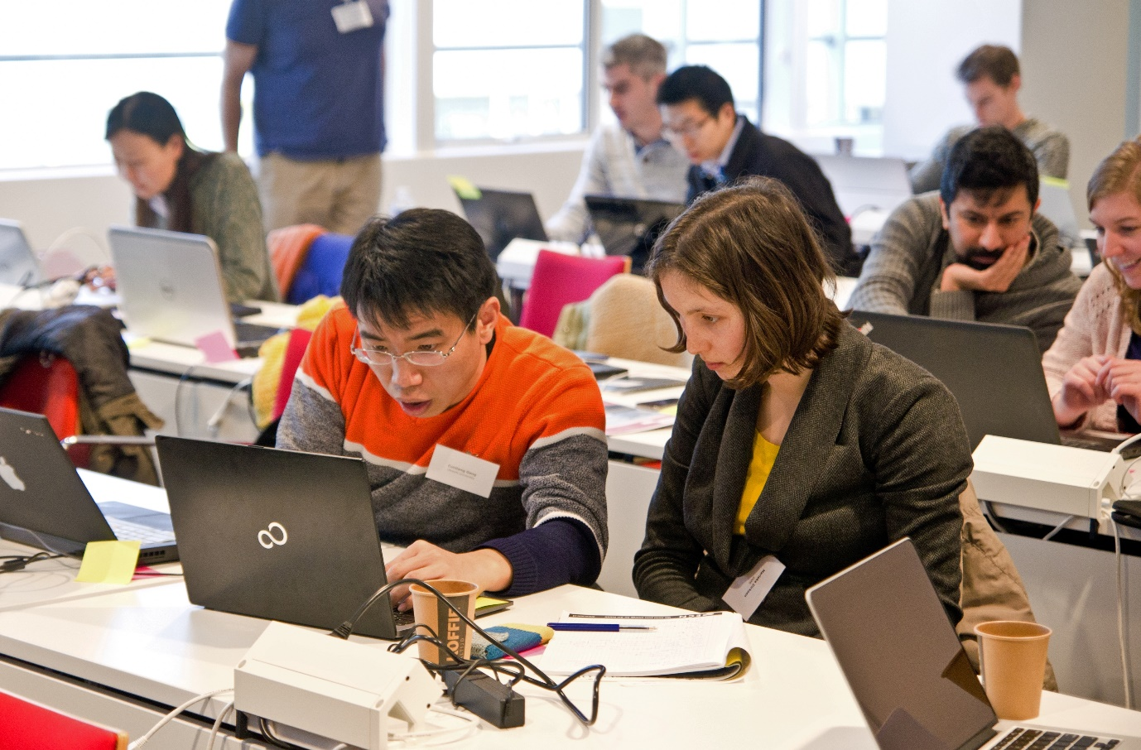



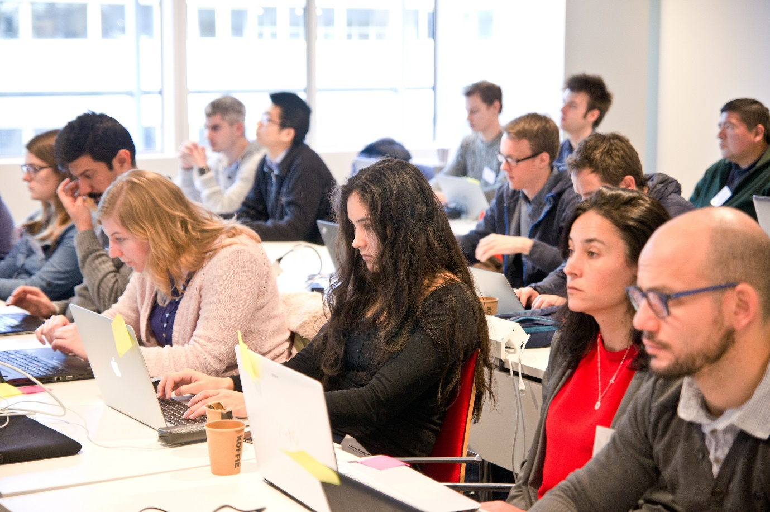

Our Digital Skills Workshops are open to researchers in the Netherlands. We also offer paid options of standard and custom workshops dedicated to your organisation. To learn more, contact: training@esciencecenter.nl
Do you want us to come and teach a workshop at your organisation?

Slide 8
Do you want to teach with our materials?
All material that we use is open-source and available online
We can help you setup workshops, contact training@esciencecenter.nl

Slide 9


Do you want to connect to fellow Research software Trainers?
We are a community of training coordinators from Dutch research initiatives delivering training in research software, programming skills, open-source code, and applied data science.
Website: researchsoftwaretraining.nl
Email: rstnl@escience.nl
Also there are RSE-meetups
nl-rse.org

Slide 10

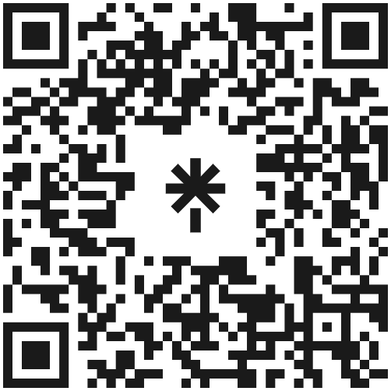








Let’s stay in touch
https://www.esciencecenter.nl/digital-skills/
training@esciencecenter.nl
+31 (0)20 460 4770
@eScienceCenter
Netherlands Escience Center
@eScienceCenter@akademienl.social

Slide 11
Most important course info
General guidelines:
Play nice, and use the collaborative document
(https://tinyurl.com/medical-image-2024)
Practical course info:
Bathrooms, exits, getting in/out of building
Special guidelines:
Advanced materials available : https://tinyurl.com/imaging-advanced

Slide 12
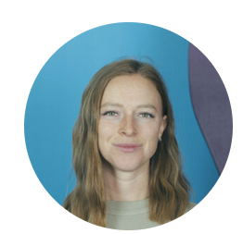
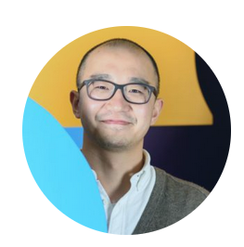
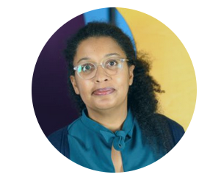
Your instructors and helpers
Giulia Crocioni:
Bio-medial engineer, developed complex curriculum
Ou Ku:
Earth observation, skilled in data processing and analytics
Candace Makeda Moore:
Started work as a photographer and programmer, became a researcher
to go to medical school, ended up with a fascination with imaging

Slide 13
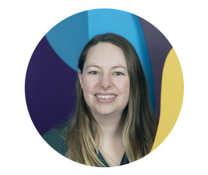
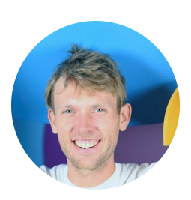
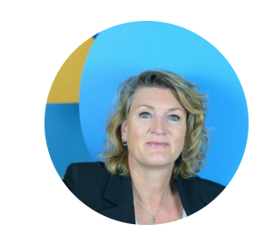
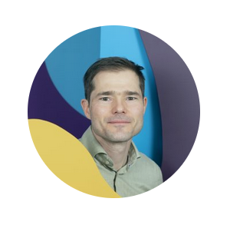
The people who make this possible
Fenne Riemslagh:
Coordinator Training Programme
Sven Van Der Brug:
Trainer & Lesson Developer
Sacha van Bruegel:
Event coordinator
Mateuz Kuzak:
Team lead of the training program

Slide 14
Medical image processing
Course outline
09:30 | Welcome and icebreaker
09:45 | Course and Center Introduction
10:00 | Introduction to Medical Imaging
10:30 | MRI I
11:00 | Coffee Break
11:15 | MRI II
12:30 | Lunch
13:30 | Registration and Segmentation with SITK
15:00 | Coffee Break
15:15 | Preparing Images for ML
16:00 | Anonymization
16:30 | Generative AI
16:45 | Wrap-up
17:00 | Drinks

