Slide 1
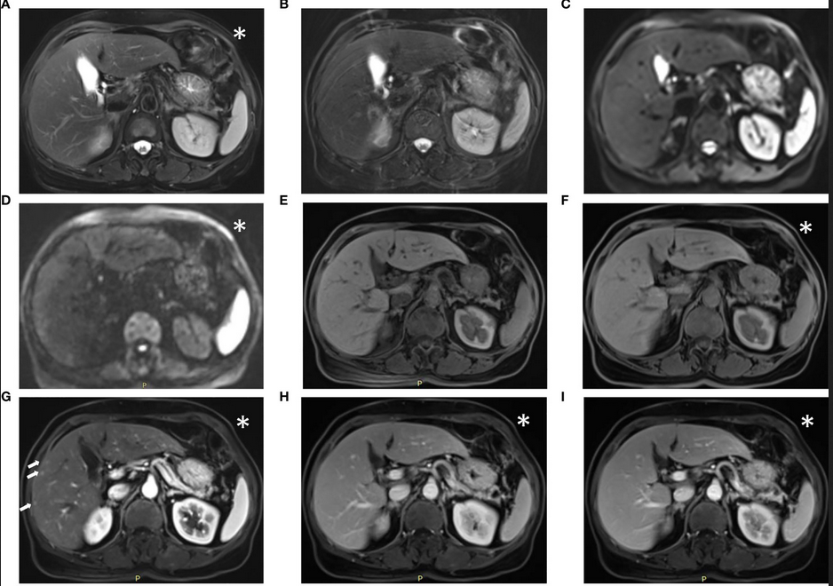
MRI
Image from The Feasibility of a Fast Liver MRI Protocol for Lesion Detection of Adults at 3.0-T, Li et al.
Notes:
this is 5min version of our 30min slidedeck :-)

Slide 2
MRI
MRI files
Working with the data
Types of MRI scans

Slide 3
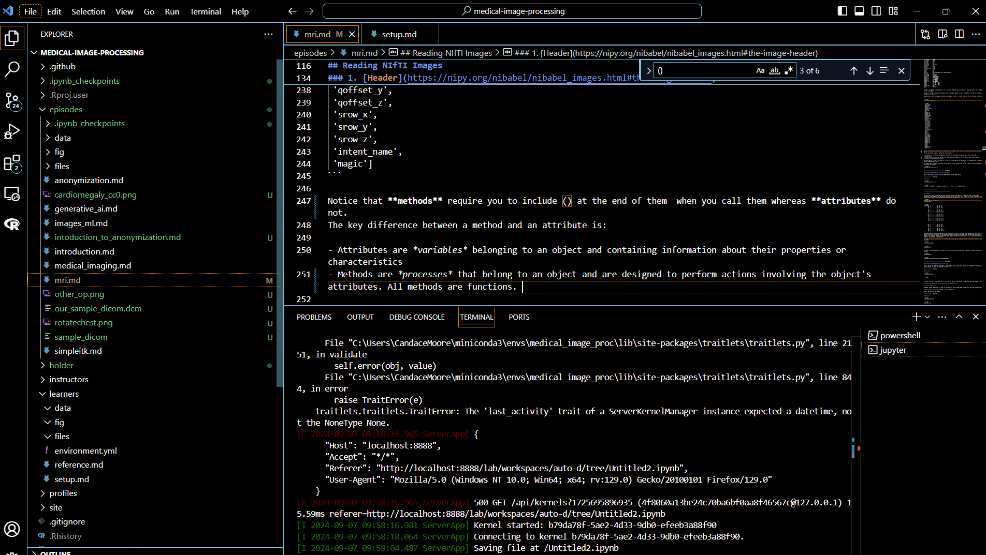
MRI: coding along
Online materials at https://esciencecenter-digital-skills.github.io/medical-image-processing/mri.html

Slide 4
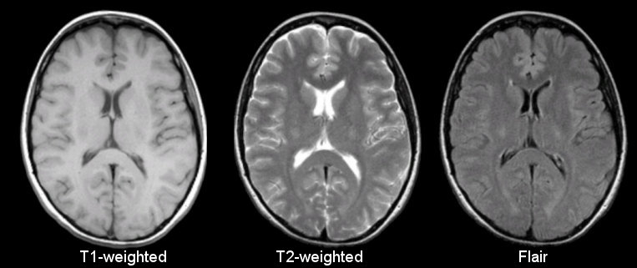
Basic sequences in anatomical MRI
Different sequences produce different intensities for various phenomena and tissues ->
Voxels of different intensity values

Slide 5
Basic (spin echo) sequences MRI
Reality is quantum, quantum is confusing (we will use classical models)
The abundant hydrogen atoms (aka protons, spins) are aligned with B (or main magnetic field)
Radiofrequency pulses
induce precessional synchronization of the spins
change in their angle (flip angle)
when off -> relaxations: dephasing, angle change
RF
Bo
µ

Slide 6
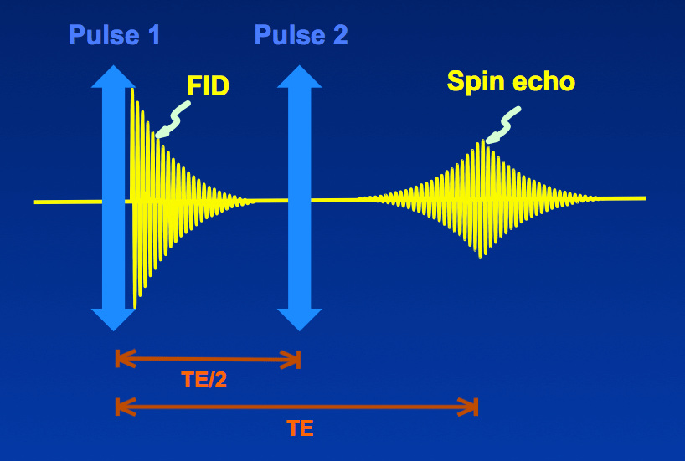
Basic (spin echo) sequences MRI
Spin echo will have two pulses (90 degree, 180 degree) before the echo
We then ‘listen in’ or get the peak signal at the time of echo
T1 signal = time until proton/spins are back into the aligned (with B0) angle
FID/T2*/T2 signals = time until proton/spins are out of sync again
We repeat the process at time of repetition
Changing time of echo and time of repetition gives us a different signal
 | T1 | T2 | PD
Time of echo | Short (10-30ms) | Long (90-140ms) | Short (15 ms)
Time of repetition | Short (300-600ms) | Long(2000ms) | Long(1000-3000ms)
Water | Low = black | High = bright/white | Middle= grey

Slide 7
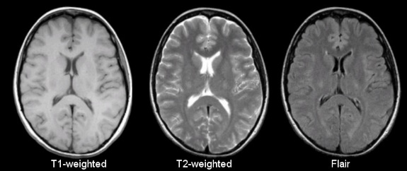
Basic sequences MRI
 | T1 | T2 | PD
Time of echo | Short | Long | Really Short
Time of repetition | Short | Long | Long
Water | Low = black | High = bright/white | Middle= grey
Fat | High, bright | High, bright | High, bright
White Matter | Brighter than GM | Darker than GM | Darker than GM
Bone | Low, black | Low, black | Low, black
Inversion time (inversion recovery pulse) → FLAIR

Slide 8
MRI: anatomical
Sample images acquired with the fast liver workflow of a man with liver metastasis:
(A) T2-weighted BLADE; (B) DWI, b = 1000 s/mm²; (C) T2-HASTE; (D, E) in-phase and out-of-phase DIXON VIBE;
(F) water images of DIXON VIBE; (G–I) contrast-enhanced T1WI VIBE with arterial-phase (G), venous-phase (H), and delayed-phase (I). The metastasis (arrow) in liver segment VII appeared as slightly high signal intensity on the T2 BLADE and T2 haste image, whereas the hepatic cysts [arrowhead in (A)] in liver segments II and IV show high signal intensity in T2 BLADE.
The metastasis is hyperintense in DWI and has low intensity in T1WI.
Image from The Feasibility of a Fast Liver MRI Protocol for Lesion Detection of Adults at 3.0-T, Li et al.

Slide 9
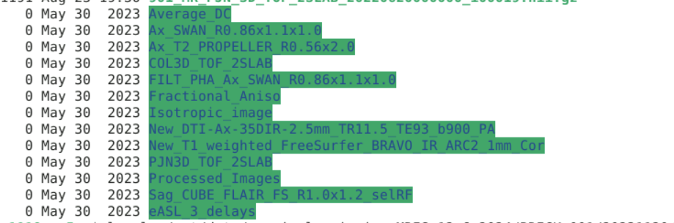
MRI: anatomical
Two different T2
BLADE = vendor specific PROPELLOR reconstruction algorithm
motion reduction technique (k-space sampling)
HASTE= vendor specific (Siemans- half fourier single short turbo spin echo) fast, k-space data after a single pulse; great for people who move like people with abdomens
BEYOND T2: FLAIR (inversion set to null water signal) is an example of inversion recovery sequences (suppress water or fat), SWI,…
Image from The Feasibility of a Fast Liver MRI Protocol for Lesion Detection of Adults at 3.0-T, Li et al.

Slide 10
MRI : file formats
Format Name | File Extension | Origin/Group | Info
DICOM | none or .dc | ACR/NEMA Consortium | https://www.dicomstandard.org/
Analyze | .img/.hdr | Analyze Software, Mayo Clinic | https://eeg.sourceforge.net/ANALYZE75.pdf
NIfTI | .nii, or nii.gz | Neuroimaging Informatics Technology Initiative | https://brainder.org/2012/09/23/the-nifti-file-format/
MINC | .mnc | Montreal Neurological Institute | https://www.mcgill.ca/bic/software/minc
NRRD | .nrrd |  | https://teem.sourceforge.net/nrrd/format.html

Slide 11

MRI : coding along
Turning DICOM → NIFTI can be done in many ways
dcm2niix convenient for BIDS standard
dcm2niix –help
generally helpful hint: library –help, --help, -h

Slide 12
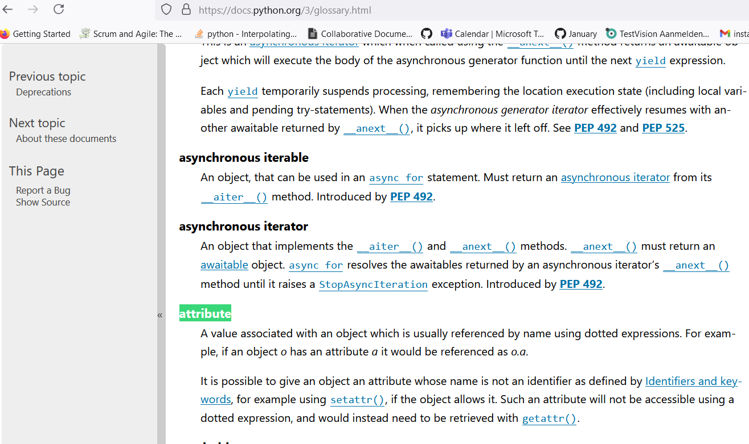
MRI: programming nomenclature
Properties, Method and Attributes in Python:
For precise definitions use the Python docs glossary
Methods can be exposed as properties i.e. array is value stored in property in get_fdata() method of nibabel

Slide 13
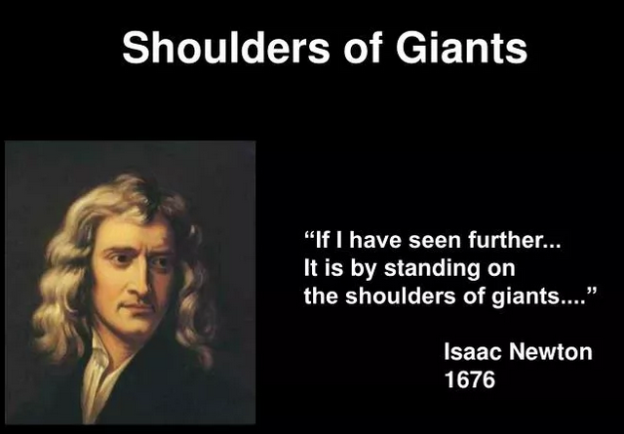
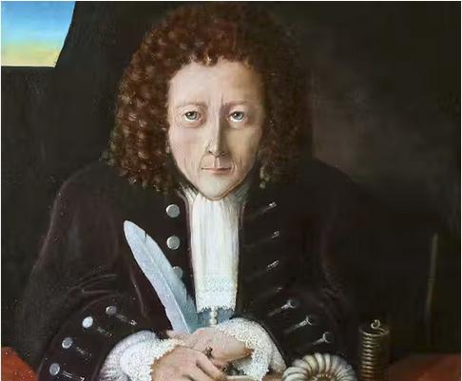
MRI: Nomenclature in general
It may be safe to use property and attribute interchangeably.
Maybe… or maybe we are all Robert Hooke

Slide 14
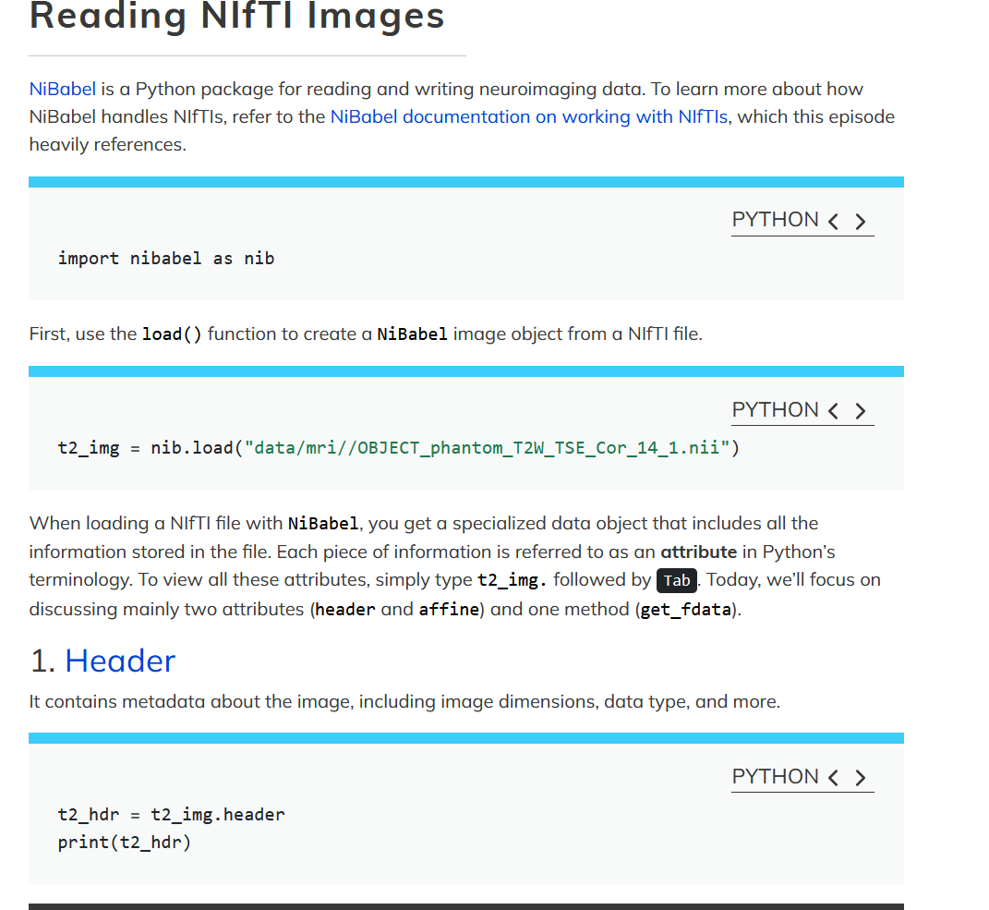
MRI: Let’s get programming
Jupyter lab

Slide 15
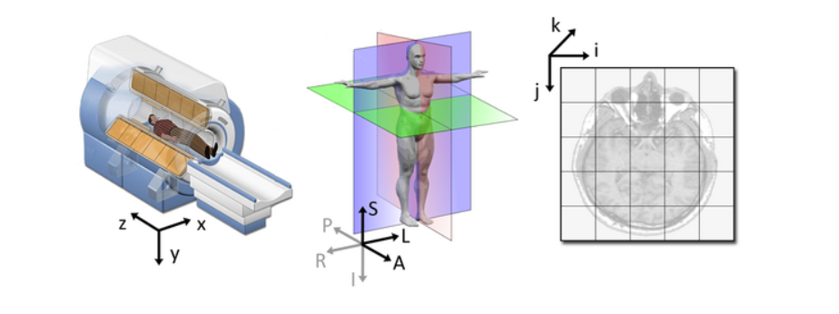
MRI: RAS+
NIfTI images have an affine with the voxel coordinates relating to the real world coordinates in RAS+ encoded space.
So here the affine matrix we have seen is going to (once we apply the matrix) put out image in RAS.
In the R axis, positive values mean move right, negative values mean move left
In the A axis, positive values mean move forward, negative values mean move posterior
In the S axis, positive values mean move up, negative values mean move inferior

Slide 16
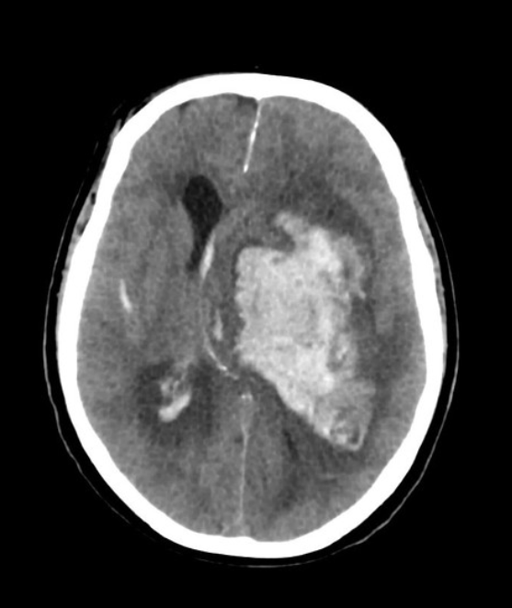
MRI: RAS+ reality
Different people have different conventions for how they want images displayed
Neuroscientists versus radiologists
Rodrigues M, Basal ganglia hemorrhage. Case study, Radiopaedia.org (Accessed on 18 Sep 2024) https://doi.org/10.53347/rID-58775

Slide 17
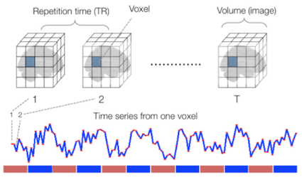
MRI: functional
Functional
Sourced from Wagner and Lindquist,2015
Reveals blood oxygen level-dependant (BOLD) signal
Four dimensional image (x, y, z and time)
Cleaning and denoising is the battle

Slide 18
MRI: functional
Fundamental tasks in fMRI preparation
Strip off non-brain tissue
Correct for motion over time (geography)
Get rid of motion signal artifacts
Correct for magnetic field inhomogeneities
Align to a T1 image
Processing suites with GUI:
FSL
commercial options: Brainlab, Dynasite
Pipeline of pipelines:
Add ANTS + other pipelines + python glue
AFNI or fMRIprep
AFNI is more complete, but fMRI preprocesses from BIDS
See carpentries material (fMRIprep, nibabel, nilearn) beware brain book

Slide 19
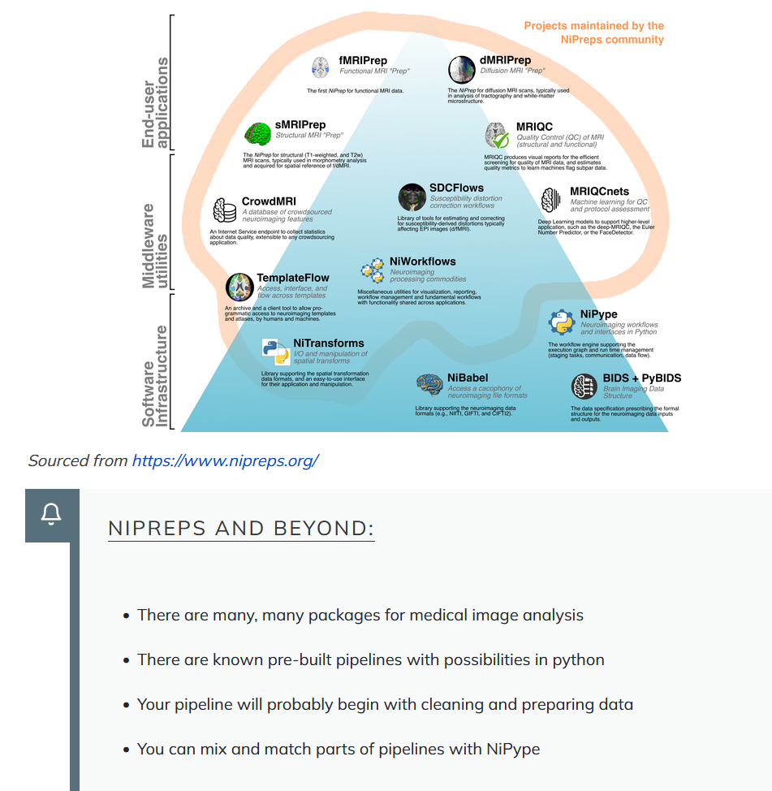
MRI: In code go* with functional maintained popular

Slide 20
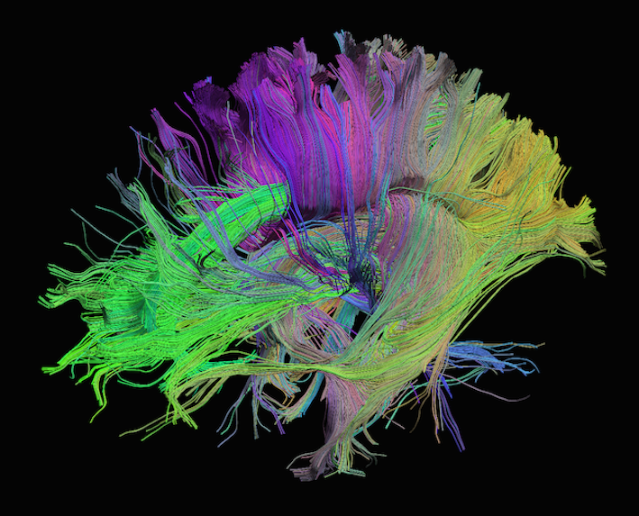
MRI: diffusion
Measures diffusion of water in order to model tissue microstructure
Four dimensional images (x, y, z + direction of diffusion)
Has parameters about the strength of the diffusion “gradient” and its direction in .bval and .bvec files

Slide 21

MRI: more and more
MRA, TOF, Perfusion sequences, new sequences…and spectroscopy

Slide 22
MRI: take home points
Imaging MRIs commonly used for research can be anatomical, functional or diffusion
MRIs can be converted from DICOMs to NIfTIs
BIDS is a standard about organizing neuroimaging data
NIfTI images contain a header, which describes the contents, and the data
NIfTI data is a multi-dimensional array of values
The position of the NIfTI data in space is determined by the affine matrix
Functional MRIs and Diffusion MRIs require heavy (pre)processing
Functional MRIs have time dimension
Diffusion MRI has b-values and b-vectors
There are many various tractography methods, each with imperfections
Materials will update, find the popular stuff
Key Points
Imaging MRIs commonly used for research can be anatomical, functional or diffusion
MRIs can be converted from DICOMs to NIfTIs
BIDS is a standard about organizing neuroimaging data
NIfTI images contain a header, which describes the contents, and the data
The position of the NIfTI data in space is determined by the affine matrix
NIfTI data is a multi-dimensional array of values
Functional MRIs and Diffusion MRIs require heavy (pre)processing
Functional MRIs have time dimension
Diffusion MRI has b-values and b-vectors
There are many various tractography methods, each with imperfections

Slide 23
Medical image processing
Course outline
09:30 | Welcome and icebreaker
09:45 | Course and Center Introduction
10:00 | Introduction to Medical Imaging
10:30 | MRI I
11:00 | Coffee Break
11:15 | MRI II
12:30 | Lunch
13:30 | Registration and Segmentation with SITK
15:00 | Coffee Break
15:15 | Preparing Images for ML
16:00 | Anonmymization
16:30 | Generative AI
16:45 | Wrap-up
17:00 | Drinks

