Slide 1




Image anonymization

Slide 2

Image anonymization
Metadata such as patient names and addresses → identification
Even images without obvious metadata → identification?

Slide 3
Image anonymization
Many tools could help you deal with DICOM metadata:
SITK
PyDICOM
Medpy
bare python

Slide 4
Image anonymization
Metadata approaches:
K-anonymity
Peel everything you don’t need
Remember DICOM fields can be used oddly and search for names, addresses, etc.
Share “wisely”?

Slide 5
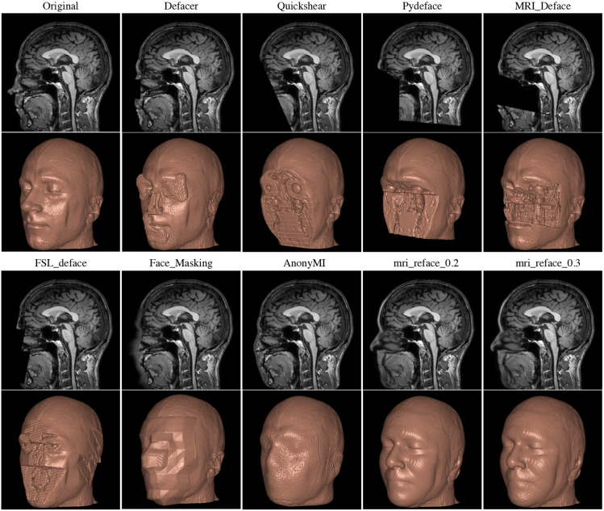
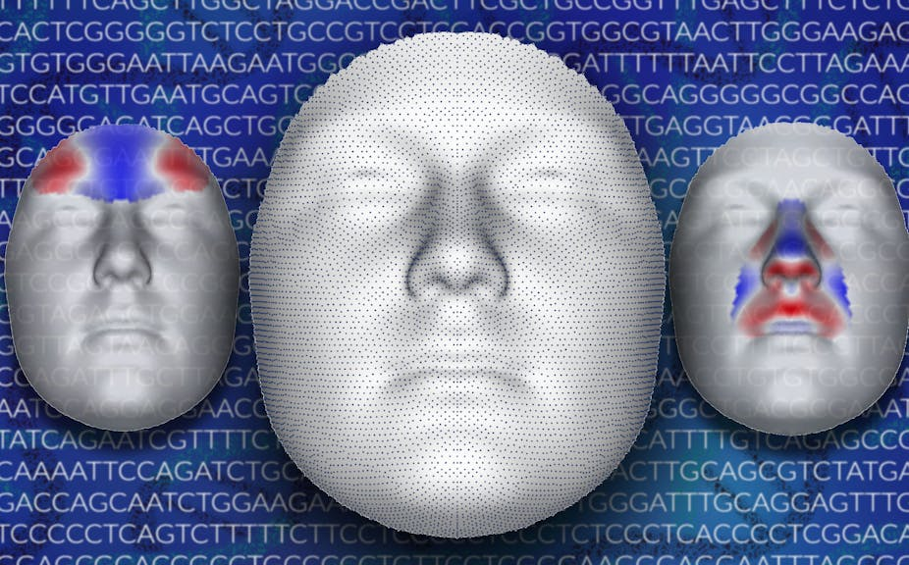
Image anonymization
Faces, defacing
Image from ‘A reproducibility evaluation of the effects of MRI defacing on brain segmentation’ by Chenyu Gao, Bennett A. Landman, Jerry L. Prince, and Aaron Carass (preprint available at https://pubmed.ncbi.nlm.nih.gov/37293070/ or on MedRxiv)
Julie D. White, CC BY-SA

Slide 6
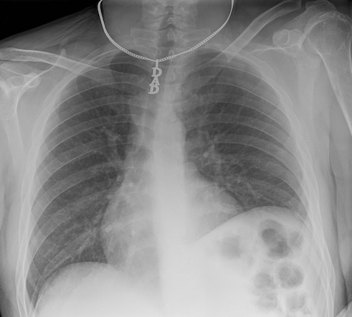

Image anonymization
Beyond faces...
Case courtesy of Ian Bickle, Radiopaedia.org. From the case rID: 61830

Slide 7
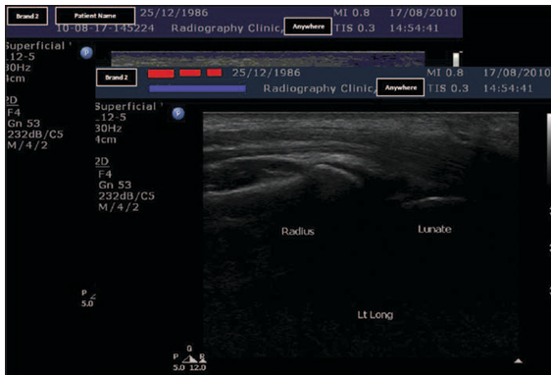
Image anonymization
Text in unexpected places...
Various methods depend on how it is annotated
Image from Gary Kin-wai Tsui Tao Chan, Automatic Selective Removal of Embedded Patient Information From Image Content of DICOM Files, AJR (2012)

Slide 8
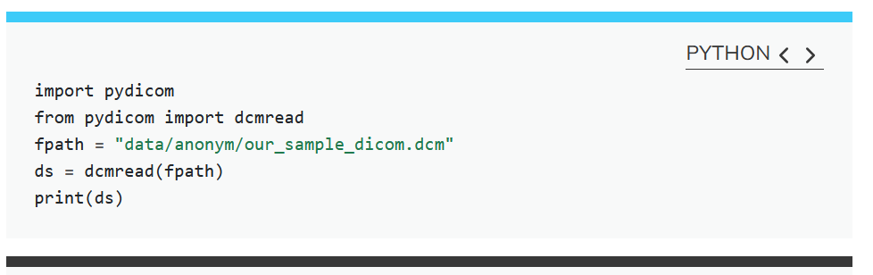
Image anonymization
Let’s get coding

Slide 9
Image anonymization
Key Points
Certain metadata should almost always be removed from DICOM files before sharing
Sharing only image files such as JPEGs or NIfTI can mitigate risks associated with metadata
Imaging data alone, even without explicit metadata, can sometimes lead to patient identification
Automated tools are available to strip metadata from DICOMs, but manual verification is necessary due to inconsistencies in how fields are utilized.
Tools exist to deface images to further protect patient identity
Several Python libraries enable access to DICOM metadata

