Slide 1
Proposition of a battery storage system
Eric Scott
Friday February 19 2016

Slide 2
About Me
From Canada
McMaster University, B.Eng.Mgmt 2014
UC Berkeley, M.Eng 2015 (Go Bears!)
SolarCity, PV Designer

Slide 3

A Battery Storage Problem…
Wind developer selling production to day-ahead ERCOT
Forecast next day’s production
Actual v. forecast deviations are sold to real-time market
Goal:
Find optimal battery size
Devise dispatch strategy
http://www.manitoulin.ca/wp-content/uploads/2012/11/wind-turbine-night-e1364309800932.jpg

Slide 4
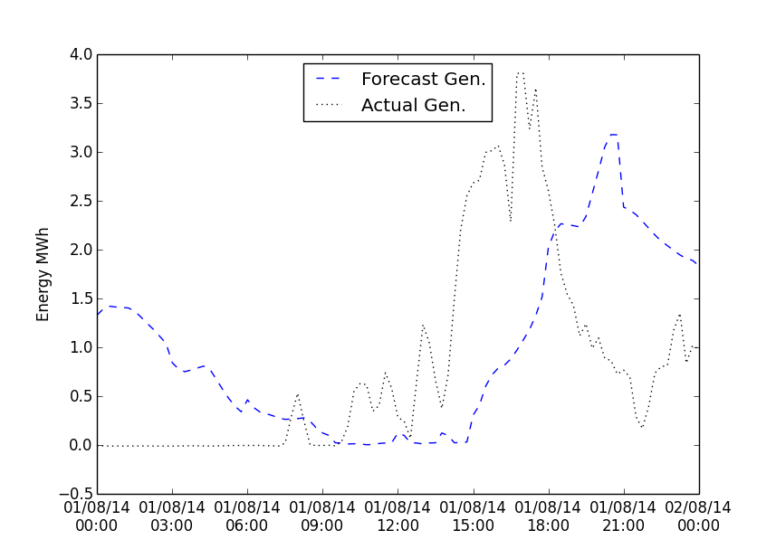
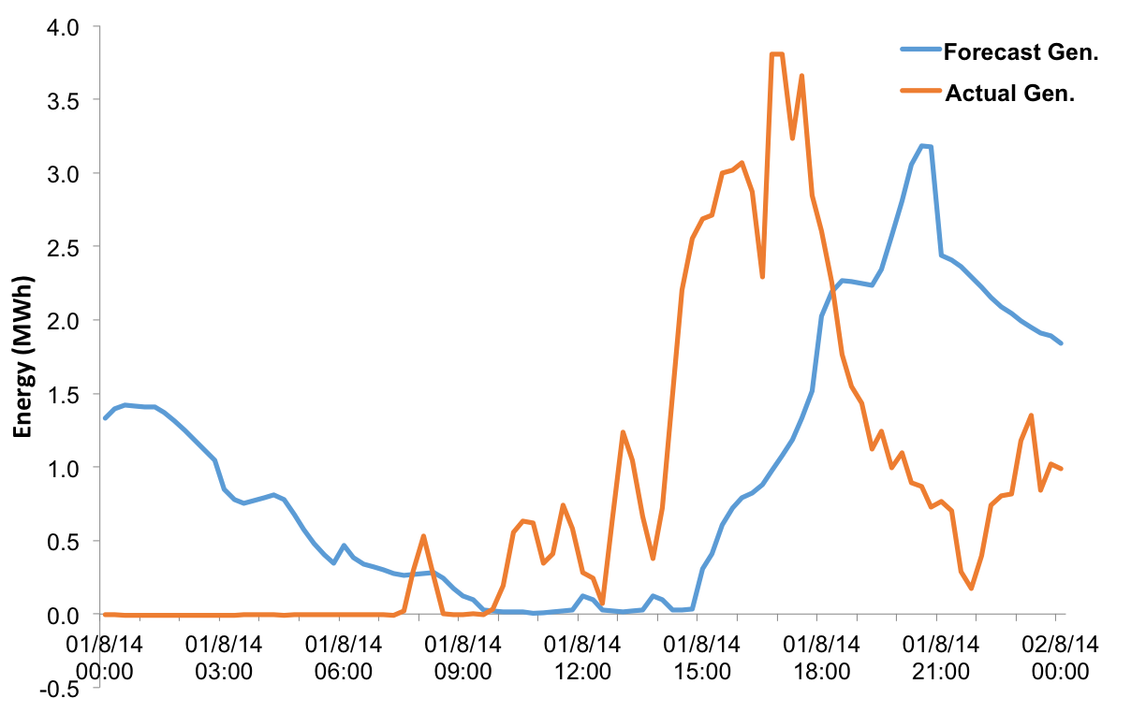
Initial Approach
Clean data first in Excel, move to Python
Calculate deviation
Max generation 6.375 MWh (15 min.)
25.5 MW wind farm (~17x 1.5 MW turbines)

Slide 5
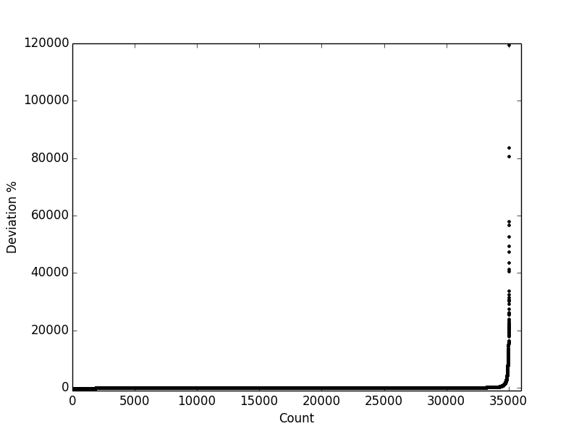
Describing the Data
1) Summary statistics:
2) Effect of outliers?:

Slide 6
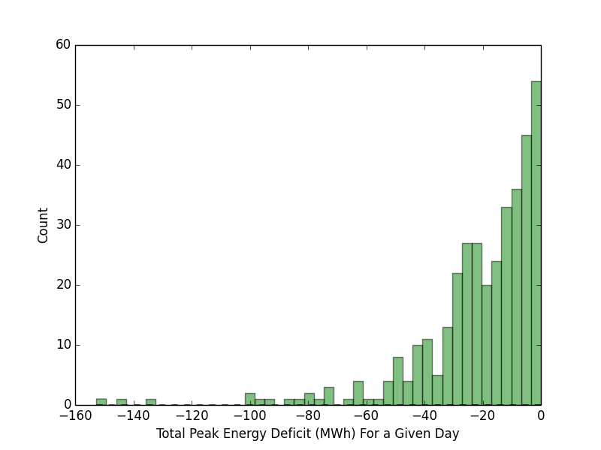
Sizing To Meet Median Deviations
Goal: Use the battery to avoid RTM peak charges
16 MWh Capacity

Slide 7
A Battery Dispatch Strategy
Algorithm built in python
Assumed ERCOT schedule:
Peak 7:00-22:00
Off-peak 0:00-7:00, 22:00-0:00
Simple approach:
Meet DA commitment if deviation < |2|%
Store excess energy during off-peak
Use stored energy to make up for insufficient peak-hour production
BASE: $392,144
WITH BATTERY: $3,045,665

Slide 8
A Valid Approach?
Pricing assumptions
DA price fixed $20/MWh
RTM peak fixed $200/MWh
RTM off-peak fixed $20/MWh
No technical considerations
Efficiency
Battery cycling
No ancillary service considerations
Other revenue streams?

Slide 9
Revising the Approach
1) Add pricing data from ERCOT
2) Include ancillary services
3) Include battery performance
4) Compare with NPV calculation
CASE 1: Standard, no battery
CASE 2: Production + battery for production shifting
CASE 3: Production + battery for AS

Slide 10
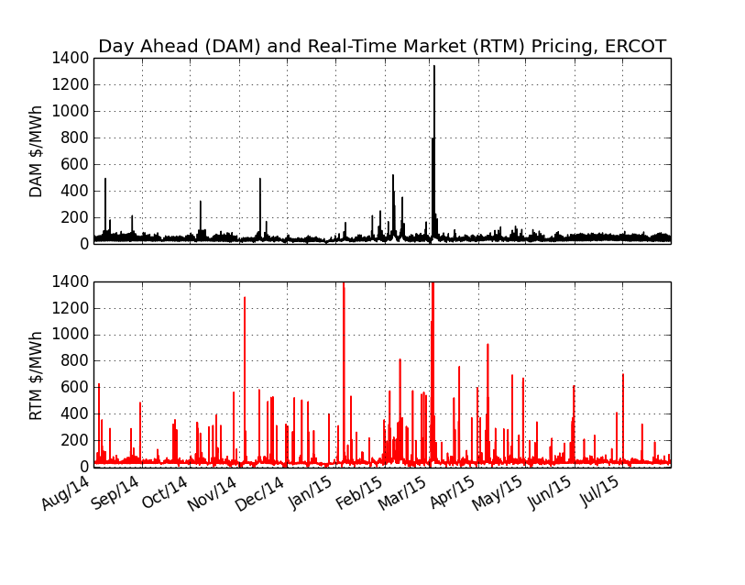
Pricing Data
ERCOT website
1 year historical pricing 2014 data
Messy
All CSV but different “structures”

Slide 11
Note on Energy Price Assumptions
Pricing assumptions were off:
DA: assumed 20, actual 36
RTM peak: assumed 200, actual 41<<<
RTM off-peak: assumed 20, actual 25

Slide 12
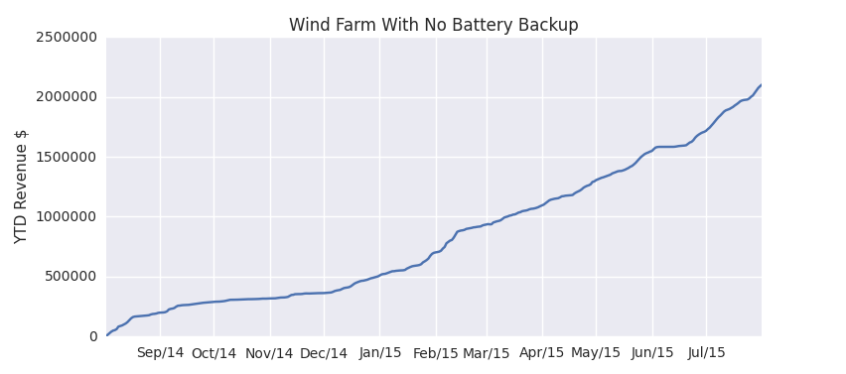
Case 1: No Battery
Simple:
Sell obligation
Sell over-delivered, pay under-delivered
$2,102,090.69

Slide 13
Case 2: Battery for Production Shift
Model similar to prior approach:
Sell excess during peak hours
Use stored energy to make up for under-delivery if available
Store during off-peak hours if capacity
Tested battery sizes from 2 to 30 MWh in increments of 4
Tracked energy transfer for power capacity
Tracked state of charge
Revenue for each size into NPV calculation

Slide 14
Technical Assumptions
Lithium-ion battery
Battery round-trip eff. of 92%
constant over lifetime
Inverter eff. of 95%
constant over lifetime
Maximum DoD of 80%
Cannot overcharge the battery
Assumed 1 cycle per day

Slide 15
NPV Assumptions Case 2
Discount cash flows over lifetime of system
1 cycle per day, 5000 cycle life, 15 year lifetime
Assumed yearly revenue is constant over system lifetime
No O&M costs
10% rate of return
$250/kWh cost of storage
No taxes, no deprecation / salvage value
Cash flow is:
Case 2(revenue with battery) – Case 1 (revenue without battery)
Case 2 rev. - $2,102,090

Slide 16
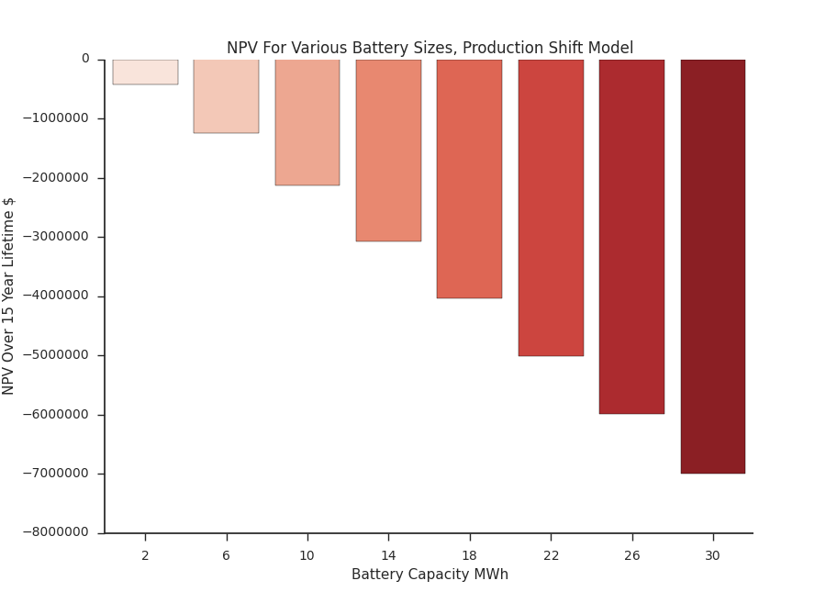
NPV For Case 2

Slide 17
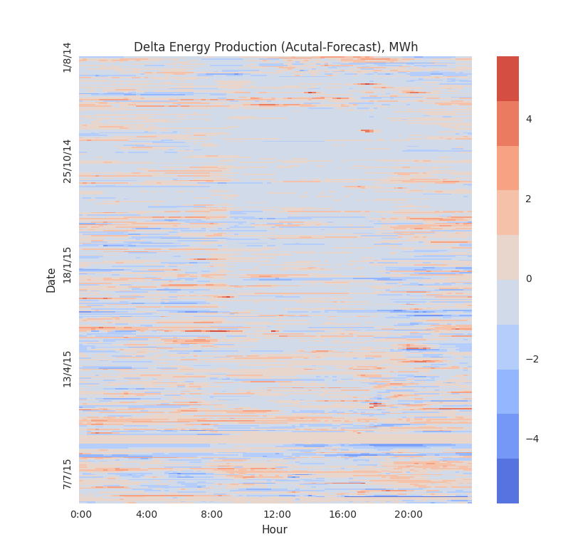
Energy Arbitrage Alone Isn’t Worth it
No positive NPV
Looking at Delta:
No major patterns
High value?

Slide 18
Case 3: Bring in the Ancillary Services
AS pricing brought into dataset from ERCOT
Different AS to bid into ERCOT
Freq. reg. up
Freq. reg. down
Rapid responsive service
Non-spinning reserve
Key AS features:
1) Predictability
2) Financially attractive

Slide 19
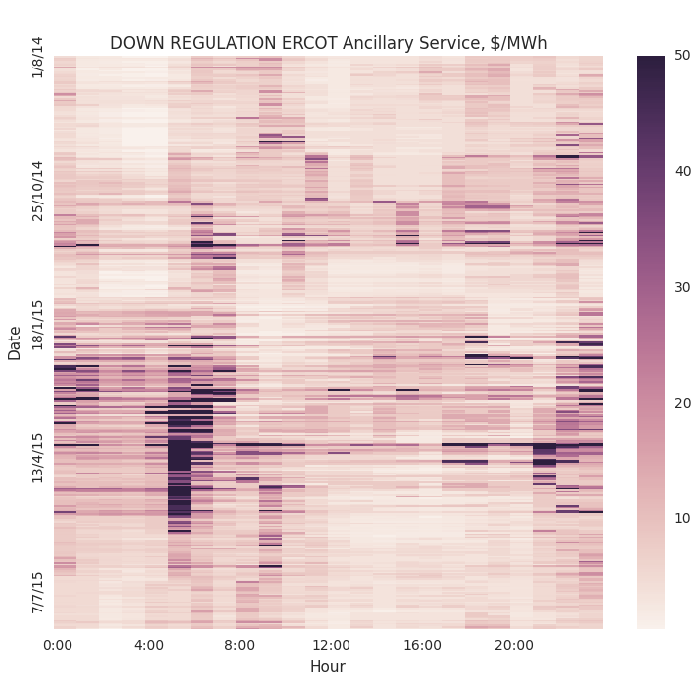
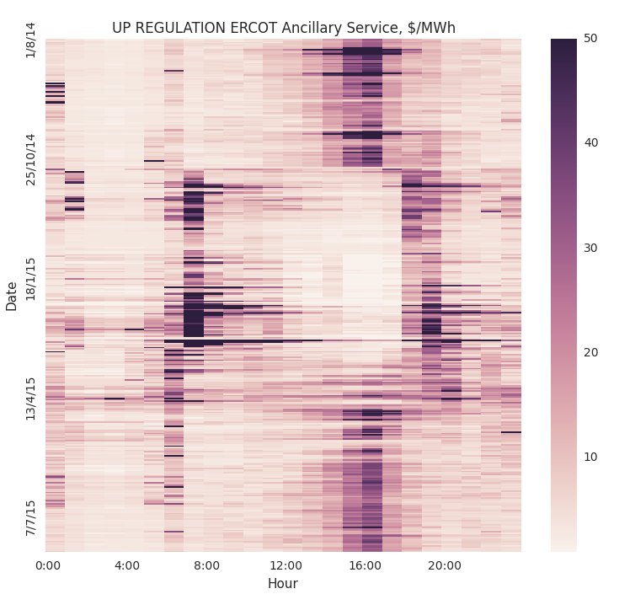
Adding in Frequency Regulation
Notes:
ERCOT RULES????

Slide 20
Case 3 Dispatch Strategy
Sell excess, pay insufficient
Tested battery energy sizes from 2-30 MWh, incr. 4MWh
Bid capacity for down regulation 5:00-7:00 (every 15min)
Bid capacity for up regulation 17:00-19:00 (every 15min)
Max charge/discharge of 0.5C (50% rated power capacity)
Ex. 2MWh battery at 1C, deliver 2MW for an hour
DoD max 80%
SoC tracked
Same efficiencies as before

Slide 21
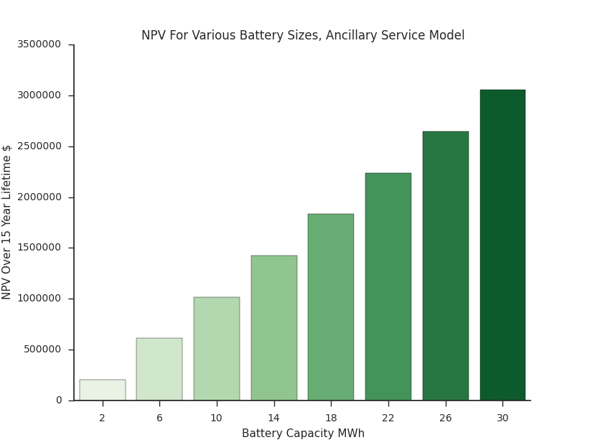
NPV for Case 3

Slide 22
Closing Remarks
Bid into ERCOT AS up to max allowed
Restricted by access to financing for project?
Can run for 2hr at peak power
Highest NPV over $3 million (30MWhr system)
Other costs not included (O&M?)
Other revenue streams not included (Nspin?)
Important note: computational complexity

Slide 23
Thank You!
Question?

Slide 24
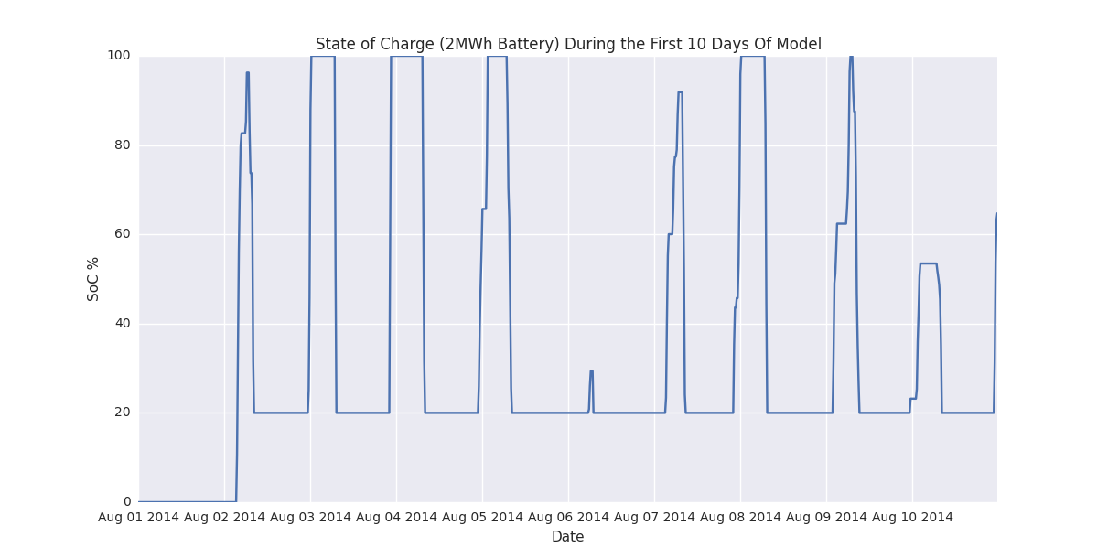
Backup
SOC case 2:

Slide 25
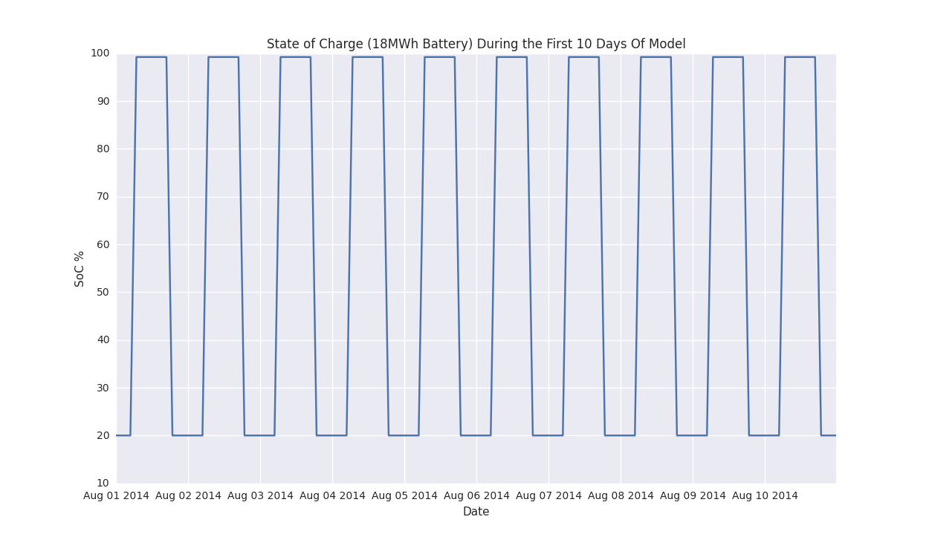
Backup
SOC case 3:

Slide 26
Backup
prices:
DAM:
mean: $39.06
std: $34.58
min $5.02
max: $1342
rtm:
mean: $36.49
std: $76.64
min $-1.29
max: $4947.72
——>> side note:
- average price of real-time during peak is $41.61
- average price of real-time during off-peak is $27.56

Slide 27
Backup
*****ANCILLARY SERVICE ARE BID IN AT MW, not MWh
regdn: >> decent pay-off, absorb electricity from grid
mean: $9.77
std: $13.23
min $0.50
max: $310
regup: >> high pay-off (huge upside), feed onto grid, moderate response time
mean: $12.48
std: $61.94
min $1.00
max: $4999.0
rrs: >> very high pay-off but needs guaranteed capacity for rapid response
mean: $14.15
std: $31.82
min $2
max: $1285.73
nspin: >> good for slow response time, low pay-off
mean: $5.47
std: $14.02
min $0.77
max: $435.70

