Slide 1


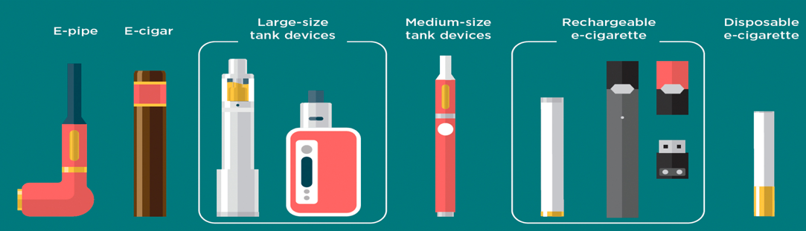
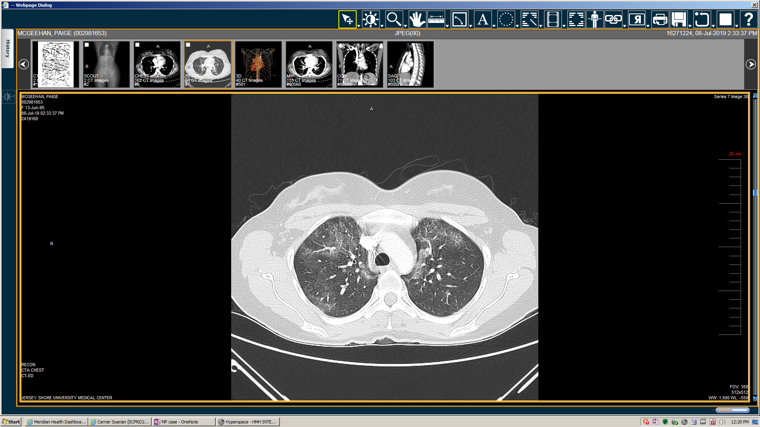
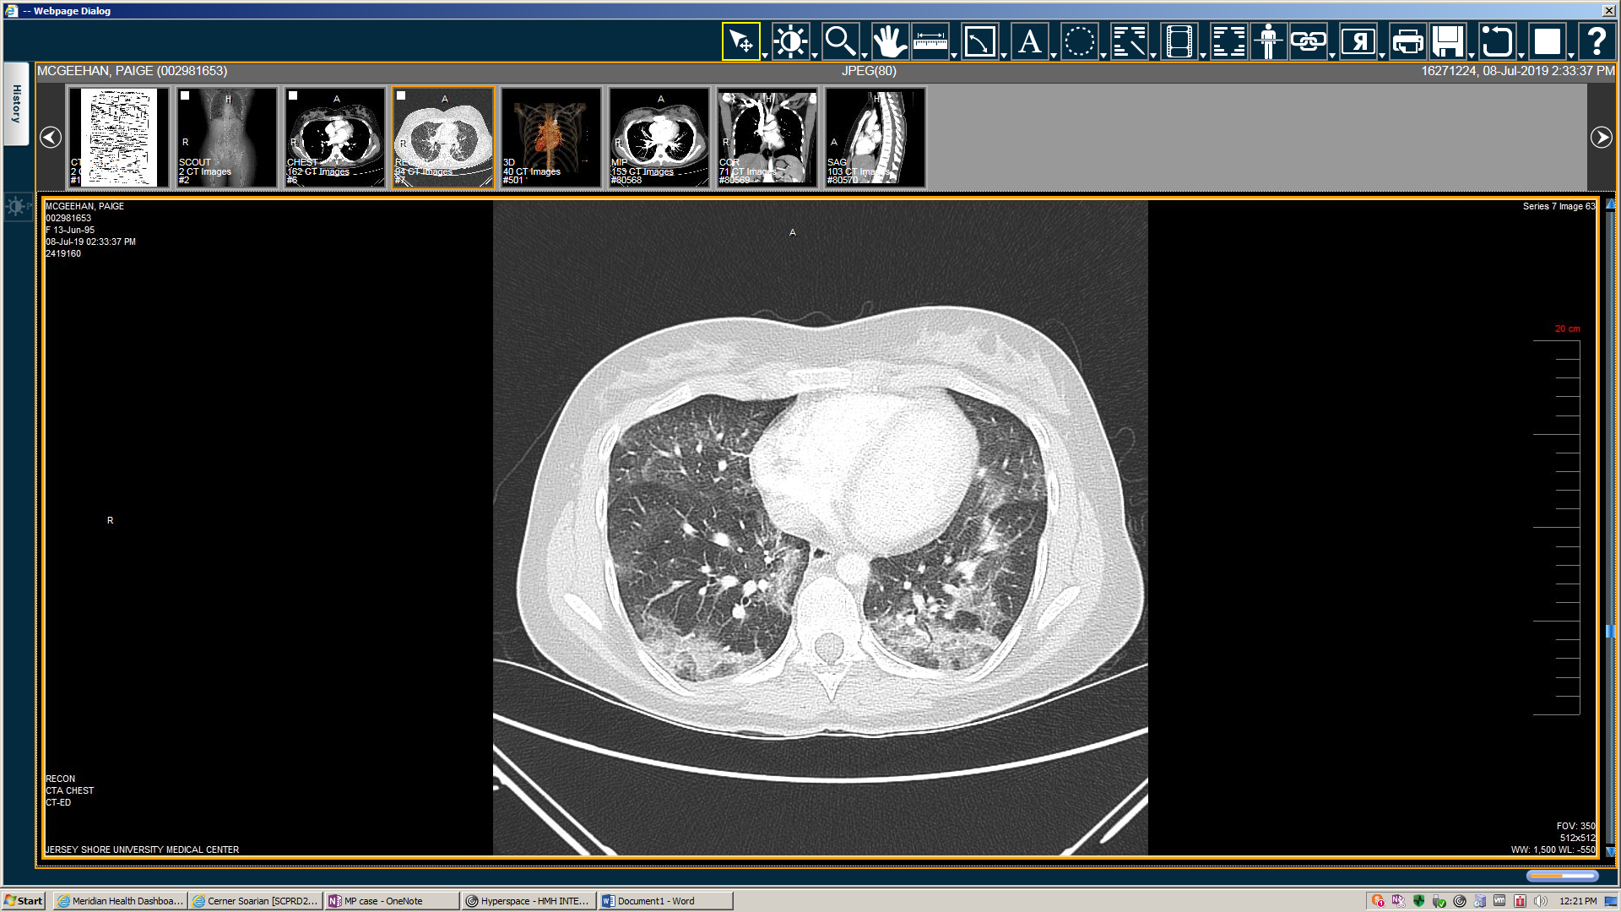
A Case Report of Vaping Associated Lung Injury and the Risk of Infections Associated With it
Ivan Richard, MD; Rana Ali, MD; Jagan Mohan Rao Vanjarapu, MD; Shakumar Patel, MD; Premal Patel, MD, Pramil Cheriyath, MD.
Department of Internal Medicine, Hackensack Meridian Health-Ocean Medical Center, Brick, NJ
Summary
Learning Objectives
Recognize the complications associated with vaping.
Discuss the risk of infections associated with vaping.
Case Presentation
A 24-year-old female with a past medical history of depression presented with worsening shortness of breath.
Associated symptoms of dyspnea on exertion, cough, fevers, chills, and pleuritic chest pain.
Her social history was significant for smoking marijuana but she quit 1 month prior.
She admitted to vaping but quit when her respiratory symptoms began.
Vitals & Physical Examination
On presentation, she was hemodynamically stable.
Physical examination was significant for decreased breath sounds and wheezing bilaterally.
Laboratory Investigations
The patient tested positive for rhinovirus and enterovirus using PCR .
She also tested positive for Mycoplasma pneumoniae IgM 1.93.
Blood cultures , influenza, and legionella were negative.
Imaging
The figures below depict transverse views of CT angiogram of the chest, demonstrating multifocal ground glass opacities bilaterally throughout the lungs and fibrotic interstitial infiltrate in the lungs bases bilaterally, relatively symmetrically.
E-cigarettes are battery-operated devices that produce aerosols by heating liquids that usually contain nicotine, cannabinoids, propylene glycol or ethylene glycol, flavoring agents, and other solvents & products.
These aerosolized components are thought to disrupt the barrier on the alveolar surface, especially surfactants in the lungs.
It is also thought to alter/compromise local immune response and cause lipoid pneumonia in some patients.
Disruption of this barrier will put the patient at risk for various infections such as mycoplasma, and viral infractions.
This patient presented with pulmonary symptoms and tested positive for mycoplasma Ig M antibodies, and viral panel (rhinovirus, enterovirus).
Along with pneumonitis, vaping will predispose the patients at an increased risk of infections as in this patient.
Vaping was previously thought to be safer but due to increased evidence on its ill-effects, other alternatives should be considered to quit smoking.
References:
https://www.cdc.gov/tobacco/basic_information/e-cigarettes/pdfs/Electronic-Cigarettes-Infographic-508.pdf
Kooragayalu S, El-Zarif S, Jariwala S. Vaping Associated Pulmonary Injury (VAPI) with superimposed Mycoplasma pneumoniae infection. Respiratory Medicine Case Reports. 2020:100997.
Grana R, Benowitz N, Glantz SA. E-cigarettes: a scientific review. Circulation. 2014;129(19):1972-86.
WBC Count (K/µL) | 17.6
Procalcitonin (ng/ml) | 40
Urine Drug Screen | Cannabinoids (+)
Arrows showing multiple ground glass opacities bilaterally
Clinical Course
It was determined that the patient's infection with rhinovirus and enterovirus were likely the cause of her abnormal CT scans and symptoms, probably induced by vaping and marijuana smoking at home.

