Slide 1

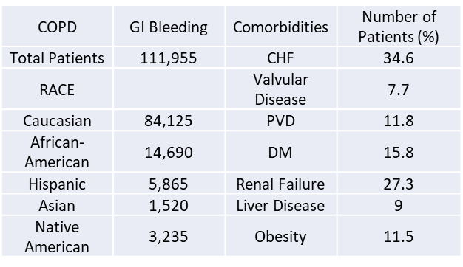
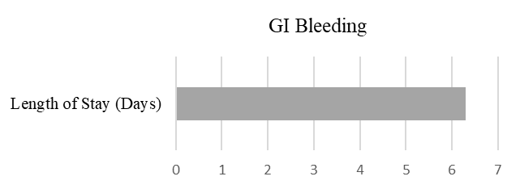
Outcomes Of Gastrointestinal Bleeding In COPD Patients
Suhrim Choe, MD; Premal Patel, MD; Satish Tadepalli, MD; Jagan Mohan Rao Vanjarapu, MD; Meet Patel, MD; Vinod Nookala, MD; Pramil Cheriyath, MD
Department of Internal Medicine, Hackensack Meridian Health Ocean Medical Center, Brick NJ
Background
Our objective of the study is to discuss the risk of Gastro-Intestinal Bleeding (GI bleeding) among the patients with chronic obstructive pulmonary disease (COPD), using ICD-10 CM codes from the most recent national database.
To date, all studies based on ICD-9 CM codes.
Our study demonstrates the outcomes of GI bleeding in COPD patients using the latest database.
Methods
We conducted a retrospective cohort study using publicly accessible National Inpatient Sample (NIS) database from October 2015 to December 2017.
It’s large sample size is ideal for developing national and regional estimates and enables analyses of rare conditions, uncommon treatments, and special populations.
Adult patients (>/=18), who had COPD were included in the study.
SAS 9.4 was used for univariate and multivariate analyses. SAS was developed by North Carolina State University.
Figure 1: Table showing racial distribution and underlying comorbidities in the study population
Figure 3: Pie chart showing various co-morbidities among the study population
The majority of them were suffering from congestive heart failure (34.6%), renal failure (27.3%, p<0.0001), peripheral vascular disease (11.8%, p<0.0001), and diabetes mellitus with complications (15.8%, p<0.0001).
In-hospital mortality was 8.07%, which was most likely due to the underlying co-morbidities, with an average length of stay of 6.3(2 - 7) days and economic burden 15,702.0 (5950.4-17005.5) USD.
Age adjusted mortality among the patients with GI bleeding is 1.93 (95% CI 1.99-1.97).
Conclusion
Based on the results from our study, we found that in COPD patients with congestive heart failure, renal failure, liver disease, alcohol abuse increases the GI bleeding risk.
Based on case-controlled study by Cappell et al, patients with COPD are likely to be elderly, smokers, alcoholics and likely steroids users than GI bleeding patients without COPD. However, regardless of these unique demographic features, patients with COPD still have significantly increased mortality from GI bleeding compare to patients without COPD.
The study further suggest that COPD severity is correlated with mortality.
Consideration of COPD co-morbidities and severity and prompt evaluation for higher level of care and for intervention in these patients would decrease the in-hospital mortality, length of stay and economic burden.
Results
There were a total of 6,464,467 patients included in study who had COPD, among them 111,955 patients with GI bleeding.
In this cohort, 84,125 (76.9%) were Caucasians, 14,690 (13.4%) were African Americans, 5865 (5.4%) were Hispanic, 1520 (1.4%) were Asian and 3235 (3.0 %) were native Americans with GI bleeding.
Figure 2: Bar diagram showing the average length of stay for patients with GI Bleeding

