Slide 1

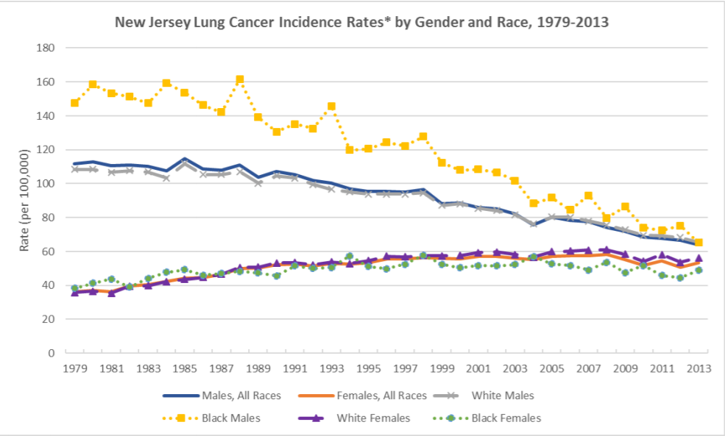
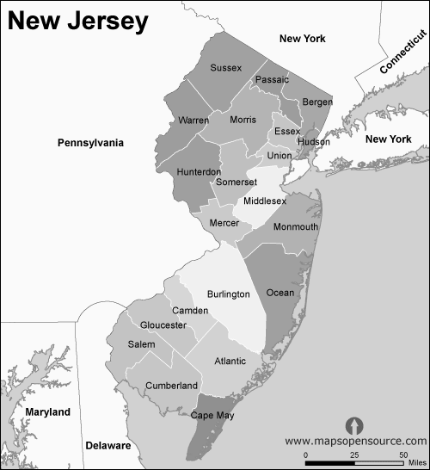
Lung Cancer Burden In New Jersey, SEER Data Registry
Palak Patel, DO; Amanda Dawson, MD; Ashley Aya, DO; Satish Tadepalli, MD; Shakumar Patel, MD; Premal Patel, MD;
Pramil Cheriyath, MD
Department of Internal Medicine, Hackensack Meridian Health Ocean Medical Center, Brick NJ
Background/Purpose:
Results
Lung cancer is the second most common cancer in the US and accounted for 24% mortality among deaths caused by all other malignancies in year 2019.
Lung cancer constitutes approximately 13 % of all cancers in the United States.
From 2012-2016, lung cancer was the 3rd most common cancer in New Jersey followed by breast and prostate cancer.
New Jersey has one of highest numbers of cases nationwide; however, the data is sparse for lung cancer distribution in New Jersey.
Our objective of this study is to look at the trends and distribution of lung cancer in NJ using SEER Data.
Figure 3: Pie chart showing gender distribution among the study population
Figure 1: Bar chart showing gender and racial distribution in the study population
A total of 102,291 lung cancer cases were reported from year 2000-2016.
Caucasians (88,207) overall have a higher prevalence rate of lung cancer compared to African-American (11,321) and other races (2763).
Female predominance was noted in Caucasians (87.2). Male predominance was noted in African-American (11.64) and other races (3). Grade I staging was seen in Caucasian (8.84), African-American (0.7) and others. Grade II was seen in Caucasians (25.56), African-American (2.9) and others (0.8), Grade III was seen in Caucasians (45.26), African-American (6.1) and others (1.2). Grade IV was seen in Caucasians (6.9), African-American (0.9) and others (0.1)
Methods
The data was obtained from the Surveillance, Epidemiology, and End Results Program of the National Cancer Institute.
The SEER Program conducts survey regarding the incidence and survival rates derived from population-based cancer registries that covers about 30% of the population of the United States.
The Prevalent cases of lung cancer in New Jersey from 2000-2016 were concluded and distributed according to race including Caucasians, African-Americans and others.
We performed descriptive analysis of lung cancer in New Jersey in different races.
Figure 4: NJ lung cancer incidence rates by gender and race, 1979-2013
Source: New Jersey State Cancer Registry
Conclusion
Caucasians have higher distribution of Lung cancer compared to African-American and other races.
The 5-year survival rate has improved in all races when compared to the survival rate seen a decade ago.
The higher incidence of lung cancer in Caucasians in New Jersey could be due to high percent population of Caucasians in New Jersey.
Further research is essential to validate our results and the significant factors, both environment and individual, that are responsible for this significance in survival rate.
Figure 2: New Jersey map with county

