Slide 1

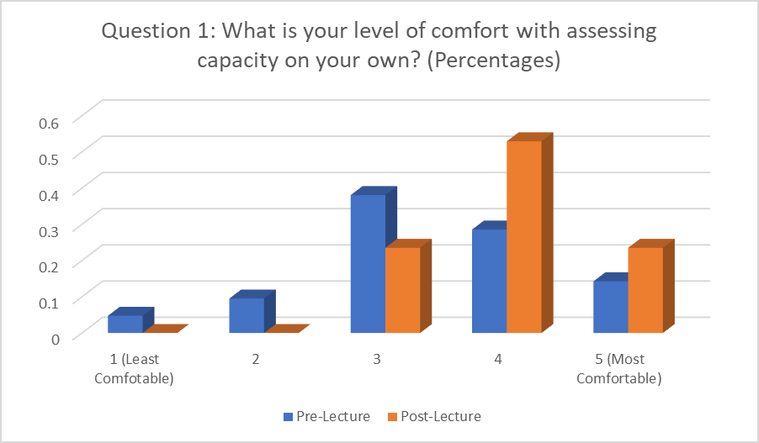
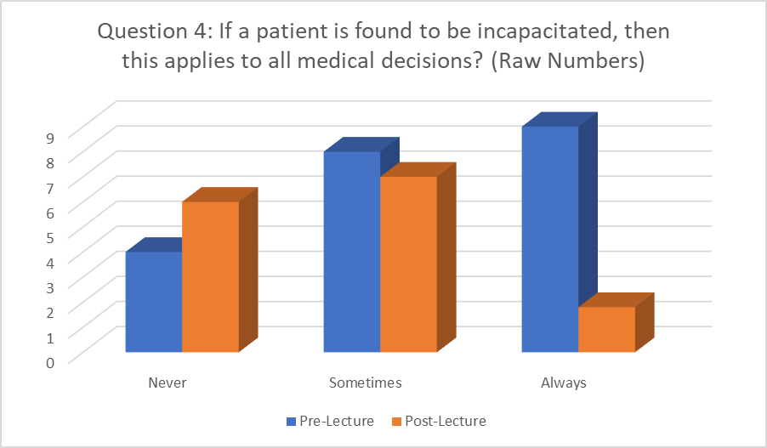
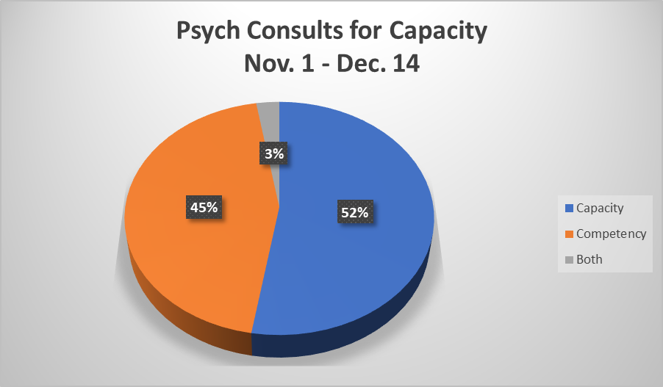
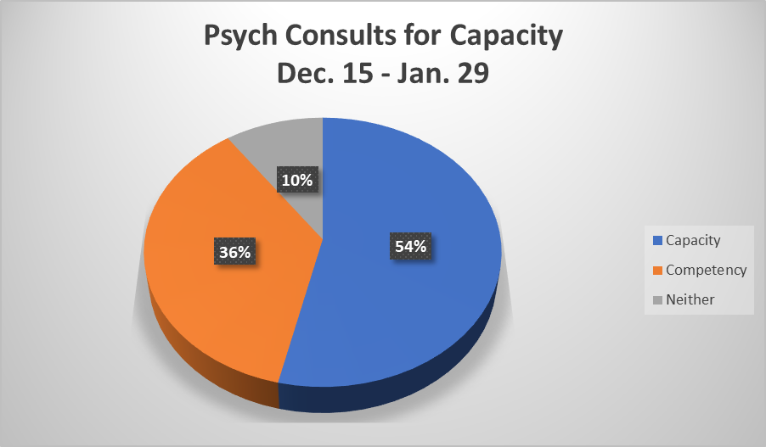
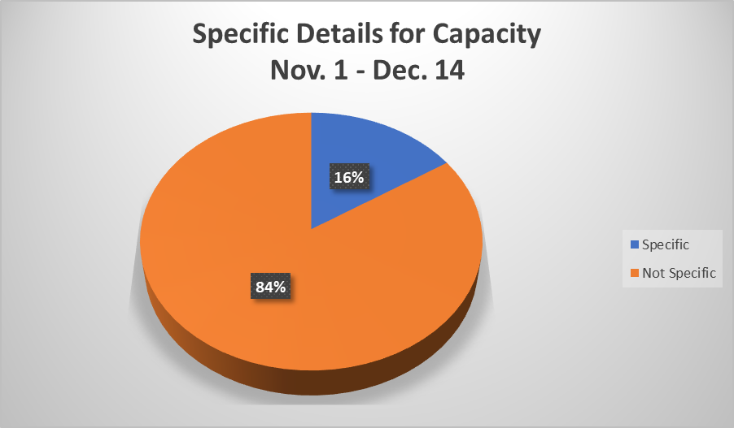
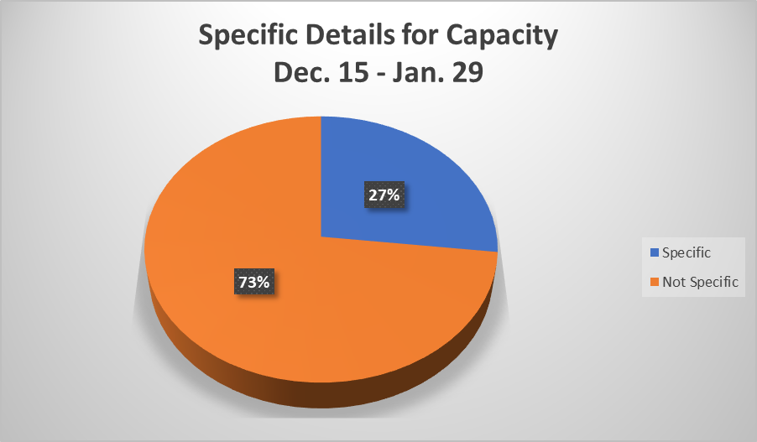
Educational Intervention Improves Physicians’ Understanding of Decision-Making Capacity and Effectively Addresses Myths Regarding Evaluating Capacity
Alex Soloway, M.D., Michelle Jaehning, M.D., Adriana Fitzsimmons, M.D.
Department of Psychiatry. Ocean Medical Center, Brick NJ
Background
Results
Conclusion
Capacity evaluation requests are increasing.
Increase in the aging population.
Increased focus on patient autonomy.
Two important aspects of capacity
The difference between capacity and competency.
Capacity is not an “all or none” phenomenon.
There is an immediate need to educate clinicians regarding capacity evaluations.
This study highlights the positive impact of education on improving clinicians’ understanding of evaluating capacity, resulting in:
An increased comfort level in capacity evaluations
Appropriate use of the term capacity as opposed to competency
Understanding that capacity is not always global.
Attendings/residents who were part of the study and participated in the pre- and post-lecture surveys stated that they would likely make less consults for capacity in the future.
As a result of the educational intervention, there was increased attention to providing specific details in consult orders regarding which aspect of decision making is in question. In summary, it is critical that all residents and clinical staff receive ongoing education in this area moving forward.
Objective
Evaluate whether a one-hour medical education lecture to internal medicine physician attendees made an appreciable difference in addressing the misconceptions regarding this topic.
Evaluation of resident/attending understanding between capacity and competency was performed by analyzing pre- and post-intervention surveys.
To check whether the clinicians improved their ability to write specific, detail-oriented notes, consults to the psychiatric consultation team were reviewed pre- and post-lecture.
Methods
References
A pre-lecture questionnaire to evaluate the audience’s understanding of capacity consults was performed.
A Post-lecture questionnaire was given with the same five questions
Between November 1st to December 14th 2018 (pre-lecture), 304 consults to the psychiatric consultation team were reviewed to determine the total number of capacity consults mentioning capacity vs. competency along with review for specificity.
The same was done from December 15th to January 29th 2019 (post-lecture), 338 consults.
were reviewed to determine the total number of capacity consults mentioning capacity vs. competency along with review for specificity. A consult met criteria for being specific if it specified the exact reason for why capacity needs to be assessed for a certain individual.
Appelbaum, Paul S., M.D. “Assessment of Patients’ Competence to Consent to Treatment.” The New England Journal of Medicine. 2007.
Atluru, Aparna M.D. “Revisiting Decision-Making Capacity.” 16 March 2017. The American Journal of Psychiatry. https://doi.org/10.1176/appi.ajp-rj.2016.111105.
Bisbing SB. “Competency and Capacity: a primer. In: Sanbar SS, Gibofsky A, Fireston MH, et al, eds. Legal Medicine. 4th ed. American College of Legal Medicine. St. Louis, Mo: Mosby. 1998 32-43.
Howe, Edmund MD JD. “Ethical Aspects of Evaluating a Patient’s Mental Capacity.” Psychiatry (Edgmont). 2009 Jul; 6(7): 15-23.
Kornfield, Donald S., M.D., Muskin, Philip R., M.D., Tahil, Fatimah A., M.D. “Psychiatric Evaluation of Mental Capacity in the General Hospital: A Significant Teaching Opportunity.” Psychosomatics. 2009 Sep-Oct; 50(5):468-73. doi: 10.1176/appi.psy.50.5.468.
Leo, Raphael J., M.D. “Competency and the Capacity to Make Treatment Decisions: A Primer for Primary Care Physicians. Prim Care Companion. J Clin Psychiatry. 1999 Oct; 1(5):131-141.

