Slide 1
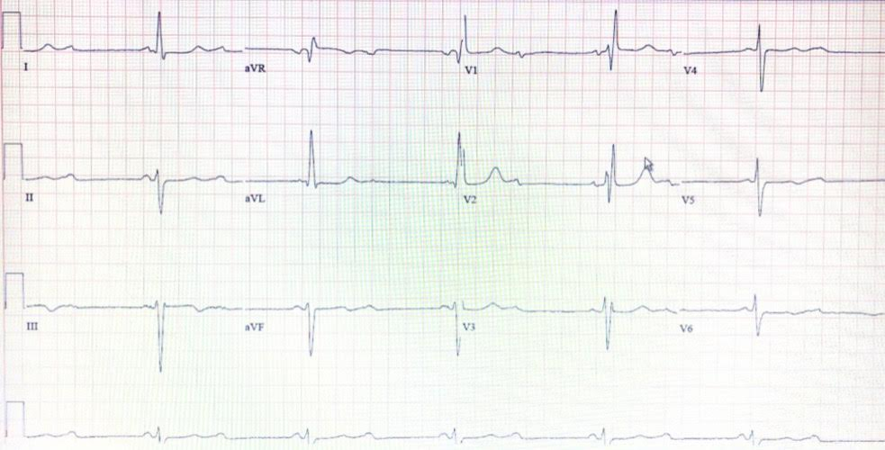
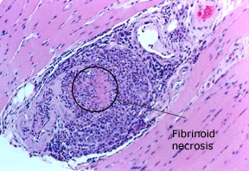
Ocean Medical Center
Complete Heart Block Secondary to Microscopic Polyangiitis: A Rare Case Presentation
Giuseppe Filice, MD; Ivan Richard, MD; Palak Patel, DO; Jeffrey Miskoff, DO.
Department of Internal Medicine, Hackensack Meridian Health-Ocean Medical Center, Brick, NJ
LEARNING OBJECTIVES
LABORATORY INVESTIGATIONS
HOSPITAL COURSE
To recognize the cardiac complications associated with microscopic polyangiitis.
To discuss the similarities between microscopic polyangiitis and granulomatosis with polyangiitis.
BUN (mg/dl) | 43
BUN/Cr ratio | 26
GFR (ml.min) | 30
Creatinine (mg/dl) | 1.68
She was admitted to the ICU for telemetry monitoring and anti-hypertensive medications were started.
She had a dual chamber pacemaker placed the next day.
The patient was monitored for the next 2 days, during which she had no further episodes of bradycardia.
Later, she was discharged home and was advised to follow up with her cardiologist.
RBC 2.63 M/uL, hemoglobin 8.8 g/dL, hematocrit 27.3%, MCV 103.8 fL, MCH 33 pg, MCHC 32.2 g/dL, and RDW 13.8%.
Troponins – Normal
CASE PRESENTATION
A 77-year-old Caucasian female with a past medical history of coronary artery disease status post-two-vessel coronary artery bypass graft (CABG) and chronic kidney disease with underlying microscopic polyangiitis presented to the emergency room with dyspnea on exertion and dizziness for two days.
The patient was previously seen by her Primary Care Physician (PCP) for bilateral lower extremity pain. Bilateral Venous Doppler ultrasound of her lower extremities and a 2-Dimensional echocardiogram were performed and resulted negative for any acute pathology.
She was also found to have a heart rate of 37 beats/min and she was placed on a holter monitor.
ELECTROCARDIOGRAM
SUMMARY
Microscopic Polyangiitis (MPA) is a small vessel vasculitis with rapidly progressive glomerulonephritis and alveolar hemorrhage; however, the manifestation of the disease varies depending on the organ system involved.
The patient initially presented to the hospital with sudden onset of dyspnea and dizziness, and on further investigation, she was found to be having a complete heart block and severe bradycardia on an electrocardiogram.
To date, there are no other cases of microscopic polyangiitis with complete heart block but the literature shows some association between granulomatosis with polyangiitis (GPA) and cardiac conduction abnormalities.
Granulomatosis with polyangiitis (GPA) may present with endocarditis, pericarditis, myocardial infarction and atrioventricular block due to infiltration causing a mass to form in the interatrial septum.
This substantiates the argument that microscopic polyangiitis (MPA) and granulomatosis with polyangiitis (GPA) may exist under a single spectrum instead of two separate entities.
The patient's EKG showed a sinus rhythm with 36 beats/min and a new-onset complete heart block, right bundle branch block, left ventricular hypertrophy, and left anterior fascicular block.
BIOPSY
VITALS & PHYSICAL EXMAINATION
During the time of admission:
On examination:
Bradycardia and a 3/6 systolic murmur that was appreciated best at the second intercostal space on the right upper sternal border.
Temperature (F) | 98.7
Blood Pressure (mmHg) | 260/70
Heart Rate ( beats/min) | 36
Respiratory rate (breaths/min) | 18
This biopsy of gastrocnemius muscle with microscopic polyangiitis depicts changes of intense inflammatory infiltrate and destruction of the blood vessel wall within the muscle.

