Slide 1
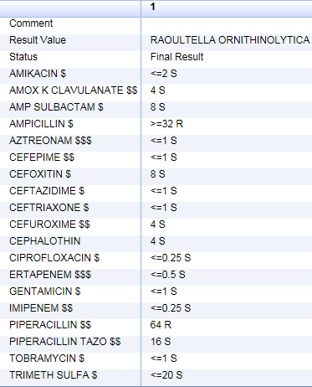
A RARE CASE OF ACUTE CHOLECYSTITIS CAUSED BY RAOULTELLA ORNITHINOLYTICA, AN EMERGING PATHOGEN
Erica De Clemente MD, Andrew Haddad MD, Charles Rutkowski MD, Christopher Bader DO, Kelly Ussery-Kronhaus MD, Kenneth Kronhaus MD
Department of Family Medicine Hackensack Meridian Health Ocean Medical Center, Brick NJ
LEARNING OBJECTIVES
PHYSICAL EXAMINATION
Recognize Raoultella ornithinolytica as a potential cause for acute cholecystitis.
Understand how to treat acute cholecystitis in a nonsurgical patient.
Vital signs in the emergency room were as follows: blood pressure 90/61 mmHg, pulse 85 beats per minute, respiratory rate 17 breaths per minute, saturating 99% on room air, temperature 97.8 degrees Fahrenheit. Physical exam was significant for a positive Murphy sign.
CASE PRESENTATION
70-year-old male with past medical history of depression, alcohol abuse, and subdural hematoma presented to his PCP’s office with the complaint of dizziness and weakness.
Upon initial assessment he was found to be hypotensive with a blood pressure of 84/52 mmHg. Patient was sent to the emergency room for further evaluation and IV fluids.
Upon presentation to the hospital, the patient also began complaining of upper abdominal pain.
Patient was found to have acute cholecystitis and an acute on chronic left sided subdural hematoma.
Given hemodynamic instability and acute brain bleed, patient was admitted to the intensive care unit
Patient was a por surgical candidate for acute cholecystitis given acute brain bleed.
A percutaneous cholecystostomy tube was placed and patient was maintained on IV fluids and IV piperacillin / tazobactam. Patient was discharged on PO cefuroxime.
Laboratory Data
WBC count | 15.7 k/uL (4.5-11)
Neutrophil percent | 84.7% (50-70)
Total bilirubin | 2.9 mg/dL (0.2-1.3)
Lipase | 18 U/L (20-55)
BUN | 26 mg/dL (5-25)
Creatinine | 2.14 mg/dL (0.61-1.24)
IMAGING
CONCLUSIONS
Gallbladder ultrasound showed gallstones with marked wall thickening and pericholecystic fluid, suggestive of acute cholecystitis
Infections with these bacteria are usually present in hospitalized patients with multiple comorbidities.
There have been reports of this bacterium being clinically isolated in humans in sputum, stools, wounds, and urine but it is a rare cause of invasive human infections.
Most notably, this bacterium has been historically identified in cases causing ascending cholangitis as well as appendicitis.
To date, there has not been a reported case of Raoultella ornithinolytica causing acute cholecystitis.
There has been one reported case of cholecystitis being caused by another bacterium of the same species, Raoultella Planticola.
WHAT IS RAOULTELLA ORNITHINOLYTICA?
Raoultella ornithinolytica is an encapsulated, gram-negative aerobic bacillus within the Enterobacteriaceae family.
This bacterium has been isolated from the gut of fish, ticks and termites.
It has also been shown to be histamine producing. This bacteria’s presence in fish has been linked to scombroid syndrome, a histamine produced illness that presents with flushing, vomiting, diarrhea, and respiratory compromise.

