Slide 1
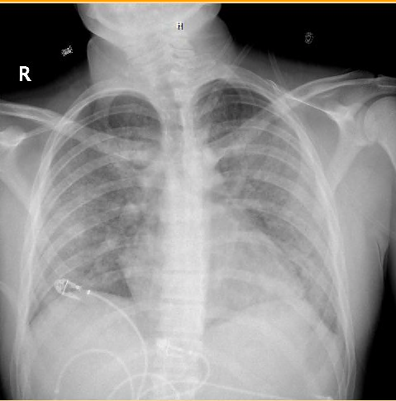
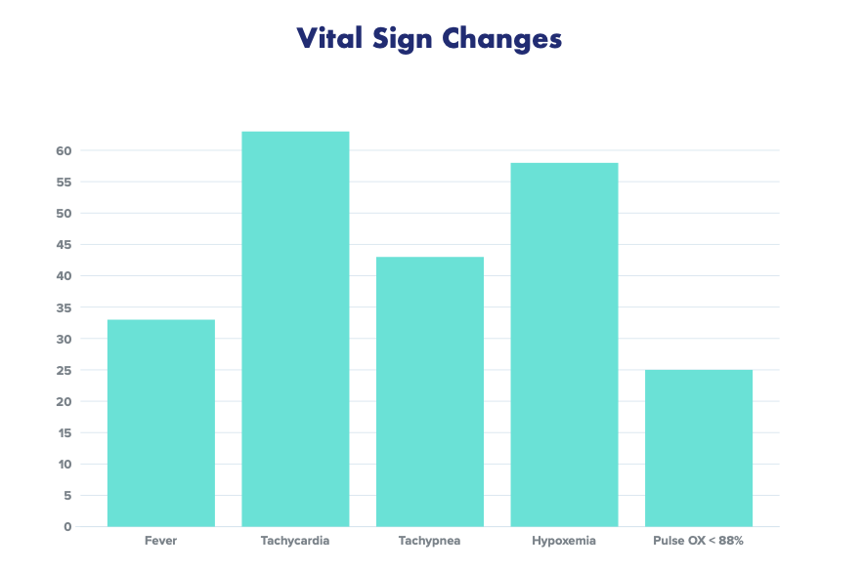
VAPING ASSOCIATED LUNG INJURY
Erica De Clemente MD, Kelsey Gallagher DO, Kelly Ussery-Kronhaus MD
Department of Family Medicine. Ocean Medical Center, Brick NJ
LEARNING OBJECTIVES
Symptoms include shortness of breath, cough, chest pain, pleuritic pain, hemoptysis, fever, chills, and GI symptoms.
Vital signs show fever, tachycardia, tachypnea, hypoxemia.
Imaging reveals diffuse bilateral consolidative ground glass opacities which spare the subpleural space. Pleural effusions are less likely but possible.
To recognize the symptoms of vaping associated lung injury.
To diagnose vaping associated lung injury via radiographic imaging.
To treat vaping associated lung injury.
CASE PRESENTATION
20-year-old male with nausea, vomiting, abdominal pain and cough for four days. He is given fluids, Zofran, and azithromycin.
Patient returns the next day with similar complaints.
INITIAL VITALS AND IMAGING
With no improvement of respiratory status, patient was started on methylprednisolone, duo nebs and incentive spirometry.
On day 5 of his hospitalization, patient admitted to recent vaping of tobacco products.
Patient underwent bronchoscopy with washout, which did not show any etiology for his pneumonia. After excluding other diagnoses, patient was diagnosed with acute lung injury secondary to vaping.
Oxygen saturation was 93% on room air.
He was found to have pneumonia, duodenitis, and possible malrotation of the small bowel.
Chest x-ray showed bilateral patchy consolidation of the lower lobes. CT of the chest shows precarinal lymphadeopathy, mild bilateral hilar fullness, and moderate diffuse pulmonary edema and airspace disease
CONCLUSIONS
Patients must have a history of vaping in the past 90 days, opacities on x-ray or CT, and exclusion of infection.
Treatment is mostly supportive with empiric antibiotics and supplemental oxygen.
Systemic steroids are not recommended unless all other options have been exhausted.
Twenty five percent of patients progress to mechanical ventilation.
The patient described above, with negative bronchial lavage, negative infectious workup, and recent history of vaping fits criteria for diagnosis.
HOSPITAL COURSE
PATHOPHYSIOLOGY
Patient desaturated after an episode of vomiting and is admitted to the intensive care unit for acute hypoxic respiratory failure.
He was treated with oxygen, Levaquin, and Bactrim.
Vaping associated pulmonary injury (VAPI) or E-cigarette and vaping associated lung injury (EVALI) was first recognized in summer of 2019.
Symptoms present due to acute lung injury with fibrinous pneumonitis and diffuse alveolar damage.

