Slide 1
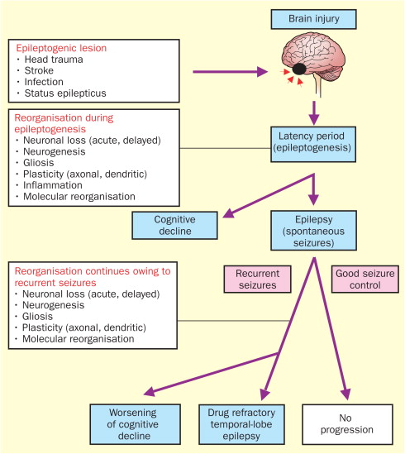
Complications Post Severe Chronic Traumatic Brain Injury Including Seizure
Charles Eke, MD; Christopher Bader, DO; Kenneth Kronhaus MD
Department of Family Medicine. Ocean Medical Center, Brick NJ
LEARNING OBJECTVES
RESULTS
CBC and metabolic panel within normal limits
EEG: no seizure activity detected
MRI: Chronic left MCA territory encephalomalacia with no other abnormalities noted
24 hour video EEG: no seizure activity detected
CONCLUSIONS
Determine whether the complications of a chronic traumatic brain injury include late-onset seizures and/or epilepsy
Management of seizures and epilepsy from post-traumatic brain injury
Although epilepsy is an important consequence of TBI, which affects 25% of patients who suffered from a severe brain injury, seizure was properly ruled out of this patient on his second hospital admission via video EEG.
Although the patient in this case had multiple risk factors which would predispose him to late post traumatic epilepsy (which occurred 2 years after his initial injury) such as the severity of the brain injury, intracranial hemorrhage at the time of the brain injury, and initial Glasgow coma scale score at the time of injury, the inability to identify his syncopal episode as a seizure means he is unlikely to suffer from epilepsy.
Had this been an epileptic episode, management would include prophylaxis with antiseizure medications such as phenytoin within one day of the severe TBI, as it has been shown to prevent early seizures (occurring within one week of TBI).
Regardless, prophylaxis has no effect on the development of post-traumatic epilepsy or late post-traumatic seizures (occurring one week after TBI).
Other long-term complications of traumatic brain injury include progressive brain atrophy, chronic traumatic encephalopathy, and Alzheimer’s disease.
CASE PRESENTATION
51 year old race car driver involved in a crash in 2018
The crash resulted in severe head injury, intracranial hemorrhage, and transection of his left carotid artery
Following the accident , the patient was paralyzed on the left side and remained in a coma for two weeks
Patient eventually recovered strength on his left side after several months
1-2 years following the accident patient presented to the emergency room after being found by his son in a state of confusion, on the floor drooling with a blank stare for several minutes
PATHOPHYSIOLOGY
PHYSICAL EXAMINATION
Vital signs were normal.
Speech: expressive dysphagia (baseline)
HEENT: indentation of teeth on tongue
REFERENCES
Long-Term Consequences of Traumatic Brain Injury: Current Status of Potential Mechanisms of Injury and Neurological Outcomes. - PubMed - NCBI. (2015).
Epilepsy after Traumatic Brain Injury - PubMed - NCBI. (2016).
Sutula, T. (2002). Is epilepsy a progressive disorder? Prospects for new therapeutic approaches in temporal-lobe epilepsy. The Lancet, 1.
(Reference 3)

