Slide 1


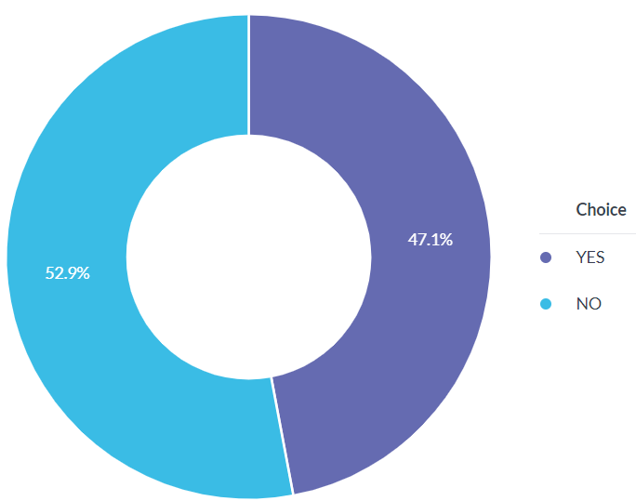
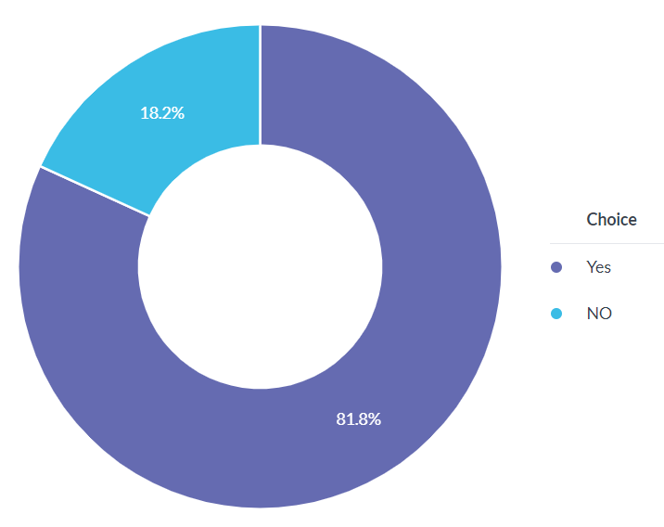
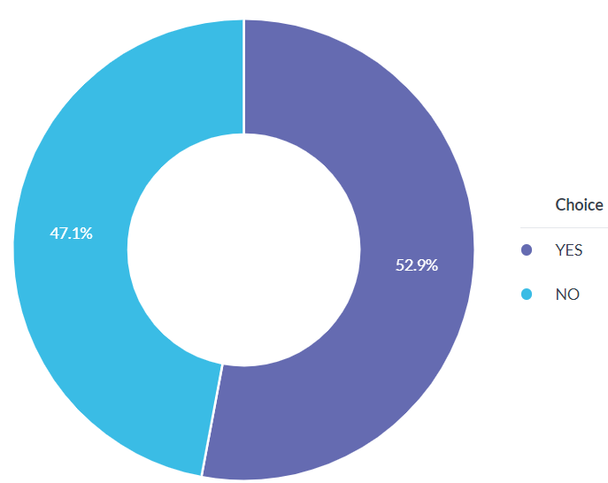
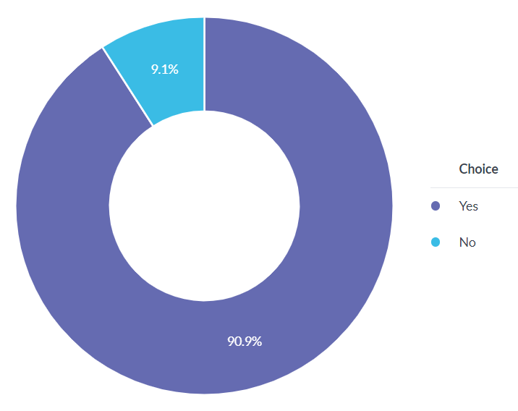
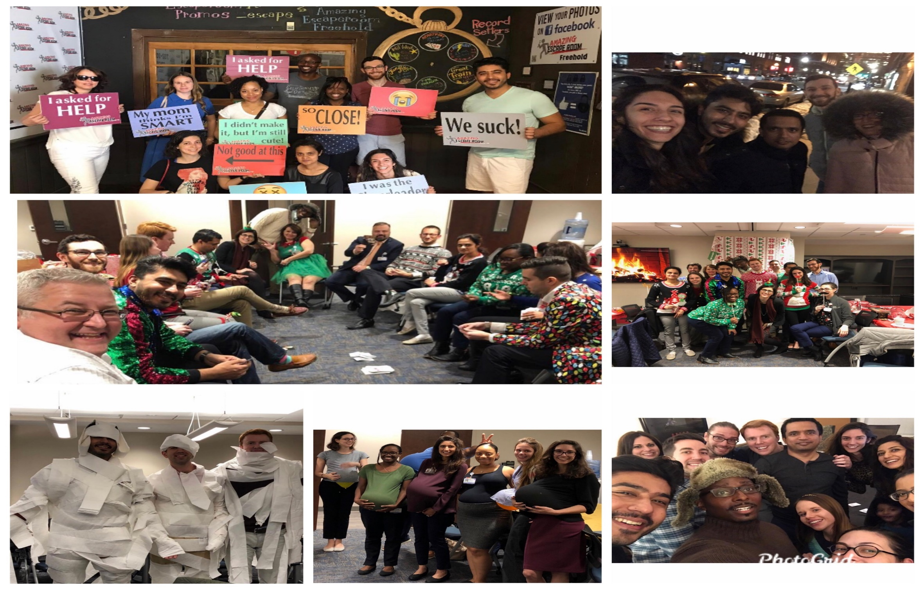
Incorporating residents’ individual cultural-religious background into the mentorship model:
A mentor-mentee perspective from two psychiatry programs
Memon, Z¹, Afzal, S², Doumas, S³, Solhkhah, R⁴
^{1,2,4} Hackensack Meridian Health- Ocean Medical Center, Brick, New Jersey
^{3,4}Hackensack Meridian Health-Jersey Shore Uni. Medical Center, Neptune, New Jersey
Background
A good mentoring relationship during residency is one well-established approach to facilitate and encourage professional growth. The United States, widely recognized as a nation of nations is a unique place to do residency because of the sheer diversity.
The literature review suggests various mentor-mentee traits deemed necessary for a successful mentoring relationship but very few if any comment on the significance of tailoring mentees cultural- religious background into the mentorship model.
A key factor in the mentor-mentee relationship is a mentorship model that embraces cultural diversity. Despite supportive evidence, this practice is often overlooked.
The published literature identifies various important traits that contribute to a successful mentoring relationship, but very few studies highlight the impact of incorporating mentees’ cultural-religious background into the mentorship model.
Results
85% (17/20 total) of mentees and 73% (11/15 total) of mentors completed the survey.
47% of mentees reported their mentors following a cultural-religious sensitive mentorship model versus 82% of mentors reporting the same.
71% of the mentees and 91% of the mentors surveyed, provided supportive feedback for adopting a mentorship model that accounts for the mentee’s individual cultural and religious needs for favorable outcomes.
Practice gap
Method(s)
An electronic survey emailed to mentees (residents) and mentors (faculty) of two psychiatry residency programs.
The mentor survey aimed to gauge the percentage of faculty that incorporate their mentee’s cultural-religious background into their mentorship model, their reasons for implementing such a practice and share their experiences.
The mentee survey intended to assess mentees’ perceptions about the utilization of cultural-religious mentorship model by their mentors and to provide input if they valued such an approach.
Educational Objective(s)
To learn differences in the perspective of mentees and mentors on the importance of incorporating mentee’s cultural-religious background into the mentorship model.
Better understand the value of adopting a cultural-religious sensitive approach.
Use the survey results to recognize and interpret trainee needs and develop tools to assist mentors to help further mentee’s professional growth.
Conclusion
This study provides a unique insight into the perspective of residents and faculty and highlights the importance of utilizing participant voices to tailor interventions for maximum impact.
Future research needs to focus on how such tailored interventions can be utilized to develop meaningful tools for better generalizability.
References:
• House, Stephanie & Spencer, Kimberly & Pfund, Christine. (2018). Understanding how
diversity training impacts faculty mentors’ awareness and behavior. International Journal
of Mentoring and Coaching in Education. 7. 00-00. 10.1108/IJMCE-03-2017-0020.
• Defining Attributes and Metrics of Effective Research Mentoring Relationships. Pfund C,
Byars-Winston A, Branchaw J, Hurtado S, Eagan K.
• A Review of Mentoring in Academic Medicine Stephen A. Geraci MD and S. Calvin
Thigpen MD American Journal of the Medical Sciences, The, 2017-02-01, Volume 353,
Issue 2, Pages 151-157, Copyright © 2017 Southern Society for Clinical Investigation
• Ragins, Belle & Kram, Kathy. (2007). The Handbook of Mentoring at Work
Resident survey result
Mentor survey result

