Slide 1

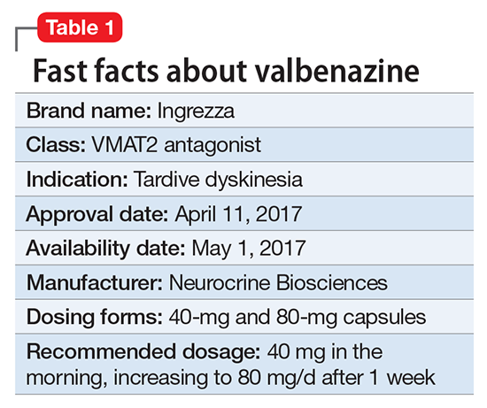
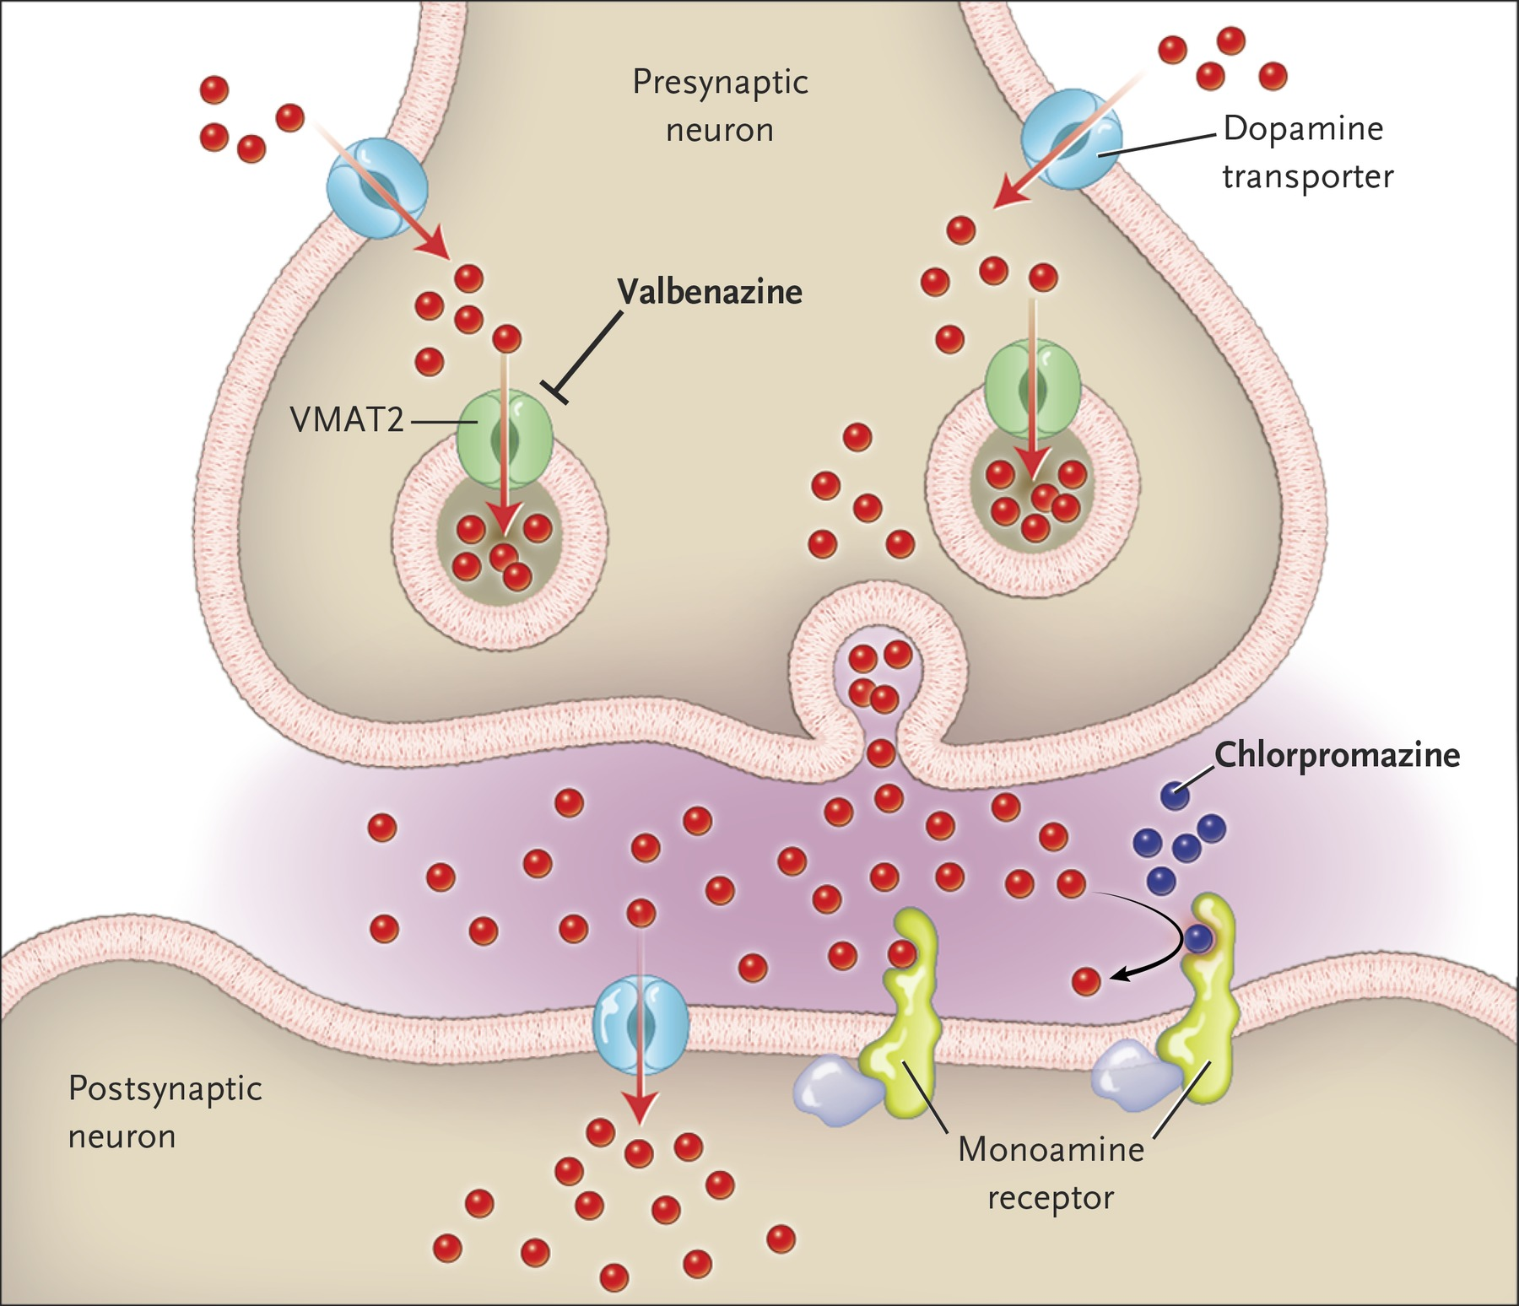
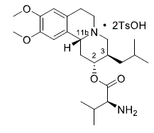
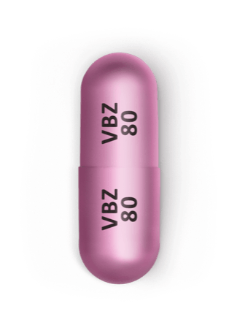
Polypharmacy in a Patient Taking Valbenazine for Tardive Dyskinesia, Leading to a Case of Neuroleptic Malignant Syndrome
Siana Ziemba, D.O., Michelle Jaehning, M.D., Adriana Fitzsimmons, M.D., Alexandra McMillan, and Nikko Rowe
Department of Psychiatry, Jersey Shore University Medical Center, Neptune NJ
Background
The Case
Discussion of Literature
Neuroleptic Malignant Syndrome (NMS) is a life-threatening neurologic emergency characterized by fever, altered mental status, autonomic dysfunction, and muscular rigidity. Although NMS is commonly associated with neuroleptics and other medications that reduce dopaminergic transmission, we introduce a novel case report suggesting that Ingrezza (valbenazine) may increase the risk of developing this reaction. NMS is caused by an abrupt decrease in dopamine activity, either from blocking dopamine receptors or withdrawal of dopaminergic agents.
Valbenazine is used to treat tardive dyskinesia (TD) in adults. TD causes involuntary movements of the tongue, lips, face, trunk, and extremities. It is a side effect of neuroleptics/anti-psychotic medications that may be used to treat schizophrenia and other mental health disorders. These symptoms of TD are thought to due to the hypersensitivity of dopamine receptors precipitated by the long-term use of antipsychotics.
Valbenazine functions as a selective VMAT-2 inhibitor, resulting in decreased amounts of dopamine being transported from the cytoplasm into presynaptic vesicles, leading to less dopamine release from pre-synaptic neurons. This medication is the first drug approved for the treatment of tardive dyskinesia.
In our search, there have been no reported cases of NMS associated with valbenazine use for tardive dyskinesia. Patients with a history of NMS were excluded in clinical trials involving valbenazine and NMS was excluded as part of the extrapyramidal symptoms reported in clinical trials post-treatment. However, our case study argues for a closer investigation on polypharmacy with valbenazine and the association with NMS.
Our patient is a 71-year-old Caucasian female who took multiple medications including Ingrezza (valbenazine), a VMAT-2 inhibitor that is FDA approved for the treatment of adult patients with tardive dyskinesia. She has a psychiatric history of schizophrenia and tardive dyskinesia, and no substance abuse history. She was admitted to the medical service with stiff posturing, tremors, rigidity, and unresponsiveness. She had a fever of 103 F, heart rate over 120 bpm, and initial CPK of 7870 iU/L. When all other medical etiologies were ruled out, it was concluded that she had NMS. By report, the patient developed bronchitis a month prior to admission, was subsequently given a 10-day course of antibiotics, and has since experienced mental deterioration, with an unstable gait and five falls during the past month.
Her home medications included amlodipine 2.5 mg daily, benztropine 0.5 mg b.i.d., trazodone 50 mg q.h.s., valbenazine 80 mg daily, and paliperidone palmitate quarterly injections with last dose two months prior to admission. She was reportedly taking clonazepam 0.5 mg b.i.d., but this was recently tapered, with her last dose one week prior to admission. She was also taking amantadine 100 mg b.i.d. in the recent past, and this was discontinued when benztropine was started. She began benztropine a month ago, starting with twice daily dosing, increasing to three times daily dosing a week later, however her mental status worsened, and the dose was reduced back to twice daily dosing. She had been psychiatrically stable with paliperidone palmitate injections.
She had been taking valbenazine for about seven months and this helped alleviate her tardive dyskinesia. In a literature search, we have not found a case of NMS in a patient taking valbenazine. In this poster, we discuss a case of NMS in a patient with exposure to valbenazine, among other agents.
Ingrezza (valbenazine) was approved by the FDA in 2017 as the first medication indicated to treat adult patients suffering from Tardive Dyskinesia (TD). Interestingly, before FDA approval for valbenazine, clinicians were using off-label medications or supplements such as tetrabenazine, clonazepam, and Ginkgo biloba for TD.
Valbenazine is a modified metabolite of the VMAT-2 inhibitor, tetrabenazine. According to Uhlyar and Rey (2018), the active metabolites from tetrabenazine include alpha and beta enantiomers. These metabolites function as VMAT2 inhibitors and antagonists at the dopamine D2 receptor, respectively. This is a racemic combination that may cause anti-psychotic adverse effects and include risk for suicidal ideation, depression, and neuroleptic malignant syndrome (NMS). There have been reported cases of NMS as a result of taking tetrabenazine off-label for TD.
The association between VMAT2 inhibitors, such as valbenazine, and NMS is often confounded by concomitant treatment with antipsychotics. In this case, valbenazine (reduces dopamine release), combined with the patient’s benztropine (prolongs release of dopamine), and long-term antipsychotic use, likely contributed to the NMS presentation. Therefore, clinicians need to remain vigilant for early signs of NMS in patients that take medications affecting dopamine activity in the brain.
.
https://www.nejm.org/doi/full/10.1056/NEJMp1704898
https://go.gale.com/ps/anonymous?id=GALE%7CA496643460&sid=googleScholar&v=2.1&it=r&linkaccess=fulltext&issn=15378276&p=AONE&sw=w
https://www.rxlist.com/ingrezza-drug.htm
https://www.ingrezzahcp.com/
References
Caroff, Stanley N. “Risk of Neuroleptic Malignant Syndrome with Vesicular Monoamine Transporter Inhibitors.” Clinical Psychopharmacology and Neuroscience. November 7, 2019. http://www.cpn.or.kr/journal/view.html?uid=1021&vmd=Full&.
Freudenreich, O. and Remington, G. “Valbenazine for Tardive Dyskinesia.” Clin Schizophr Relat Psychoses. Summer 2017; 11(2):113-119. doi:10.3371/CSRP.OFGR.071717.
Gallego, Juan A. M.D., Nielsen, Jimmi M.D., Hert Marc De M.D., Kane, John M. M.D., and Correll, Christoph U. M.D. “Safety and Tolerability of Antipsychotic Polypharmacy. Expert Opin Drug Saf. 2012 Jul; 11(4): 527-542.
Josiassen, Richard C., Kane, John M., Liang, Grace S., Burke, Joshua, and O’Brien, Christopher F. “Long-Term Safety and Tolerability of Valbenazine (NBI-98854) in Subjects with Tardive Dyskinesia and a Diagnosis of Schizophrenia or Mood Disorder. Psychopharmacol Bull. 2017 Aug 1; 47(3): 61-68.
Mosley, Lillian L Smith, Mosley II, Juan F., Fleischfresser, Jessica R., and Reed, Tiffani. “Vesicular Monoamine Transporter Type 2 (VMAT2) Inhibitors in the Management of Tardive Dyskinesia.” Clinical Medical Reviews and Case Reports. 2017. Volume 4, Issue 12. DOI: 10.23937/2378-3656/1410198.
Su, Y.-P., Chang, C.-K., Hayes, R.D., Harrison, S., Lee, W., Broadbent, M., Taylor, D., Stewart, R. “Retrospective Chart Review on Exposure to Psychotropic Medications Associated with Neuroleptic Malignant Syndrome. 15 November 2013. Acta Psychiatrica Scandinavica. Volume 130, Issue 1. https://doi.org/10.1111/acps.12222.
Uhlyar, Stepan PharmD and Rey, Jose A PharmD, BCPP. “Valbenazine(Ingrezza): The First FDA-Approved Treatment for Tardive Dyskinesia.” Pharmacy and Therapeutics. 2018 June; 43(6): 328-331.

