Slide 1
Buildpacks - the future of containers?
Eamon Scullion

Slide 2
Lets talk about the prehistoric days.. (Before 2013)
Buildpacks - the future of containers?
Developers focus on building their apps, Ops worry about the infrastructure side of things.
Once a release is ready, developers package up their app (JAR, binary etc) and hand over to Operations to deploy on their infrastructure:
Developers
Code Artifact e.g JAR
Operations

Slide 3
Lets talk about the prehistoric days.. (Before 2013)
Buildpacks - the future of containers?
If something went wrong with the release, it was usually due to differences in environments e.g “It works on my machine”
Developers
Code Artifact e.g JAR
Operations

Slide 4
Changed everything…
Buildpacks - the future of containers?

Slide 5
What is a docker container?
Buildpacks - the future of containers?
Standardized way to package up software and dependencies
Each container runs in isolation
Share the same OS kernel
Docker Image - the basis of a Docker container
Defined by “DockerFiles”
Source: https://www.docker.com/resources/what-container

Slide 6
Benefits of Docker containers
Buildpacks - the future of containers?
Consistent environment between developer’s machine and production
No longer have the “it works on my machine” problem
Portable - works on all platforms
Isolate apps from each other - perfect for micro-services architecture
App code
Runtime
OS Image
Container

Slide 7
Docker Introduces some problems..
Buildpacks - the future of containers?
Developers can now have control over the entire stack - their app code, runtime used, underlying OS ran on the container, etc.
So who has responsibility of maintaining and patching the infrastructure?
App code
Runtime
OS Image
Container

Slide 8
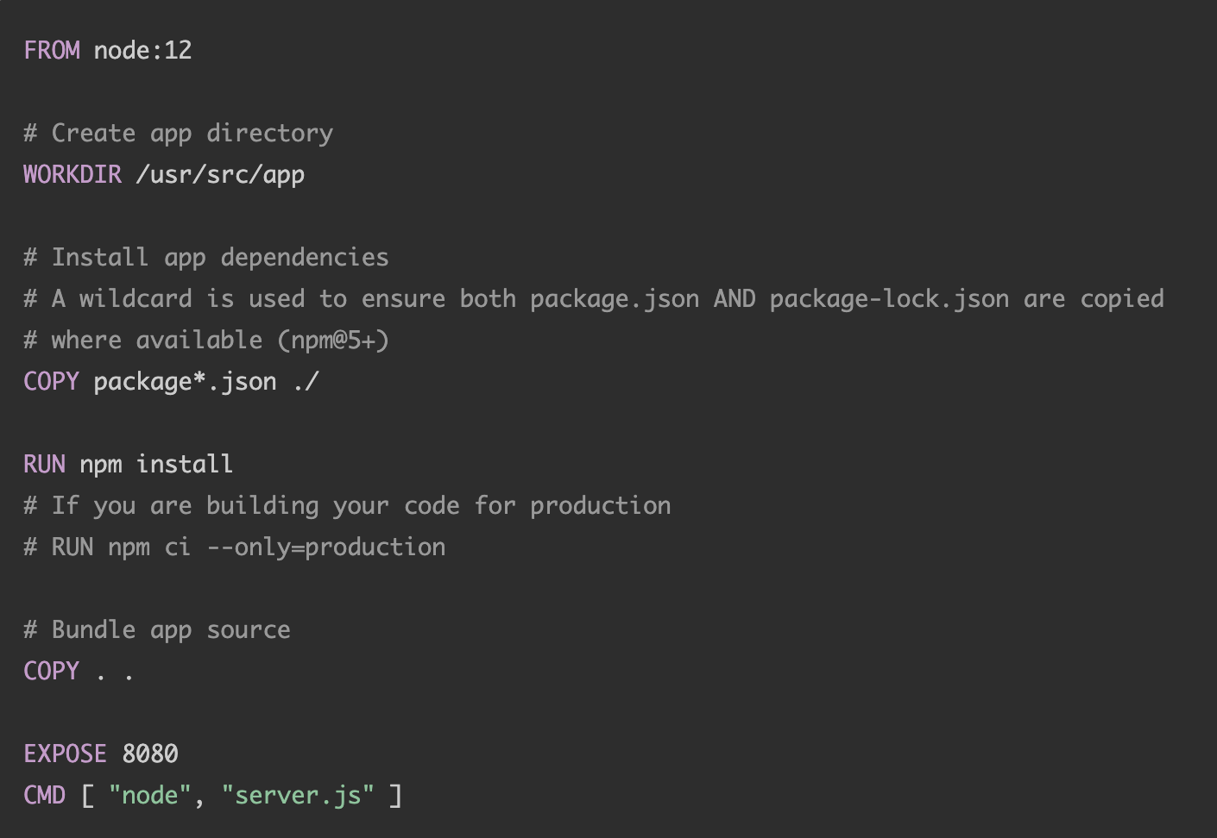
Dockerfiles
Buildpacks - the future of containers?
Dockerfiles are used to define how your docker image is constructed.
This is an example Dockerfile for a NodeJS app.

Slide 9
Dockerfiles
Buildpacks - the future of containers?
What OS does it use? Have you checked how many OS vulnerabilities there are?
No image tag used, latest version available will be pulled each time. Favour fixed tags e.g node:12.
This is a large base docker image, increasing the attack surface. Favour minimal secure images.
No USER is specified, so the image will run as root by default. Could have root access to docker host, allowing attack to install and run malicious software.

Slide 10
Dockerfile summary
Buildpacks - the future of containers?
Dockerfiles offer great flexibility and are generally easy to set up.
Unfortunately, container security is usually an afterthought.
Not every developer is going to know the complete ins and outs of docker best practices.

Slide 11
Top 10 Docker security practices
Buildpacks - the future of containers?
Prefer minimal base images
Least privileged user
Sign and verify docker images to mitigate MITM (Man-in-the-middle) attacks
Find, fix and monitor for open source vulnerabilities
Don’t leak sensitive information to Docker images
Use fixed tags for immutability
Use COPY instead of ADD commands
Use metadata labels
Use multi-stage build for small and secure images
Use a linter
Source: https://snyk.io/blog/10-docker-image-security-best-practices/

Slide 12
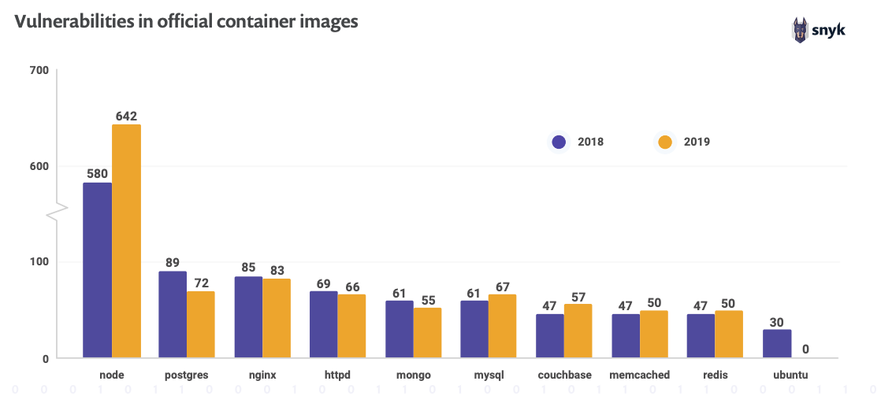
Some haunting statistics..
Buildpacks - the future of containers?
Source: Snyk - The State of Open Source Security: https://snyk.io/open-source-security/

Slide 13
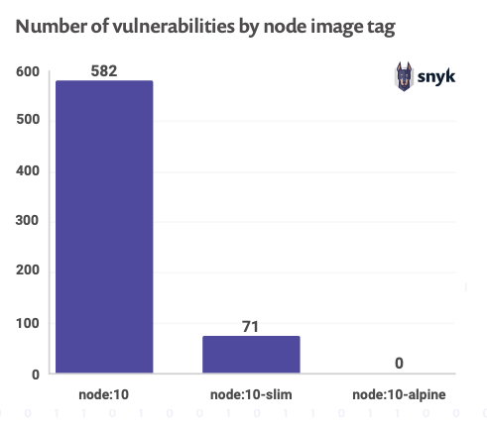
Where are all these vulnerabilities coming from?
Buildpacks - the future of containers?
Most vulnerabilities come from the underlying OS used by the image.
Results indicate that slimming down image (reducing number of libraries) can reduce the attack surface.
Another solution is ensuring your base images are using a securely patched OS.
Source: Snyk - The State of Open Source Security: https://snyk.io/open-source-security/

Slide 14
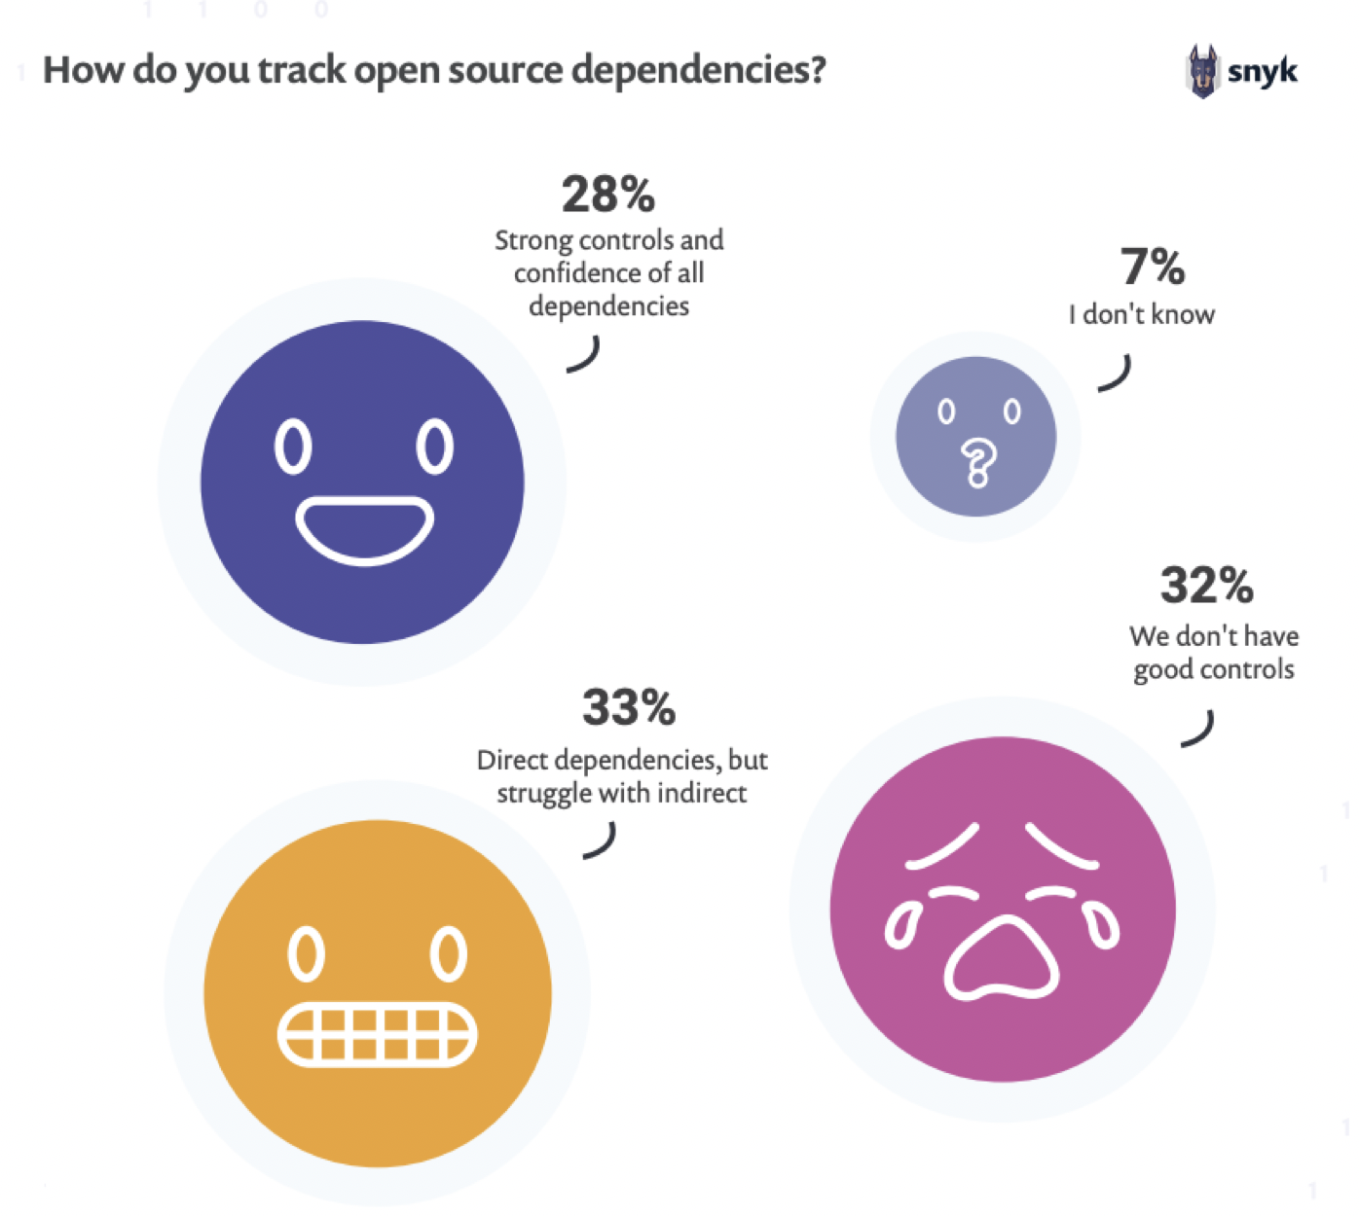
Keeping track of dependencies
Buildpacks - the future of containers?
A key risk factor for organisations using open source software is maintaining a “Bill-of-Materials” - what open source libraries and packages are included in the software they produce.
It is difficult to get a good view of your direct open source dependencies in your code, and your indirect dependencies that are introduced as a result.
Source: Snyk - The State of Open Source Security: https://snyk.io/open-source-security/

Slide 15
What happens if a Security vulnerability is discovered?
Buildpacks - the future of containers?
Reach out to all teams, get permission and coordinate to make the change.
Upgrade each app individually, each Dockerfile could look completely different.
Because of how Dockerfile caching works, every app will need to be completely rebuilt as layers below OS are invalidated.
Costly and time expensive chore, taking you away from solving more important problems.

Slide 16
Is there another way?
Buildpacks - the future of containers?

Slide 17
INTRODUCING BUILDPACKS
Buildpacks - the future of containers?

Slide 18
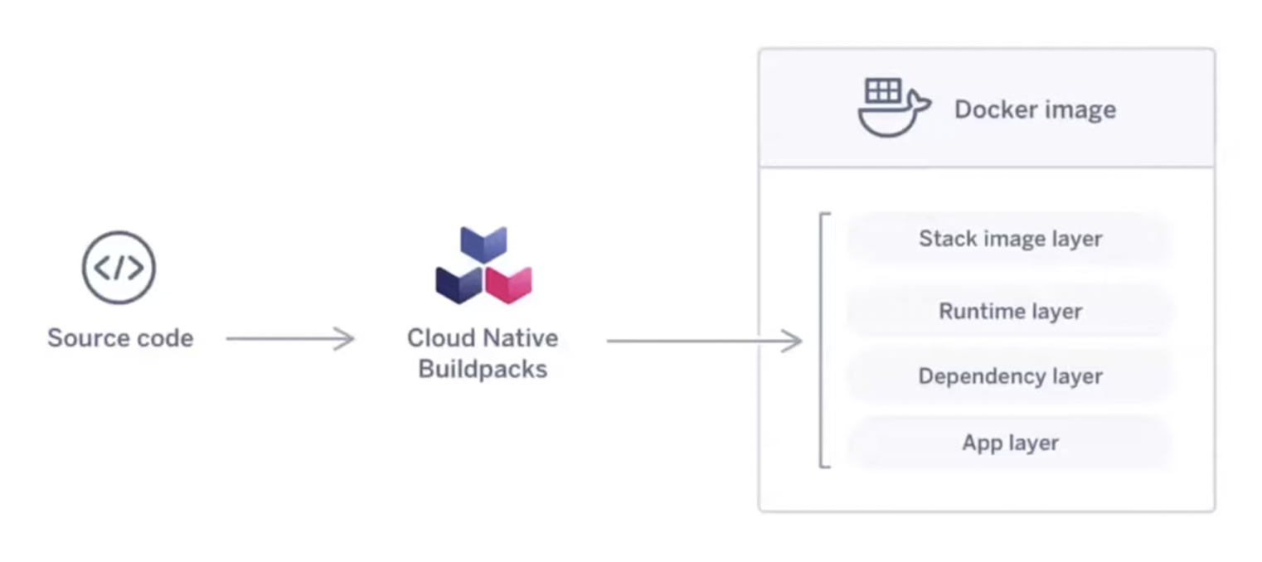
What are buildpacks?
Buildpacks - the future of containers?
CNCF sandbox project initiated by Pivotal and Heroku in 2018. Has been used in their platforms for many years.
Take in source code, detect how to build it, run a buildpack and output a docker image.

Slide 19
Buildpacks main advantages
Buildpacks - the future of containers?
Reusable - use the same buildpack on many apps (e.g one Java buildpack for all your micro-services)
Fast - only re-builds and uploads layers when necessary (thanks to rebasing)
Modular - combine buildpacks to create composite images, for example, one buildpack for building a React and Java app (difficult to achieve with Dockerfile)
Safe - apps meet security requirements without any effort from developer

Slide 20
How do buildpacks work?
Buildpacks - the future of containers?
DETECT
Detect app type and select buildpacks
Analyze optimisation opportunities to re-use layers from previous build
Build the image by applying each selected buildpack
Export the image to Docker or a remote registry
Cache image layers for the next build
Analysis
BUILD
Export
Cache

Slide 21
How does this look for developers?
Buildpacks - the future of containers?
Now developers only need to worry about their application code.
Buildpacks detect what the type of app, and provides the mechanism for packaging into a runnable docker image.
App code
Runtime
OS Image
Buildpack Operator
Developers
Container

Slide 22

What if we need to patch a security vulnerability?
Buildpacks - the future of containers?
Previously we mentioned that in Dockerfile caching, changing OS layer would require rebuilding the entire image.
Buildpacks use rebasing, allowing you to update one specific layer without needing to rebuild other layers.
This means that if you want to patch a security vulnerability, you can do it in minutes.
Source code
Node modules
Yarn 1.2
Node 10
Heroku-16
Container

Slide 23
What if we need to patch a security vulnerability?
Buildpacks - the future of containers?
If we want to upgrade our OS layer (Heroku-16 to 18), we are able to replace that single layer, without rebuilding the whole image
Source code
Node modules
Yarn 1.2
Node 10
Heroku-16
Container

Slide 24
What if we need to patch a security vulnerability?
Buildpacks - the future of containers?
If we want to upgrade our OS layer (Heroku-16 to 18), we are able to replace that single layer, without rebuilding the whole image.
Using Dockerfile, we would have had to make this change to every individual Dockerfile.
Source code
Node modules
Yarn 1.2
Node 10
Heroku-18
Container

Slide 25
List of Features
Buildpacks - the future of containers?
Advanced Caching - Robust caching is used to improve performance.
Bill-of-Materials - Insights into the contents of the app image.
Modular - Multiple build packs can be used to create an app image.
Multi-language - Supports more than one programming language family.
Multi-process - Image can have multiple entrypoints for each operational mode.
Minimal app image - Image contains only what is necessary.
Rebasing - Instant updates of base images without re-building
Reproducibility - Reproduces the same image direct by re-running the build.
Reusability - Leverage production-ready build packs maintained by the community.
Source: https://buildpacks.io/features/

Slide 26
How to get started?
Buildpacks - the future of containers?
The main way that you interact with buildpacks is using the Pack CLI.
Running “pack suggest-builders” will give you a list of recommended builders that you can get started with, usually those that are battle-hardened by years of production by Heroku and Pivotal.
If your organization has the requirement, you can also create your own builders for your own specific needs.
buildpacks.io has extensive documentation on this: https://buildpacks.io/docs/operator-guide/create-a-builder/

Slide 27

Pack CLI Quick start
Buildpacks - the future of containers?
Use Cloud Foundry buildpack:
Run buildpack:
Works for Java, Node, .NET core, Go etc

Slide 28
My experience with Buildpacks
Buildpacks - the future of containers?
Spring Boot 2.3 brought in support for buildpacks which was what got me interested in them. With a single command (gradle bootBuildImage or mvn spring-boot:build-image), you can make use of Paketo buildpacks to build your docker images out of the box.
The main thing that interested me was the performance - I have gotten used to building and pushing docker images that would require 100MB upload each time; but with buildpacks, it was lowered to KBs! Docker push times dropped from minutes to seconds with very little configuration.
For other frameworks, I highly recommend Pack CLI as your main way to interact with buildpacks.
If you use platforms such as Heroku, Pivotal Cloud Foundry, Google Cloud Platform, they have built-in support and specific tools to optimise buildpacks for their platforms.

Slide 29
Links
Buildpacks - the future of containers?
Docker security best practices - https://snyk.io/blog/10-docker-image-security-best-practices/
Snyk State of Open Source Security - https://snyk.io/open-source-security/
https://buildpacks.io/

Slide 30
Questions?
Buildpacks - the future of containers?
Contact: escull638@gmail.com

