Slide 1
Lecture 2:
Propositional Logic
Section 1.1 (Continued)

Slide 2
Implication

Slide 3
Implication
If p and q are propositions, then p →q is a conditional statement or implication which is read as “if p, then q ” and has this truth table:
Example: If p denotes “I am at home.” and q denotes “It is raining.” then p →q denotes “If I am at home then it is raining.”
In p →q , p is the hypothesis (antecedent or premise) and q is the conclusion (or consequence).
p | q | p →q
T | T | T
T | F | F
F | T | T
F | F | T

Slide 4
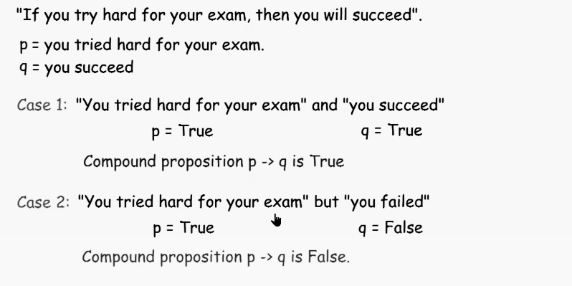
An example

Slide 5
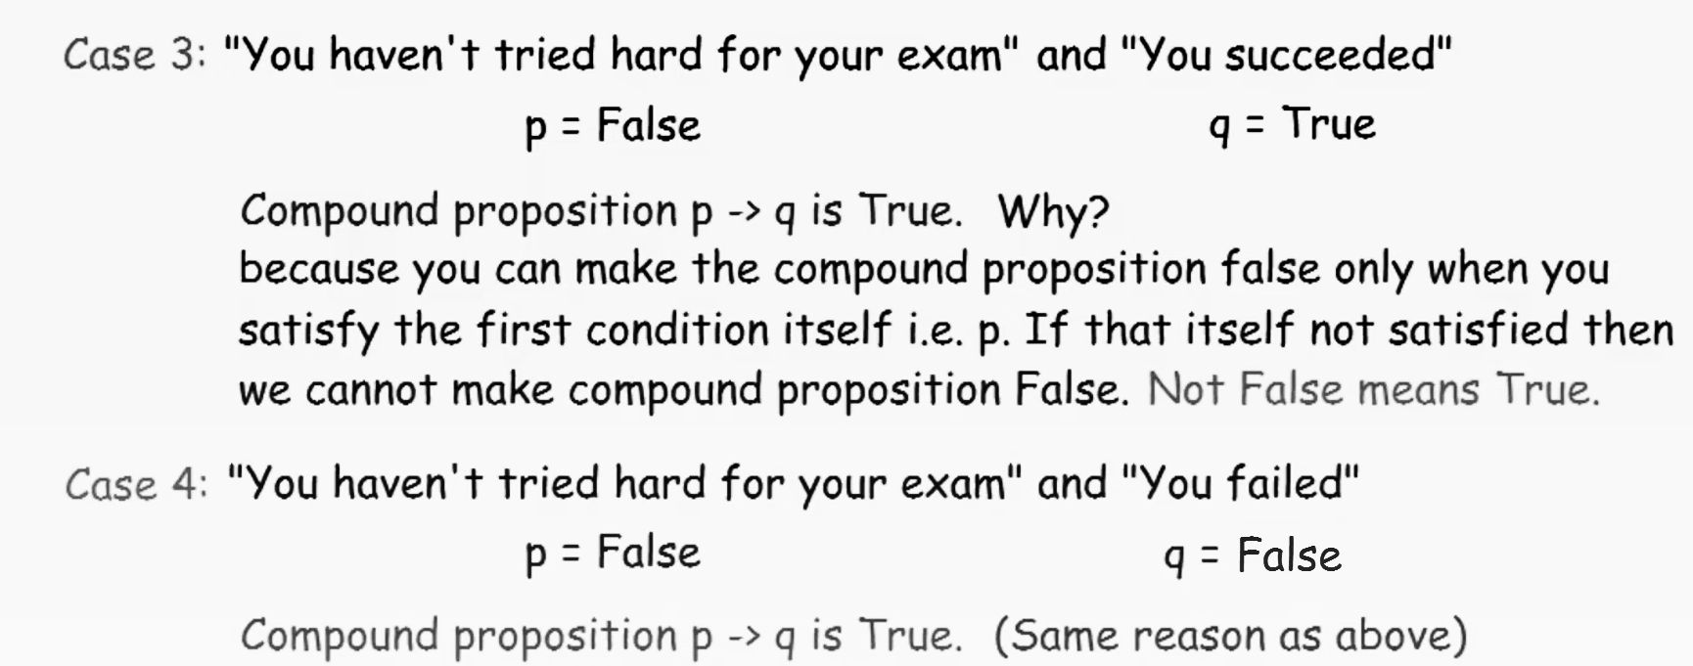
An example

Slide 6
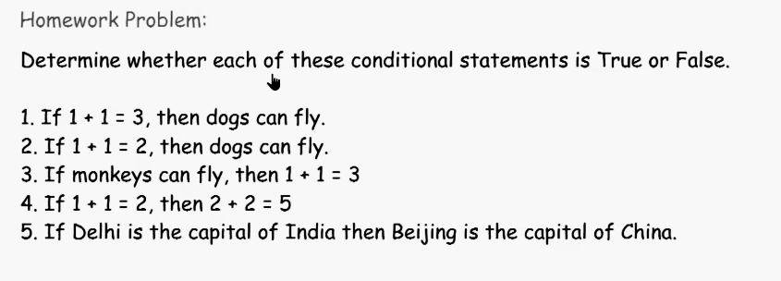

Slide 7
Understanding Implication
In p →q there does not need to be any connection between the antecedent or the consequent. The “meaning” of p →q depends only on the truth values of p and q.
These implications are perfectly fine, but would not be used in ordinary English.
“If the moon is made of green cheese, then I have more money than Bill Gates. ”
“If the moon is made of green cheese then I’m on welfare.”
“If 1 + 1 = 3, then you will buy combat boots.”

Slide 8
Understanding Implication (cont)
Another way to view the logical conditional is to think of an obligation or contract.
“If I am elected, then I will lower taxes.”
“If you get 100% on the final, then you will get an A.”
If the politician is elected and does not lower taxes, then the voters can say that he or she has broken the campaign pledge. Something similar holds for the professor. This corresponds to the case where p is true and q is false.

Slide 9
Different Ways of Expressing p →q
p implies q
p only if q
q when p
q if p
p is sufficient for q
q is necessary for p
if p, then q
if p, q
q unless ¬p
q if p
q whenever p
q follows from p
a necessary condition for p is q
a sufficient condition for q is p

Slide 10
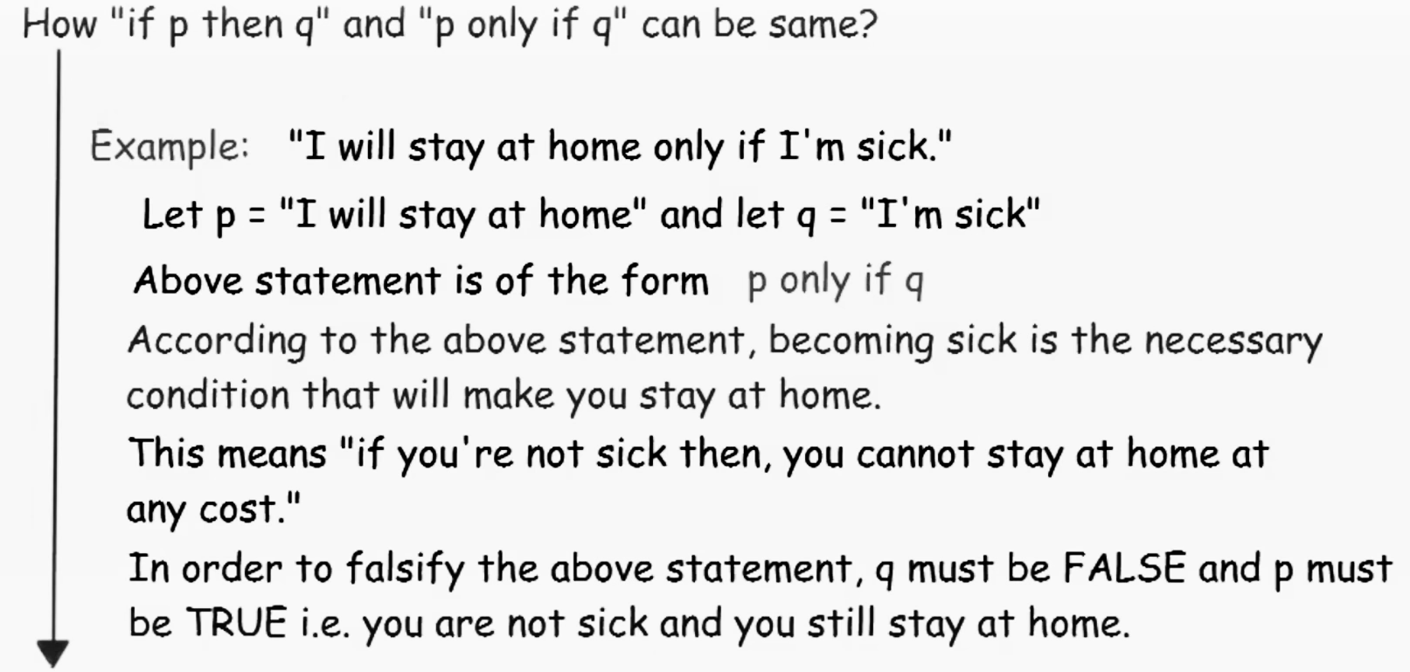


Slide 11
Converse, Contrapositive and Inverse

Slide 12
Converse, Contrapositive, and Inverse
From p →q we can form new conditional statements .
q →p is the converse of p →q
¬q → ¬ p is the contrapositive of p →q
¬ p → ¬ q is the inverse of p →q
Example: Find the converse, inverse, and contrapositive of “Raining is a sufficient condition for me not going to town.”
Solution:
converse: If I do not go to town, then it is raining.
inverse: If it is not raining, then I will go to town.
contrapositive: If I go to town, then it is not raining.

Slide 13
Biconditional
If p and q are propositions, then we can form the biconditional proposition p ↔q , read as “p if and only if q .” The biconditional p ↔q denotes the proposition with this truth table:
If p denotes “I am at home.” and q denotes “It is raining.” then p ↔q denotes “I am at home if and only if it is raining.”
p | q | p ↔q
T | T | T
T | F | F
F | T | F
F | F | T

Slide 14
Expressing the Biconditional
Some alternative ways “p if and only if q” is expressed in English:
p is necessary and sufficient for q
if p then q , and conversely
p iff q

Slide 15
Truth Tables For Compound Propositions
Construction of a truth table:
Rows
Need a row for every possible combination of values for the atomic propositions.
Columns
Need a column for the compound proposition (usually at far right)
Need a column for the truth value of each expression that occurs in the compound proposition as it is built up.
This includes the atomic propositions

Slide 16
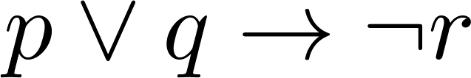
Example Truth Table
Construct a truth table for
p | q | r | ¬r | p ∨ q | p ∨ q → ¬r
T | T | T | F | T | F
T | T | F | T | T | T
T | F | T | F | T | F
T | F | F | T | T | T
F | T | T | F | T | F
F | T | F | T | T | T
F | F | T | F | F | T
F | F | F | T | F | T

Slide 17
Equivalent Propositions
Two propositions are equivalent if they always have the same truth value.
Example: Show using a truth table that the conditional is equivalent to the contrapositive.
Solution:
p | q | ¬ p | ¬ q | p →q | ¬q → ¬ p
T | T | F | F | T | T
T | F | F | T | F | F
F | T | T | F | T | T
F | F | T | T | T | T

Slide 18
Using a Truth Table to Show Non-Equivalence
Example: Show using truth tables that neither the converse nor inverse of an implication are not equivalent to the implication.
Solution:
p | q | ¬ p | ¬ q | p →q | ¬ p →¬ q | q → p
T | T | F | F | T | T | T
T | F | F | T | F | T | T
F | T | T | F | T | F | F
F | F | T | T | T | T | T

Slide 19
Problem
How many rows are there in a truth table with n propositional variables?
Solution: 2^{n}
Note that this means that with n propositional variables, we can construct 2^{n} distinct (i.e., not equivalent) propositions.

Slide 20
Precedence of Logical Operators
Operator | Precedence
¬ | 1
∧ ∨ | 2 3
→ ↔ | 4 5
p ∨q → ¬r is equivalent to (p ∨q) → ¬r
If the intended meaning is p ∨(q → ¬r )
then parentheses must be used.

