Slide 1
Lecture 3:
Propositional Equivalence
Section 1.3

Slide 2
Tautologies, Contradictions, and Contingencies
A tautology is a proposition which is always true.
Example: p ∨¬p
A contradiction is a proposition which is always false.
Example: p ∧¬p
A contingency is a proposition which is neither a tautology nor a contradiction, such as p
P | ¬p | p ∨¬p | p ∧¬p
T | F | T | F
F | T | T | F

Slide 3
Logical Equivalence: Examples
Two compound propositions p and q are logically equivalent if p↔q is a tautology.
We write this as p ⇔ q or as p ≡ q where p and q are compound propositions.
Two compound propositions p and q are equivalent if and only if the columns in a truth table giving their truth values agree.
This truth table shows that ¬p ∨ q is equivalent to p → q.
p | q | ¬p | ¬p ∨ q | p→ q
T | T | F | T | T
T | F | F | F | F
F | T | T | T | T
F | F | T | T | T

Slide 4
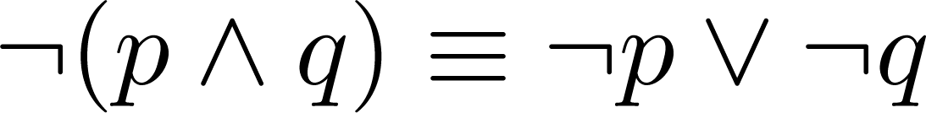
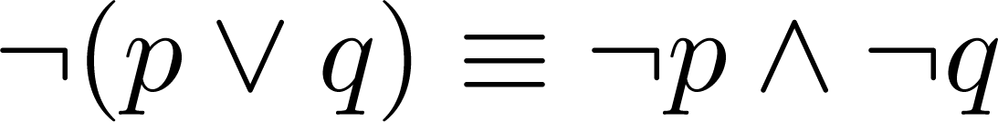
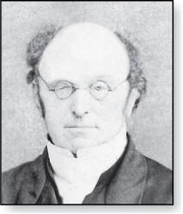
Example: De Morgan’s Laws
Augustus De Morgan
1806-1871
This truth table shows that De Morgan’s Second Law holds.
p | q | ¬p | ¬q | (p∨q) | ¬(p∨q) | ¬p∧¬q
T | T | F | F | T | F | F
T | F | F | T | T | F | F
F | T | T | F | T | F | F
F | F | T | T | F | T | T

Slide 5
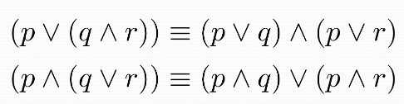
Example: Distributive Laws
This truth table shows that distributive law of disjunction over conjunction holds.
p | q | r | q ∧ r | p ∨ (q ∧ r) | p ∨ q | p ∨ r | (p ∨ q) ∧ (p ∨ r)
T | T | T | T | T | T | T | T
T | T | F | F | T | T | T | T
T | F | T | F | T | T | T | T
T | F | F | F | T | T | T | T
F | T | T | T | T | T | T | T
F | T | F | F | F | T | F | F
F | F | T | F | F | F | T | F
F | F | F | F | F | F | F | F

Slide 6
Predicates and Quantifiers
Section 1.4

Slide 7
Section Summary
Predicates
Variables
Quantifiers
Universal Quantifier
Existential Quantifier
Negating Quantifiers
De Morgan’s Laws for Quantifiers
Translating English to Logic

Slide 8
Introducing Predicate Logic
Predicate logic uses the following new features:
Variables: x, y, z
Predicates: P(x), M(x)
Quantifiers (to be covered in a few slides):
Propositional functions are a generalization of propositions.
They contain variables and a predicate, e.g., P(x)
Variables can be replaced by elements from their domain.

Slide 9
Propositional Functions
Propositional functions become propositions (and have truth values) when their variables are each replaced by a value from the domain (or bound by a quantifier, as we will see later).
For example, let P(x) denote “x > 0” and the domain be the integers. Then:
P(-3) is false.
P(0) is false.
P(3) is true.
Often the domain is denoted by U. So in this example U is the integers.

Slide 10
Examples of Propositional Functions
Let “x + y = z” be denoted by R(x, y, z) and U (for all three variables) be the integers.
Find these truth values:
R(2,-1,5) Solution: F
R(3,4,7) Solution: T
R(x, 3, z) Solution: Not a Proposition
Now let “x - y = z” be denoted by Q(x, y, z), with U as the integers. Find these truth values:
Q(2,-1,3) Solution: T
Q(3,4,7) Solution: F
Q(x, 3, z) Solution: Not a Proposition

Slide 11
Compound Expressions
If P(x) denotes “x > 0,” find these truth values:
P(3) ∨ P(-1) Solution: T
P(3) ∧ P(-1) Solution: F
P(3) → P(-1) Solution: F
P(3) → ¬P(-1) Solution: T
Expressions with variables are not propositions and therefore do not have truth values. For example,
P(3) ∧ P(y)
P(x) → P(y)
When used with quantifiers (to be introduced next), these expressions (propositional functions) become propositions.

Slide 12
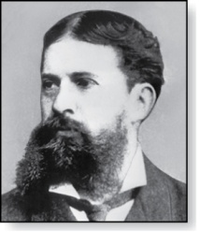
Quantifiers
Charles Peirce (1839-1914)
We need quantifiers to express the meaning of English words including all and some:
“All men are Mortal.”
“Some cats do not have fur.”
The two most important quantifiers are:
Universal Quantifier, “For all,” symbol: ∀
Existential Quantifier, “There exists,” symbol: ∃
We write as in ∀x P(x) and ∃x P(x).
∀x P(x) means P(x) is true for every x in the domain.
∃x P(x) means P(x) is true for some x in the domain.
The quantifiers are said to bind the variable x in these expressions.

Slide 13
Universal Quantifier
∀x P(x) is read as “For all x, P(x)” or “For every x, P(x)”
Examples:
If P(x) denotes “x > 0” and U is the integers, then ∀x P(x) is false.
If P(x) denotes “x > 0” and U is the positive integers, then ∀x P(x) is true.
If P(x) denotes “x is even” and U is the integers, then ∀x P(x) is false.

Slide 14
Existential Quantifier
∃x P(x) is read as “For some x, P(x)”, or as “There is an x such that P(x),” or “For at least one x, P(x).”
Examples:
If P(x) denotes “x > 0” and U is the integers, then ∃x P(x) is true. It is also true if U is the positive integers.
If P(x) denotes “x < 0” and U is the positive integers, then ∃x P(x) is false.
If P(x) denotes “x is even” and U is the integers, then ∃x P(x) is true.

Slide 15
Thinking about Quantifiers
When the domain is finite, we can think of quantification as looping through the elements of the domain.
To evaluate ∀x P(x) loop through all x in the domain.
If at every step P(x) is true, then ∀x P(x) is true.
If at a step P(x) is false, then ∀x P(x) is false and the loop terminates.
To evaluate ∃x P(x) loop through all x in the domain.
If at some step, P(x) is true, then ∃x P(x) is true and the loop terminates.
If the loop ends without finding an x for which P(x) is true, then ∃x P(x) is false.
Even if the domains are infinite, we can still think of the quantifiers this fashion, but the loops will not terminate in some cases.

Slide 16
Properties of Quantifiers
The truth value of ∃x P(x) and ∀ x P(x) depend on both the propositional function P(x) and on the domain U.
Examples:
If U is the positive integers and P(x) is the statement “x < 2”, then ∃x P(x) is true, but ∀x P(x) is false.
If U is the negative integers and P(x) is the statement “x < 2”, then both ∃x P(x) and ∀x P(x) are true.
If U consists of 3, 4, and 5, and P(x) is the statement “x > 2”, then both ∃x P(x) and ∀x P(x) are true.
But if P(x) is the statement “x < 2”, then both ∃x P(x) and∀ x P(x) are false.

Slide 17
Precedence of Quantifiers
The quantifiers ∀ and ∃ have higher precedence than all the logical operators.
For example, ∀x P(x) ∨ Q(x) means (∀x P(x))∨ Q(x)
∀x (P(x) ∨ Q(x)) means something different.
Unfortunately, often people write ∀x P(x) ∨ Q(x) when they mean ∀x (P(x) ∨ Q(x)).

Slide 18
Translating from English to Logic
Example 1: Translate the following sentence into predicate logic: “Every student in this class has taken a course in Java.”
Solution:
First decide on the domain U.
Solution 1: If U is all students in this class, define a propositional function J(x) denoting “x has taken a course in Java” and translate as ∀x J(x).
Solution 2: But if U is all people, also define a propositional function S(x) denoting “x is a student in this class” and translate as ∀x (S(x)→ J(x)).
∀x (S(x) ∧ J(x)) is not correct. What does it mean?

Slide 19
Translating from English to Logic
Example 2: Translate the following sentence into predicate logic: “Some student in this class has taken a course in Java.”
Solution:
First decide on the domain U.
Solution 1: If U is all students in this class, translate as
∃x J(x)
Solution 2: But if U is all people, then translate as ∃x (S(x) ∧ J(x))
∃x (S(x)→ J(x)) is not correct. What does it mean?

Slide 20
Equivalences in Predicate Logic
Statements involving predicates and quantifiers are logically equivalent if and only if they have the same truth value
for every predicate substituted into these statements and
for every domain of discourse used for the variables in the expressions.
The notation S ≡T indicates that S and T are logically equivalent.
Example: ∀x ¬¬S(x) ≡ ∀x S(x)

Slide 21
Thinking about Quantifiers as Conjunctions and Disjunctions
If the domain is finite, a universally quantified proposition is equivalent to a conjunction of propositions without quantifiers and an existentially quantified proposition is equivalent to a disjunction of propositions without quantifiers.
If U consists of the integers 1,2, and 3:
Even if the domains are infinite, you can still think of the quantifiers in this fashion, but the equivalent expressions without quantifiers will be infinitely long.

Slide 22
Negating Quantified Expressions
Consider ∀x J(x)
“Every student in your class has taken a course in Java.”
Here J(x) is “x has taken a course in Java” and
the domain is students in your class.
Negating the original statement gives “It is not the case that every student in your class has taken Java.” This implies that “There is a student in your class who has not taken Java.”
Symbolically ¬∀x J(x) and ∃x ¬J(x) are equivalent

Slide 23
Negating Quantified Expressions (continued)
Now Consider ∃ x J(x)
“There is a student in this class who has taken a course in Java.”
Where J(x) is “x has taken a course in Java.”
Negating the original statement gives “It is not the case that there is a student in this class who has taken Java.” This implies that “Every student in this class has not taken Java”
Symbolically ¬∃x J(x) and ∀x ¬J(x) are equivalent

Slide 24
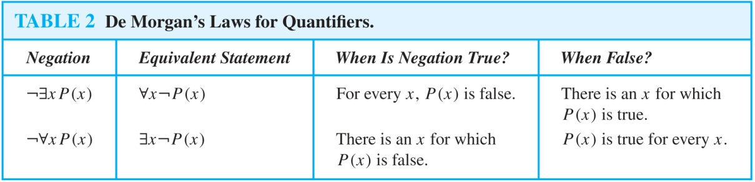
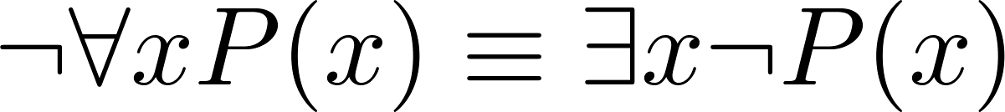
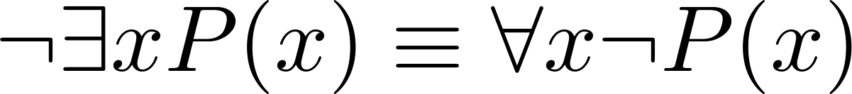
De Morgan’s Laws for Quantifiers
The rules for negating quantifiers are:
The reasoning in the table shows that:

Slide 25
Translation from English to Logic
Examples:
“Some student in this class has visited Mexico.”
Solution: Let M(x) denote “x has visited Mexico” and S(x) denote “x is a student in this class,” and U be all people.
∃x (S(x) ∧ M(x))
“Every student in this class has visited Canada or Mexico.”
Solution: Add C(x) denoting “x has visited Canada.”
∀x (S(x)→ (M(x)∨C(x)))

Slide 26
Some Fun with Translating from English into Logical Expressions
U = {fleegles, snurds, thingamabobs}
F(x): x is a fleegle
S(x): x is a snurd
T(x): x is a thingamabob
Translate “Everything is a fleegle”
Solution: ∀x F(x)

Slide 27
Translation (cont)
U = {fleegles, snurds, thingamabobs}
F(x): x is a fleegle
S(x): x is a snurd
T(x): x is a thingamabob
“Nothing is a snurd.”
Solution: ¬∃x S(x) What is this equivalent to?
Solution: ∀x ¬ S(x)

Slide 28
Translation (cont)
U = {fleegles, snurds, thingamabobs}
F(x): x is a fleegle
S(x): x is a snurd
T(x): x is a thingamabob
“All fleegles are snurds.”
Solution: ∀x (F(x)→ S(x))

Slide 29
Translation (cont)
U = {fleegles, snurds, thingamabobs}
F(x): x is a fleegle
S(x): x is a snurd
T(x): x is a thingamabob
“Some fleegles are thingamabobs.”
Solution: ∃x (F(x) ∧ T(x))

Slide 30
Translation (cont)
U = {fleegles, snurds, thingamabobs}
F(x): x is a fleegle
S(x): x is a snurd
T(x): x is a thingamabob
“No snurd is a thingamabob.”
Solution: ¬∃x (S(x) ∧ T(x)) What is this equivalent to?
Solution: ∀x (¬S(x) ∨ ¬T(x))

Slide 31
Translation (cont)
U = {fleegles, snurds, thingamabobs}
F(x): x is a fleegle
S(x): x is a snurd
T(x): x is a thingamabob
“If any fleegle is a snurd then it is also a thingamabob.”
Solution: ∀x ((F(x) ∧ S(x))→ T(x))

Slide 32
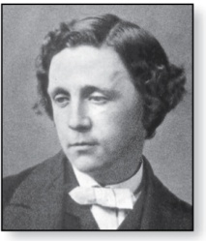
Lewis Carroll Example
Charles Lutwidge Dodgson
(AKA Lewis Caroll)
(1832-1898)
The first two are called premises and the third is called the conclusion.
“All lions are fierce.”
“Some lions do not drink coffee.”
“Some fierce creatures do not drink coffee.”
Here is one way to translate these statements to predicate logic. Let P(x), Q(x), and R(x) be the propositional functions “x is a lion,” “x is fierce,” and “x drinks coffee,” respectively.
∀x (P(x)→ Q(x))
∃x (P(x) ∧ ¬R(x))
∃x (Q(x) ∧ ¬R(x))
Later we will see how to prove that the conclusion follows from the premises.

